Slide 1
Time Sheet Training
Enrichment Classes
revised 2021-10

Slide 2
Futura Payroll Highlights
Time Sheets & Expense Reports are paid monthly, and are due the following month by the 5th at 5pm
If first class is in October, then all October hours and expenses are due before November 5th at 5pm
If first class is in February, then all February hours and expenses are due before March 5th at 5pm
Any September or January training hours should be added to this first time sheet
Submit all items via email to: Dessa@FuturaAdventures.com
Include your location in the subject line (Milwaukee, Madison, Minnesota)
por ejemplo: “Dessa Amble time sheet Wisconsin”
I will reply an email receipt of hours received within 24-48 hours
New teachers start at $30/hour for enrichment classes
Training, Observing & Late Parent time is paid at $10.50/hour
$25 material deposit
Paid the 15th of each month via Direct Deposit
Access paystubs online

Slide 3
Time Sheets
Word document
Only the 1st - 31st of the previous month should be included
do not include November 1st class with October hours
Only include hours that you have already worked
Classes scheduled for under 1 hour are still paid at 1 full hour
Set up & clean up time should not be included in the class time submitted
Compensation is included in the higher hourly pay rate
All time should be submitted in hours
por ejemplo: 15 minutes should be reported as .25 hours
Include notes of any extra events

Slide 4
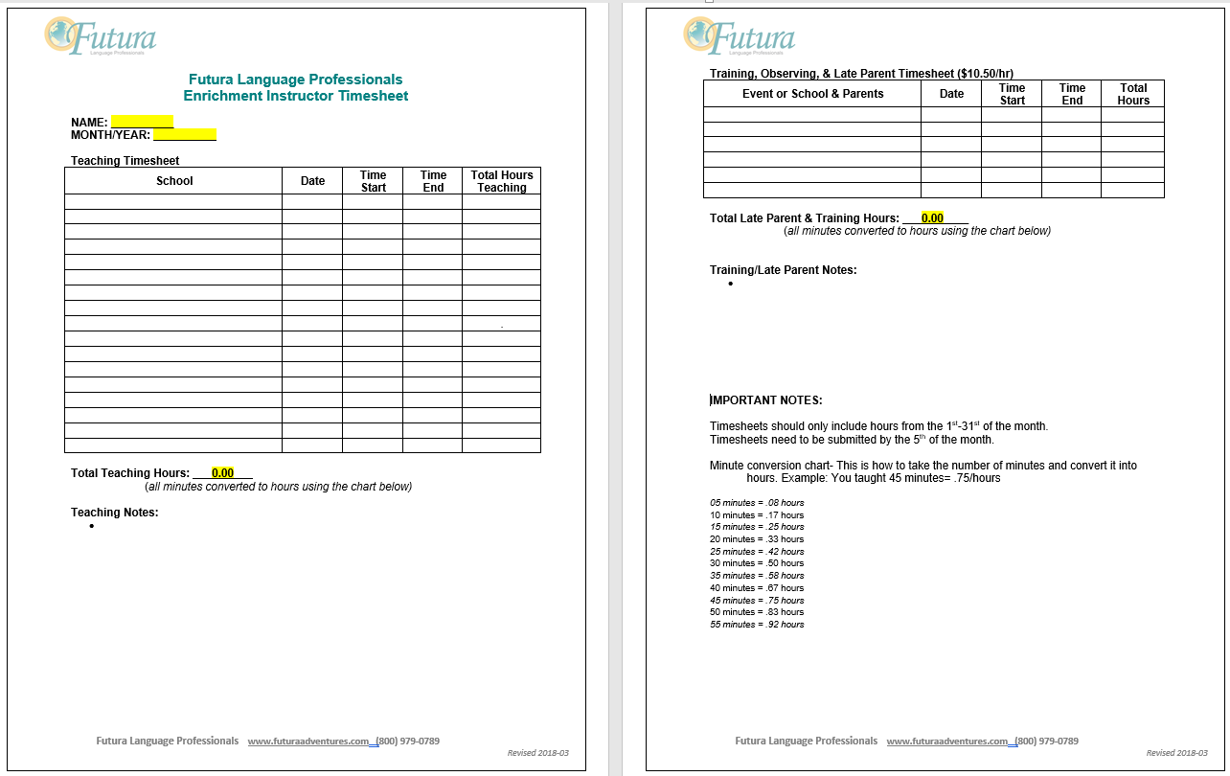

Slide 5
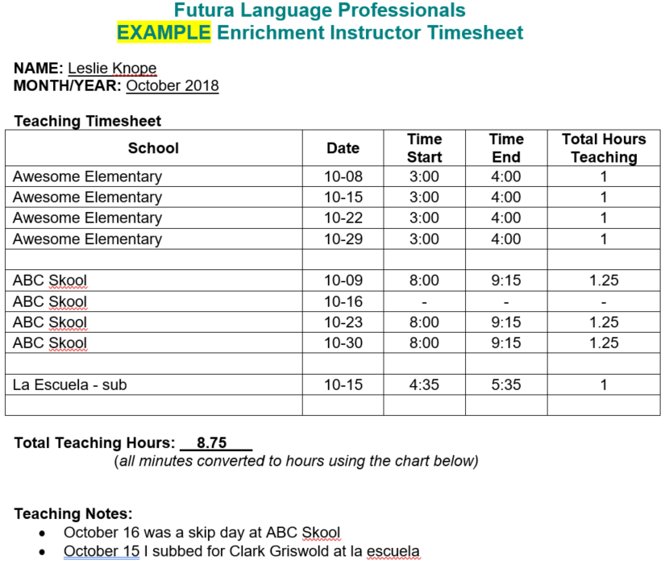
Time Sheet Example

Slide 6
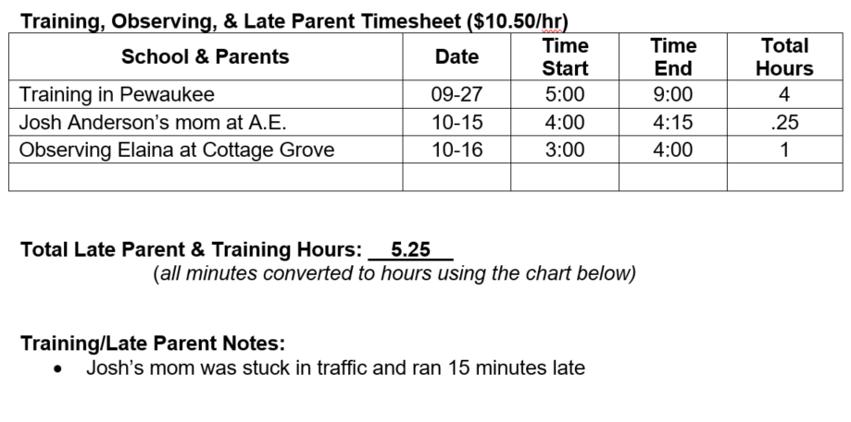
Time Sheet Examples cont.

Slide 7
Payroll Recap
Time Sheets & Expense Reports due each month by the 5th at 5pm
If your first classes are in October, then your first time sheet and expense report with receipts are due before November 5th at 5pm
Any September training hours should be added to this first time sheet
Submit all items via email to: Dessa@FuturaAdventures.com
Include your location in the subject line (Wisconsin, Madison, Minnesota)
por ejemplo: “Dessa Amble time sheet Wisconsin”
Paid the 15th of each month via Direct Deposit
Questions? Contact Dessa Amble
Dessa@FuturaAdventures.com

Slide 8
Have a GREAT year!

