Slide 1
Expenses Training
Enrichment Classes
revised 2021-10

Slide 2
Expense Reports
Excel document
Submitted monthly, only including expenses from the previous month
Expense Allotments – classroom management tools, printing, back-up snacks, & things to help enhance students learning
Semesterly, $25 for 1st class, $10 for each additional class
If you teach 1 class in the fall semester → $25 expense allotment, 2 classes → $35, 3 classes → $45
Snacks – all our classes are nut free, some schools don’t allow snacks, check with your Manager
Receipts necessary for any reimbursement (other than printing at home)
Scan & email PDF attachment
Take a photo and email as attachment *TIP: take a photo of the receipt right away, so you don’t have to save the receipt for up to a month
Printing – 1st day Parent Introduction Letter, Cultural Images
At-home copies → $0.05 per copy
Printer paper & ink separately are not reimbursable
$25 material deposit taken from first paycheck, returned in full on last paycheck when all items have been returned to area Manager
Covers Futura curriculum guides, flashcards, teacher kit, library items, any items expensed that another teacher could use
You are responsible for keeping track of your remaining expense allotment total

Slide 3
Printing at Office Depot / Office Max
1st day Parent Introduction Letter, Cultural Images
Office Depot/Office Max Store Purchasing Program
Discounted pricing
Print on colored paper
Order Prints Online
https://business.officedepot.com/index.do
Log In: FuturaAdventures
Password & additional instructions to follow
Be sure to check with your local Office Depot/Office Max as each is run slightly differently

Slide 4
What To Do: What NOT To Do:
Take advantage of the library! Our Futura library has many useful items for a great classroom, such as:
conversation balls
flyswatters
microphones
white boards & dry erase markers
stickers
Dollar Store/Doller Tree & Goodwill are a great resources for classroom items also!
Skip the paper! Your classes should be FUN, so worksheets are completely unnecessary
Utilize your families! Parents are asked to send their children with a healthy snack each week.
Bring culture into the classroom! Cultural reinforcements are a great way to teach various topics
Use your money to make you a better teacher! Create visuals to enhance learning such as flashcards and postcards.
Don’t go snack crazy! Don’t buy costly items for snacks. Instead buy in bulk for those students that forget—Like boxed raisins or a large bag of pretzels to share
Don’t give a sticker/prize for EVERYTHING! Students go through the whole day at school without stickers/prizes, so it is okay to play a game and not to give the winners something each time.
Don’t stock up on craft items! Crafts are a very small portion of our classes, so utilize the Futura library to pick up items instead of splurging on materials.

Slide 5
Expense Reports
←1
←2
←3
←4

Slide 6
Expense Report Example
←1
←2
←3
←4

Slide 7
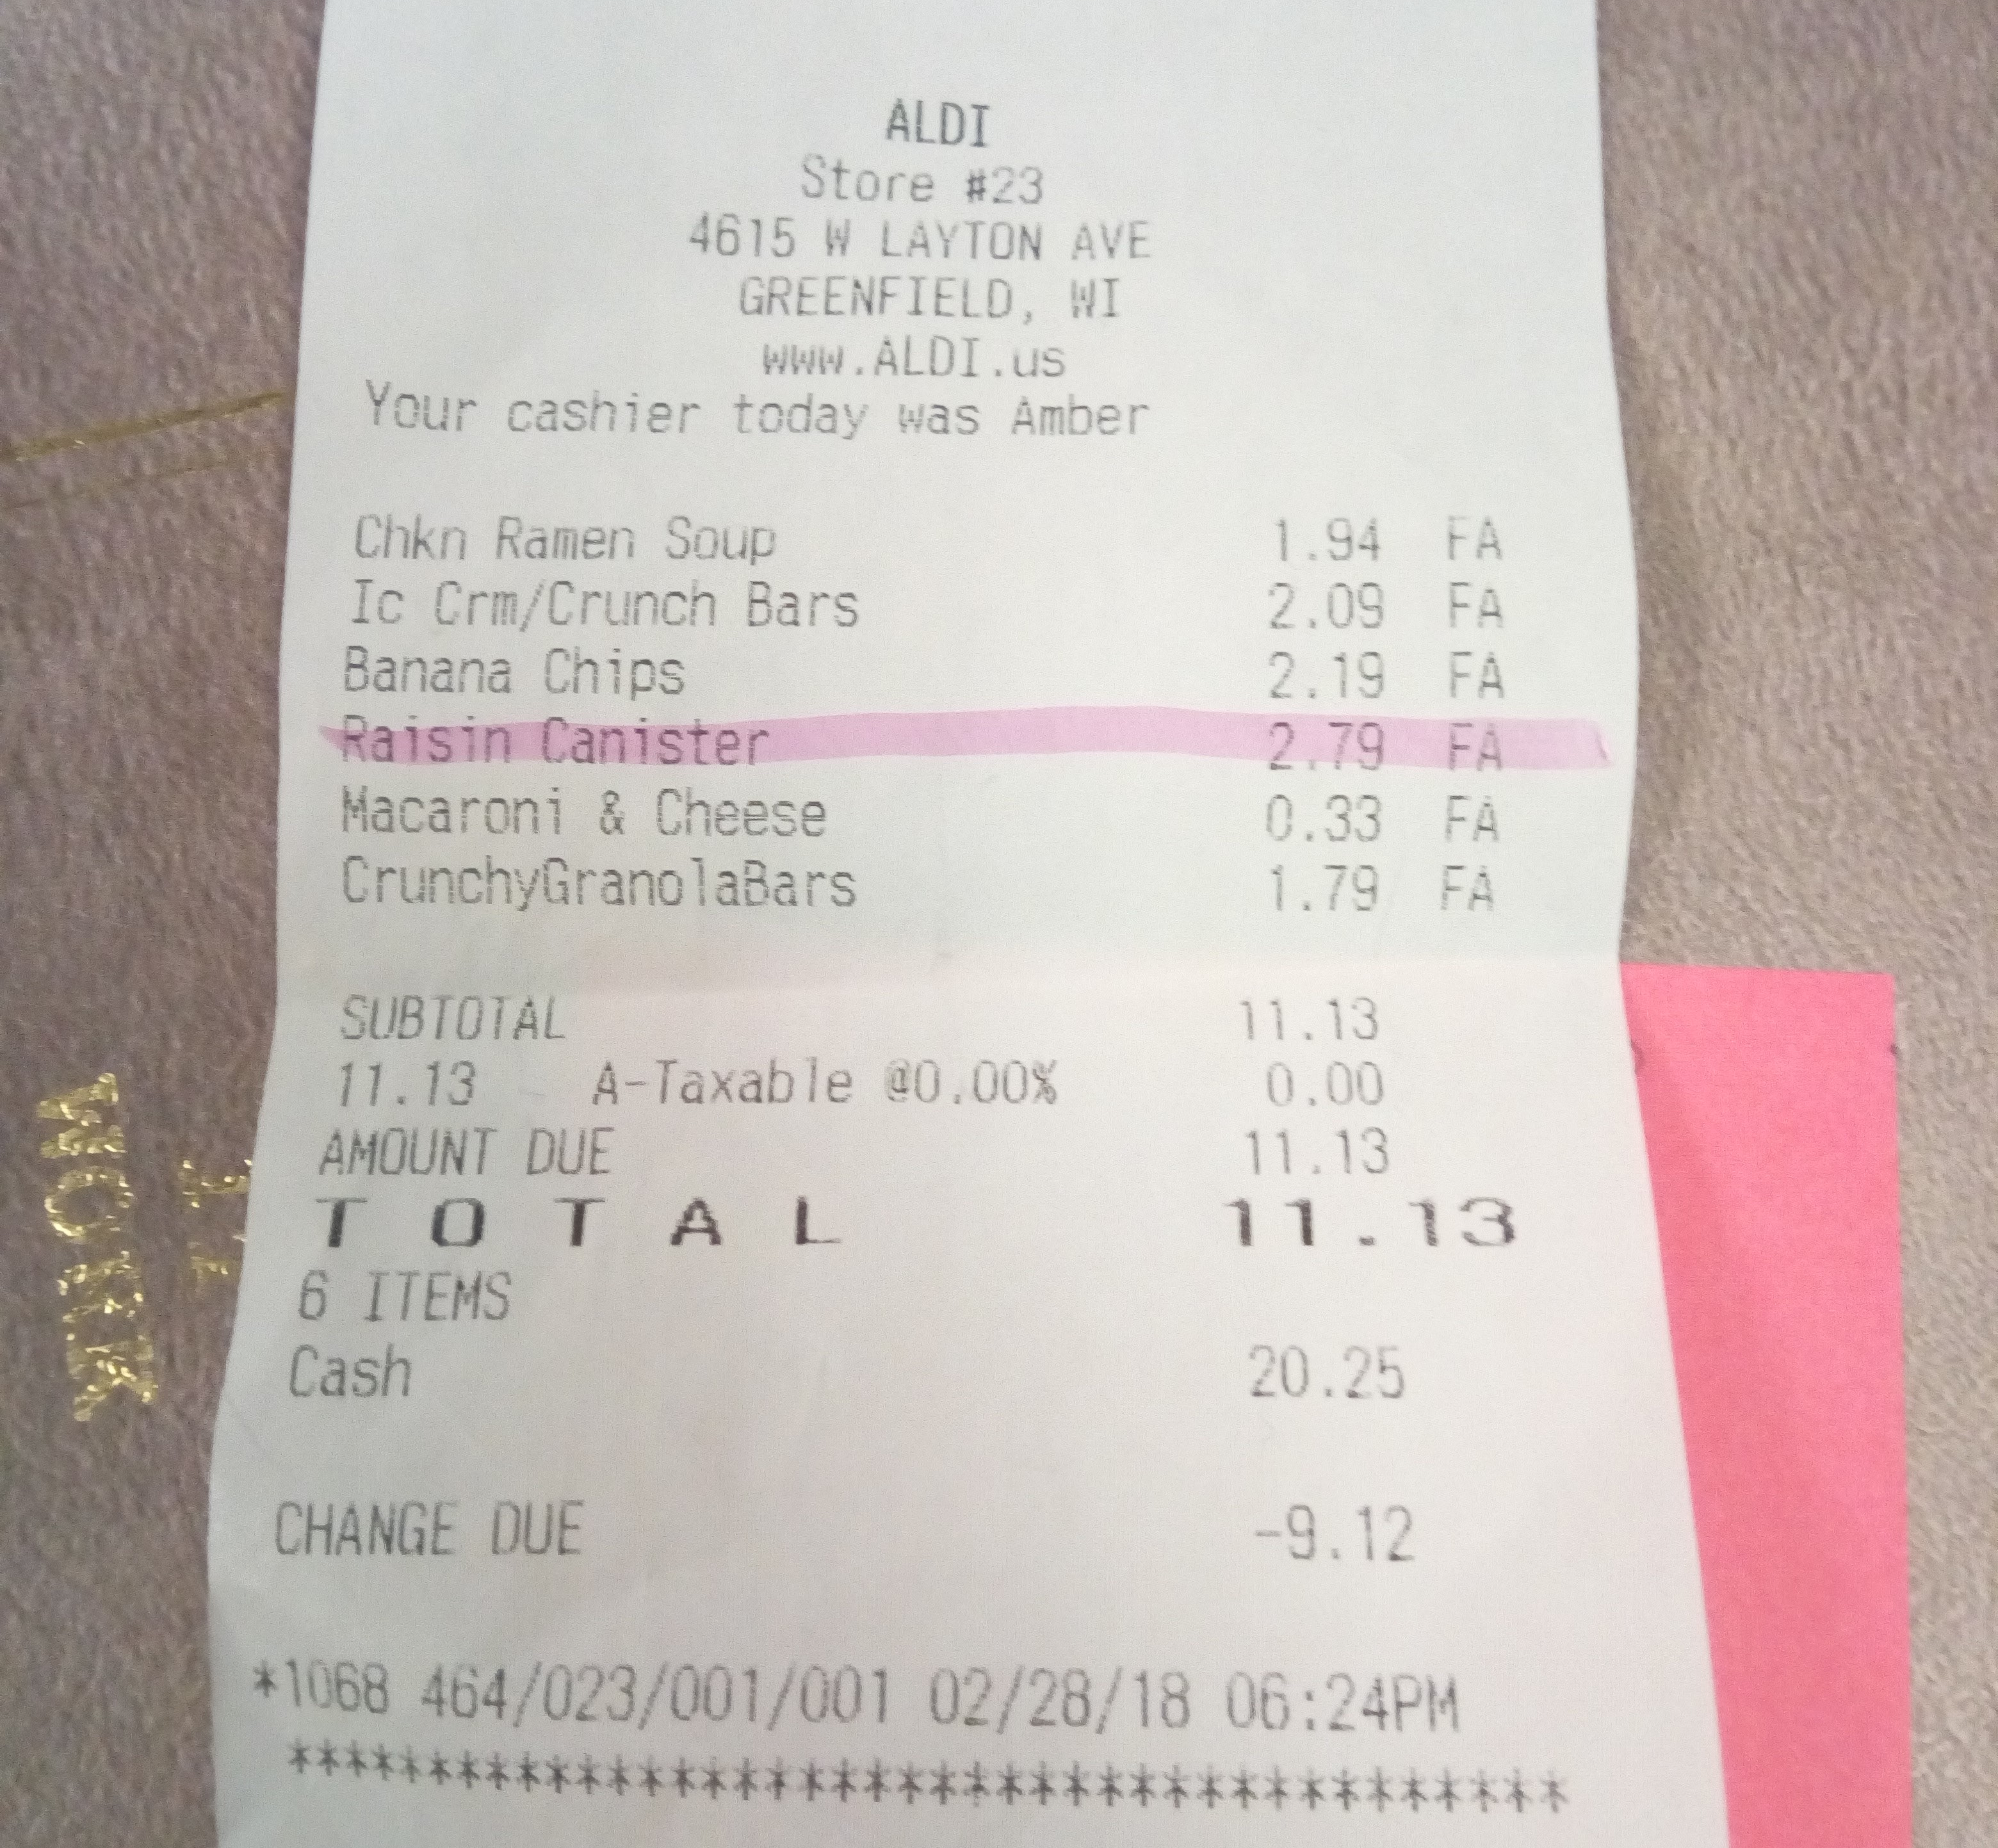
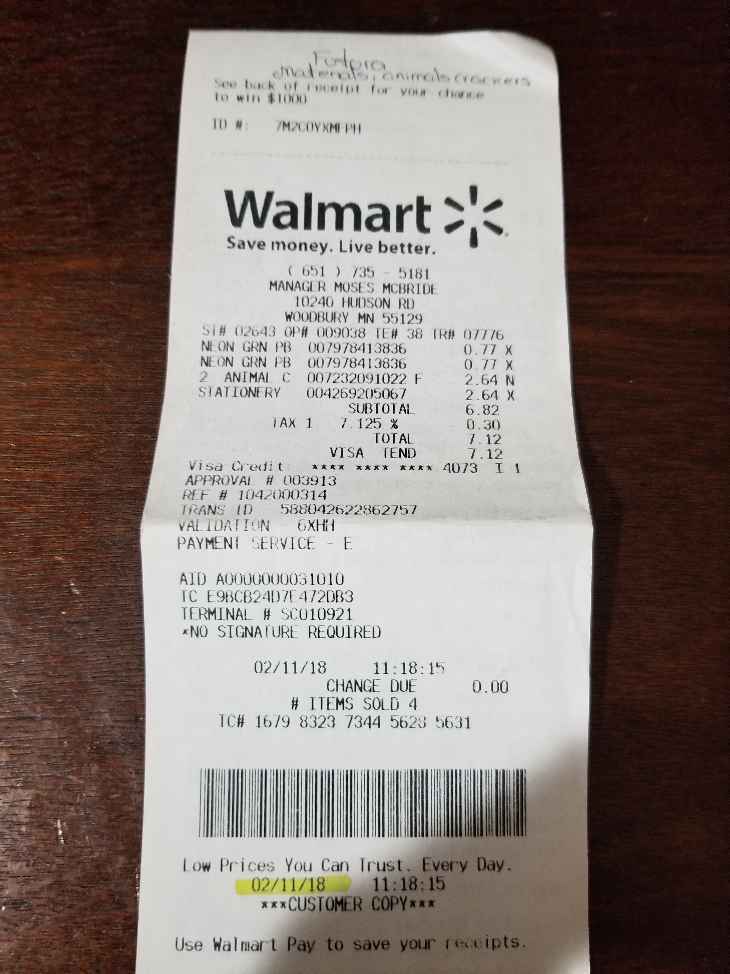
Examples of Receipts

Slide 8
Expense Reports Recap
Expense Allotment each semester based on number of classes assigned
Expense Reports with all receipts due each month by the 5th at 5pm
If your first classes are in October, then your first expense report with receipts are due before November 5th at 5pm
Submit all items with time sheets via email to:
payroll@FuturaAdventures.com
Paid with hourly wages
Questions? Contact Payroll
payroll@FuturaAdventures.com

Slide 9
Have a GREAT year!

