Slide 1
Expenses Training
Integrated Classes

Slide 2
Integrated Expense Reports
Excel document
Submitted each month or at the end of each semester (with December or May/June hours)
Expense Allotments
Integrated expense allotments are for the full year
Refer to your schools teaching contract, as each school is different
For purchasing things like cultural items, visual aides, posters, maracas, things for games, culture treats, etc.
Check with your school first for basic items such as dry erase markers, tissues, etc.
Receipts necessary for any reimbursement
Scan & email PDF attachment
Take a photo and email as attachment
Printing should be done at the schools
If you print a few sheets at home, these are reimbursed at $0.05 each
Office Depot/Office Max Store Purchasing Program
$25 material deposit taken from first paycheck, returned in full when all items have been returned to area Manager
Covers Futura curriculum guides, library items, any items expensed that another teacher could use
You are responsible for keeping track of your remaining expense allotment

Slide 3
Printing
All printing for integrated classes should be done at the school
If you cannot print at school, let us know as soon as possible
Office Depot/Office Max Store Purchasing Program
Discounted pricing
Print on colored paper
Printing In Store
Physical card to scan to receive discount
Check with your local store first
Printing Online
https://business.officedepot.com/index.do
Log In: FuturaAdventures
Password & additional instructions to follow
Be sure to check with your local Office Depot/Office Max as each is run slightly differently
Save all receipts for copies made outside of the school and include them with your expense report

Slide 4
Expense Reports
←1
←2
←3
←4

Slide 5
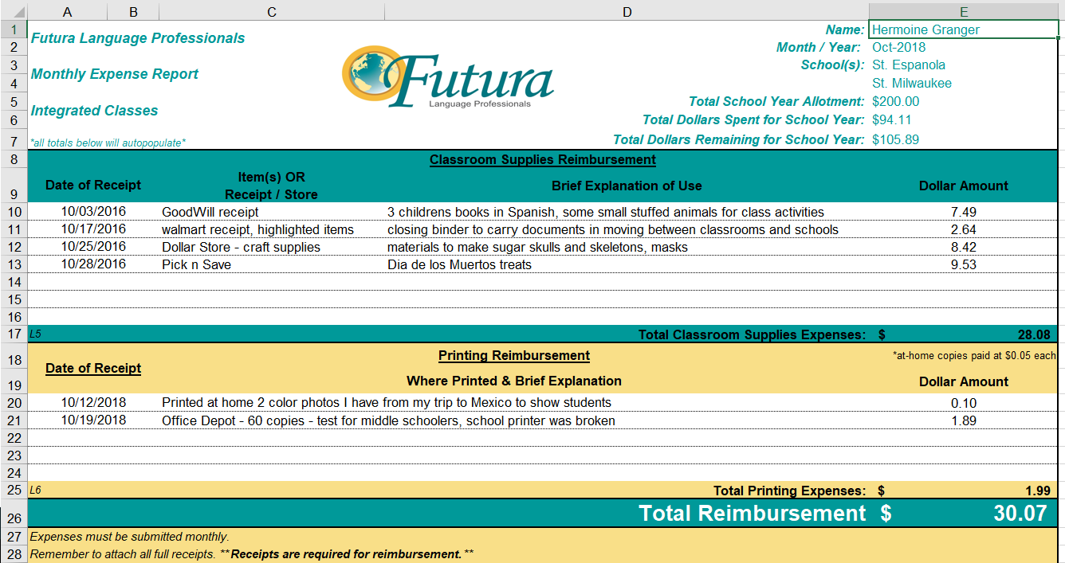
Expense Report Example
←1
←2
←3
←4

Slide 6
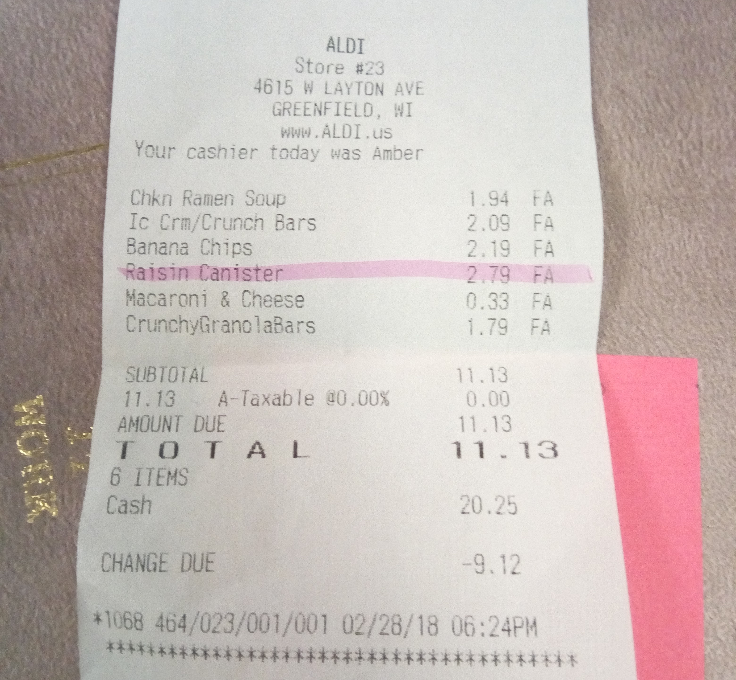
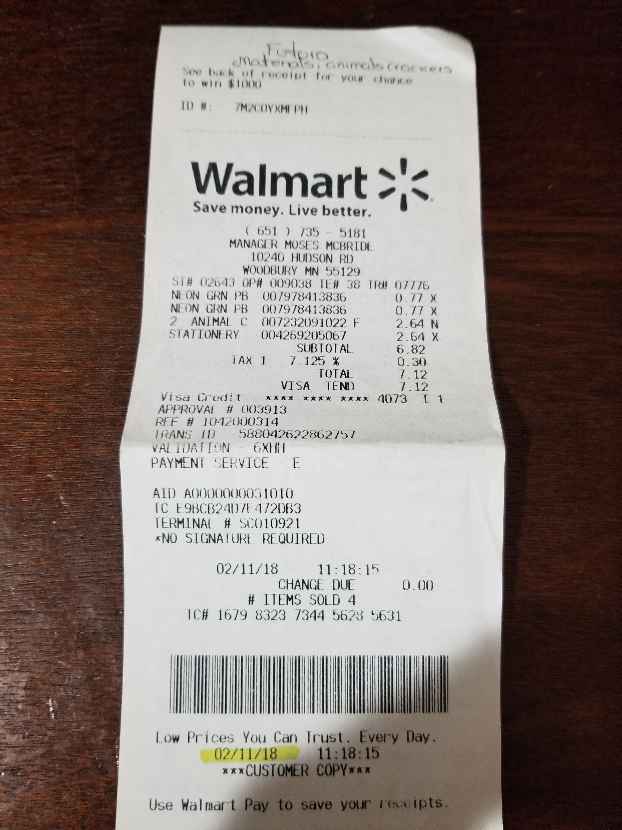
Examples of Receipts

Slide 7
Expense Reports Recap
Submitted each month by the 5th or each semester along with December hours and May hours
Integrated expense allotments are for the full year
Refer to your schools teaching contract for allotment, as each school is different
You are only eligible for reimbursement up to the total amount of your expense allotment(s), so spend wisely and track your total
Receipts are necessary for reimbursement
Items reimbursed for become the property of Futura Language Professionals
Submit all items with time sheets via email to payroll@futuraadventures.com
Paid with hourly wages
Questions? Contact the payroll coordinator

Slide 8
Have a GREAT school year!

