Slide 1
Expenses Training
Enrichment Classes
revised 2021-10

Slide 2
Expense Reports
Excel document
Submitted monthly, only including expenses from the previous month
Expense Allotments – classroom management tools, printing, & things to help enhance students learning
Semesterly, $25 for 1st course, $10 for each additional course
If you teach 1 course in the fall semester → $25 expense allotment, 2 course → $35, 3 courses → $45
Receipts necessary for any reimbursement (other than printing at home)
Scan & email PDF attachment
Take a photo and email as attachment *TIP: take a photo of the receipt right away, so you don’t have to save the receipt for up to a month
Printing – 1st day Parent Introduction Letter, Cultural Images
At-home copies → $0.05 per copy
Printer paper & ink separately are not reimbursable
$25 material deposit taken from first paycheck, returned in full on last paycheck when all items have been returned to area Manager
Covers Futura curriculum guides, flashcards, teacher kit, library items, any items expensed that another teacher could use
You are responsible for keeping track of your remaining expense allotment total

Slide 3
Printing at Office Depot / Office Max
1st day Parent Introduction Letter, Cultural Images
Office Depot/Office Max Store Purchasing Program
Discounted pricing
Print on colored paper
Order Prints Online
https://business.officedepot.com/index.do
Log In: FuturaAdventures
Password & additional instructions to follow
Be sure to check with your local Office Depot/Office Max as each is run slightly differently

Slide 4
Helpful Tips:
Don’t stock up on craft items! Crafts are a very small portion of our classes, so utilize the Futura library to pick up items instead of splurging on supplies.
We are not allowed to use the classroom materials such as coloring supplies in the room you are using. You can ask the students to use colors if they have them in their backpacks.
Don’t hesitate to ask your area manager or fellow teachers for any resources, questions, etc.
Take advantage of the Futura library! Our Futura library has many useful items for a great classroom, such as:
conversation balls
flyswatters
microphones
white boards
stickers
Start with the basics needed & use the expense allotment to make you a better teacher: Copies, certificates with stickers, visuals, props, etc.
Don’t give a prize for EVERYTHING! Students go through the whole day at school without candy/prizes, so it is okay to play a game and not to give the winners something each time. Please limit candy/treats in general. Stickers and high fives work well for praise!
WHERE TO GO:
Dollar Tree/Dollar General/Five Below have great affordable options for classroom supplies!
Target Dollar section at the front of the store can be a great resource.
Office Max/Depot with the Futura Business Solutions SPC account for discounted copies and supplies.
Michaels & Hobby Lobby can often have good prices.

Slide 5
Expense Reports
←1
←2
←3
←4

Slide 6
Expense Report Example
←1
←2
←3
←4

Slide 7
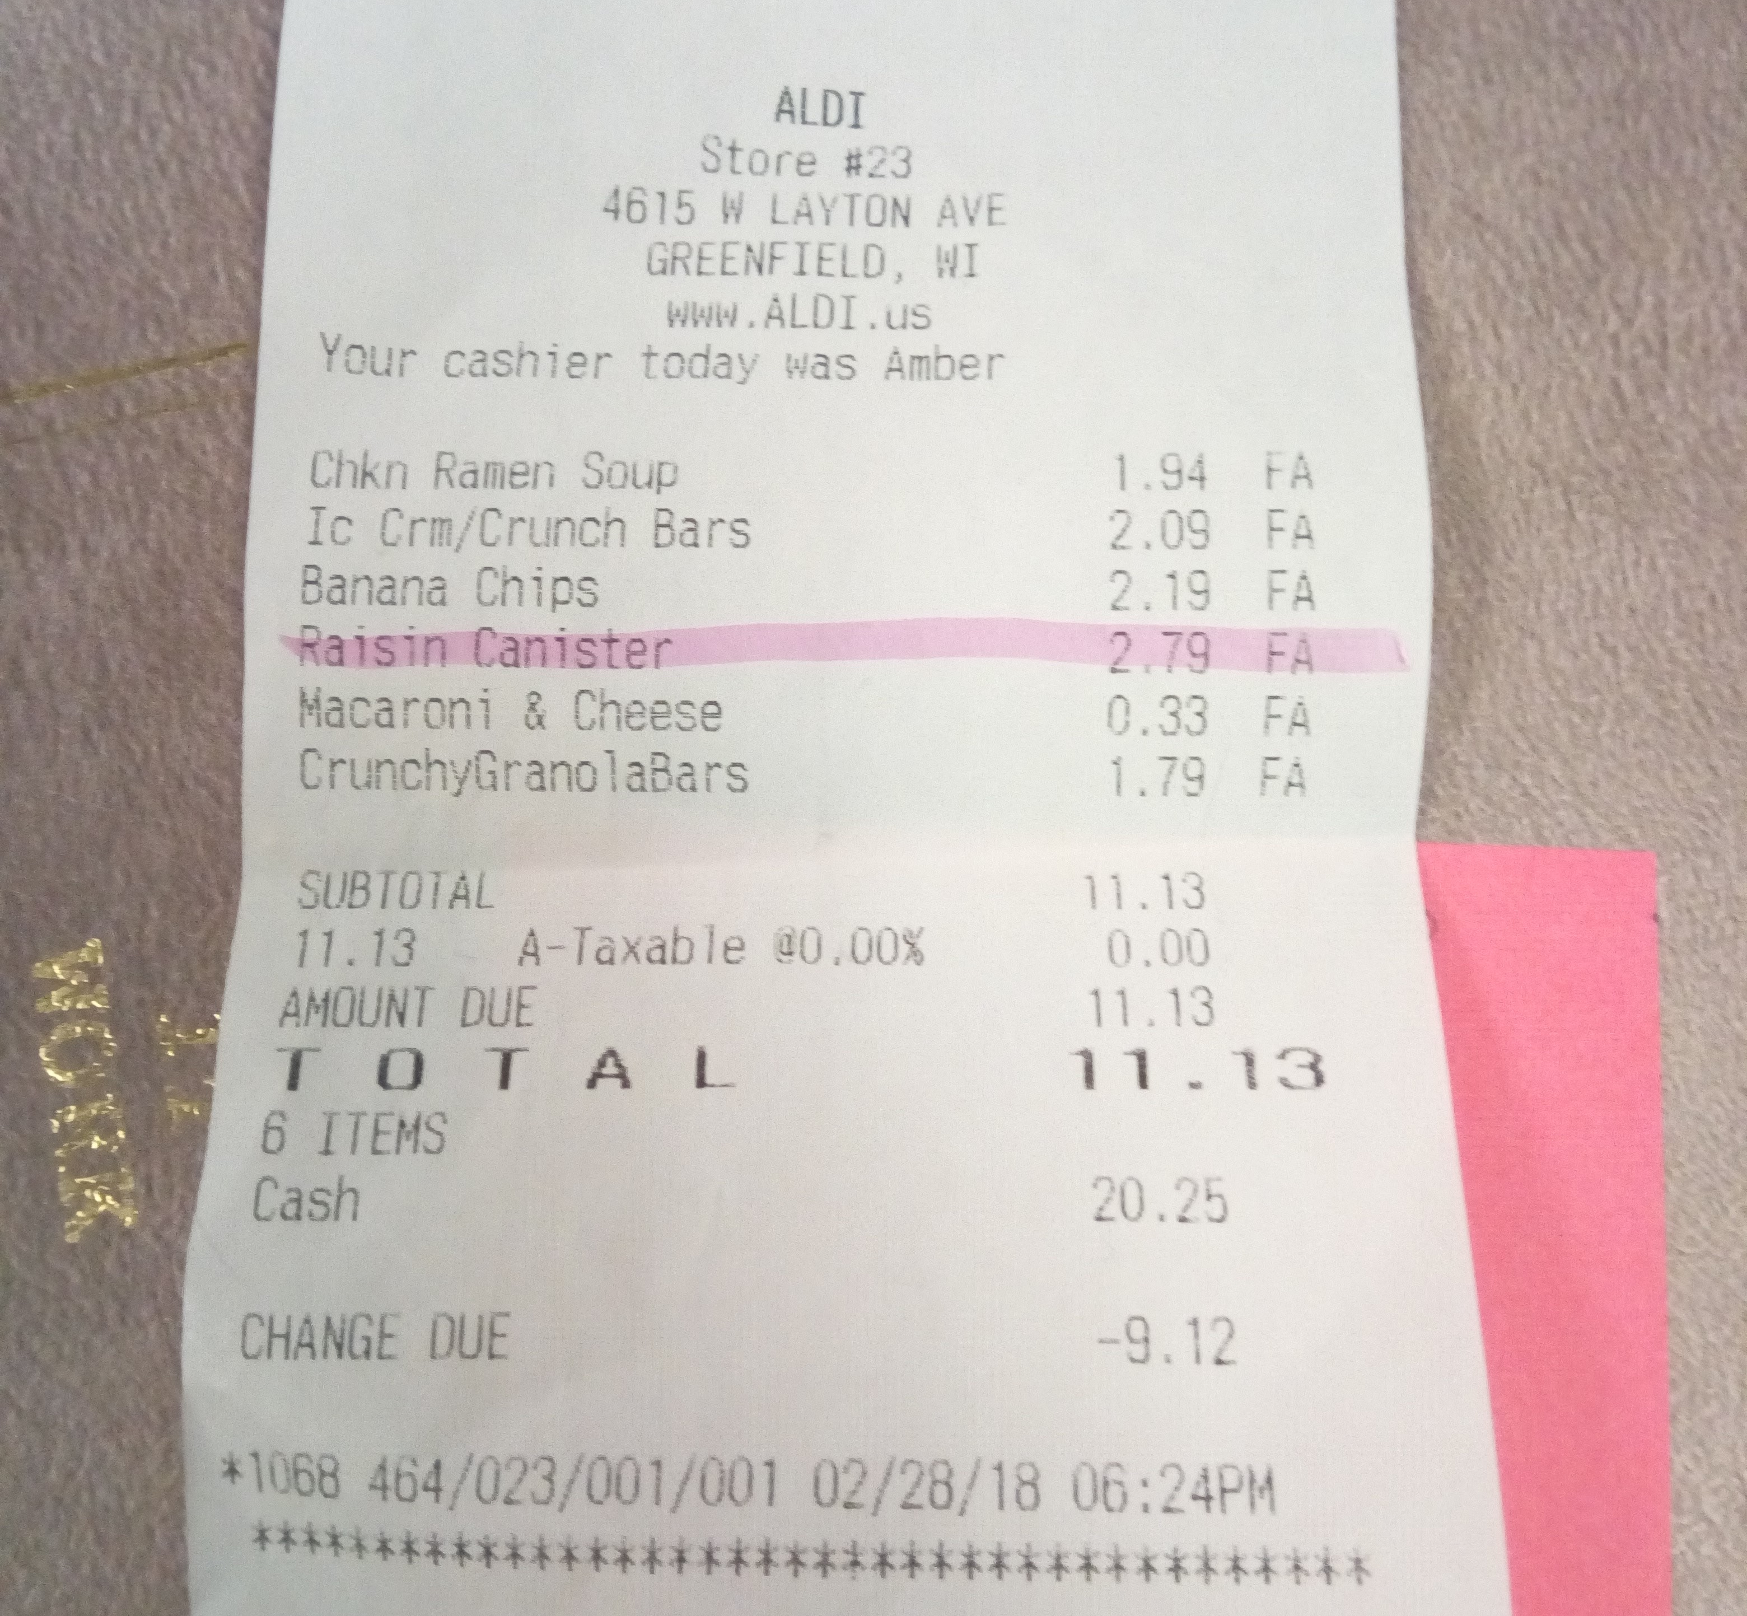
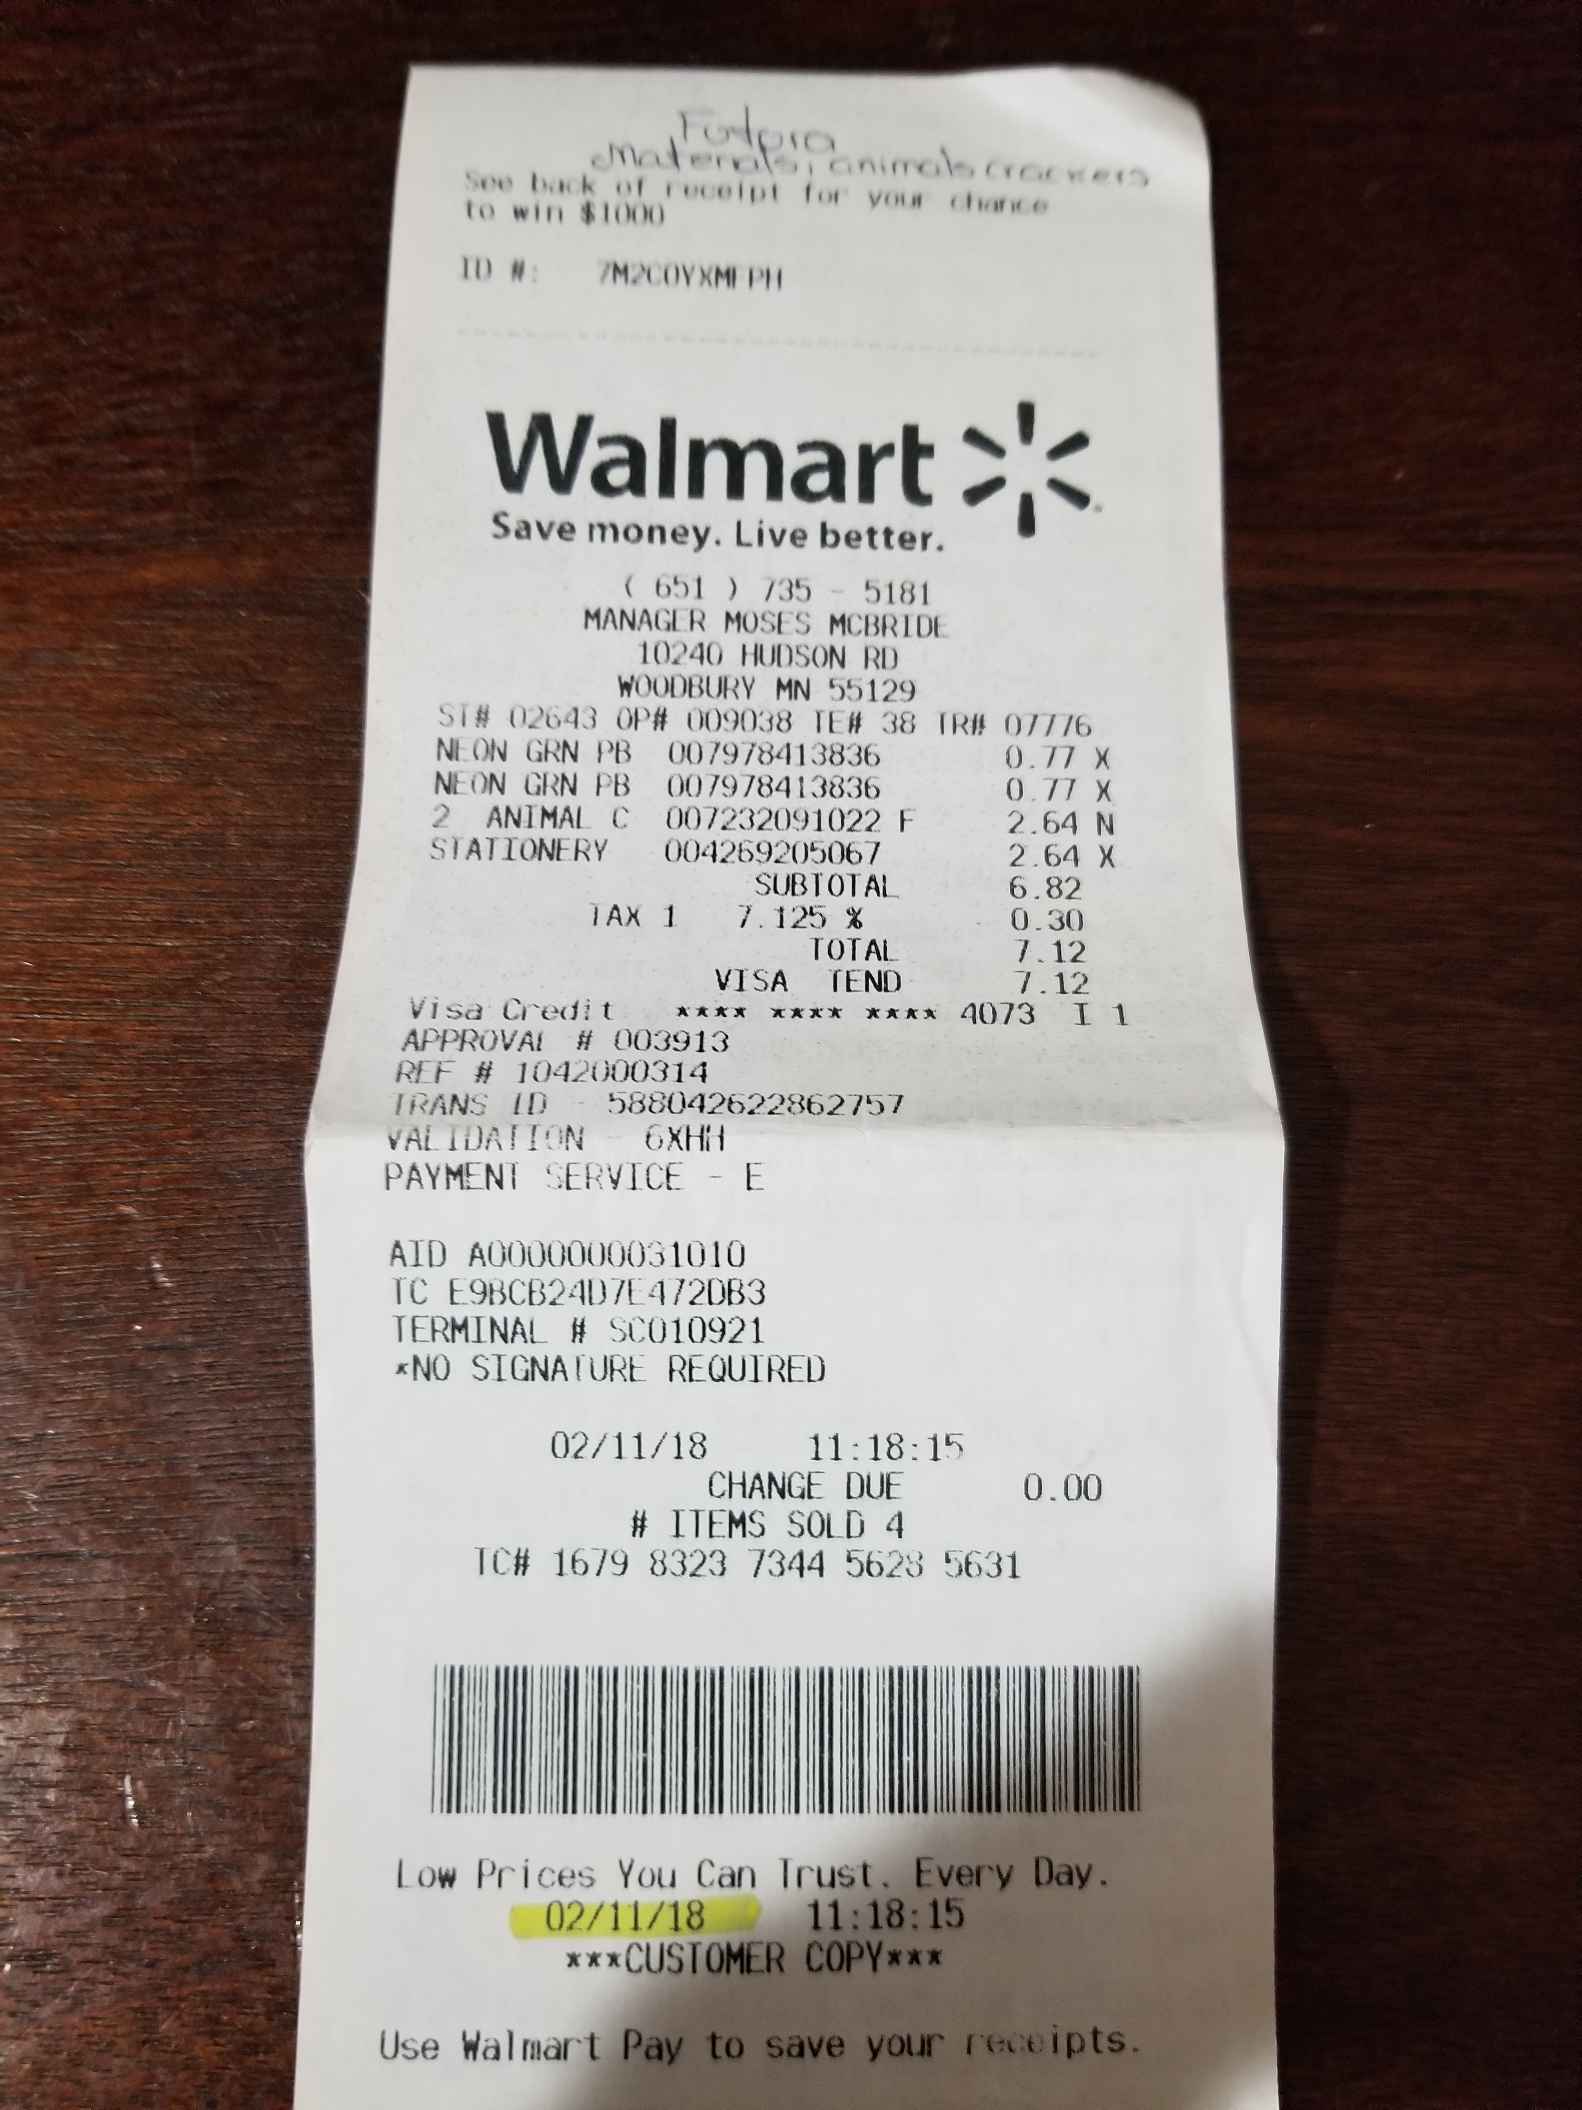
Examples of Receipts

Slide 8
Expense Reports Recap
Expense Allotment each semester based on number of classes assigned
Expense Reports with all receipts due each month by the 5th at 5pm
If your first classes are in October, then your first expense report with receipts are due before November 5th at 5pm
Submit all items with time sheets via email to:
payroll@FuturaAdventures.com
Paid with hourly wages
Questions? Contact Payroll
payroll@FuturaAdventures.com

Slide 9
Have a GREAT year!

