Slide 1
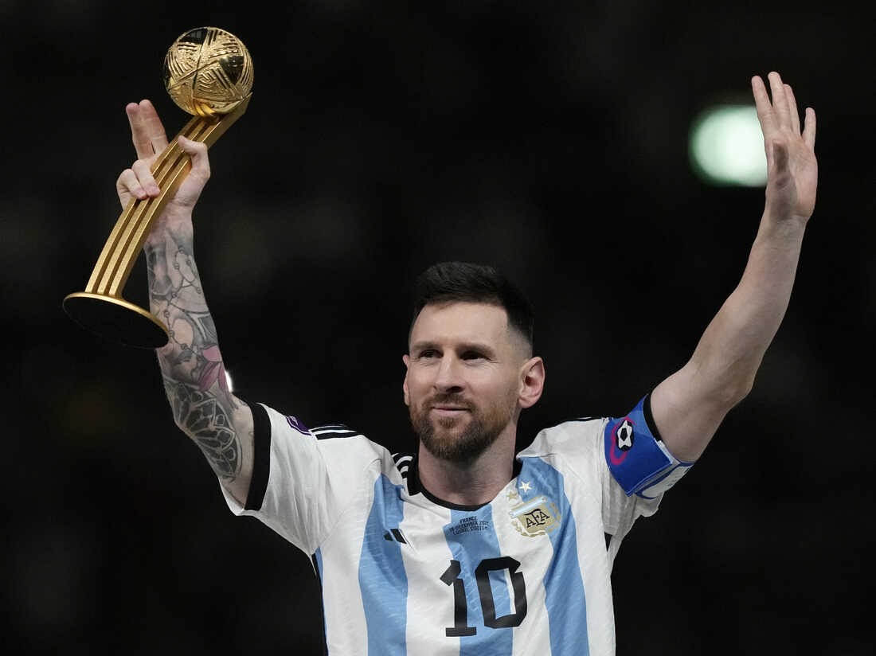
Lionel Messi
World Soccer Legend!

Slide 2
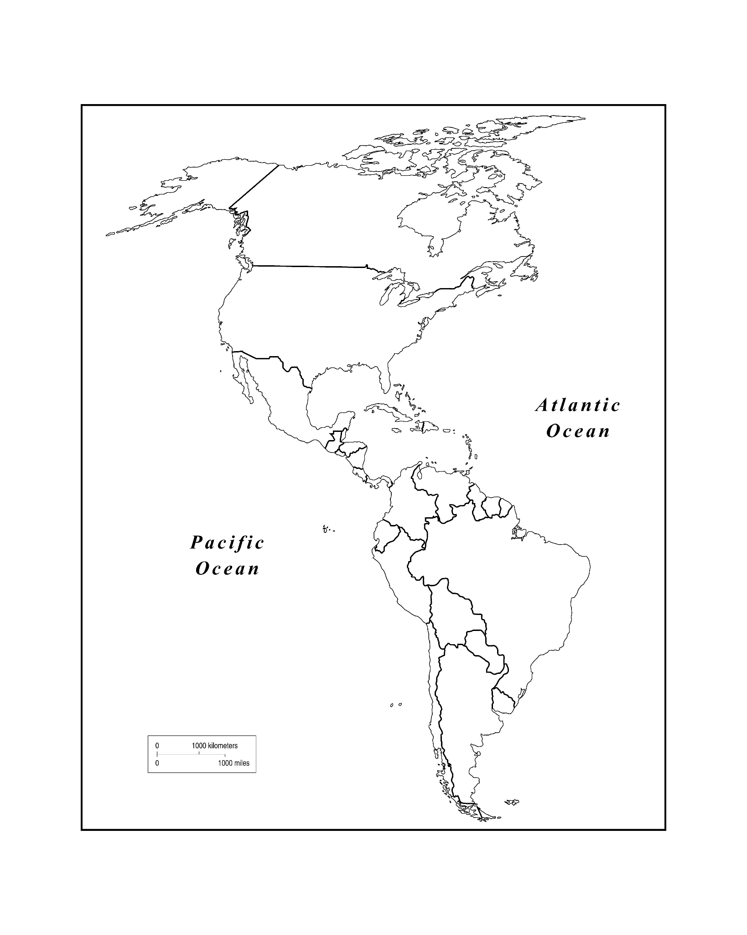
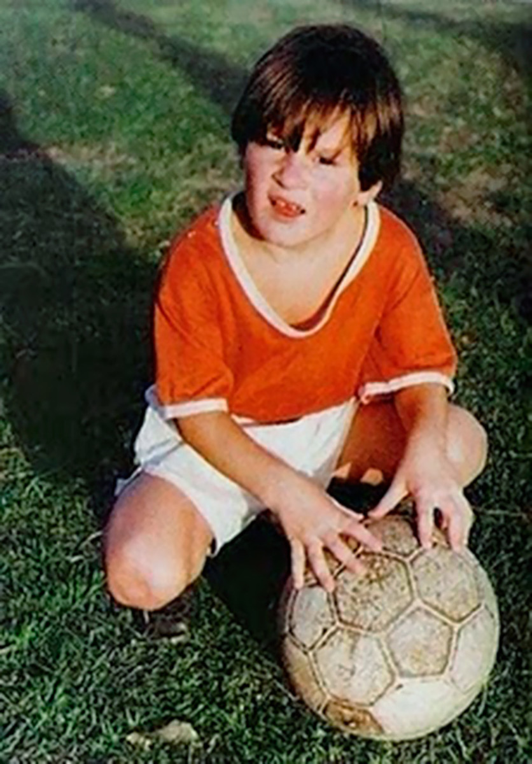
Messi was born in Rosario, Argentina.
USA
Argentina

Slide 3
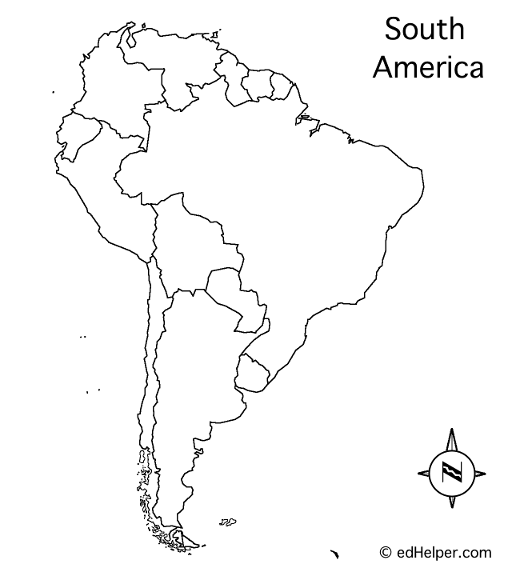
Rosario, Argentina

Slide 4
La bandera de Argentina

Slide 5
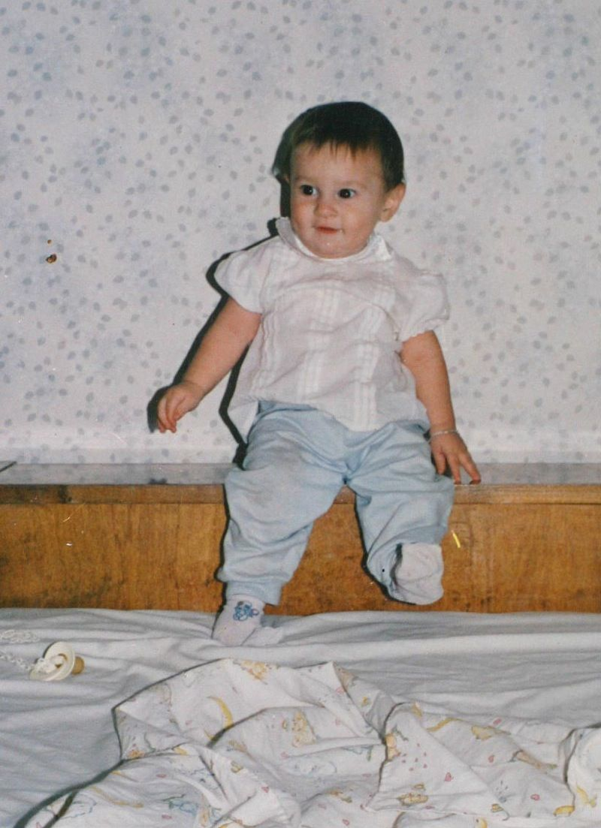
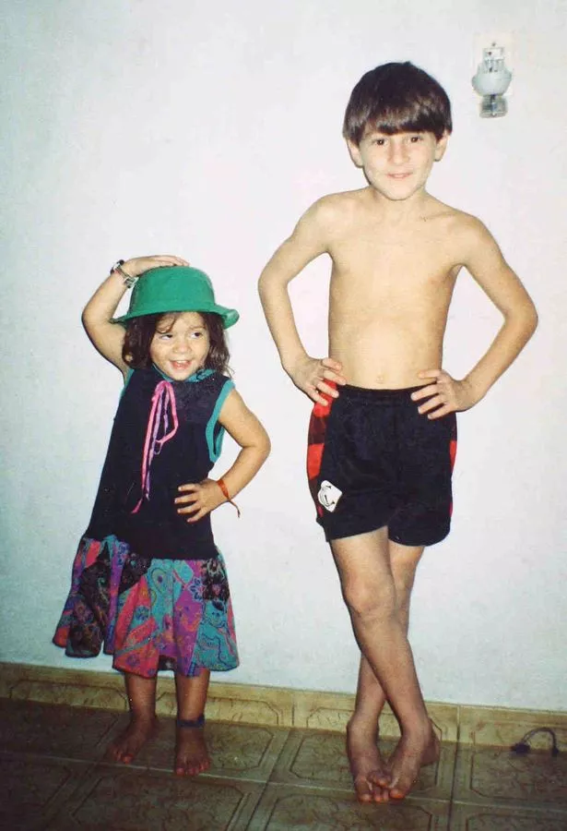
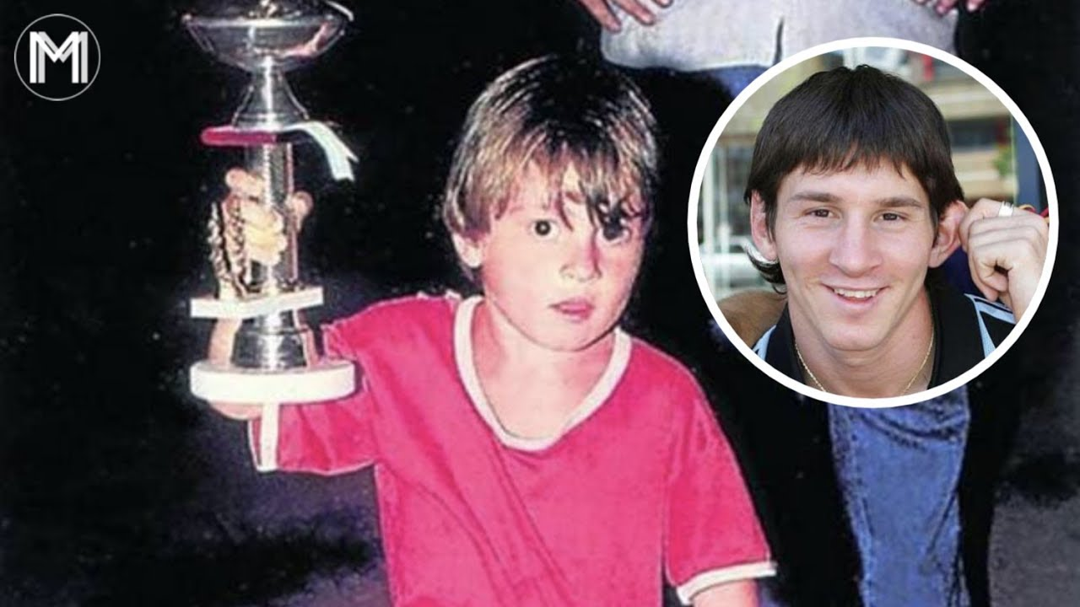
Messi was a talented soccer player as a young child. However, he faced some health challenges.

Slide 6
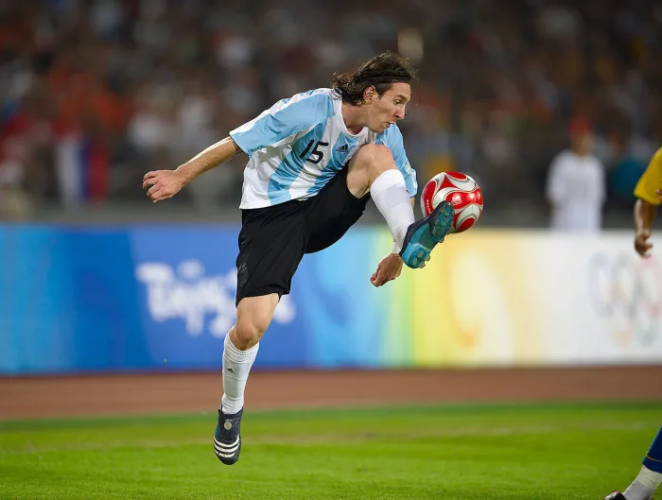
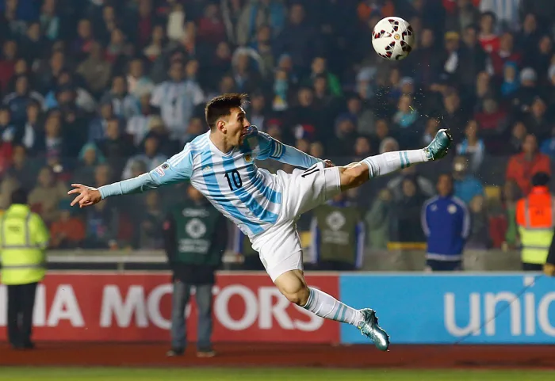
He overcame these challenges to become one of the greatest soccer players of all time!

Slide 7
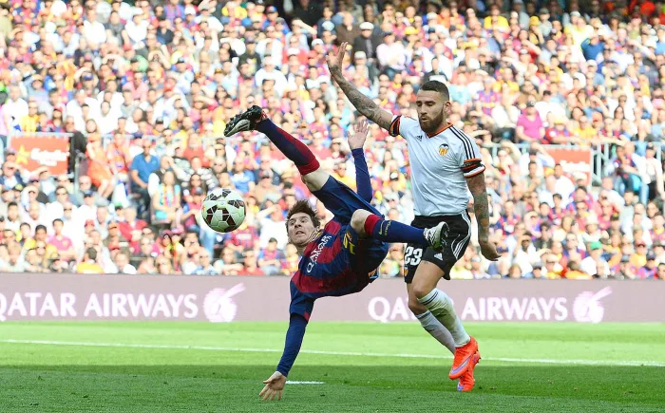
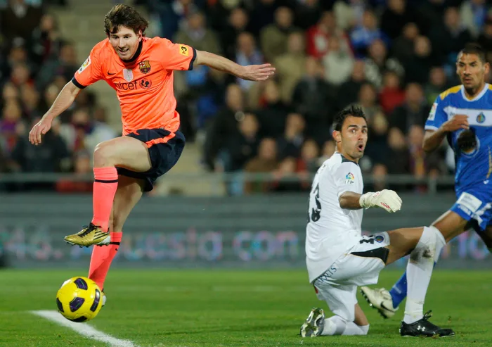

Slide 8
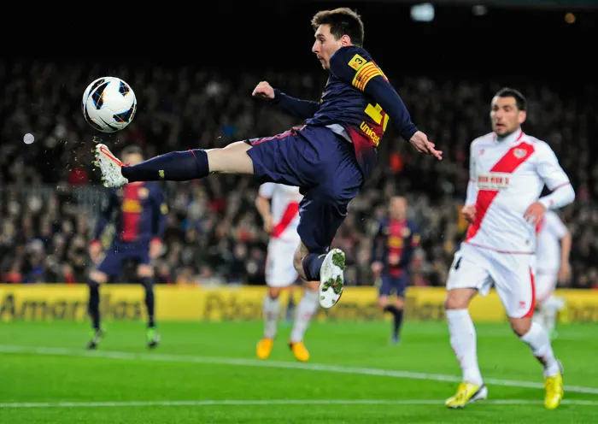
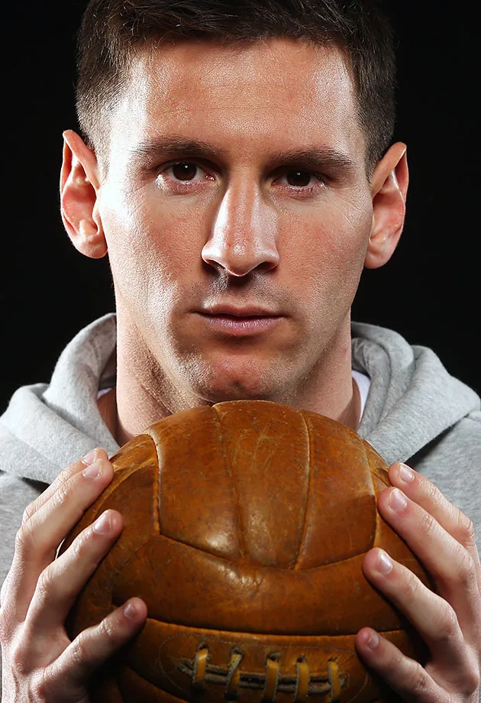
Let’s learn more about Lionel Messi!

Slide 9
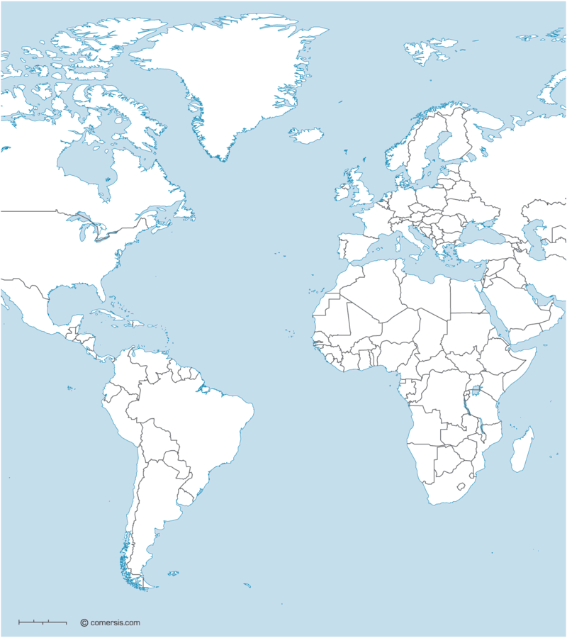
USA
Barcelona, Spain
Rosario, Argentina

Slide 10
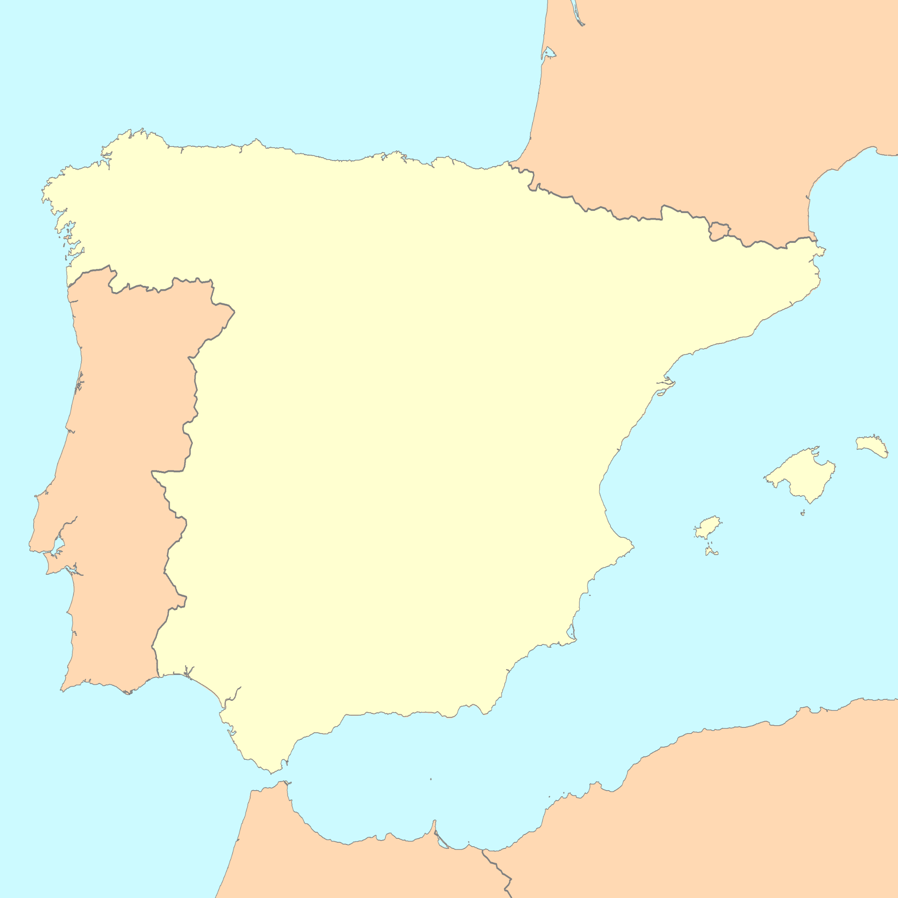
Barcelona
España

Slide 11
Essential Questions – Messi’s Childhood:
What was Messi like as a child?
What obstacles/challenges did Messi face?
What difficult decision did Messi and his family have to make for Messi’s future?

Slide 12
Essential Questions – Messi, the Soccer Player:
Where did Messi play (for what team) for most of his career?
What is Messi’s soccer-playing style?
What accomplishments did Messi achieve in his career?
Where is Messi playing now?

Slide 13
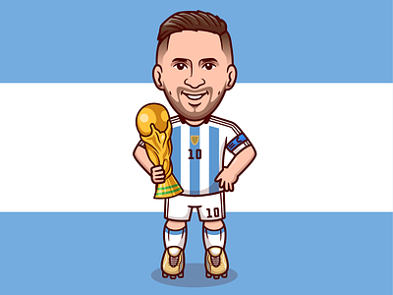
Essential Questions – Messi and His Legacy:
How will Messi be remembered throughout history?
Besides having amazing soccer skills, how is Messi an inspiration to others?

