Slide 1
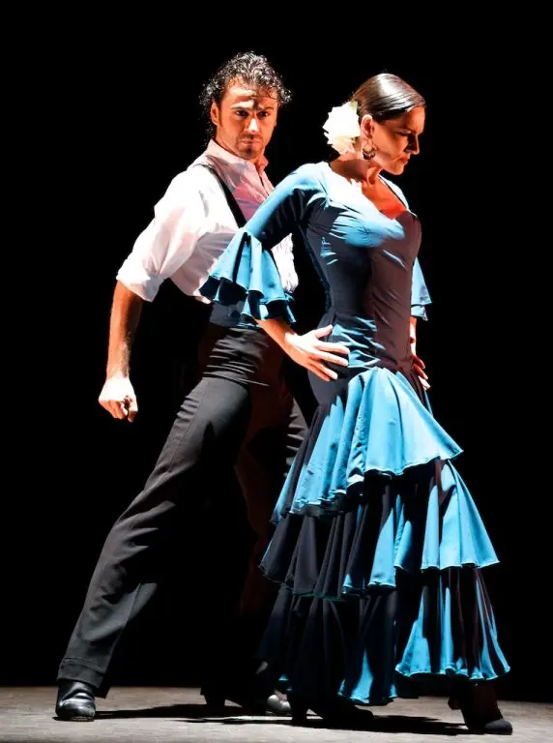
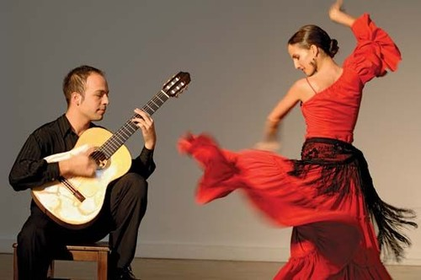
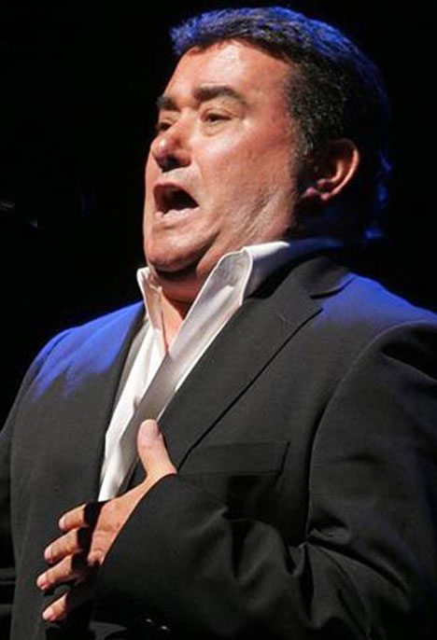
El flamenco

Slide 2
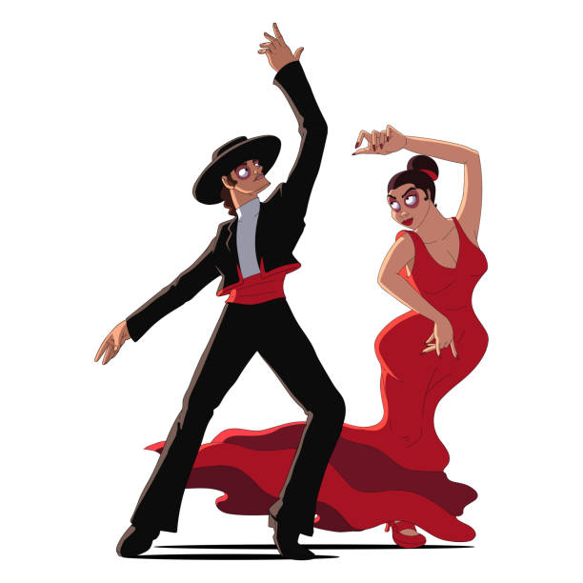
What is flamenco?
Flamenco is an art form that includes three parts:
el cante (song)
el baile (dance)
el toque (hand clapping and guitar)

Slide 3
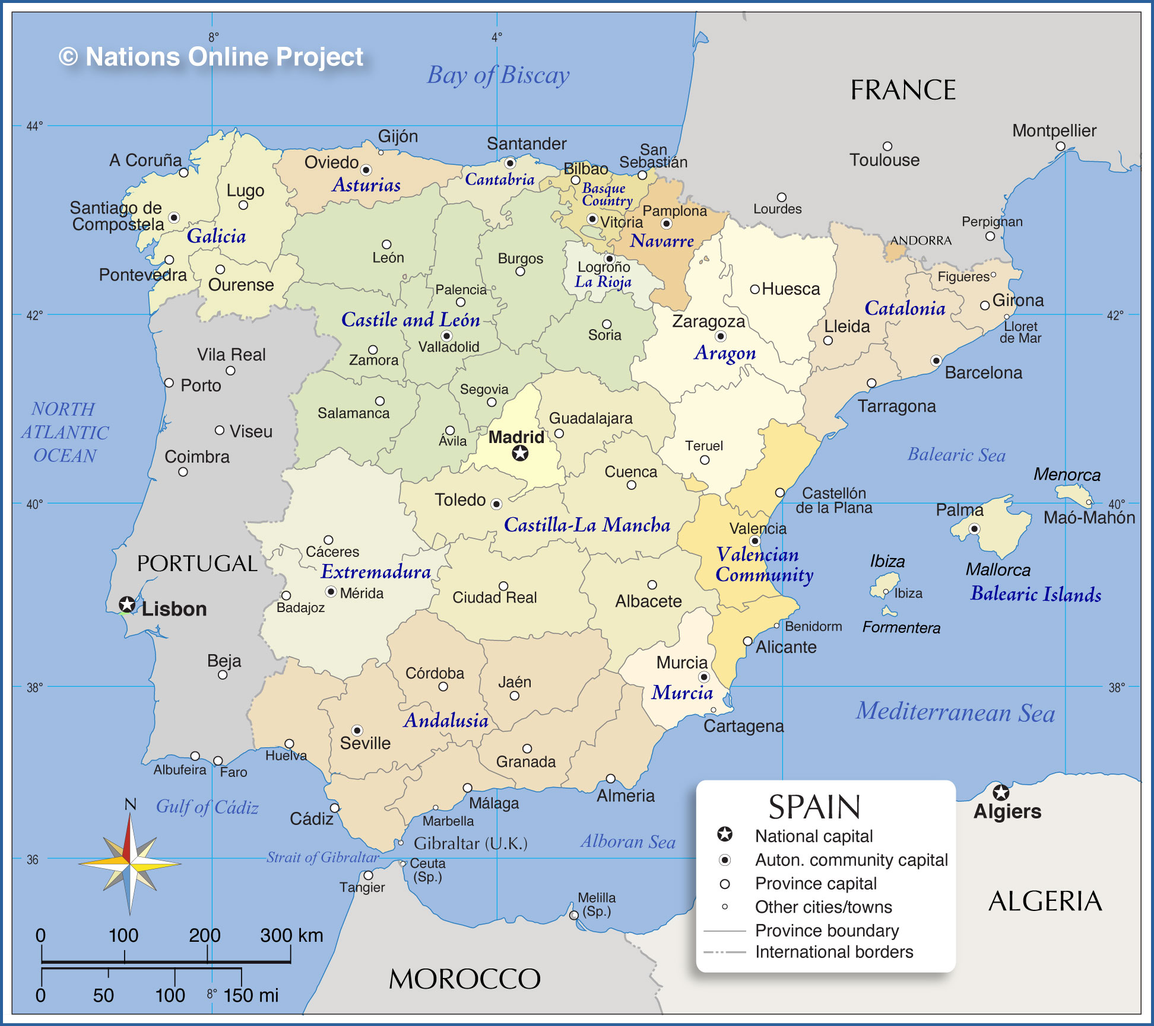
Where did flamenco originate?
Flamenco originated centuries ago in southern Spain, in a region called Andalucía.

Slide 4
How are flamenco musicians and dancers trained?
– Traditionally, flamenco artists learned their art from friends, relatives, and neighbors.
– In modern times, flamenco artists are formally trained.
– However, regular people still participate casually in flamenco at street festivals or among friends and family.

Slide 5
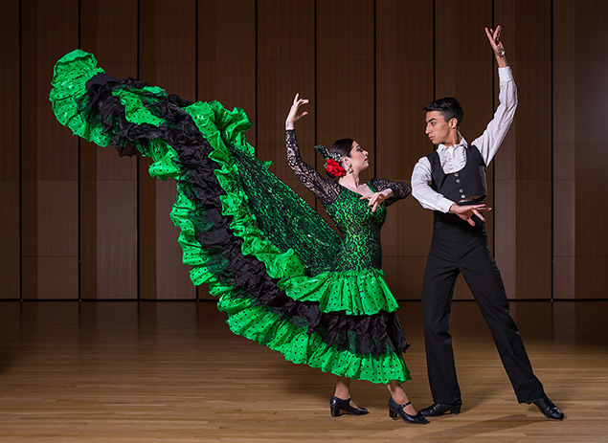
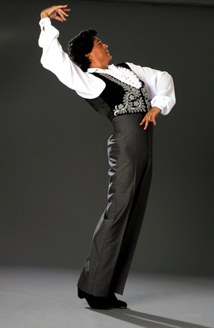
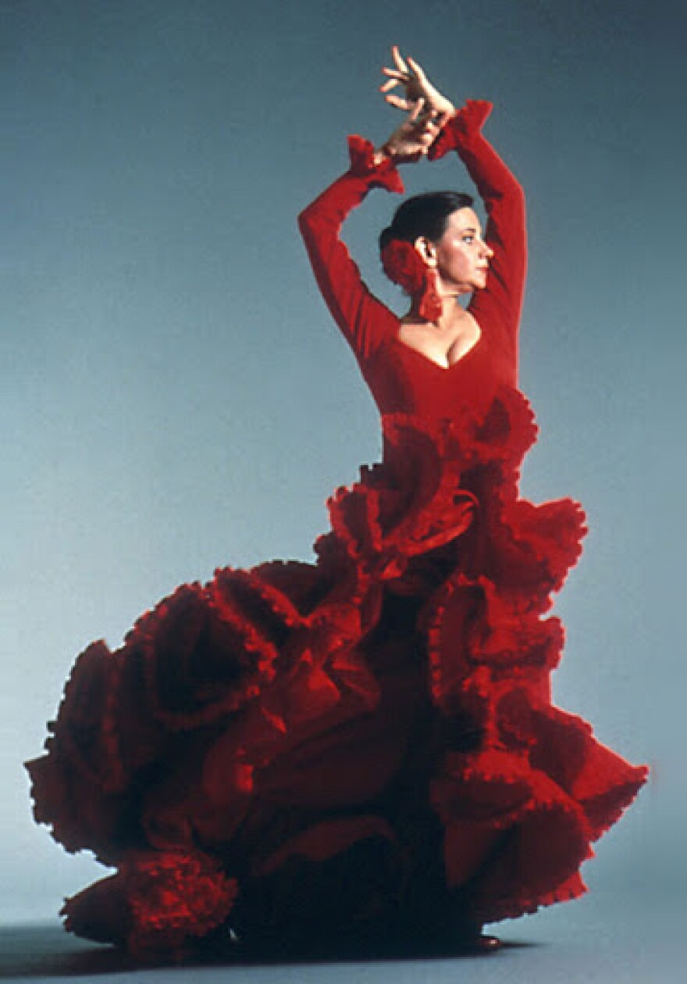
El Baile: Flamenco Dancing

Slide 6
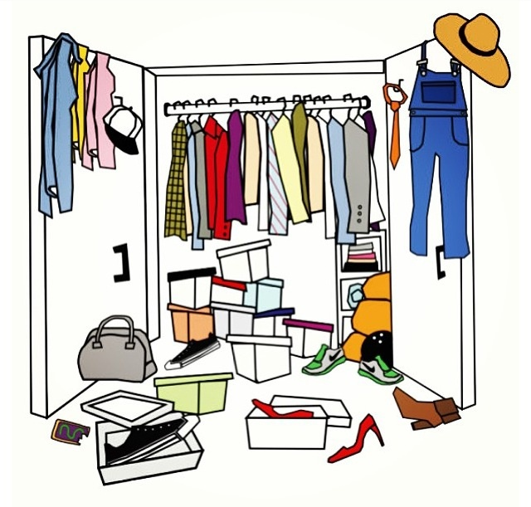
What do flamenco dancers wear?

Slide 7
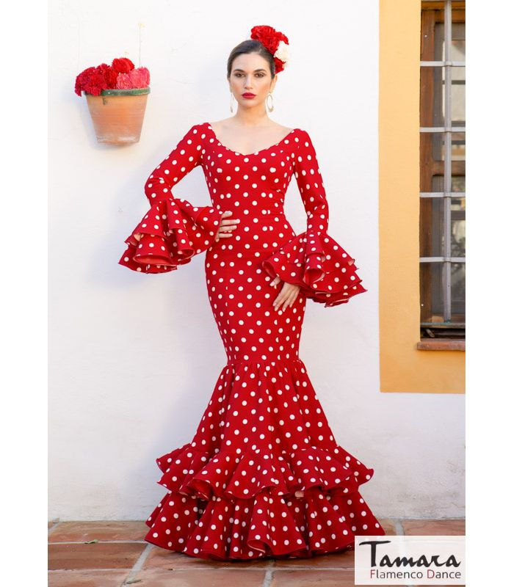
Las mujeres (women):
vestido/falda con volantes (dress/skirt with ruffles)
el mantón (embroidered shawl)
los zapatos con tacones (shoes with heels/taps)

Slide 8
Los hombres (men):
pantalones (pants)
camisa y chaleco (shirt and vest)
los zapatos con tacones (shoes with heels/taps)
similar style to bullfighter

Slide 9
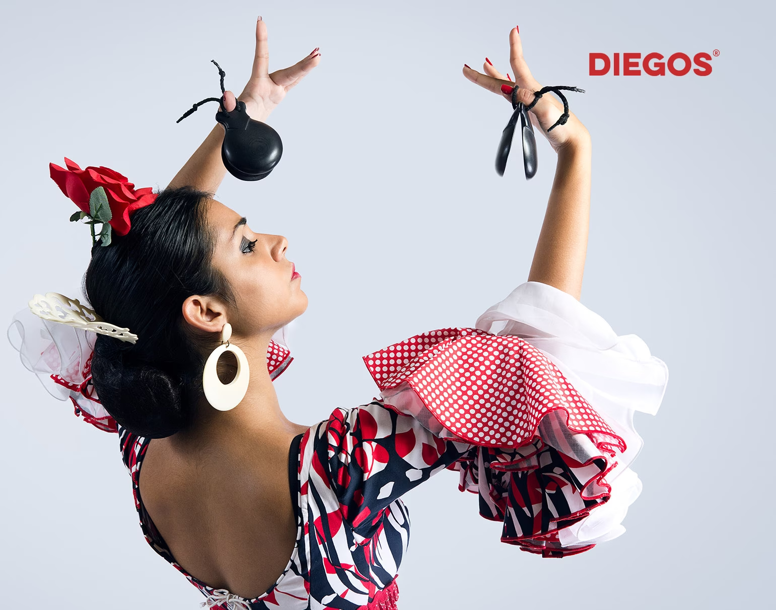
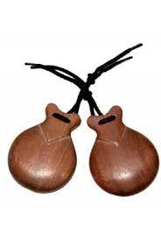
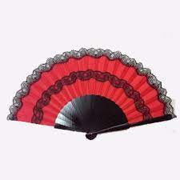
What props might a female flamenco dancer use?
castañuelas (castanets)
abanico (fan)

Slide 10
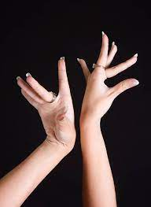
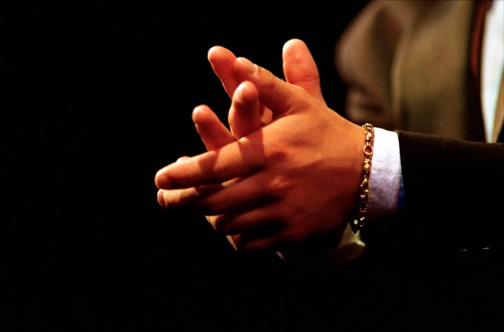
What are the basic elements of flamenco dance?
el floreo (flowery movement of hands)
el zapateado (rhythmic sounds of feet)
las palmas (rhythmic clapping)
la emoción (facial expressions)

Slide 11
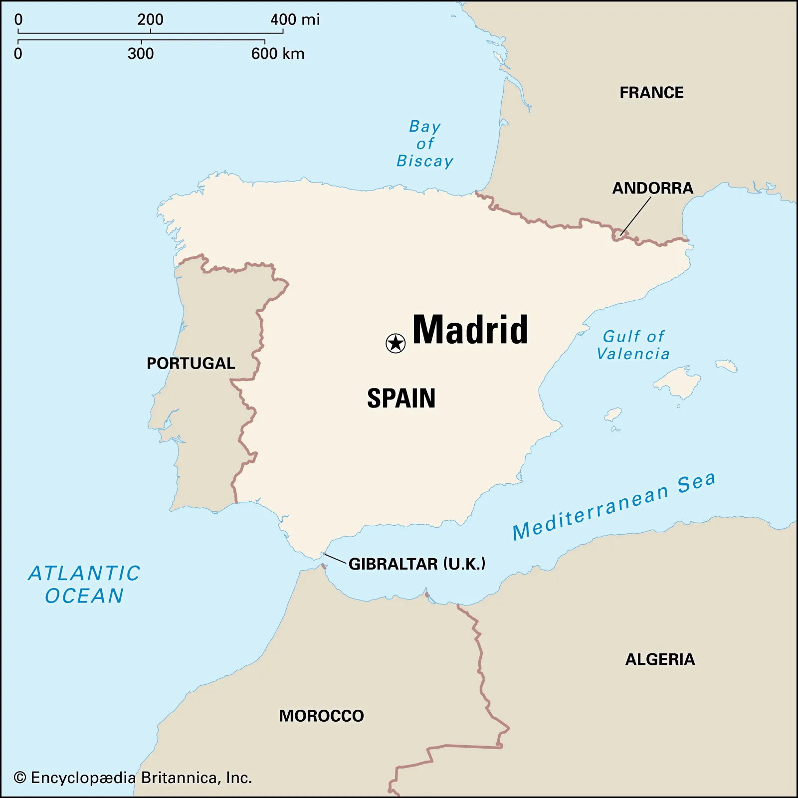
Let’s look at pictures from a real flamenco show in Madrid!

Slide 12
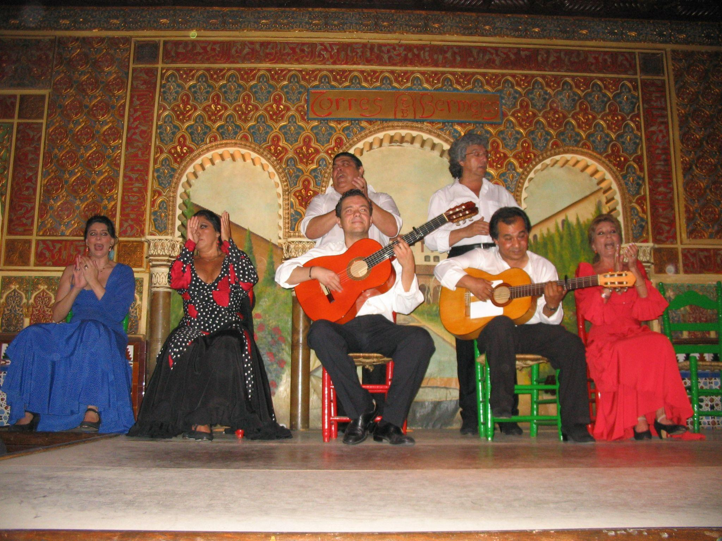

Slide 13
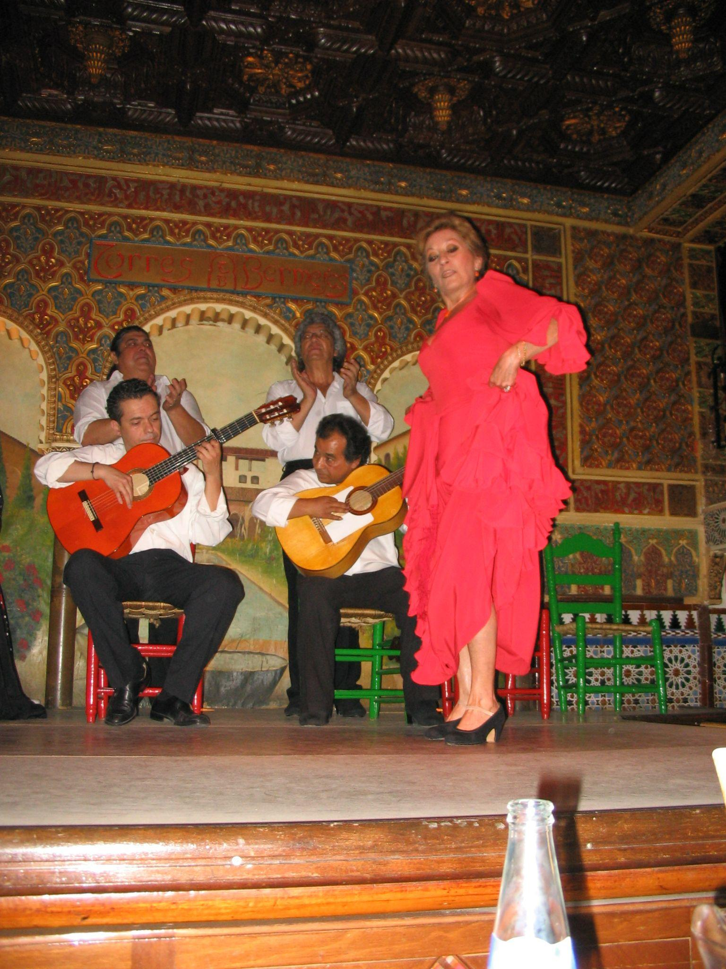
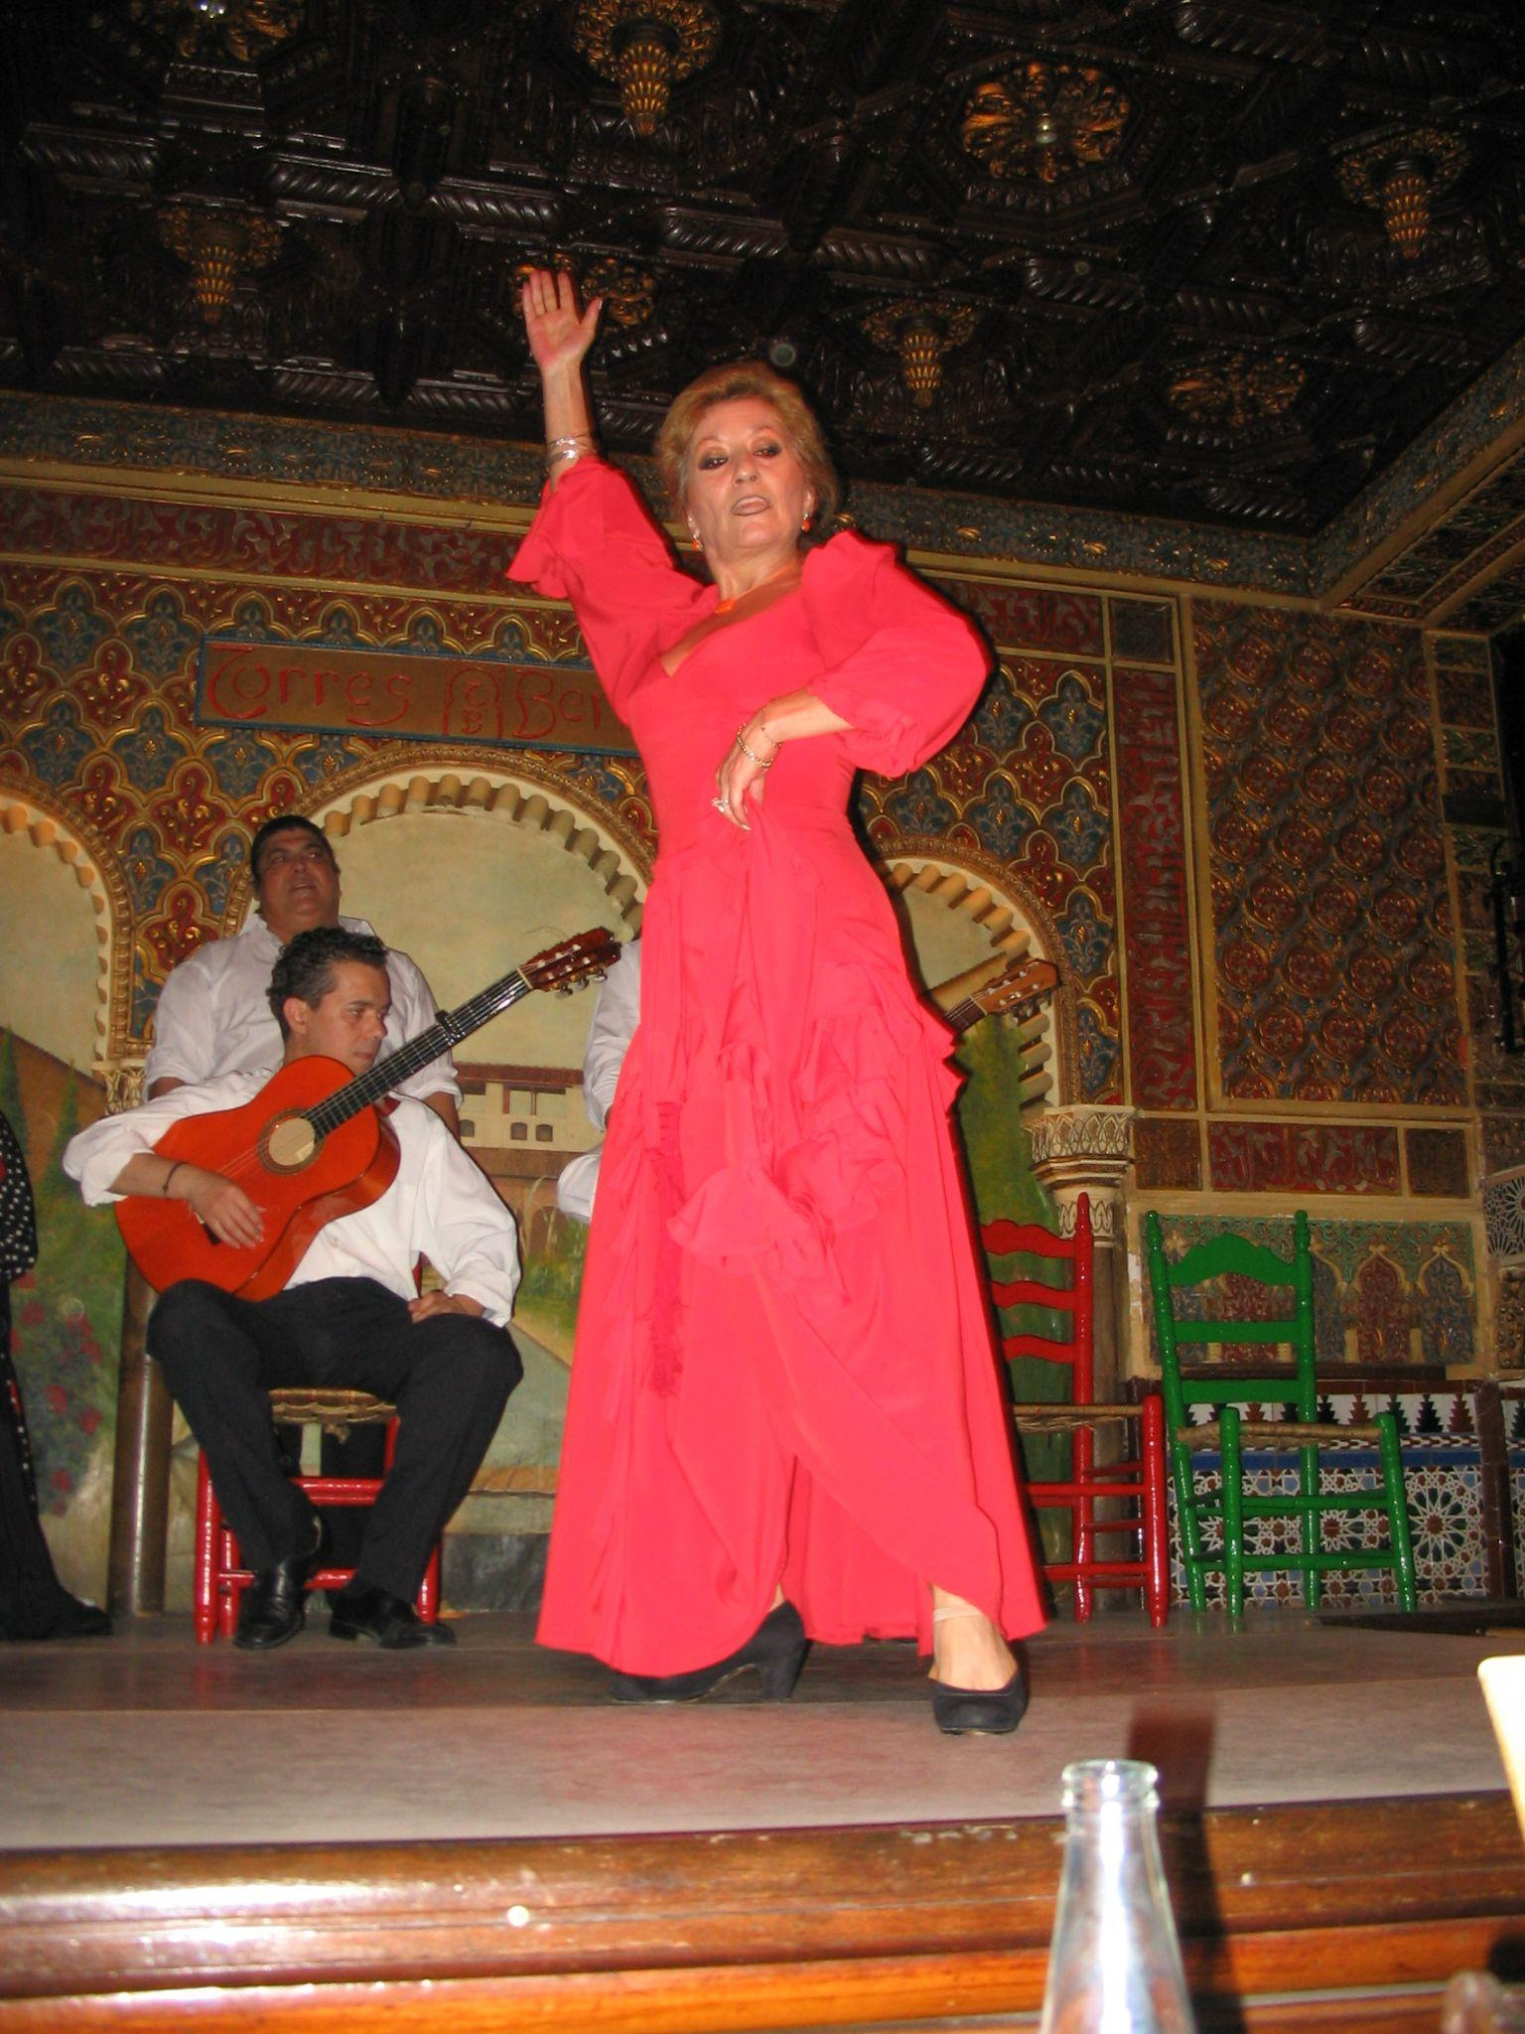

Slide 14
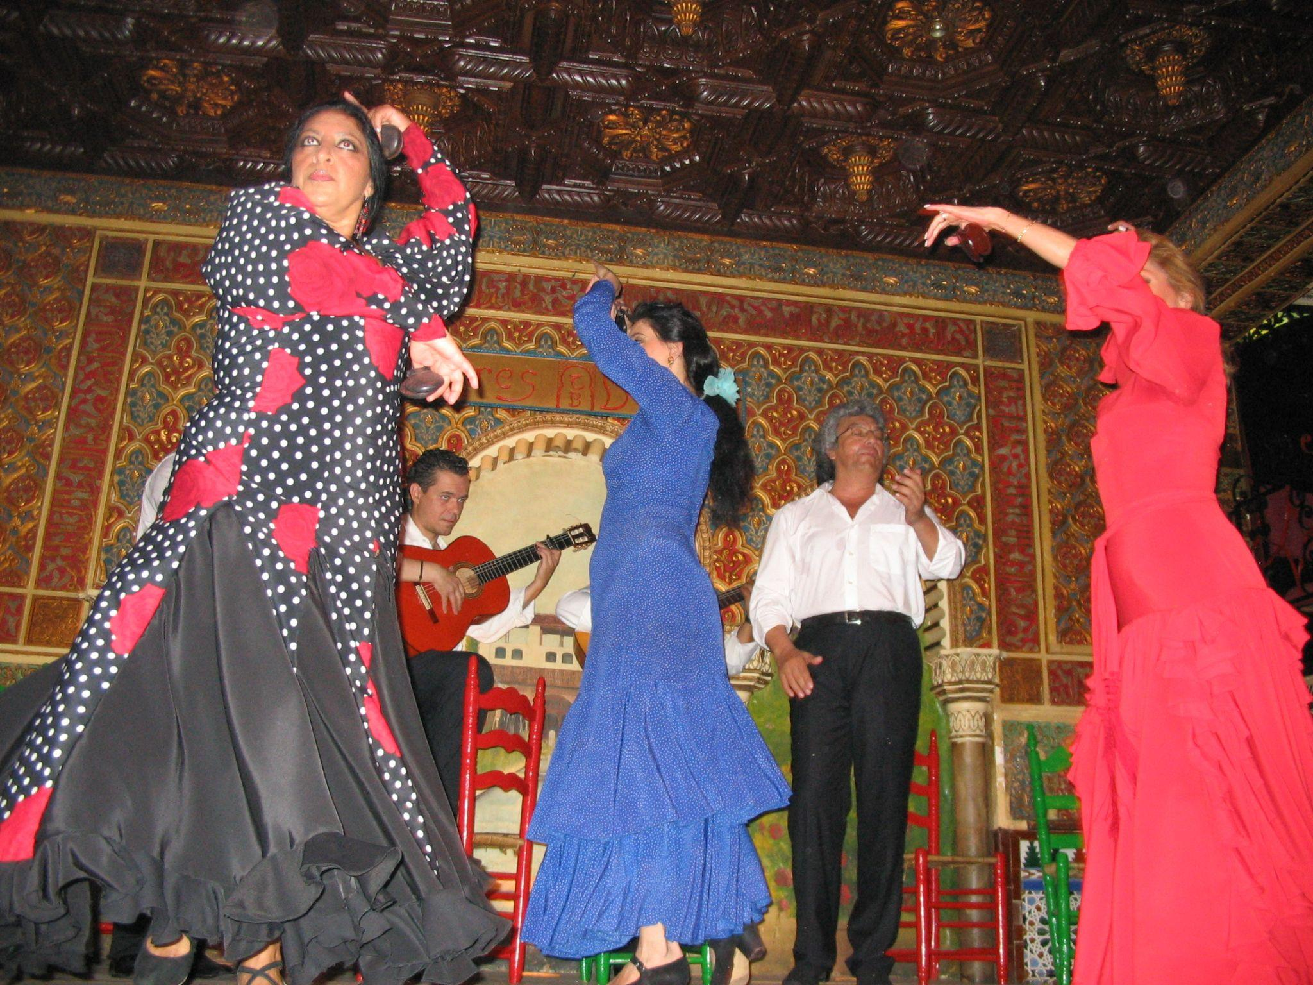

Slide 15
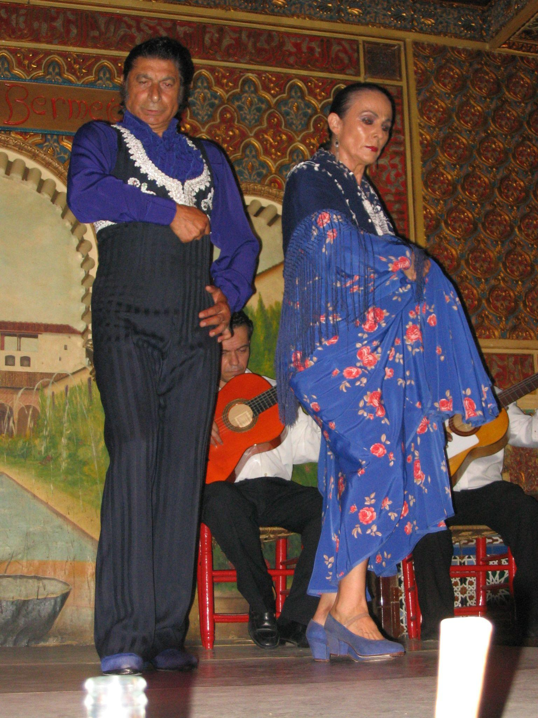
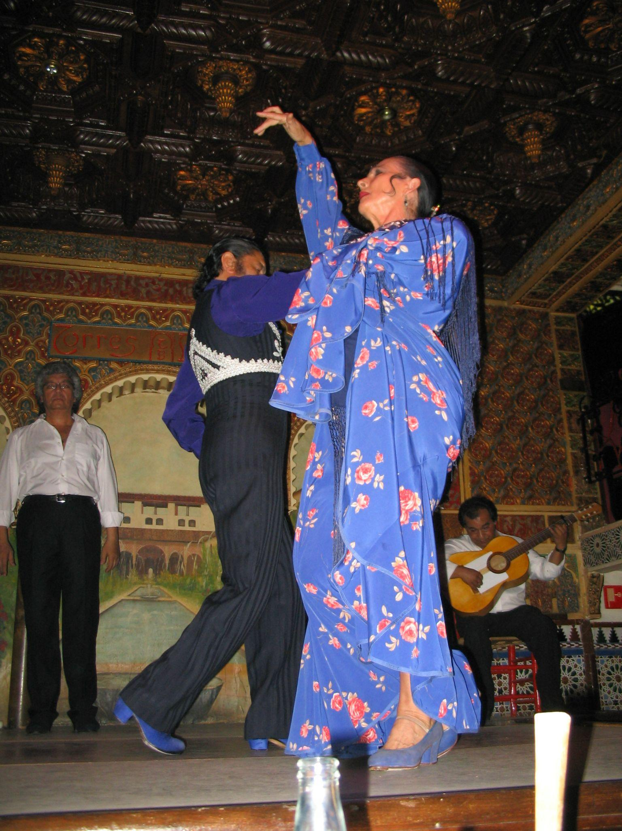

Slide 16
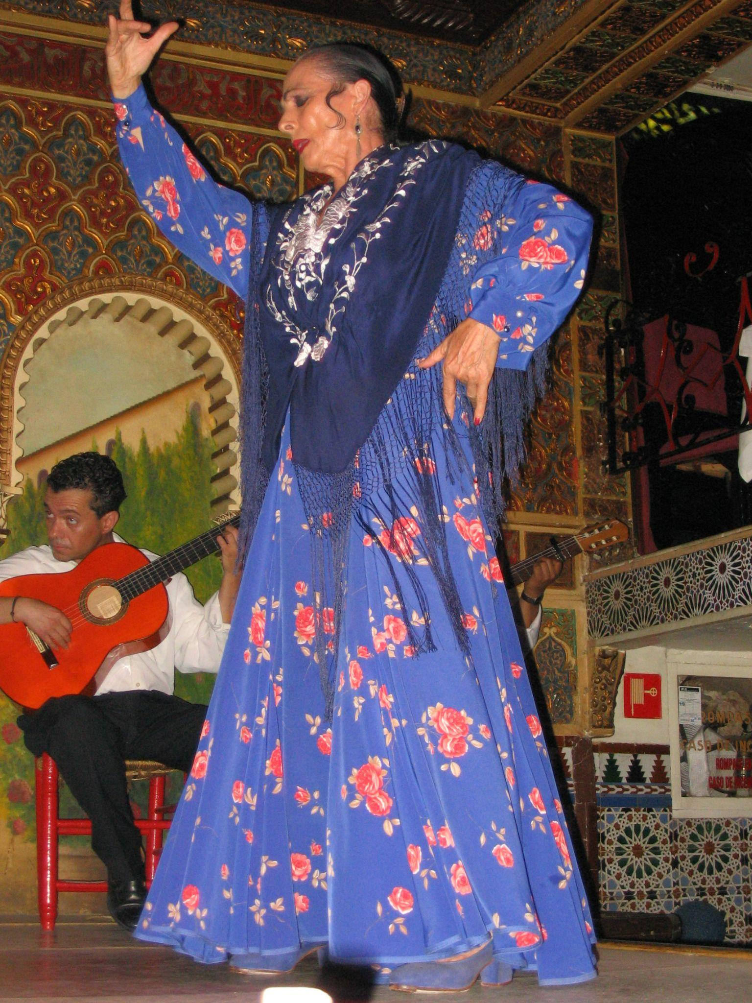
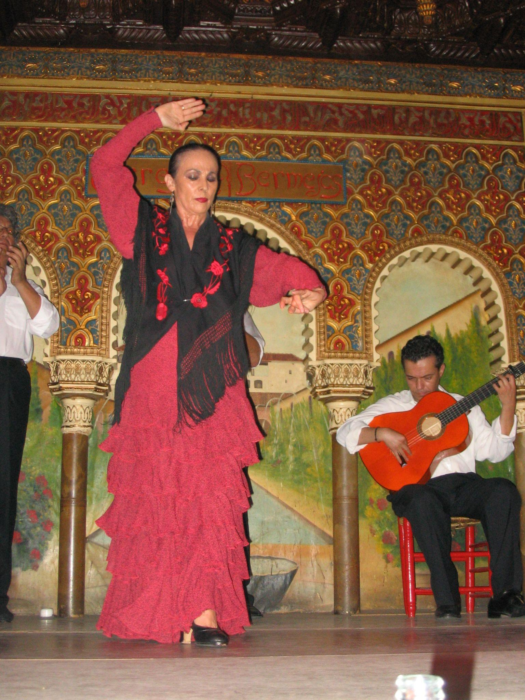

Slide 17
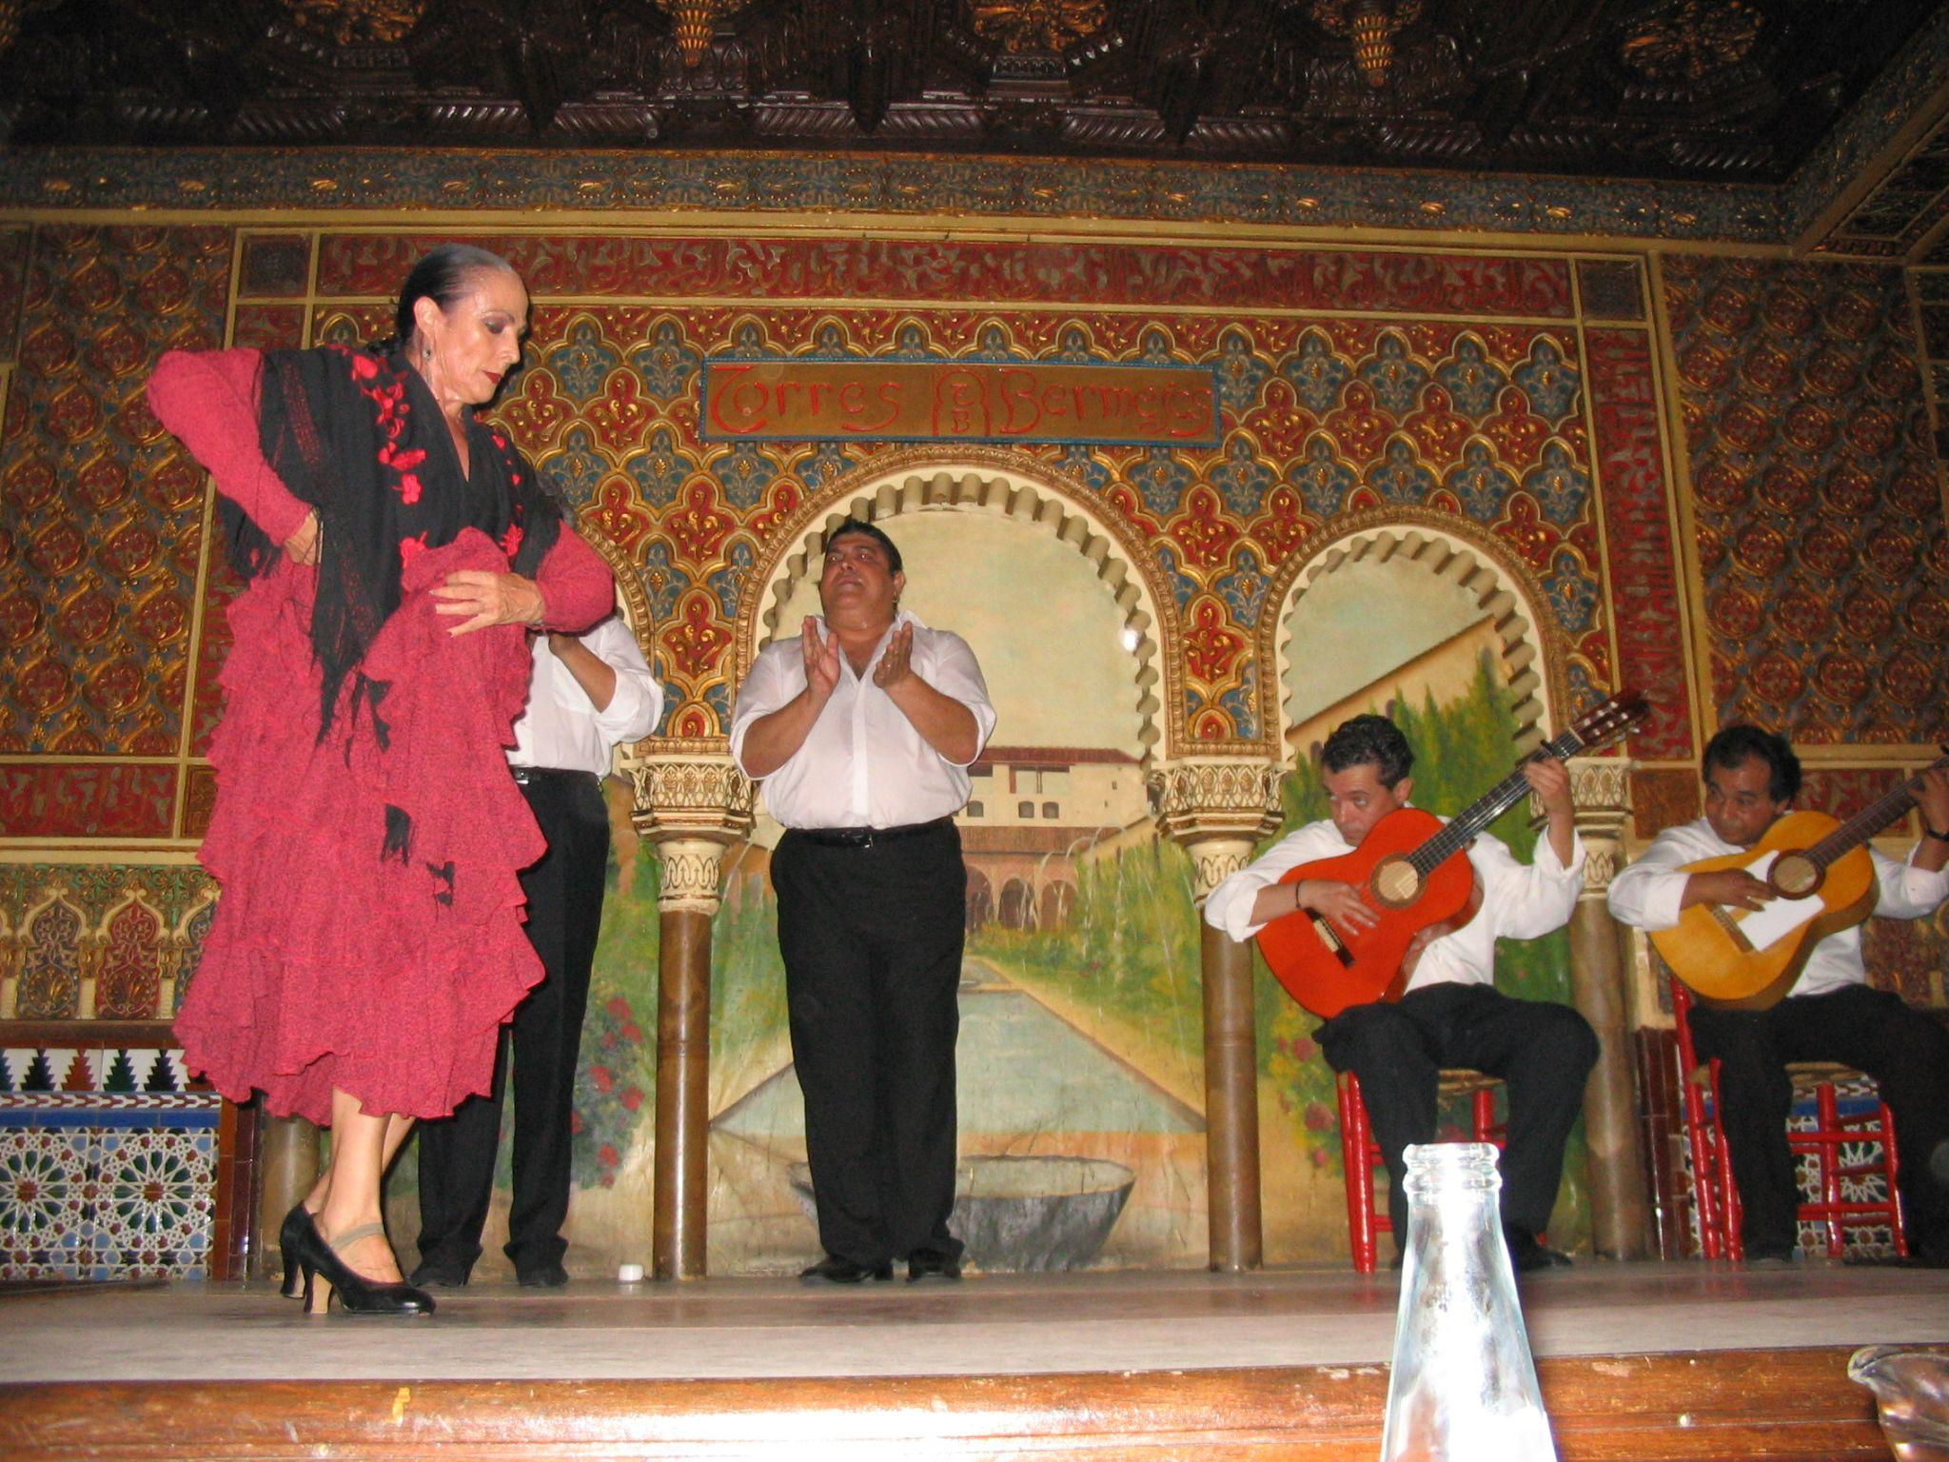

Slide 18
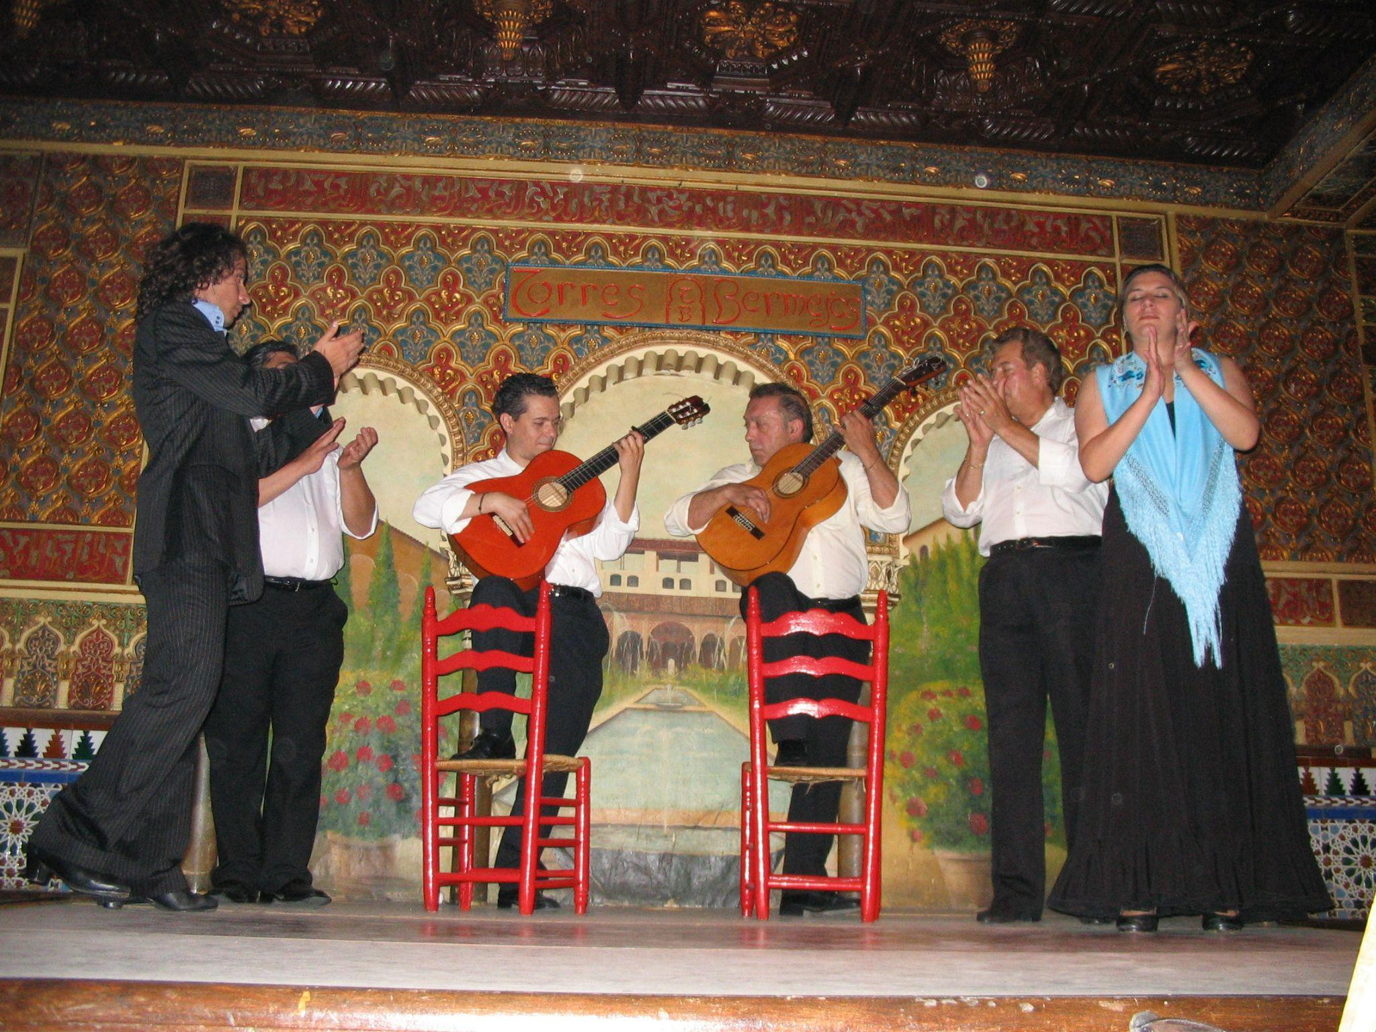

Slide 19
