Slide 1
Vamos a Charlar
Clase 1

Slide 2
Introducciones
¿Cómo te llamas? What’s your name?
¿Cómo estás? / ¿Qué tal? How are you? / What’s up?
¿Qué te gusta hacer? What do you like to do?
¿Qué quieres aprender en esta clase? What do you want to learn in this class?
Notes:
• Introduce yourself to the class in Spanish, tell us how you’re feeling, and one or two things you like to do, and what they are interested in learning Spanish in the kitchen. ¿Cómo te llamas? ¿Cómo estás? ¿Qué tal? ¿Qué te gusta hacer? ¿Qué quieres aprender en esta clase? What motivated you to join this class? *Goal to encourage participants to speak/practice Spanish.

Slide 3
Vocabulario
¿Qué? | What?
¿Por qué? | Why?
¿Cuál? | Which?
¿Cuándo? | When?
¿Cómo? | How?
¿Dónde? | Where?
Notes:
Vamos a aprender el vocabulario útil para conversar/charlar. We are going to learn vocabulary to use in conversations. Use the PowerPoint visual to teach the vocabulary and encourage participants to repeat the Spanish after you. Question words are important to know for conversation so that you can ask a variety of different questions.

Slide 4
Vocabulario
¿Quién? | Who?
¿Cuánto/a? | How much?
¿Cuántos/as? | How many?
¿Adónde? | To where?
¿De dónde? | From where?
¿De quién? | From whom?
Notes:
Vamos a aprender el vocabulario útil para conversar/charlar. We are going to learn vocabulary to use in conversations. Use the PowerPoint visual to teach the vocabulary and encourage participants to repeat the Spanish after you. Question words are important to know for conversation so that you can ask a variety of different questions.

Slide 5
Charla
Describe tu casa. Describe your house.
¿Dónde vives? Where do you live?
¿Cuántos cuartos hay en tu casa? How many rooms are in your house?
¿Cuántos niveles hay en tu casa? How many levels are in your house?
¿Cuál cuarto es tu favorito y porque? What room is your favorite and why?
¿Con quién vives? Who do you live with?
¿Tienes hermanos, esposo, o hijos? Do you have siblings, spouse, or children?
¿Qué te gusta hacer en tu casa? What do you do in your house?
¿Te gusta cocinar? Do you like to cook?
¿Quién cocina en tu casa? Who cooks in your house?
¿Cuántos televisores tienes? How many TVs do you have?
¿Te gusta ver películas, documentarios, o series? Do you like to watch movies, documentaries, or shows?
¿Te gusta levantarte temprano o dormir hasta tarde? Do you like to wake up early or sleep in?
Describe tu vecindario. Describe your neighborhood.
Notes:
Charla: Below are conversation starters and questions/answers that participants can use to practice conversation related to topics about their home in practical conversation settings. *Teacher: Review the conversation starters below and ensure participants understand the questions and answers. Option 1- (if a small class or for more beginner level) Keep the class as a group and screen share – having participants take turns asking/answering the questions. Depending upon the level of the participants, help them through the answers. Option 2- (if a larger class or more advanced) After screen sharing and brief review of conversation topics, divide them into pairs or small groups to practice in break out rooms. Use the feature of screen sharing during the breakout rooms so they can see the questions during the breakout.

Slide 6
Charla (Intermediate/Advanced)
Describe la casa de tus sueños. Describe your dream house.
Describe las casas en las que has vivido. Describe the houses you’ve lived in.
Describe la casa de tu infancia. Describe your childhood home.
Notes:
Note for teacher with intermediate/advanced level: Incorporate questions that could challenge participants to use subjunctive or past tense.
a. Describe la casa de tus sueños.
b. Describe las casas en las que has vivido.
c. Describe la casa de tu infancia.

Slide 7
Los Verbos - Vocabulary
¿Te gusta cocinar? Do you like to cook?
¿Cuáles quehaceres haces? What household chores do you do?
¿Cuáles quehaceres te gustan hacer? What household chores do you like to do?
¿Qué haces en tu jardín? What do you do in your yard?
Notes:
Review example sentences, and conversation related to household chores:
a. Describe la casa de tus sueños.
b. Describe las casas en las que has vivido.
c. Describe la casa de tu infancia.

Slide 8
Los Verbos - Vocabulary
quehaceres | household chores
cocinar | to cook
hornear | to bake
asar | to grill
lavar la ropa; los platos | to wash clothes; dishes
cortar el cesped/el pasto | to cut the grass
plantar las flores | to plant flowers
palear la nieva | to shovel snow
coser | to knit, sew
reparar cosas | to repair things
Notes:
Review example sentences, and conversation related to household chores:
a. Describe la casa de tus sueños.
b. Describe las casas en las que has vivido.
c. Describe la casa de tu infancia.

Slide 9
Actividad~ Yo también
Me gusta mi casa. | I like my house.
No me gusta mi casa. | I don’t like my house.
Quiero un jardín grande. | I want a large garden.
Me gusta me vecindario. | I like my neighborhood.
Quiero más vecinos. | I want more neighbors.
Prefiero vivir solo/a. | I prefer to live alone.
Me encantan mis mascotas | I love my pets.
Yo tambien: I agree
Yo tampoco: Me neither
Notes:
As you describe household chores or activities in sentences encourage participants to respond by raising their hand and saying “yo también” if they agree or “no, no yo tampoco” for ‘me neither.’
a. Describe la casa de tus sueños.
b. Describe las casas en las que has vivido.
c. Describe la casa de tu infancia.

Slide 10
Actividad~ Yo también
Yo tambien: I agree
Yo tampoco: Me neither
Yo hago la mayoría de los quehaceres. | I do the majority of the household chores.
Mis hijos hacen muchos quehaceres. | My children do a lot of chores.
Me gusta plantar las flores. | I like to plant flowers.
No me gusta palear la nieve. | I don’t like to shovel snow.
Notes:
As you describe household chores or activities in sentences encourage participants to respond by raising their hand and saying “yo también” if they agree or “no, no yo tampoco” for ‘me neither.’
a. Describe la casa de tus sueños.
b. Describe las casas en las que has vivido.
c. Describe la casa de tu infancia.

Slide 11
Nota Cultural - Cultural Note
https://www.youtube.com/watch?v=6AShBmRM4f8
Here is a video of Casa Mila in Barcelona, Spain, which was designed by the famous architect Antoni Gaudi between 1906-1912.
After watching the video, discuss the building’s architecture, interior design, and how it differs from the typical structure of American architecture.
Notes:
Time permitting, share this video of Casa Mila in Barcelona, Spain, which was designed by the famous architect Antoni Gaudi. Discuss the building’s architecture, interior design, and what makes it different from the typical structure of houses you see in America.

Slide 12
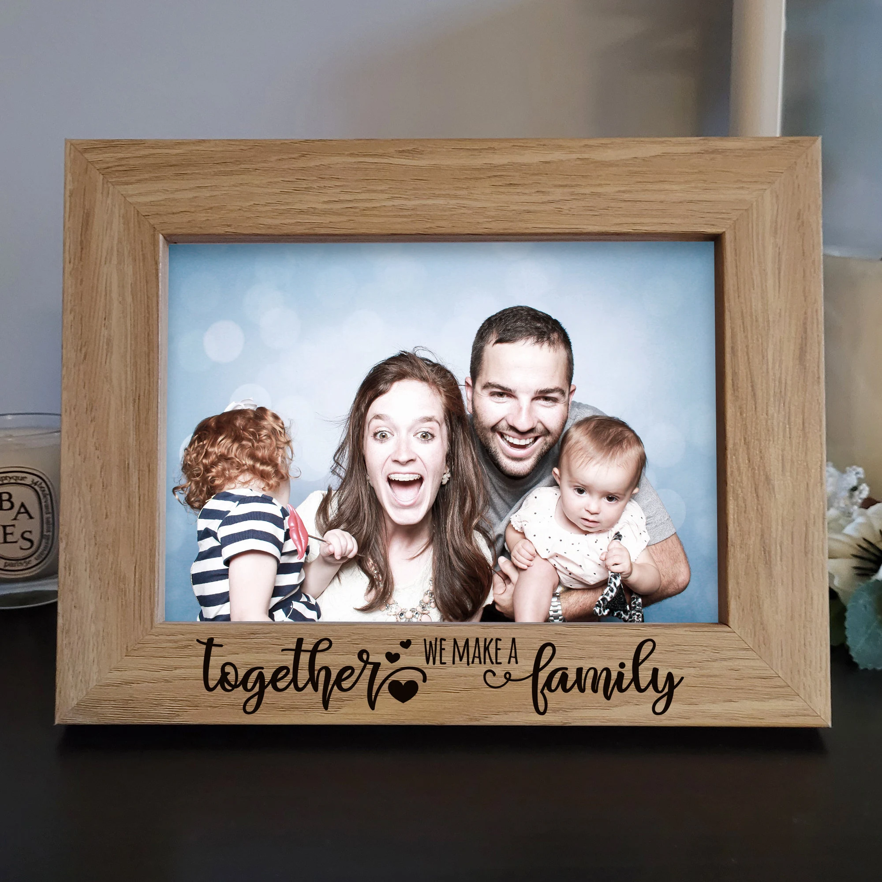
Tarea
For next week, find something in your home that is important to you or a favorite item to share. Prepare a few sentences to describe it in Spanish and why it’s important. IE: favorite mug – if you love to start their day with coffee, book you are reading, sewing needles or favorite cooking tool, etc.
Notes:
Tarea: Encourage participants to find something in their home that is important to them or a favorite item to share. They can prepare a few sentences to describe it in Spanish and why it’s important to them. This will be a good way to start the next class and share with the class. IE: favorite mug – if they love to start their day with coffee, book they are reading, sewing needles or favorite cooking tool, etc.

