Slide 1
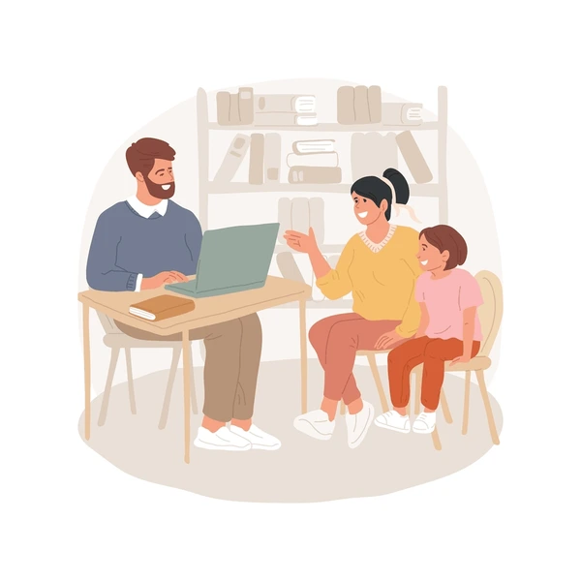
Parent Communication
en la clase de español

Slide 2

Communicating Full-Class Updates
– Use a communication system that is compatible with your school’s system:
– Nightly/weekly take-home folder?
– Full class email list?
– Google Classroom parent updates?
– Utilize an “Ask your child about _____” focus to guide at-home discussions about Spanish class

Slide 3

Communicating About
Individual Student Grades
– Parent-Teacher conference time is a great time to provide a written grade update, especially for middle school students
– Provide an individual grade update, highlighting missing assignments

Slide 4
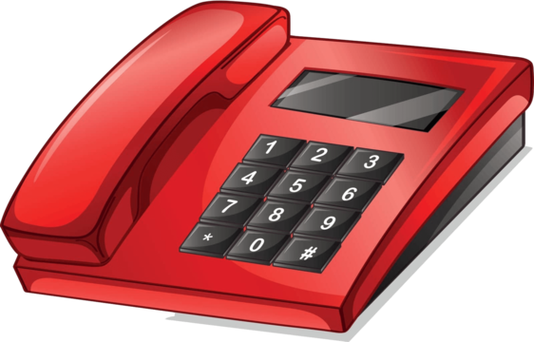
Communicating about
Individual Student Behavior
– Reach out to a parent when other classroom interventions are not working
– Helpful starter phrase: “Just wanted to touch base with you…”
– Monitor your tone in an email
– Include a positive comment about student in your email
– Phone call is best

Slide 5

Communicating About Food Allergies
– Please reach out to parents of children with food allergies before bringing food into the classroom!

Slide 6

Communicating a Positive/Just Because Message to Parents
–Take time to send a quick positive email about a student behavior or achievement!
–This will make someone’s day!

