Slide 1
Presenta…
¡Vamos con los animales!
Let’s go with the animals!

Slide 2
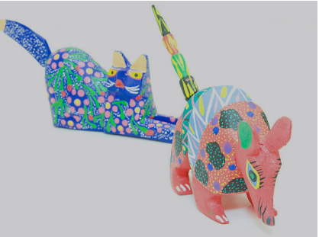
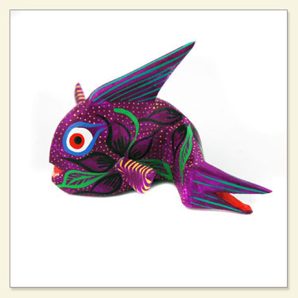
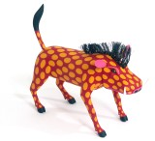
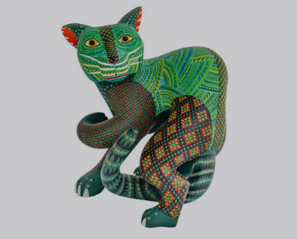
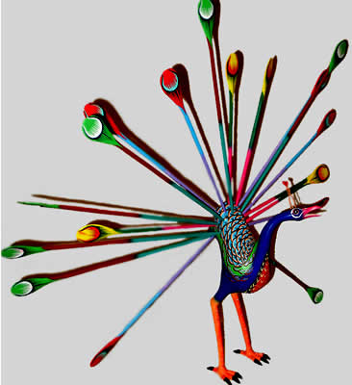
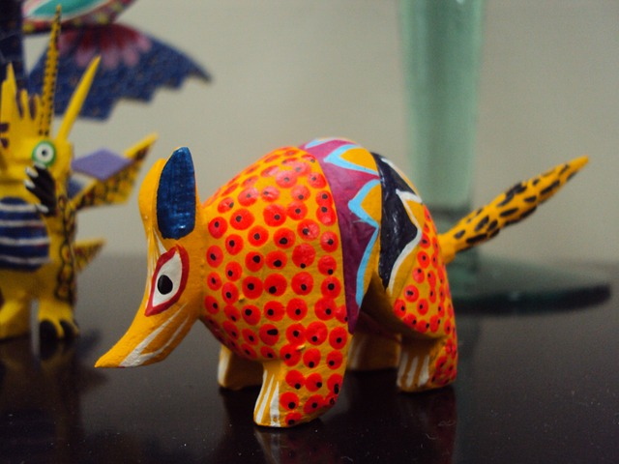
Notes:
About Xolo Ceramics/Alebrijes
In indigenous Mexican culture, Xolo dogs are believed to protect the living and guide the souls of the dead through the underworld. Alebrijes on the other hand are a popular folk art depicting fantastic colorful creatures. Paper-mache, wood, and ceramic figures of both Alebrijes and Xolo dogs are often used to decorate an ofrenda during Día de los Muertos
The first alebrijes were created by indigenous artist Pedro Linares. Linares often said that in 1943, he fell very ill. While he was in bed unconscious, he dreamt of a strange place resembling a forest. There, he saw trees, rocks, and clouds that suddenly transformed into strange unknown animals. He saw “a donkey with butterfly wings, a rooster with bull horns, and a lion with an eagle head”, and all of them were shouting one word “Alebrijes! Alebrijes! Alebrijes!” Before this happened, he was already a cartonero (papier-mâché) artisan. Upon recovery, he began recreating these creatures that he had seen in cartonería, the making of three-dimensional sculptures with different types of papers, strips of papers and engrudo (glue made out of wheat flour and water).

Slide 3
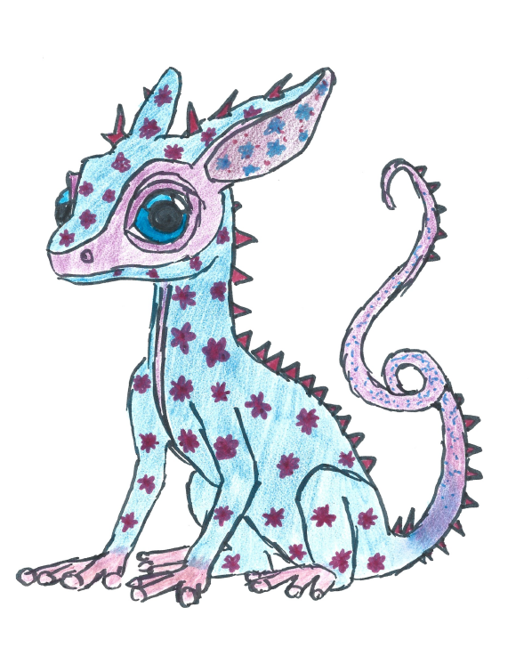
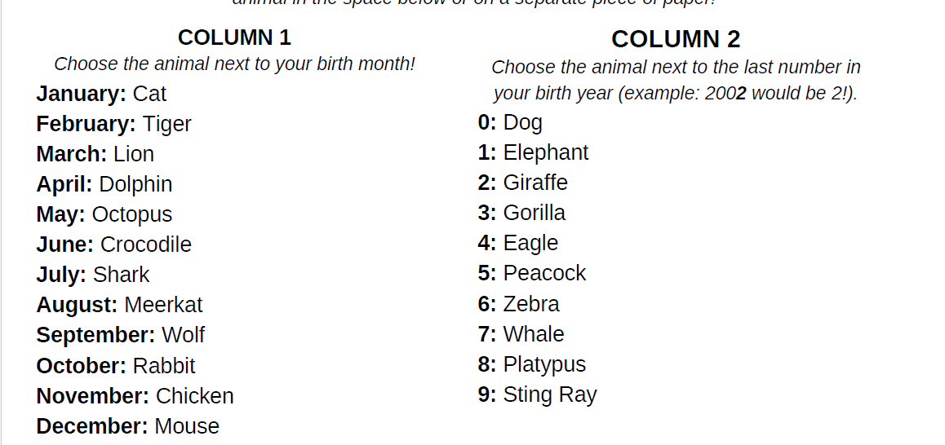
Make your own alebrije!

Slide 4
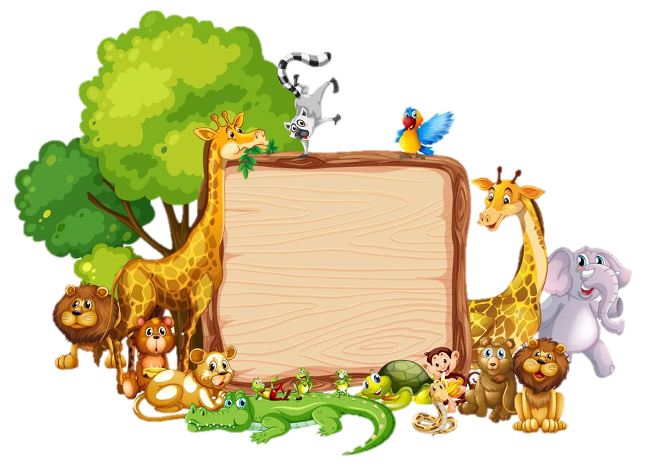
Los Animales
Animales, Animales
Me gustan los animales.
Los chiquitos, los grandotes
Los con plumas, los peludos.
Animales, animales
Me gustan los animales

Slide 5
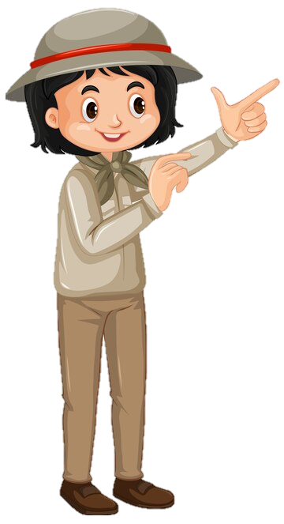
Does it have..?

Slide 6
Does it have..?
=
¿Tiene..?

Slide 7
It has..

Slide 8
It has..
=
Tiene…

Slide 9
Veterinarian

Slide 10
Veterinarian
=
Veterinario(a)

Slide 11
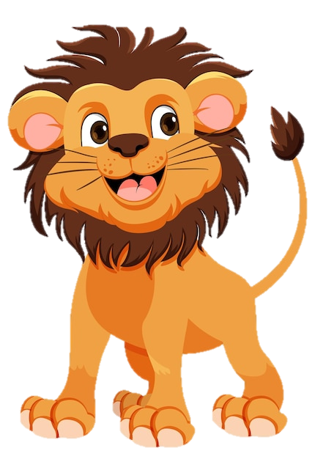
Tail

Slide 12
Tail
=
Cola

Slide 13
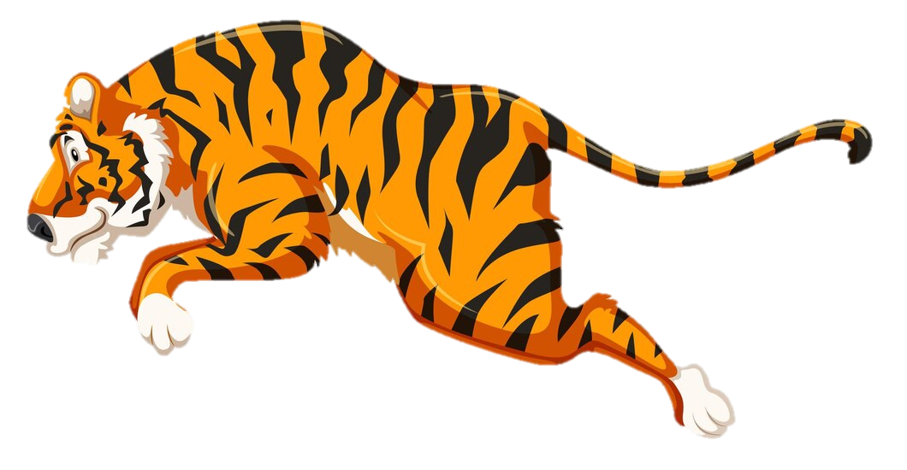
Feet (paws)

Slide 14
Feet (paws)
=
Patas

Slide 15
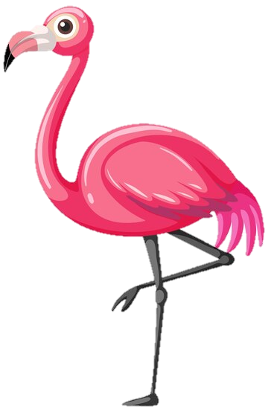
Beak

Slide 16
Beak
=
Pico

Slide 17
Wings

Slide 18
Wings
=
Alas

Slide 19
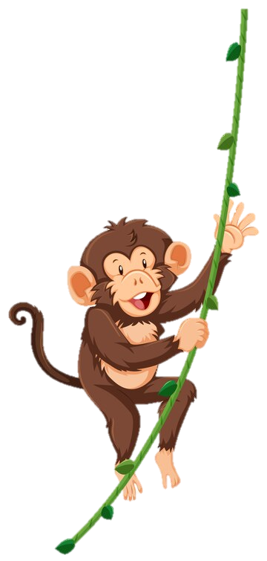
Legs

Slide 20
Legs
=
Piernas

Slide 21
Body

Slide 22
Body
=
Cuerpo

Slide 23
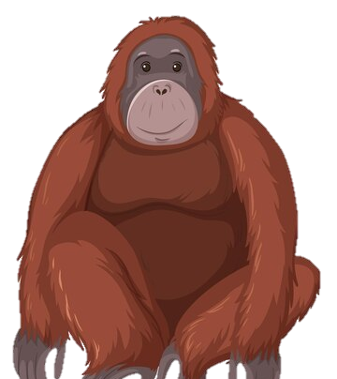
Fur

Slide 24
Fur
=
Pelo

Slide 25
Feathers

Slide 26
Feathers
=
Plumas

Slide 27
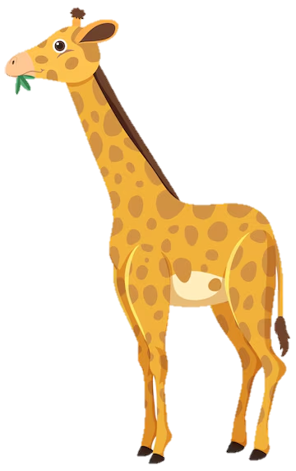
Nose

Slide 28
Nose
=
Nariz

Slide 29
Mouth

Slide 30
Mouth
=
Boca

Slide 31
GUESS THE IMAGE
Notes:
https://spinthewheel.cc/pictures

Slide 32
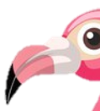
Notes:
https://spinthewheel.cc/pictures

Slide 33
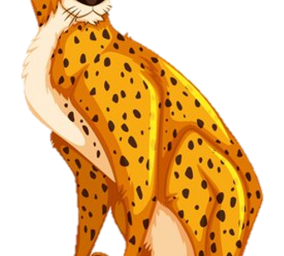
Notes:
https://spinthewheel.cc/pictures

Slide 34
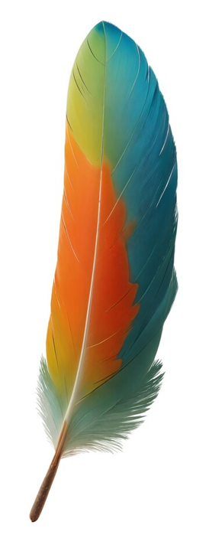
Notes:
https://spinthewheel.cc/pictures

Slide 35
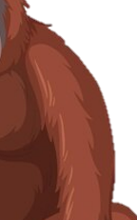
Notes:
https://spinthewheel.cc/pictures

Slide 36
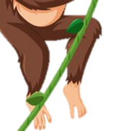
Notes:
https://spinthewheel.cc/pictures

Slide 37
Notes:
https://spinthewheel.cc/pictures

Slide 38
Notes:
https://spinthewheel.cc/pictures

Slide 39
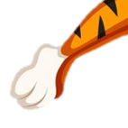
Notes:
https://spinthewheel.cc/pictures

Slide 40
Notes:
https://spinthewheel.cc/pictures

Slide 41
Buenas Noches
Buenas noches,
Buenas noches
¿Cómo estás?,
¿Cómo estás?
Muy bien, gracias,
Muy bien, gracias
Ya me voy, Ya me voy

Slide 42
Thank you!
¡Gracias!

