Slide 1
Presenta…
¡Vamos con los animales!
Let’s go with the animals!

Slide 2
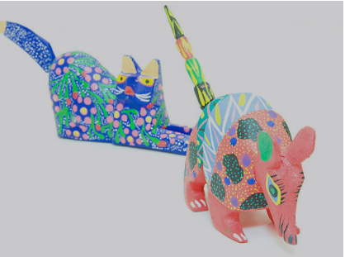
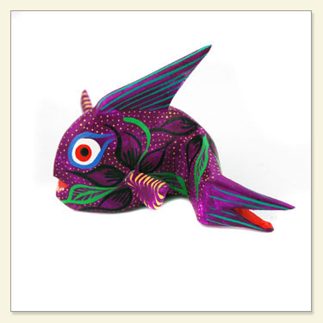
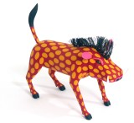
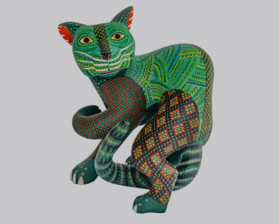
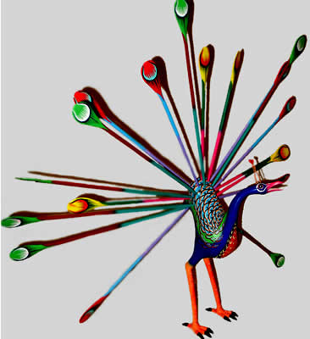
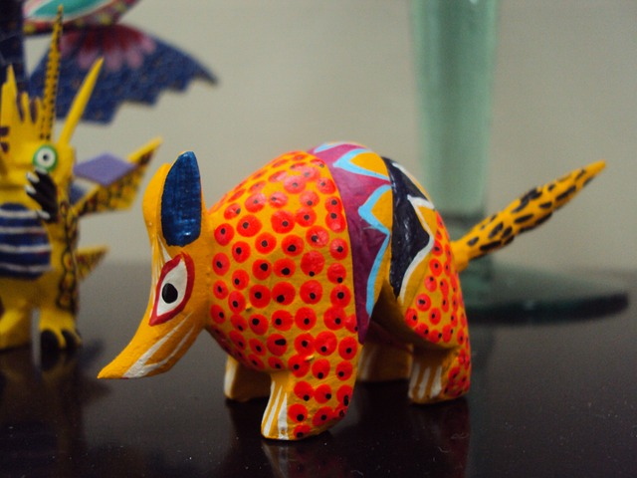
Notes:
About Xolo Ceramics/Alebrijes
In indigenous Mexican culture, Xolo dogs are believed to protect the living and guide the souls of the dead through the underworld. Alebrijes on the other hand are a popular folk art depicting fantastic colorful creatures. Paper-mache, wood, and ceramic figures of both Alebrijes and Xolo dogs are often used to decorate an ofrenda during Día de los Muertos
The first alebrijes were created by indigenous artist Pedro Linares. Linares often said that in 1943, he fell very ill. While he was in bed unconscious, he dreamt of a strange place resembling a forest. There, he saw trees, rocks, and clouds that suddenly transformed into strange unknown animals. He saw “a donkey with butterfly wings, a rooster with bull horns, and a lion with an eagle head”, and all of them were shouting one word “Alebrijes! Alebrijes! Alebrijes!” Before this happened, he was already a cartonero (papier-mâché) artisan. Upon recovery, he began recreating these creatures that he had seen in cartonería, the making of three-dimensional sculptures with different types of papers, strips of papers and engrudo (glue made out of wheat flour and water).

Slide 3
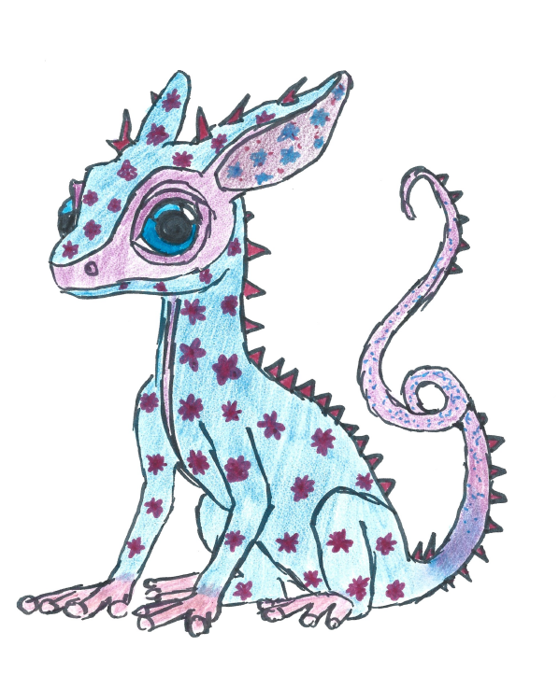
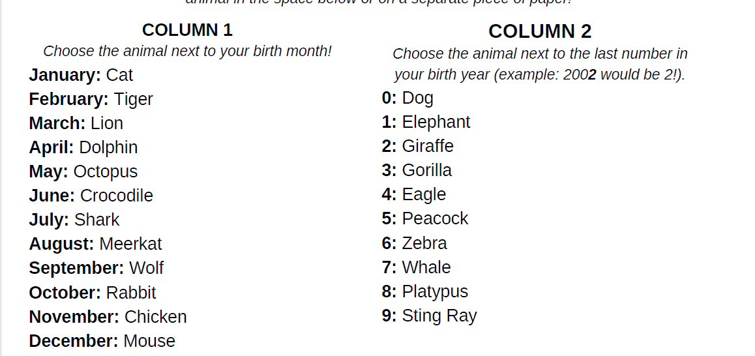
Make your own alebrije!

Slide 4
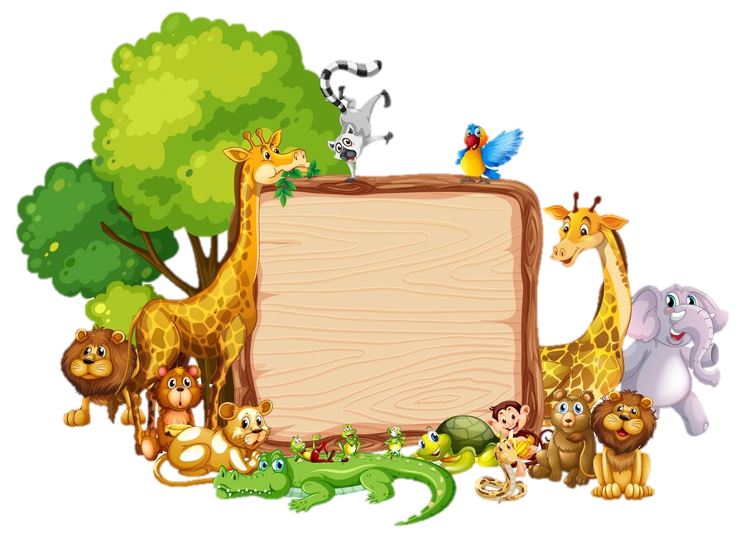
Los Animales
Animales, Animales
Me gustan los animals.
Los chiquitos, los grandotes
Los con plumas, los peludos.
Animales, animals
Me gustan los animales

Slide 5
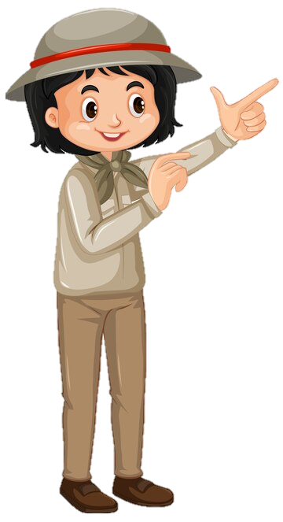
Does it have..?

Slide 6
Does it have..?
=
¿Tiene..?

Slide 7
It has..

Slide 8
It has..
=
Tiene…

Slide 9
Tail

Slide 10
Tail
=
Cola

Slide 11
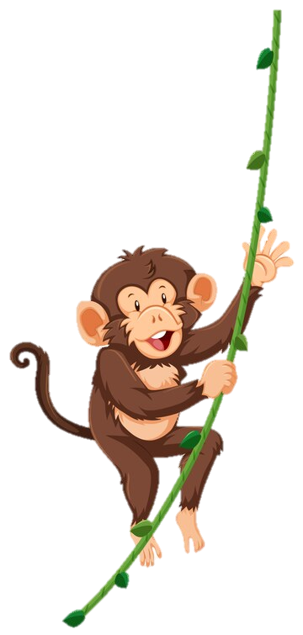
Legs

Slide 12
Legs
=
Piernas

Slide 13
Body

Slide 14
Body
=
Cuerpo

Slide 15
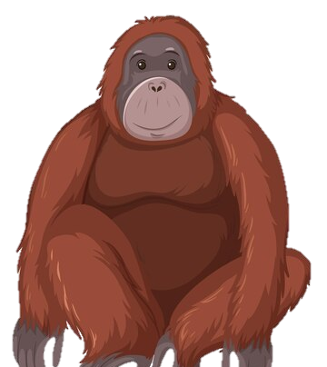
Fur

Slide 16
Fur
=
Pelo

Slide 17
Feathers

Slide 18
Feathers
=
Plumas

Slide 19
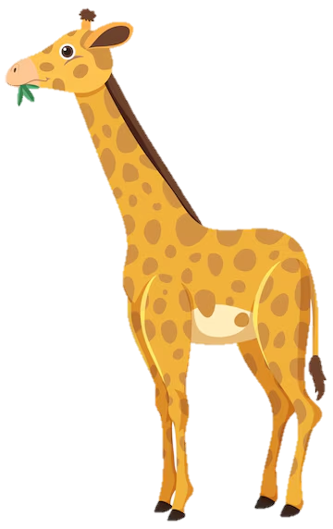
Nose

Slide 20
Nose
=
Nariz

Slide 21
Mouth

Slide 22
Mouth
=
Boca

Slide 23
GUESS THE IMAGE
Notes:
https://spinthewheel.cc/pictures

Slide 24
Notes:
https://spinthewheel.cc/pictures

Slide 25
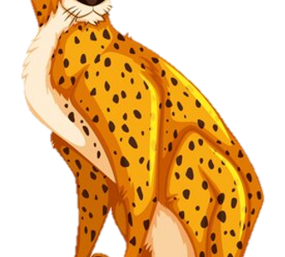
Notes:
https://spinthewheel.cc/pictures

Slide 26
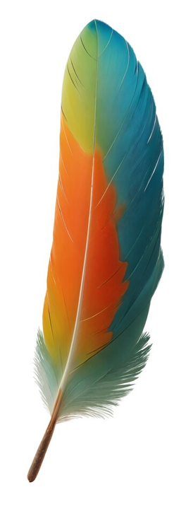
Notes:
https://spinthewheel.cc/pictures

Slide 27
Notes:
https://spinthewheel.cc/pictures

Slide 28
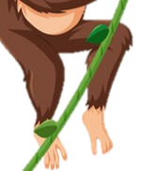
Notes:
https://spinthewheel.cc/pictures

Slide 29
Notes:
https://spinthewheel.cc/pictures

Slide 30
Notes:
https://spinthewheel.cc/pictures

Slide 31
Notes:
https://spinthewheel.cc/pictures

Slide 32
Notes:
https://spinthewheel.cc/pictures

Slide 33
Buenas Noches
Buenas noches,
Buenas noches
¿Cómo estás?,
¿Cómo estás?
Muy bien, gracias,
Muy bien, gracias
Ya me voy, Ya me voy

Slide 34
Thank you!
¡Gracias!

