Slide 1
Presenta…
Middle School Prep
¡Preparación para la escuela secundaria!

Slide 2
Verbs, Verbs, Verbs:
-ar, -er, -ir

Slide 3
To hug
=
Abrazar

Slide 4
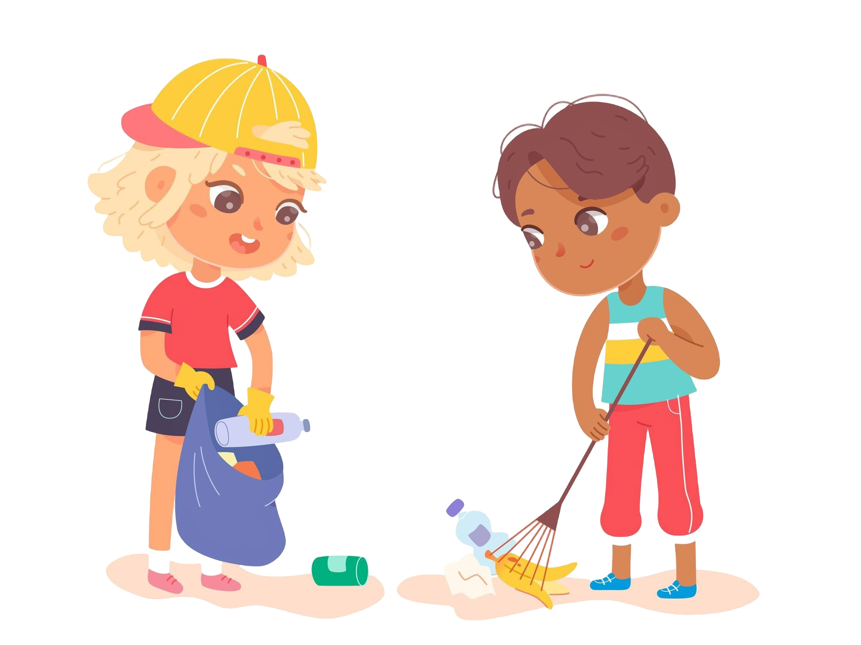
To help
=
Ayudar

Slide 5
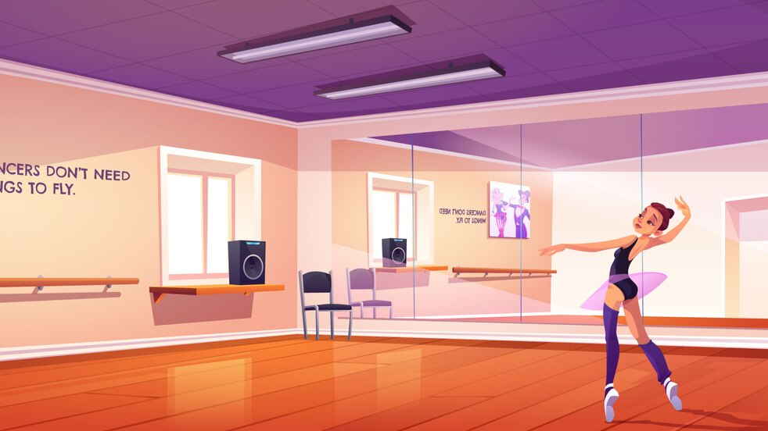
To dance
=
Bailar

Slide 6
To kiss
=
Besar

Slide 7
To look for
=
Buscar

Slide 8
To change
=
Cambiar

Slide 9
To sing
=
Cantar

Slide 10
To buy
=
Comprar

Slide 11
To answer
=
Contestar

Slide 12
To rest
=
Descansar

Slide 13
To draw
=
Dibujar

Slide 14
To send
=
Enviar

Slide 15
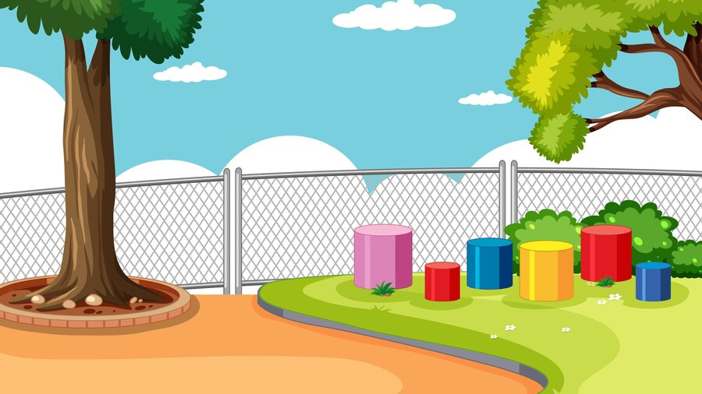
To listen
=
Escuchar

Slide 16
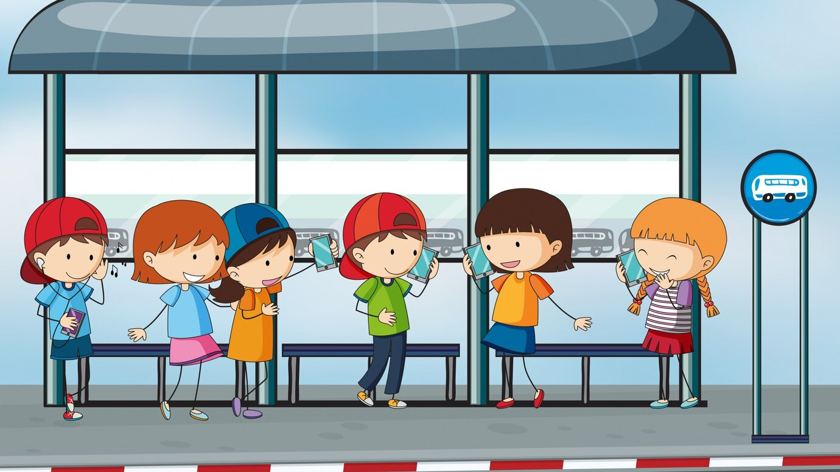
To wait for
=
Esperar

Slide 17
To study
=
Estudiar

Slide 18
To explain
=
Explicar

Slide 19
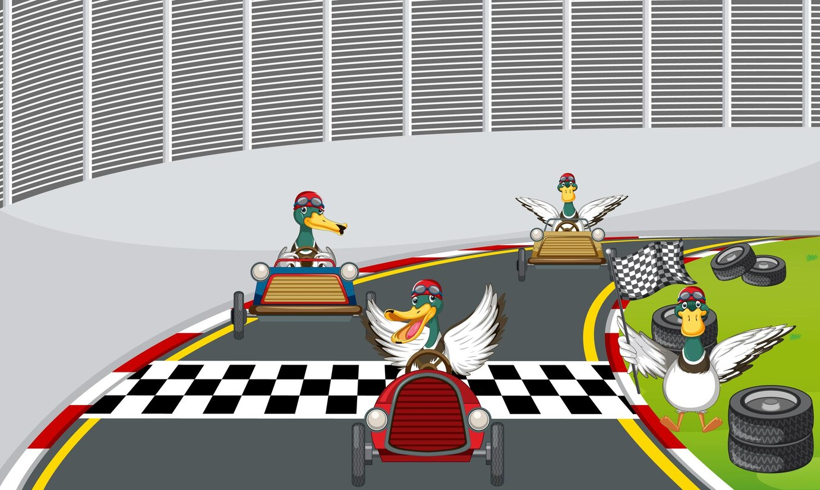
To win
=
Ganar

Slide 20
To spend
=
Gastar

Slide 21
To talk/speak
=
Hablar

Slide 22
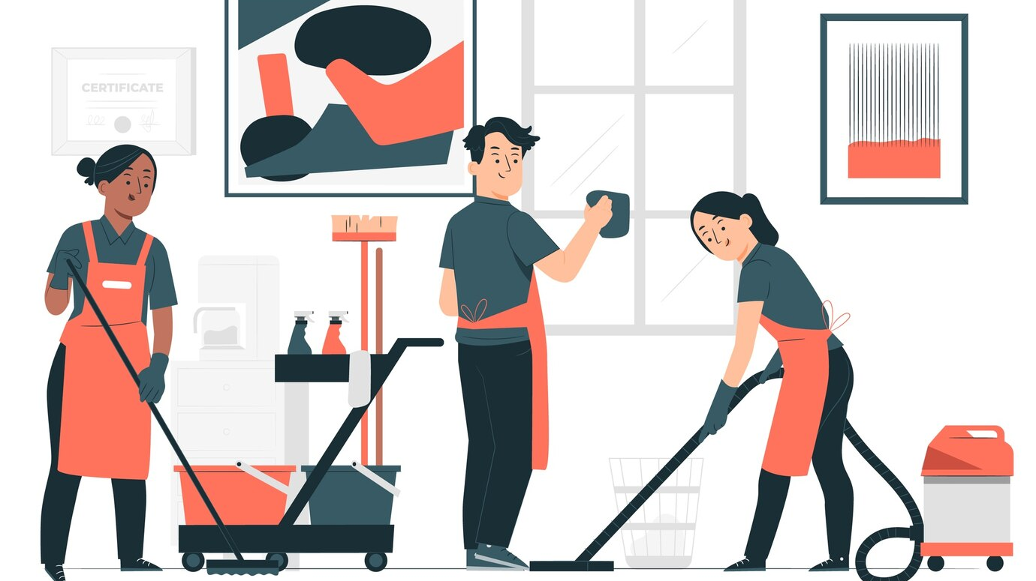
To clean
=
Limpiar

Slide 23
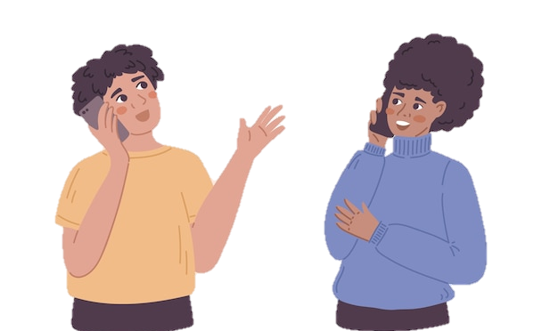
To call
=
Llamar

Slide 24
To arrive
=
Llegar

Slide 25
To wear
=
Llevar

Slide 26
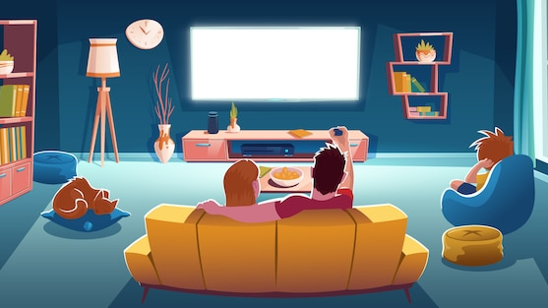
To watch/look at
=
Mirar

Slide 27
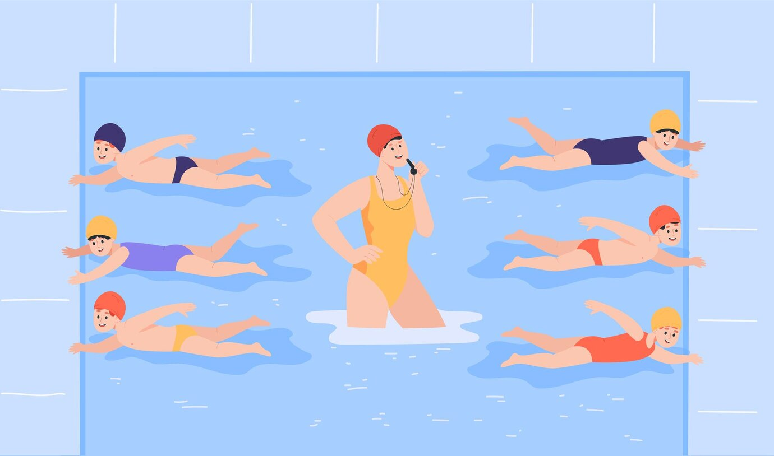
To swim
=
Nadar

Slide 28
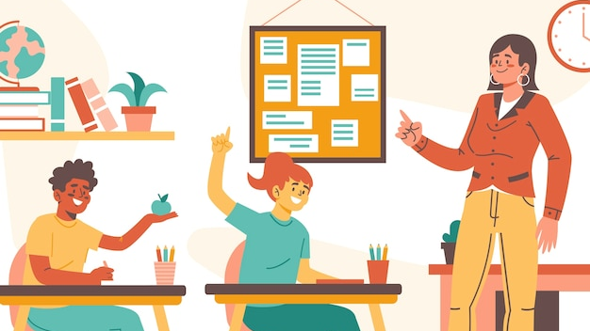
To ask
=
Preguntar

Slide 29
To return
=
Regresar

Slide 30
To work
=
Trabajar

Slide 31
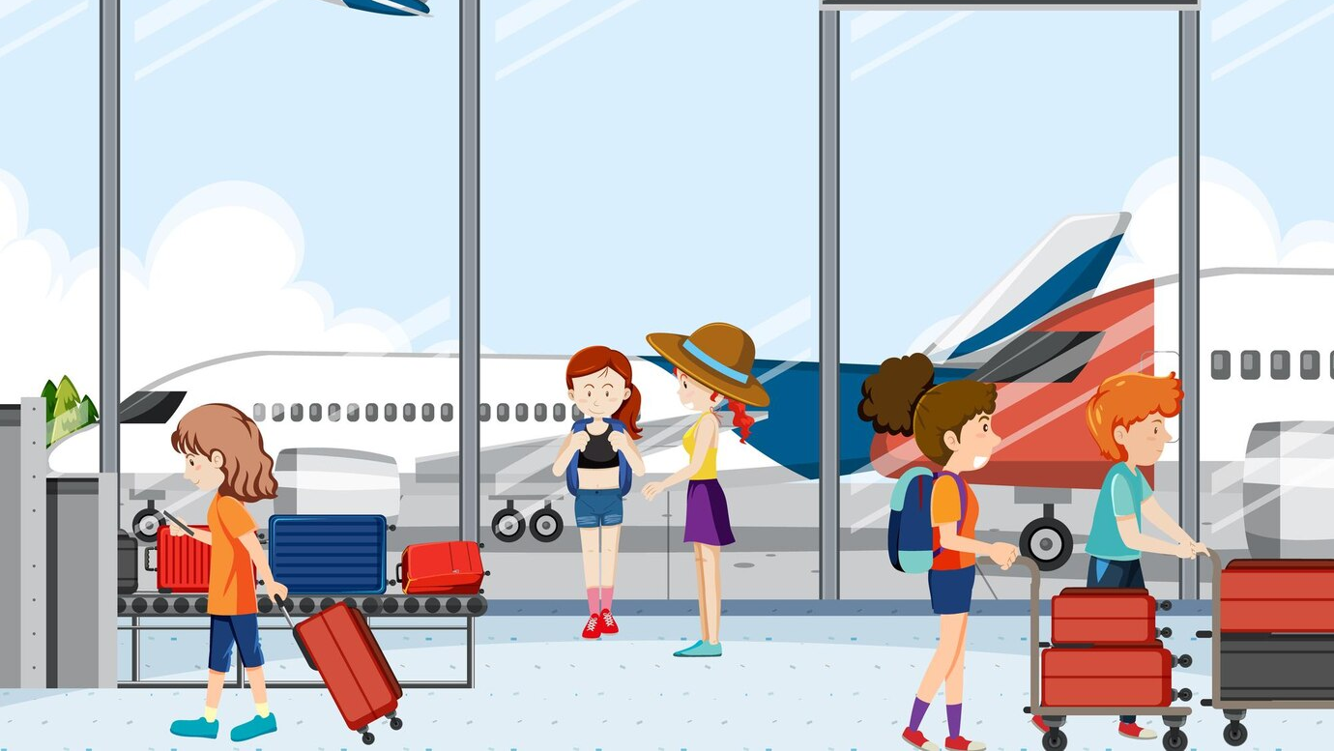
To travel
=
Viajar

Slide 32
To visit
=
Visitar

Slide 33
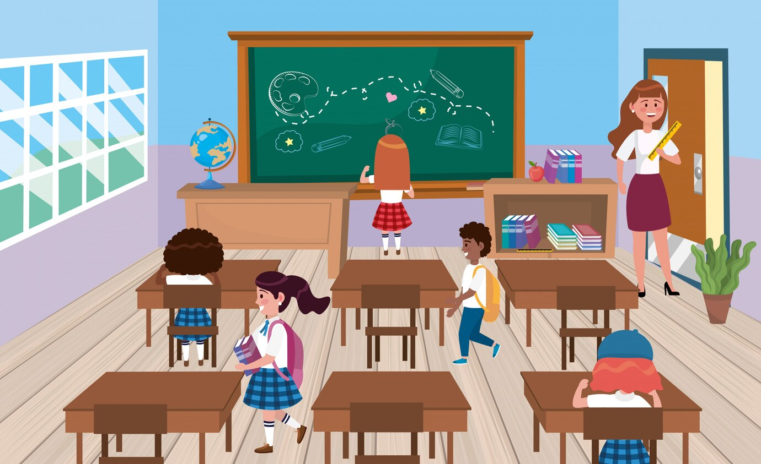
To learn
=
Aprender

Slide 34
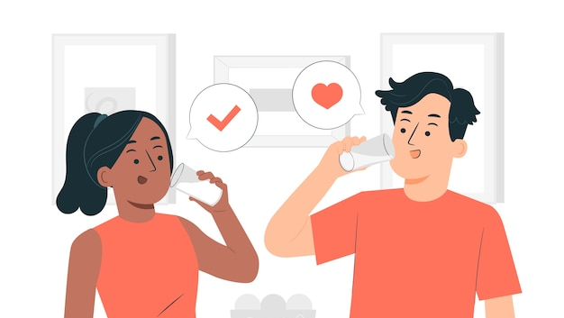
To drink
=
Beber

Slide 35
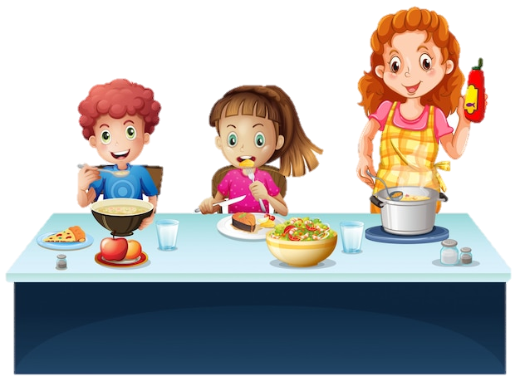
To eat
=
Comer

Slide 36
To understand
=
Comprender

Slide 37
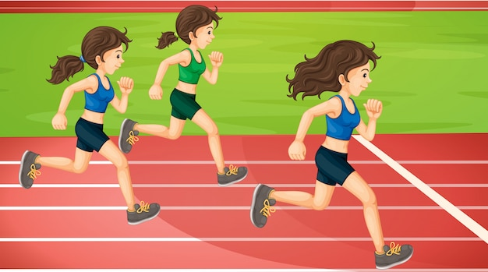
To run
=
Correr

Slide 38
To believe
=
Creer

Slide 39
To read
=
Leer

Slide 40
To learn
=
Aprender

Slide 41
To open
=
Abrir

Slide 42
To decide
=
Decidir

Slide 43
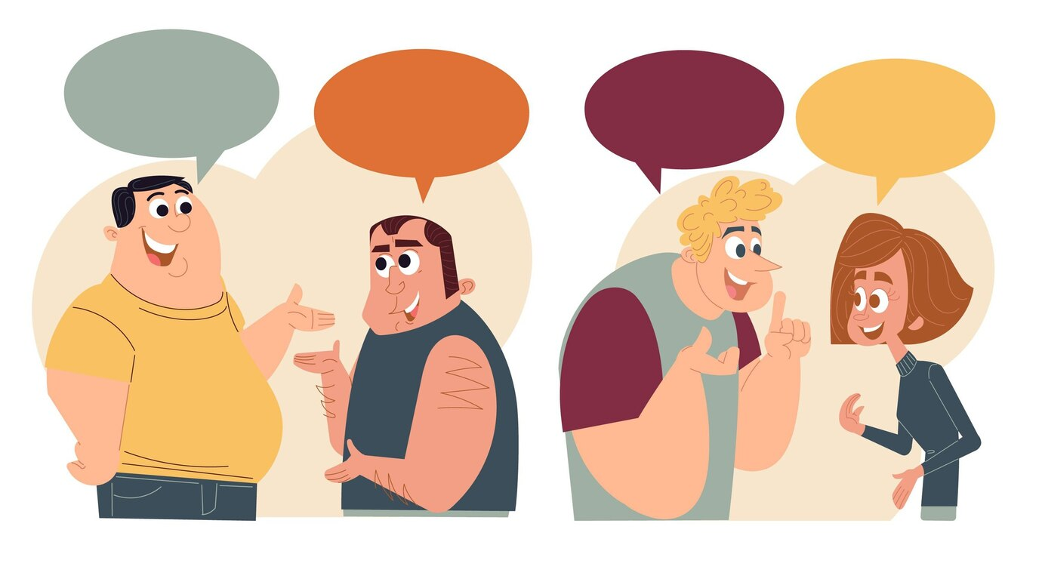
To discuss
=
Discutir

Slide 44
To write
=
Escribir

Slide 45
To receive
=
Recibir

Slide 46
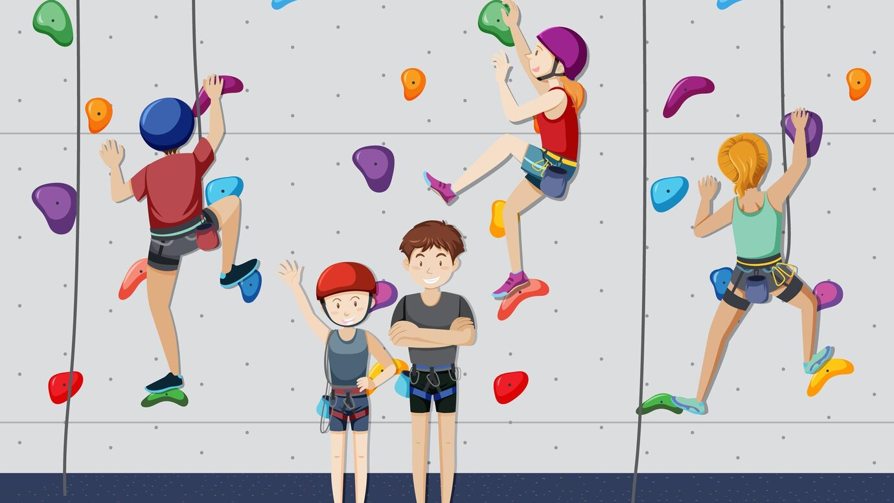
To climb/go up
=
Subir

Slide 47
To live
=
Vivir

Slide 48
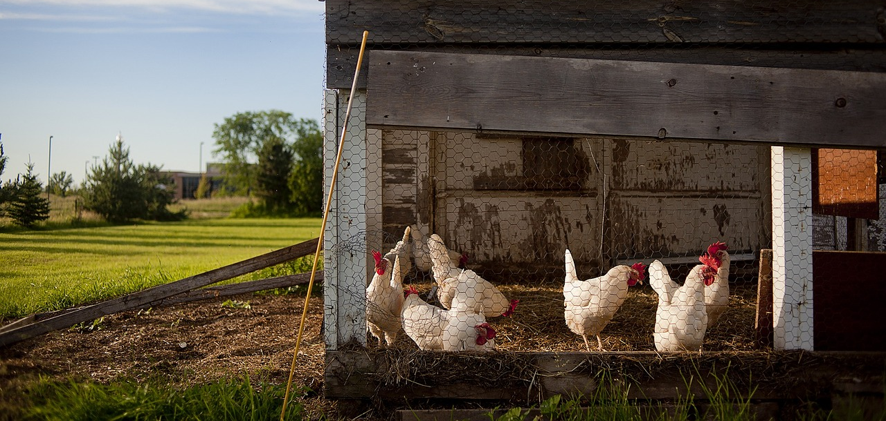
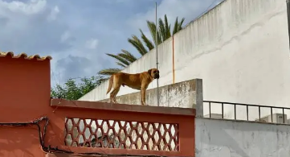
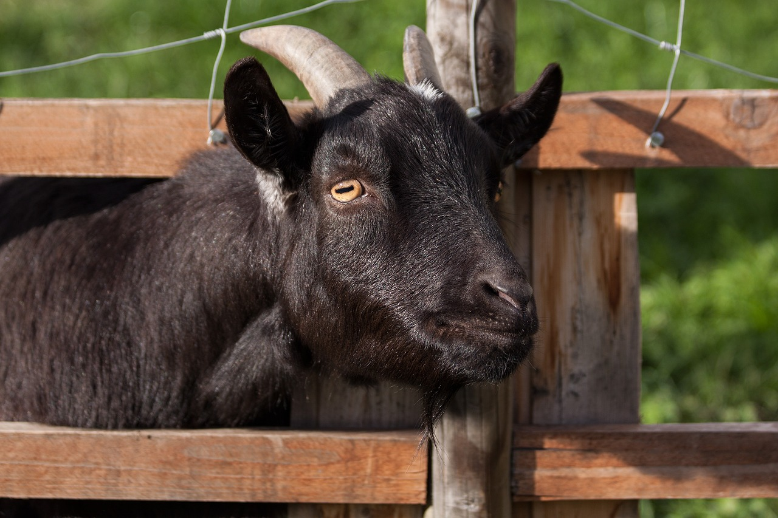
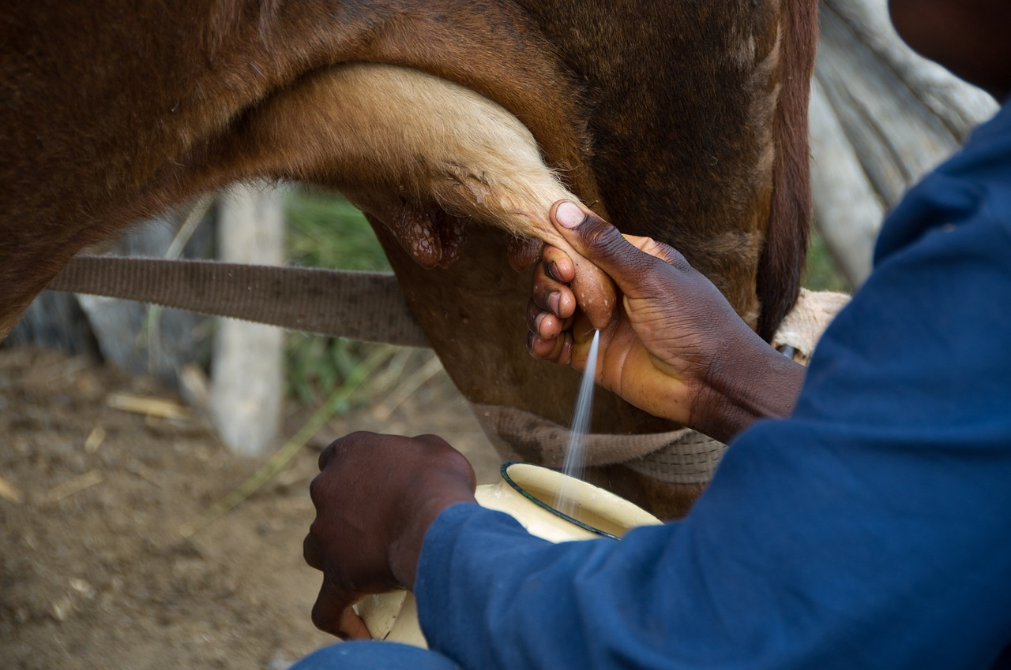
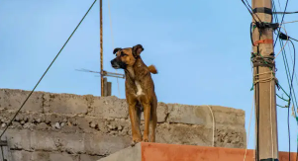

Slide 49
¡Gracias por atender!
Thank you for attending!

