Slide 1
Level II part I
COLORS

Slide 2
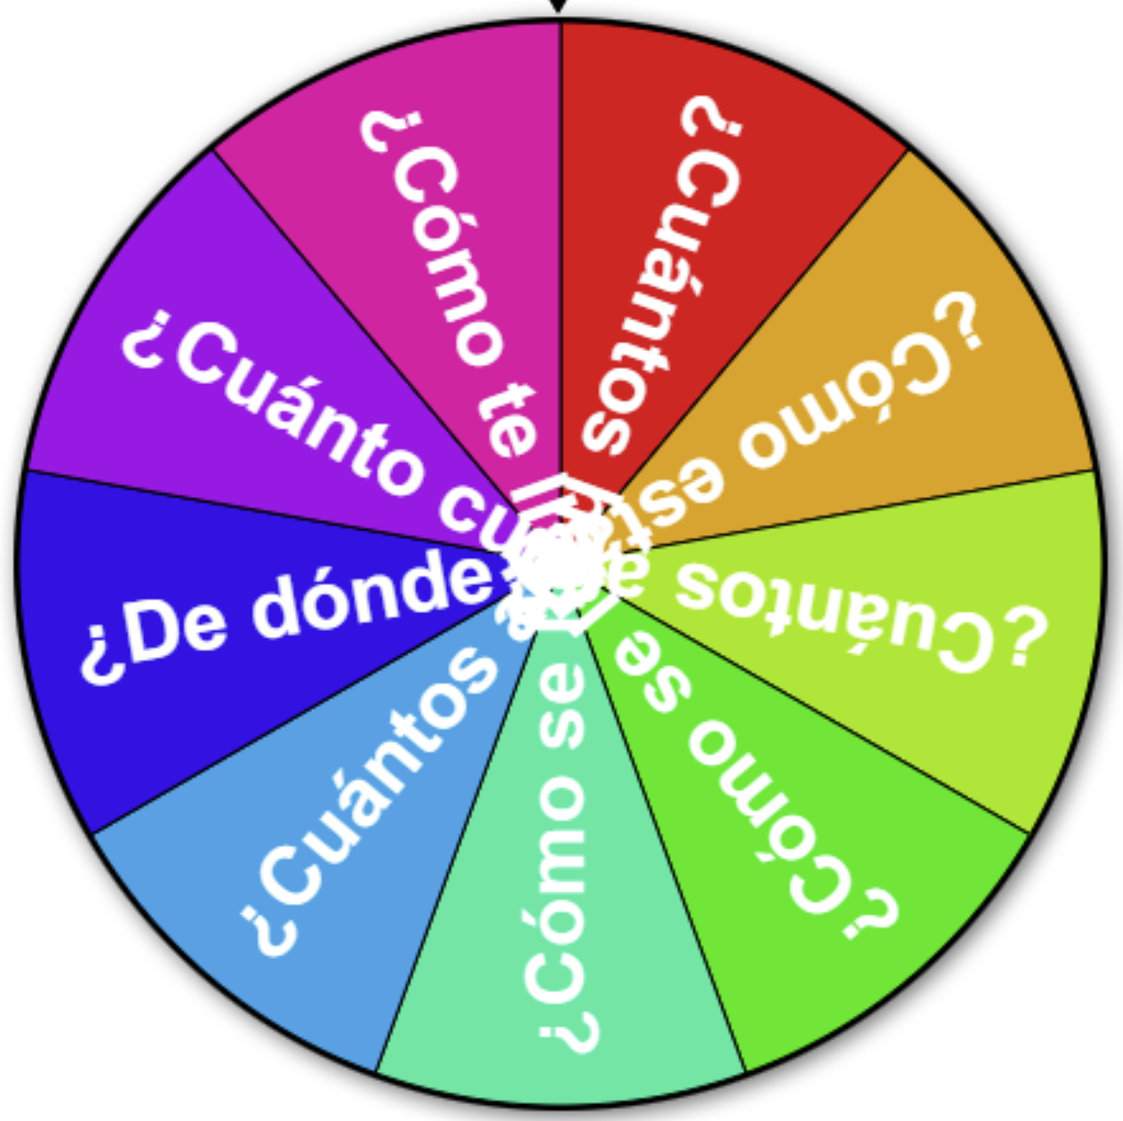
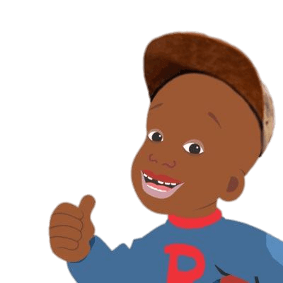
¡Calentemos con preguntas!
Instructions: Let’s warm up with some review questions! Click the spinner and respond in Español.
¡Si se puede!

Slide 3
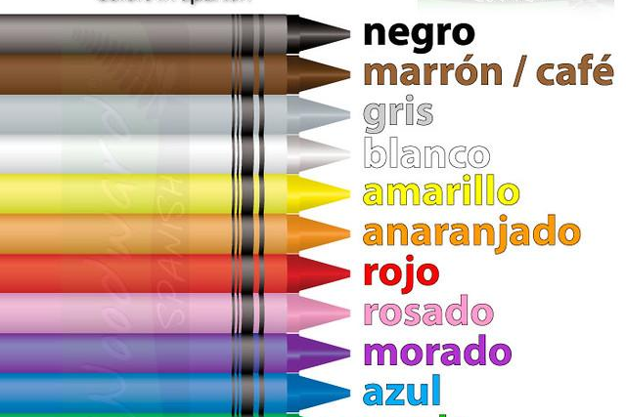
Level II Part I
la ropa
los colores
los animales
el tiempo
las estaciones
el cuerpo

Slide 4
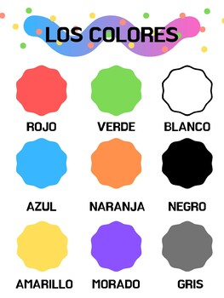
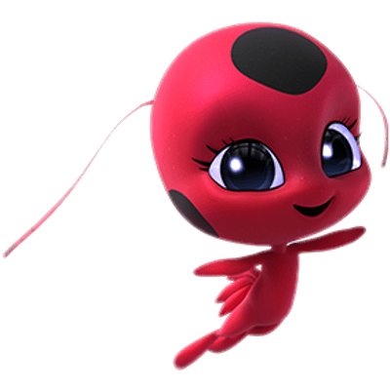
¡Hola amigo! Empezamos con los colores!
Click to play

Slide 5
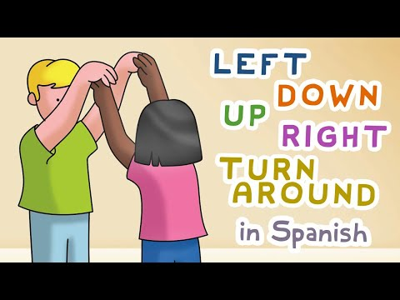
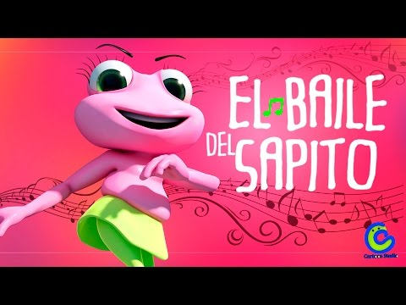
¡cantemos y bailemos!
¡cantemos y bailemos!
Click to watch
Click to watch

Slide 6
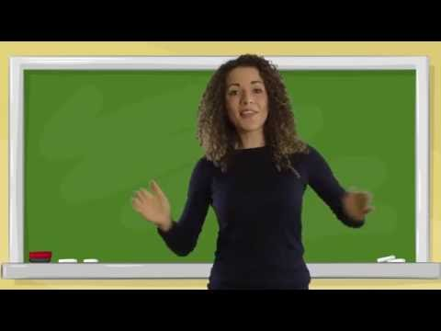
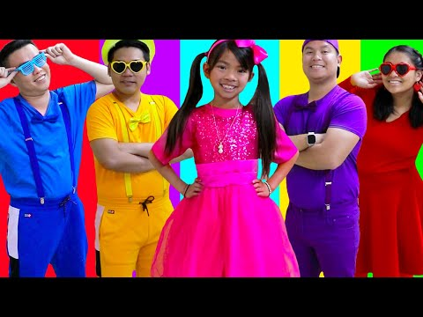
¡los colores!
¡los colores!
Click to watch

Slide 7
i. THE COLORS
STUDENTS WILL BE ABLE TO ASK WHAT COLOR SOMETHING IS AND ALSO ANSWER QUESTIONS REGARDING COLOR

Slide 8
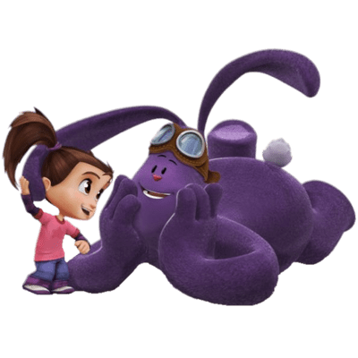
los colores
SPANISH | ENGLISH
Rojo | Red
Blanco | White
Azul | Blue
Gris | Grey
Verde | Green
Negro | Black
Rosado / Rosa | Pink
Anaranjado | Orange
Morado / Púrpura | Purple
Amarillo | Yellow
SPANISH | ENGLISH
Café / Marrón | Brown
Los Colores | The Colors
¿De qué color es? | What color is it?

Slide 9
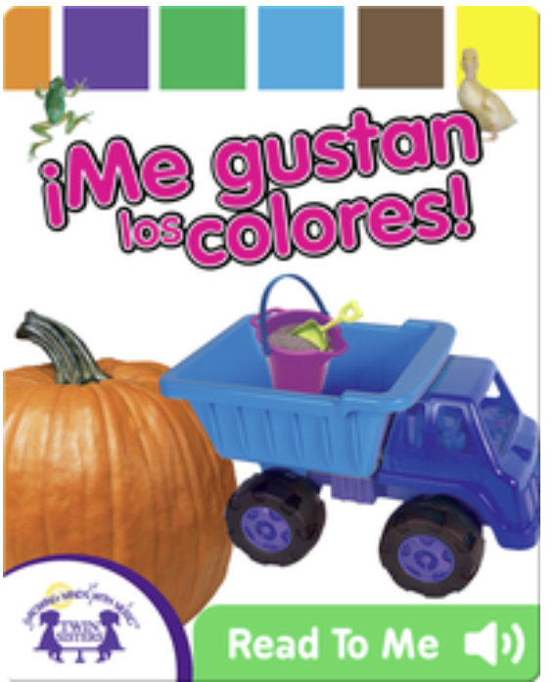

Slide 10
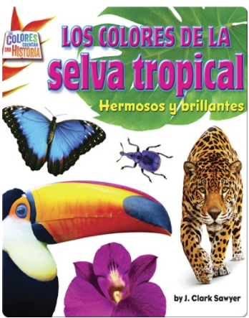
¡leemos un cuento!
Click to read

Slide 11
¡leemos un cuento!
Click to read

Slide 12
¡leemos un cuento!
Click to read

Slide 13
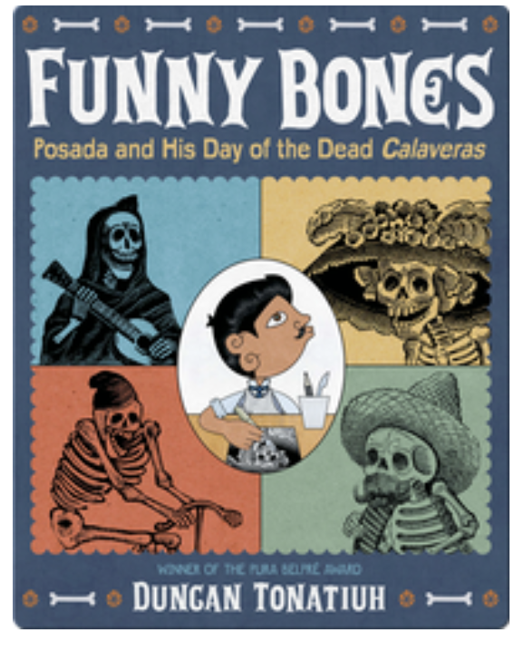
¡leemos un cuento!
Click to read

Slide 14
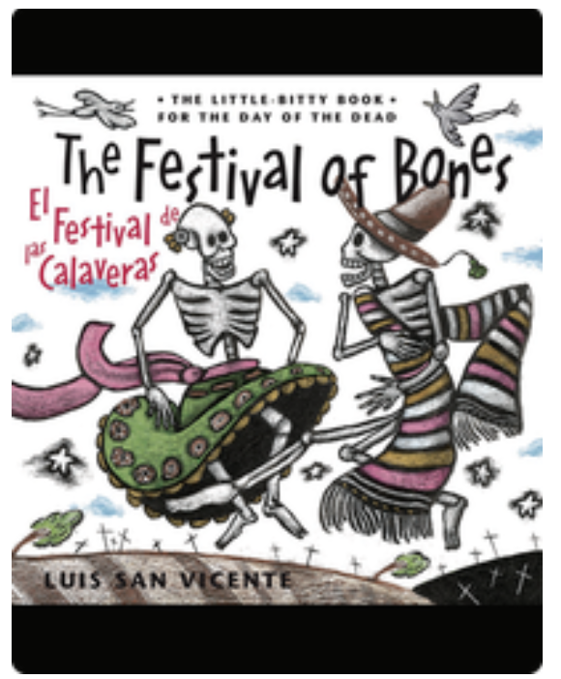
Click to read

Slide 15
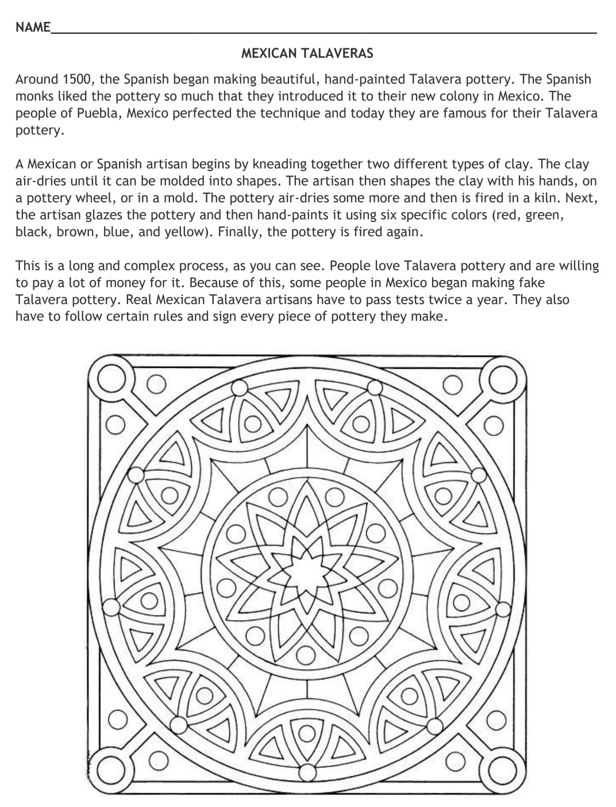
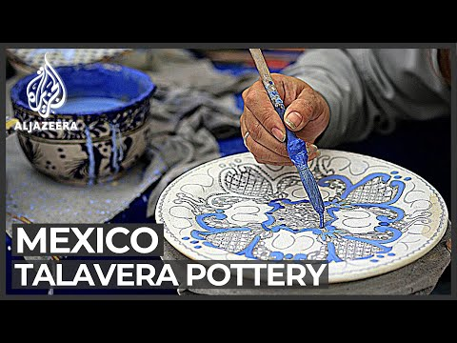
Click to watch
Click to download

Slide 16
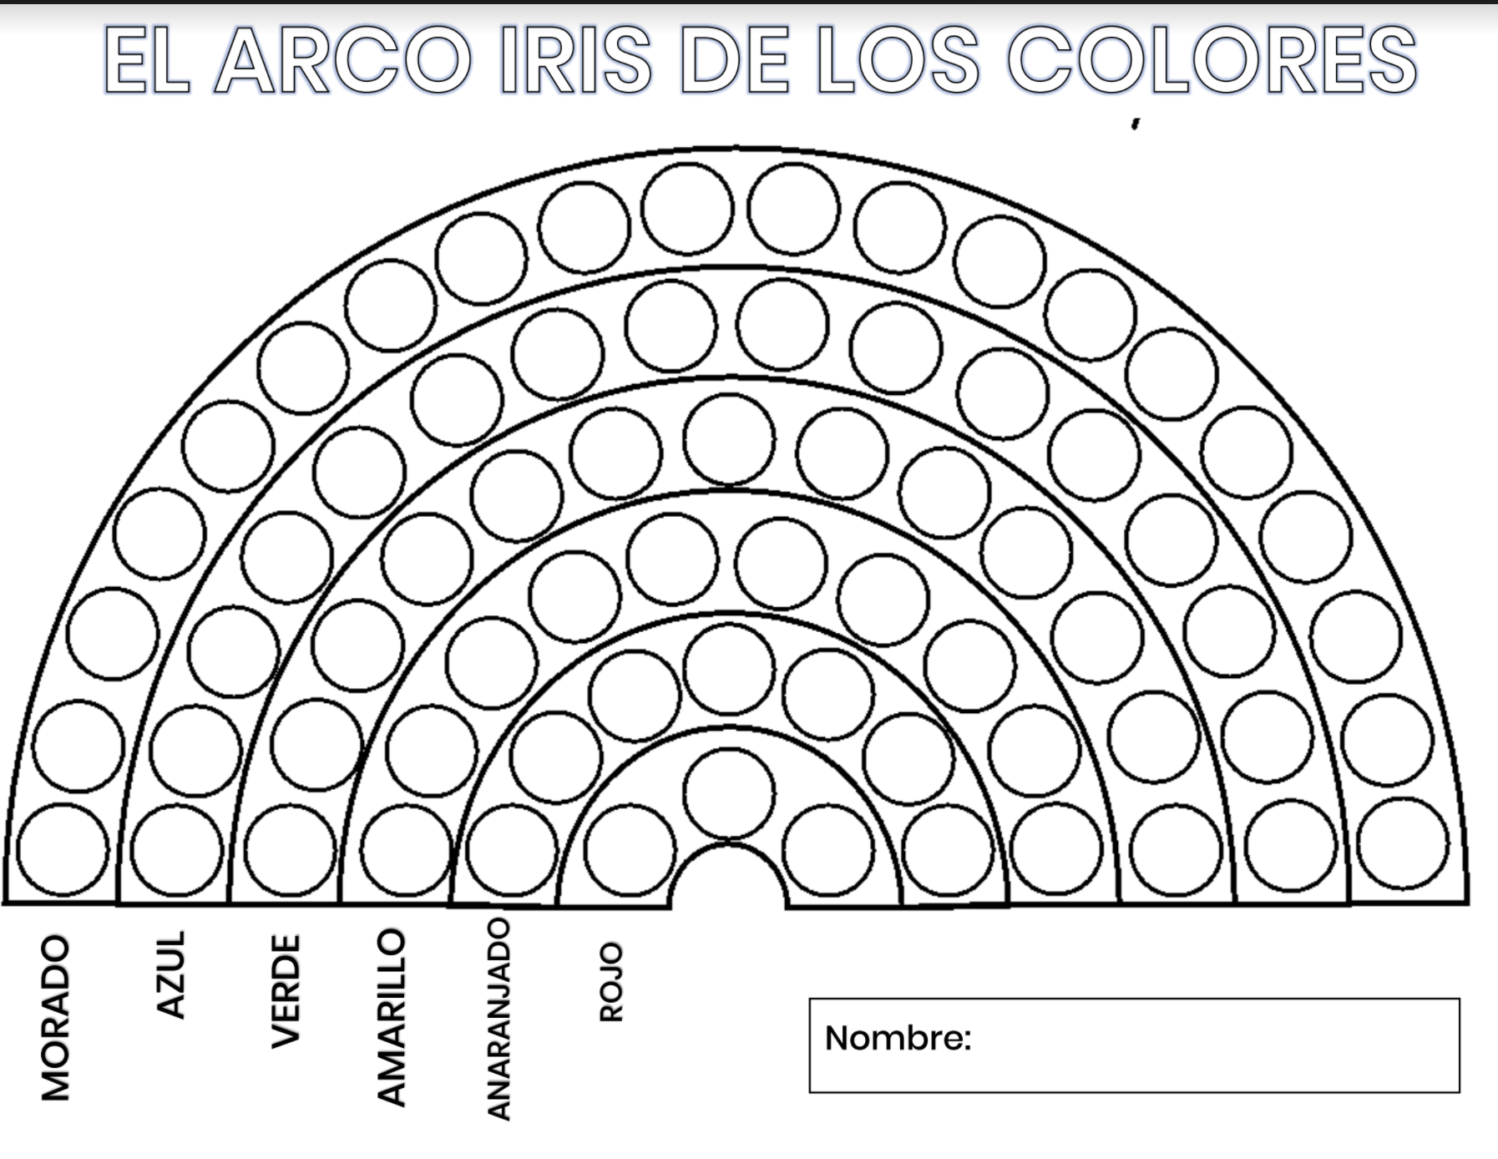
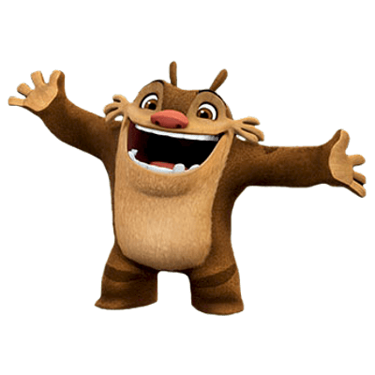
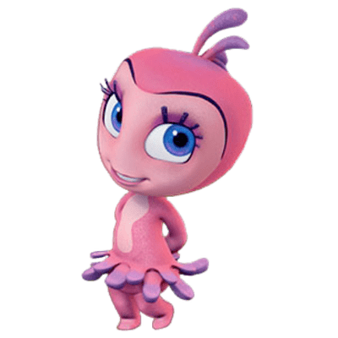
Los colores
rainbow of skittles
Instructions: Color each row of circles according to the Spanish words found below each row!
Click to download

Slide 17
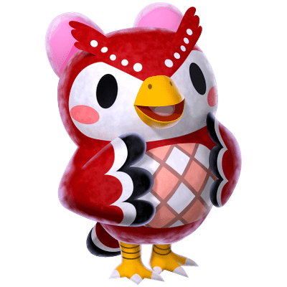
Los colores
la la llama
Instructions: Color each square according to the Spanish code found on the page!
Click to download

Slide 18
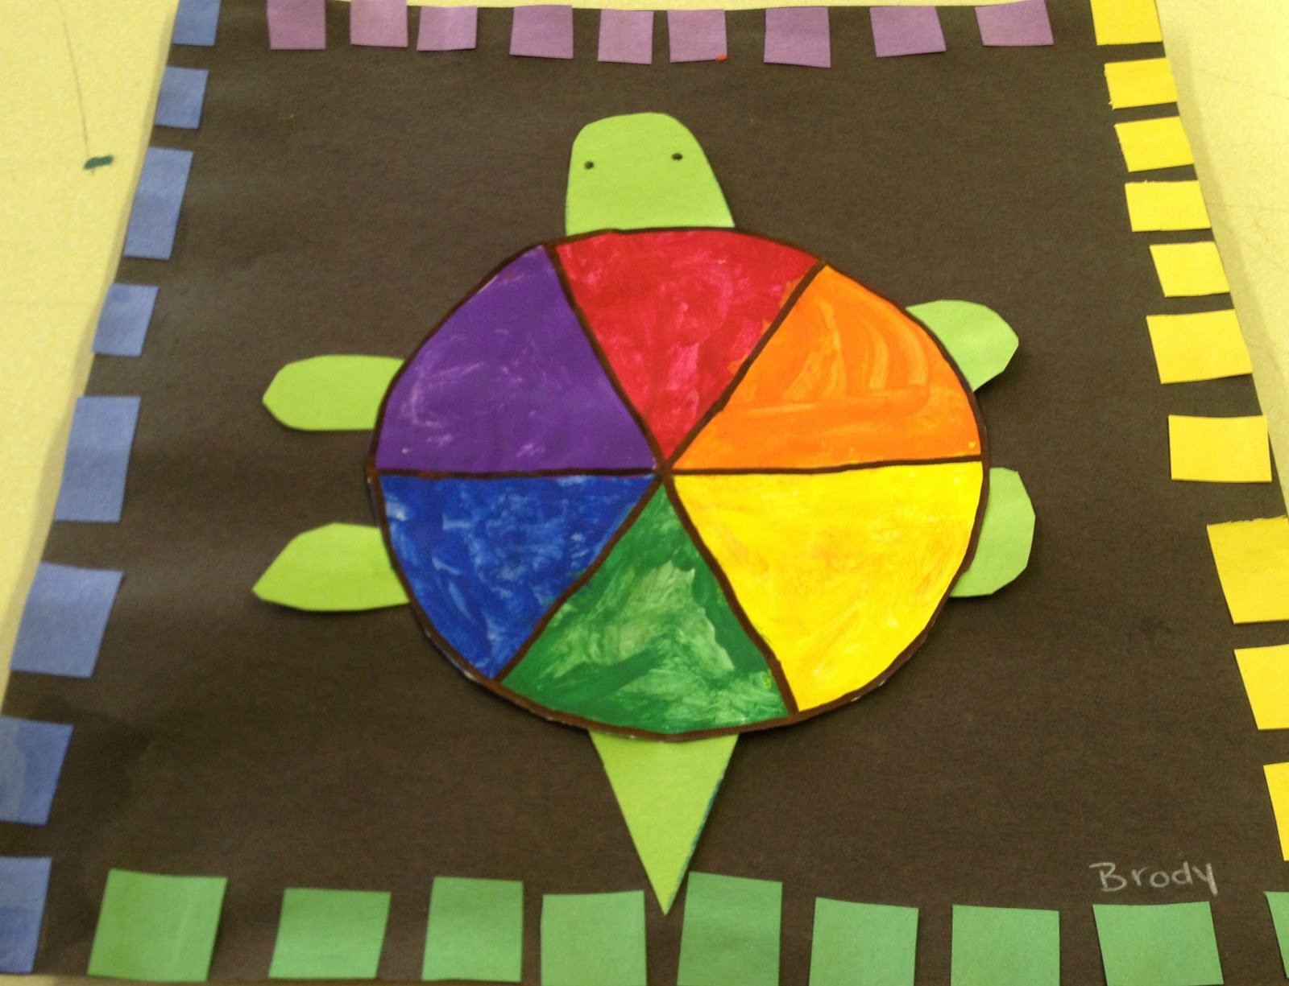
Los colores
la tortuga
Instructions: Color and label each section of the turtle with a different color from our vocabulary.
Then, cut out squares of morado, amarillo, verde and azul and glue them to the border.
Click to download

Slide 19
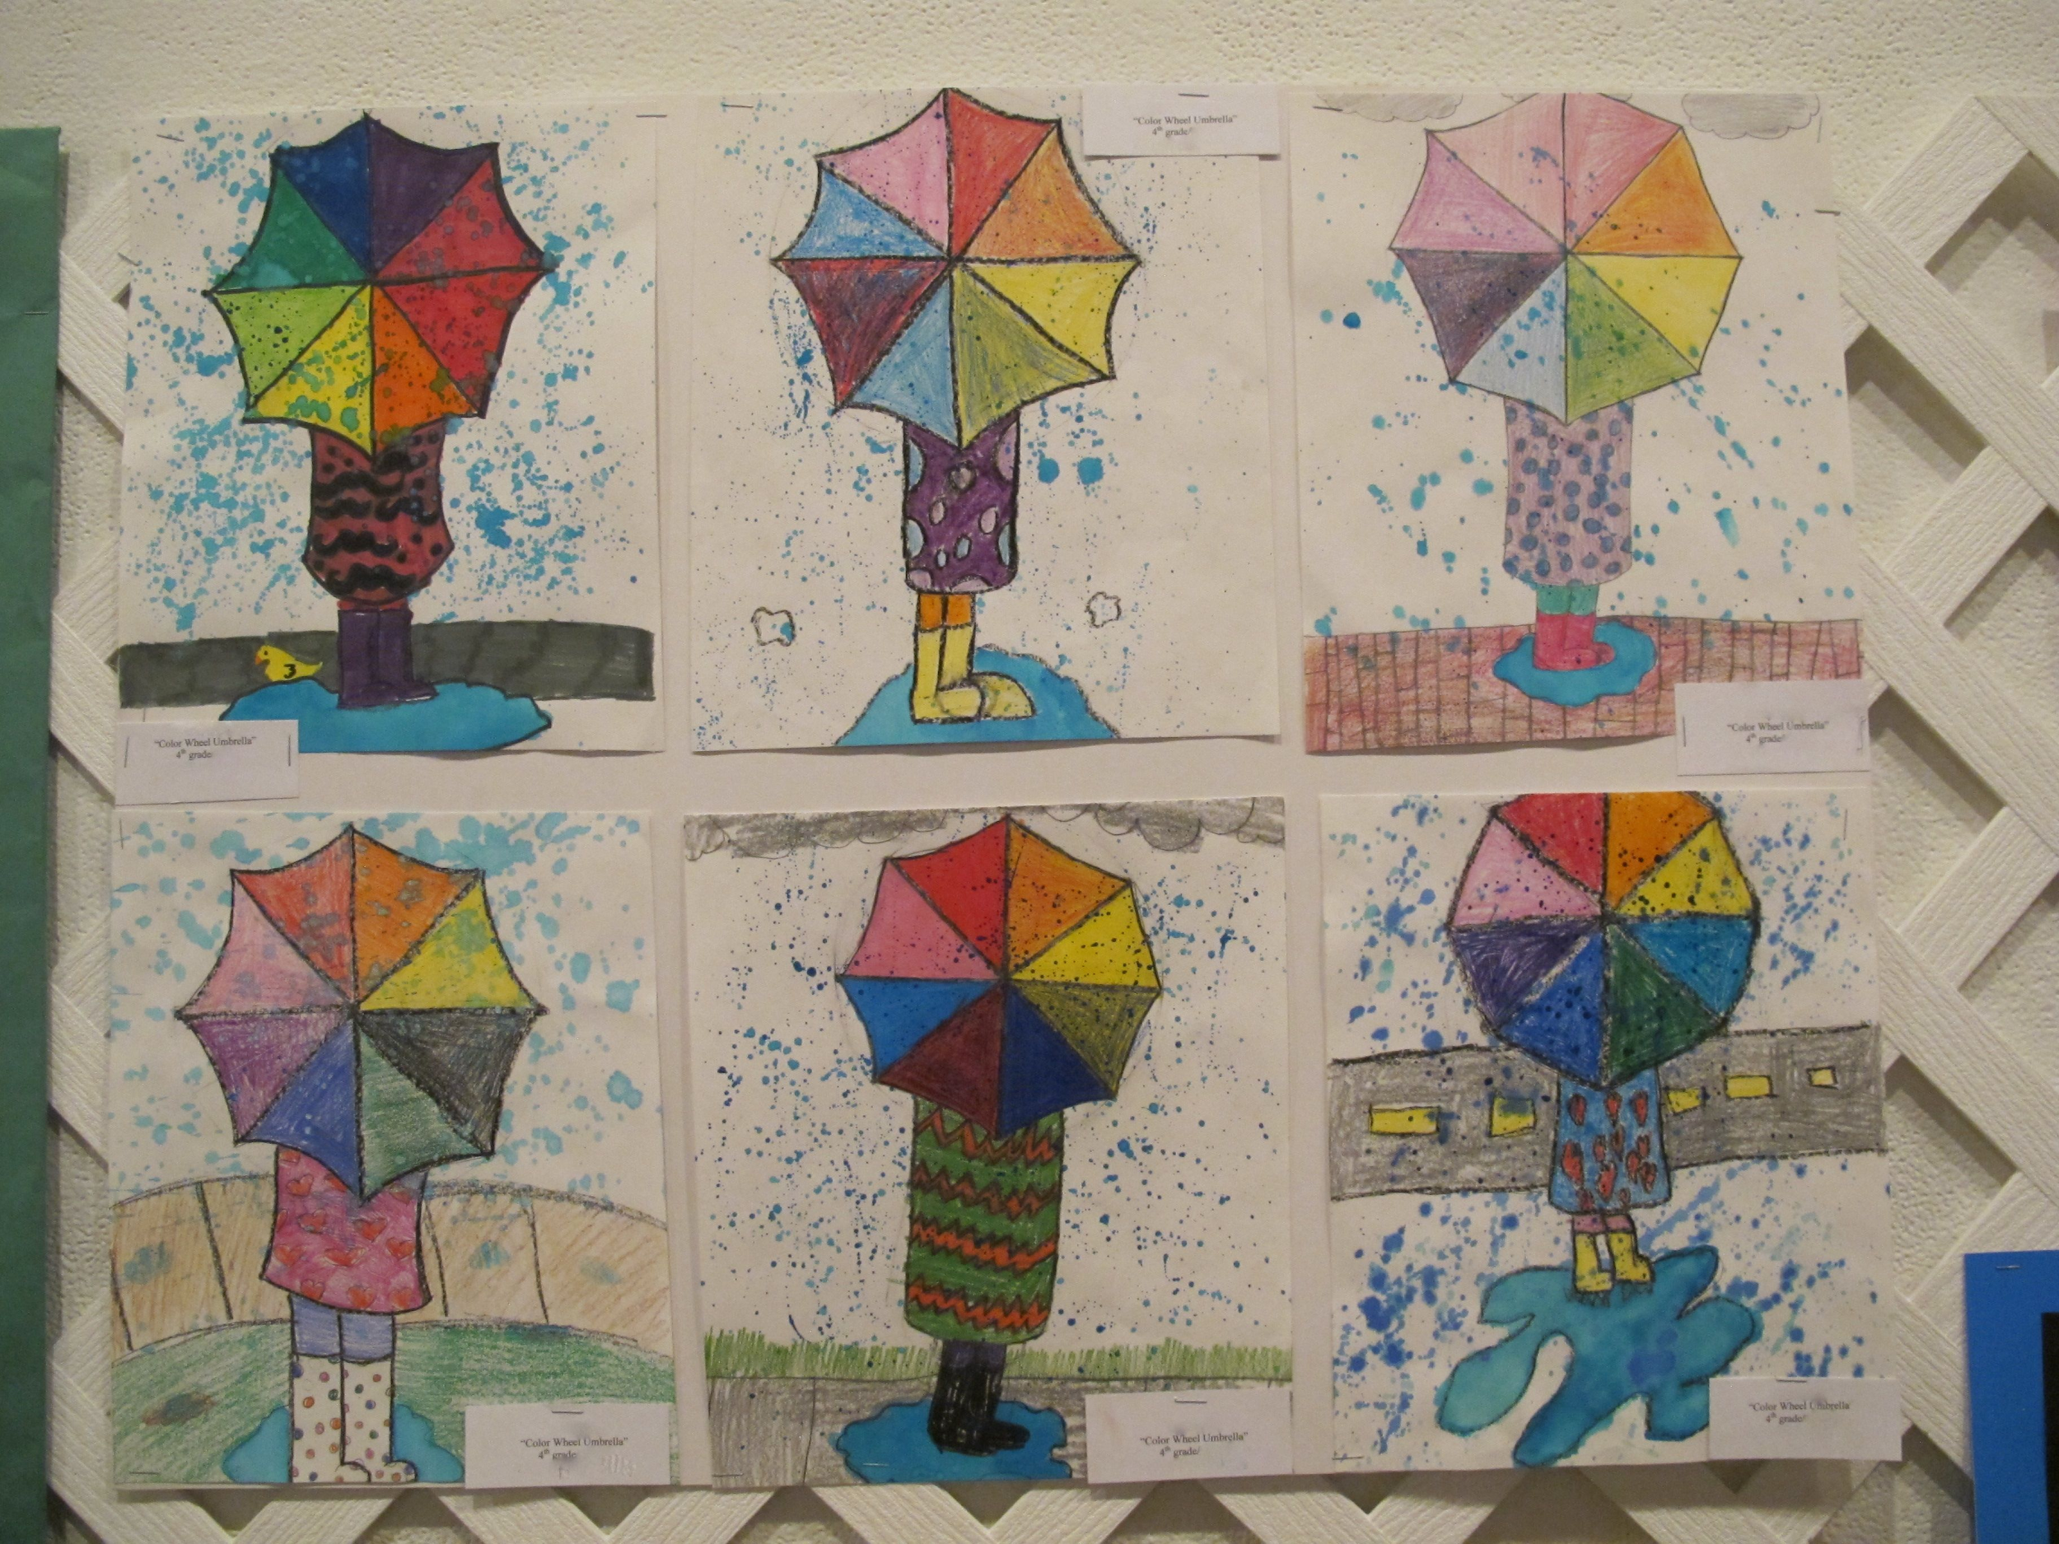
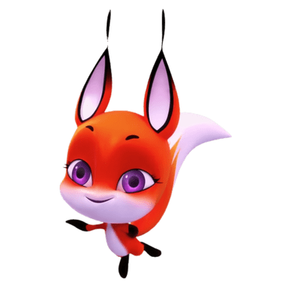
Los colores
¡está lloviendo!
Instructions: Draw an umbrella, then, color and label each section with a different color from our vocabulary.
Then, draw yourself standing under la lluvia!

Slide 20
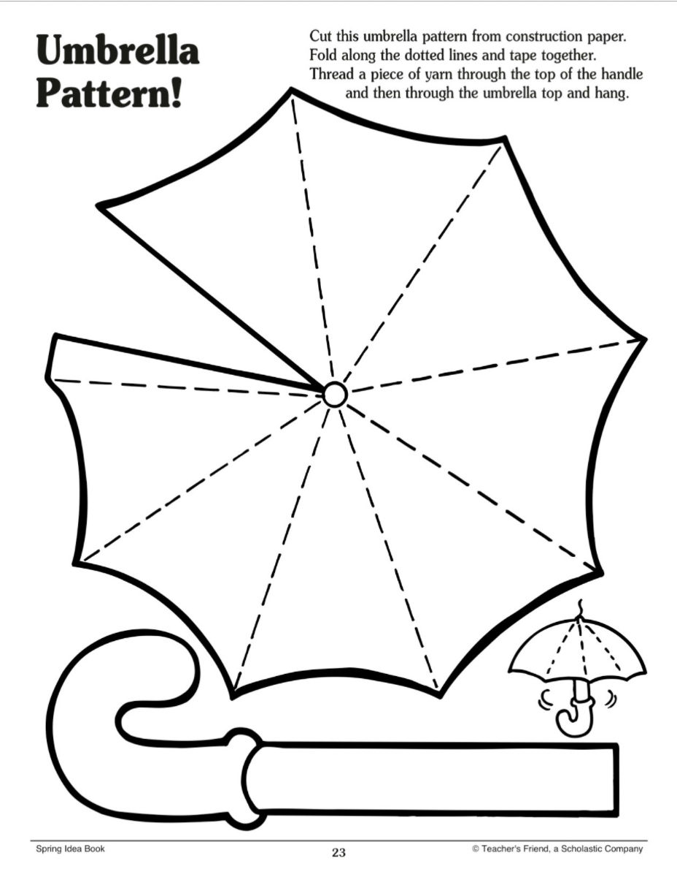
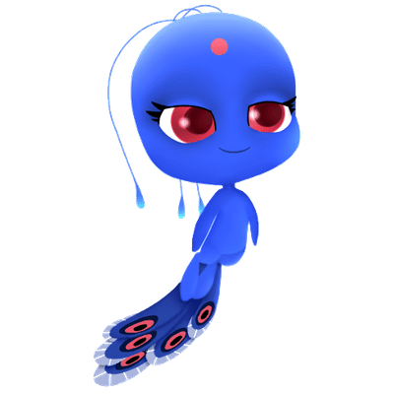
Los colores
la paragua
Instructions: Color and label each section with a different color from our vocabulary.
Then, cut out, fold,
and glue your paragua together!
Click to download

Slide 21
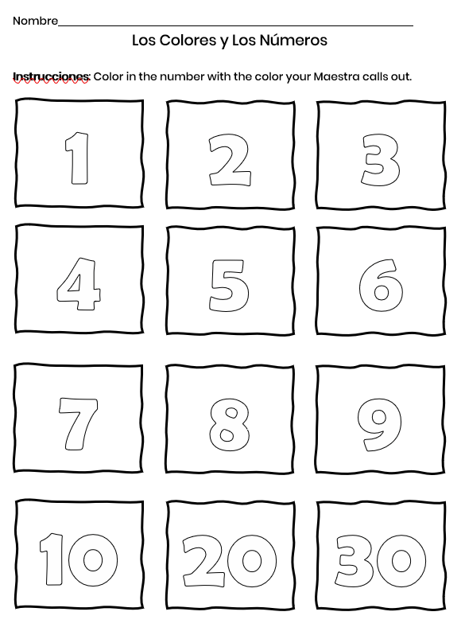
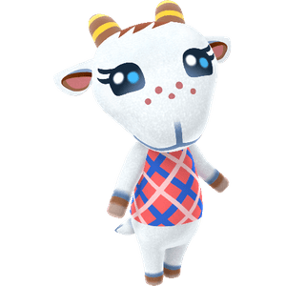
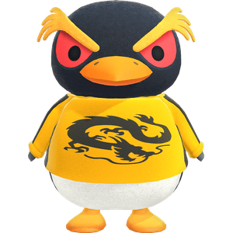
Los colores
rainbow of skittles
Instructions: Color each number according to the Spanish words your Maestra says.
Click to download

Slide 22
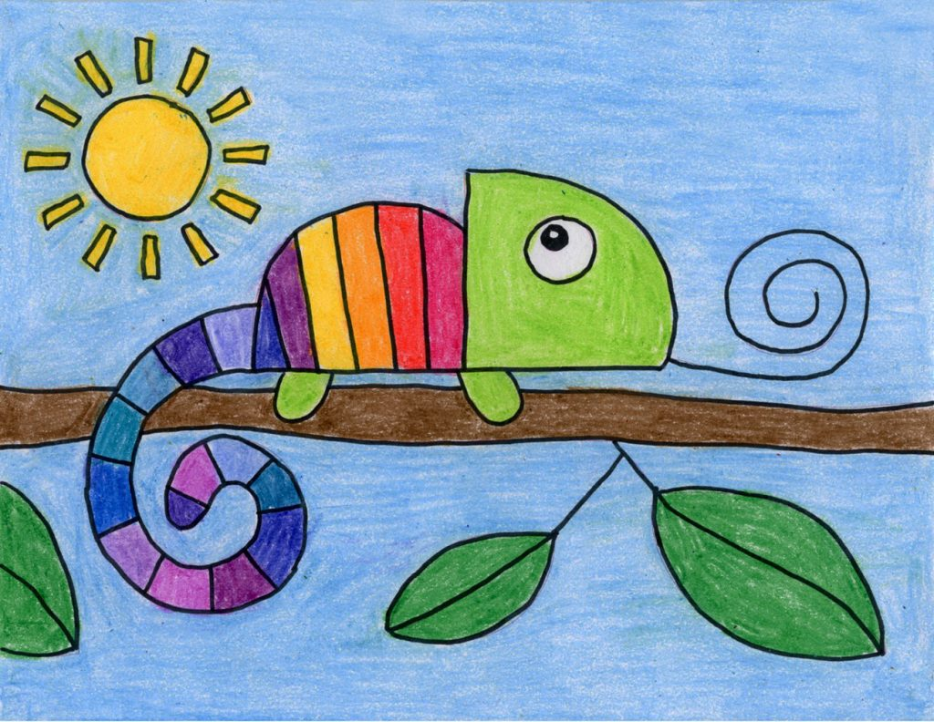
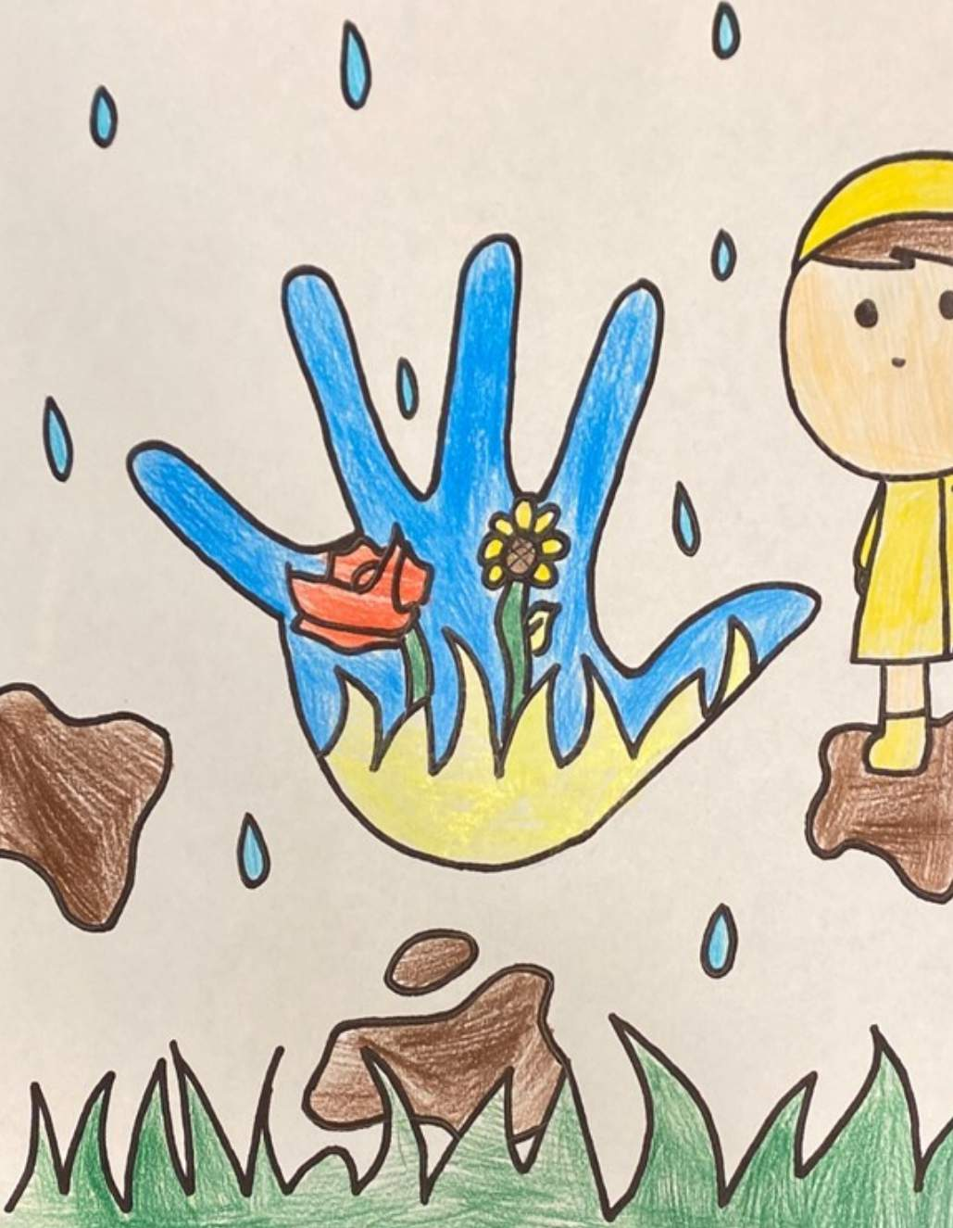
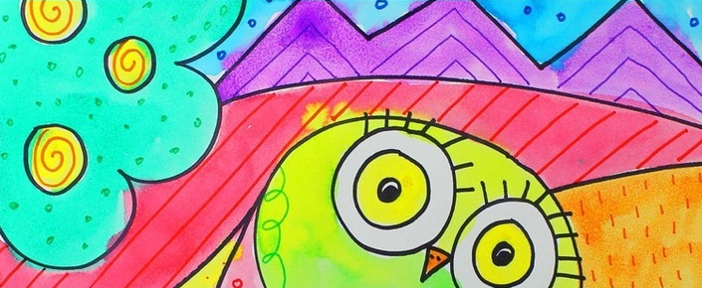
Los colores
¡el arte loco!
Instructions: Have your colors ready to go, it’s time for an art exhibition! I’ll say a color in Español and you use it to start coloring.
But the fun begins when I call out a new color! You’ll drop the color you have and pick up the new one.

Slide 23
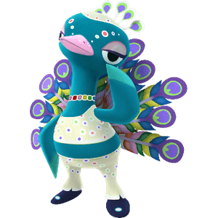
Los colores
COLOR COMMAND
Instructions: I’ll say a color in Español and you’ll race to find an item that matches that color.

Slide 24
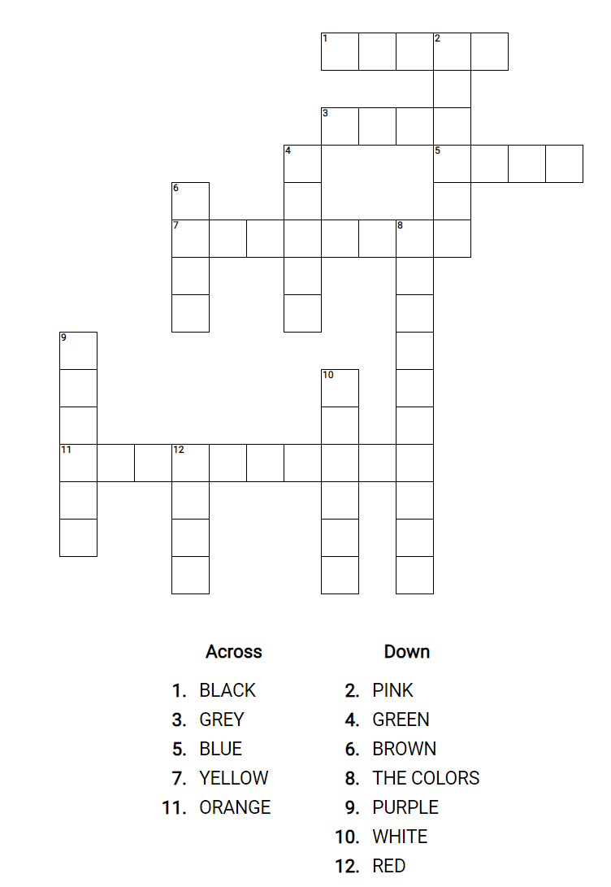
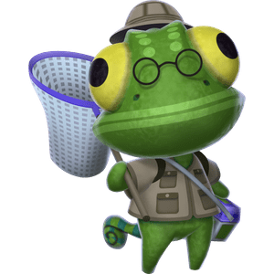
Los colores
COLOR crossword
Instructions: Download and complete the colors crossword puzzle
Click to download

Slide 25
drag your answer here
ROJO
drag your answer here
ANARANJADO
Instructions: Drag the terms to match their Spanish translation
drag your answer here
AMARILLO
drag your answer here
NEGRO
drag your answer here
VERDE
drag your answer here
ROSADO
drag your answer here
BLANCO
drag your answer here
MORADO
drag your answer here
AZUL
drag your answer here
CAFÉ
drag your answer here
GRIS

Slide 26
Los colores
ANARANJADO
VERDE
mata la mosca
ROSADO
MORADO
AZUL
BLANCO
ROJO
NEGRO
AMARILLO
Buenas noches
Señora
GRIS
De nada
ROSA

Slide 27
Los colores
mata la mosca

Slide 28
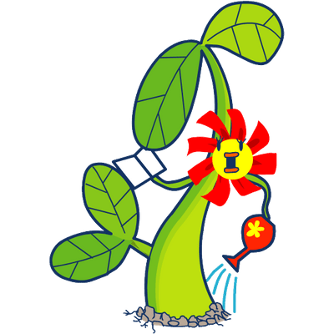
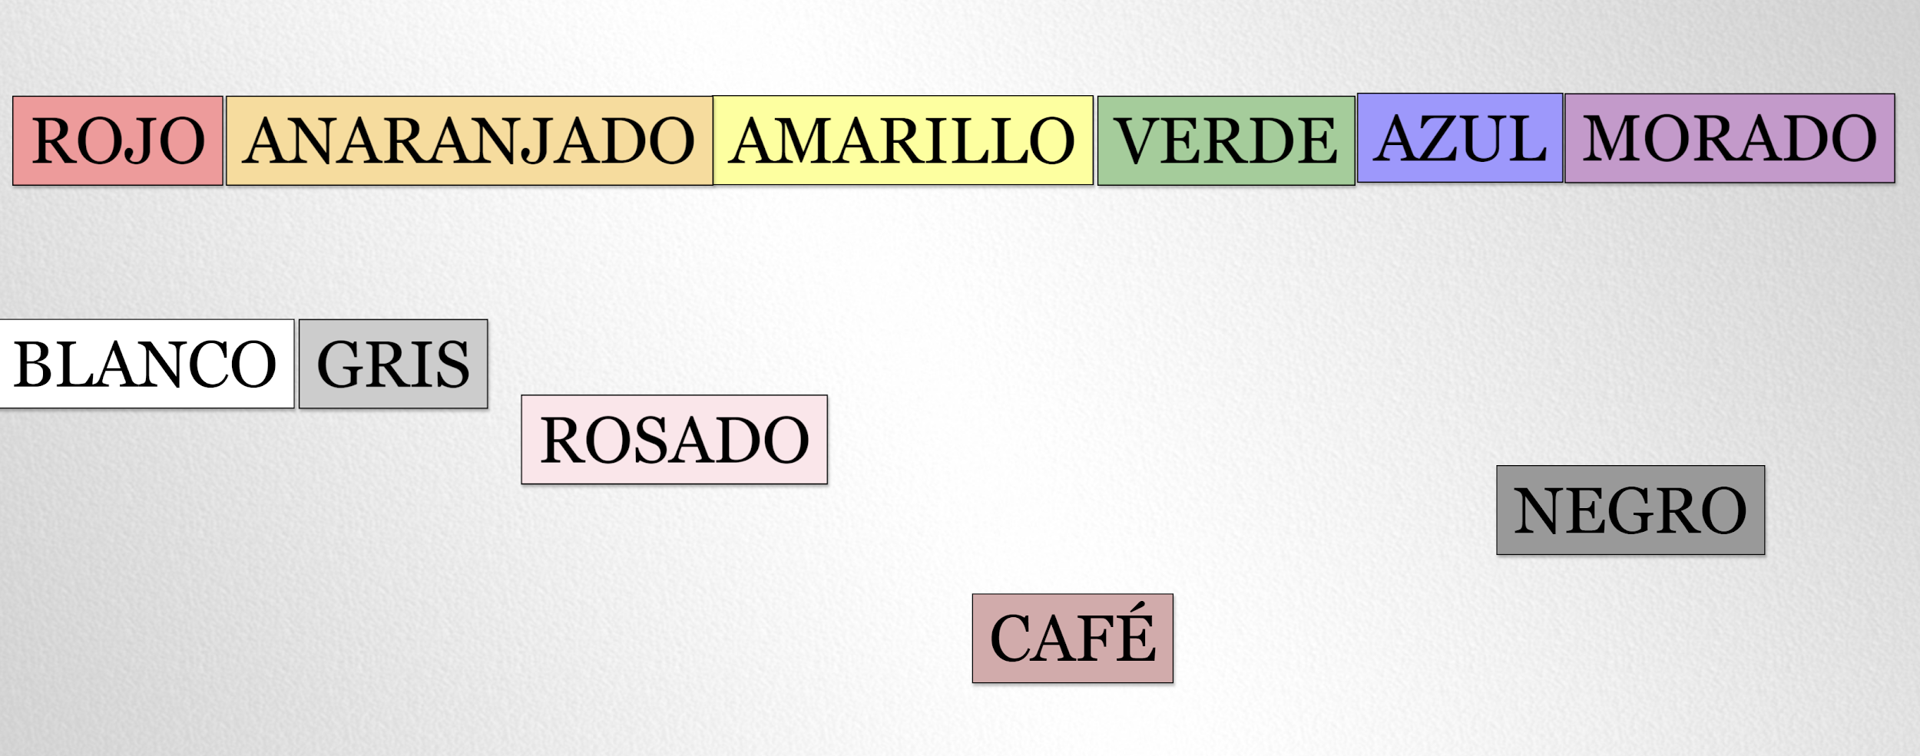
Los colores
Instrucciones: Click on the flower below to play Flower Power!
Instrucciones: I’ll say a color and you drag it to the top!
Click to play
Click to play

Slide 29
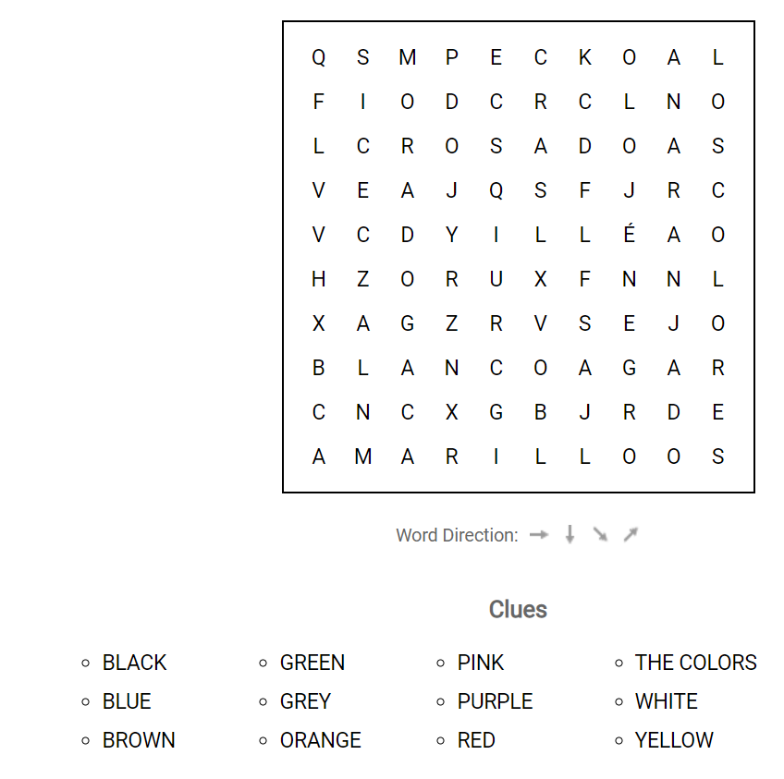
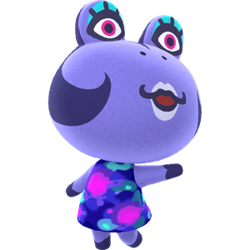
palabra scramble!
Instructions: Translate the colors into Spanish and find the Spanish word for each color in the scramble

Slide 30
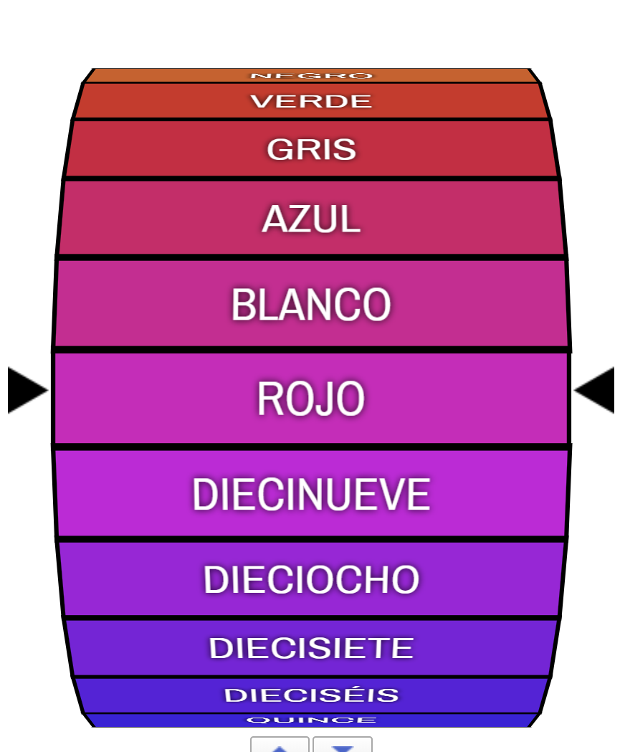
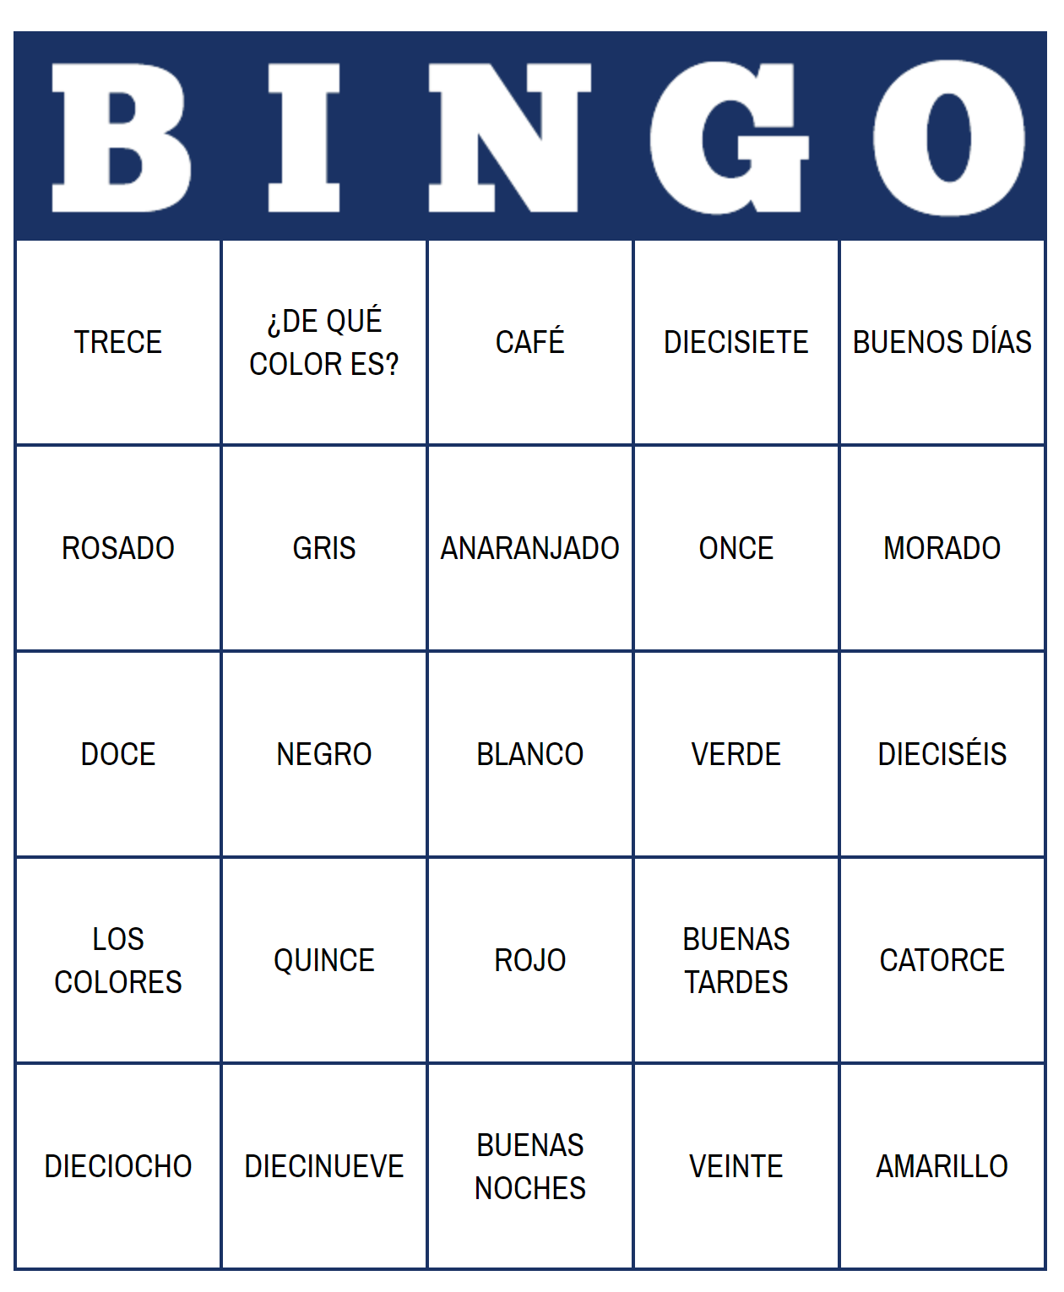
Los colores
¡Juguemos!
Instrucciones: Click on the pictures to play Lotería and Randomizer! Say the numbers in English and Spanish.

Slide 31
Los colores
¡Hola amigo! Me llamo María Gómez. Mi color favorito es morado. ¿Cuál es tu color favorito?
Juego de conversaciones
Instructions: Take turns asking,
¿Cuál es tu color favorito?
and answering with,
Mi color favorito es (and your favorite color!)
1

Slide 32
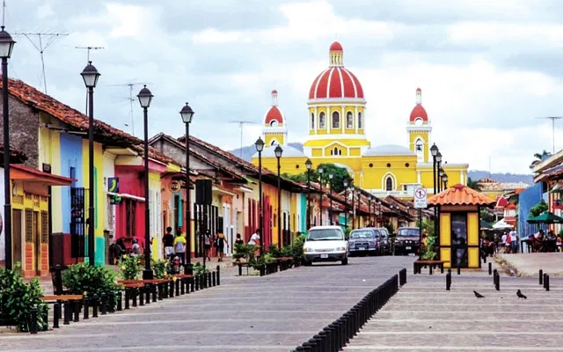
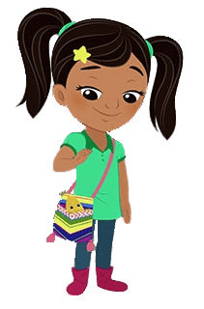
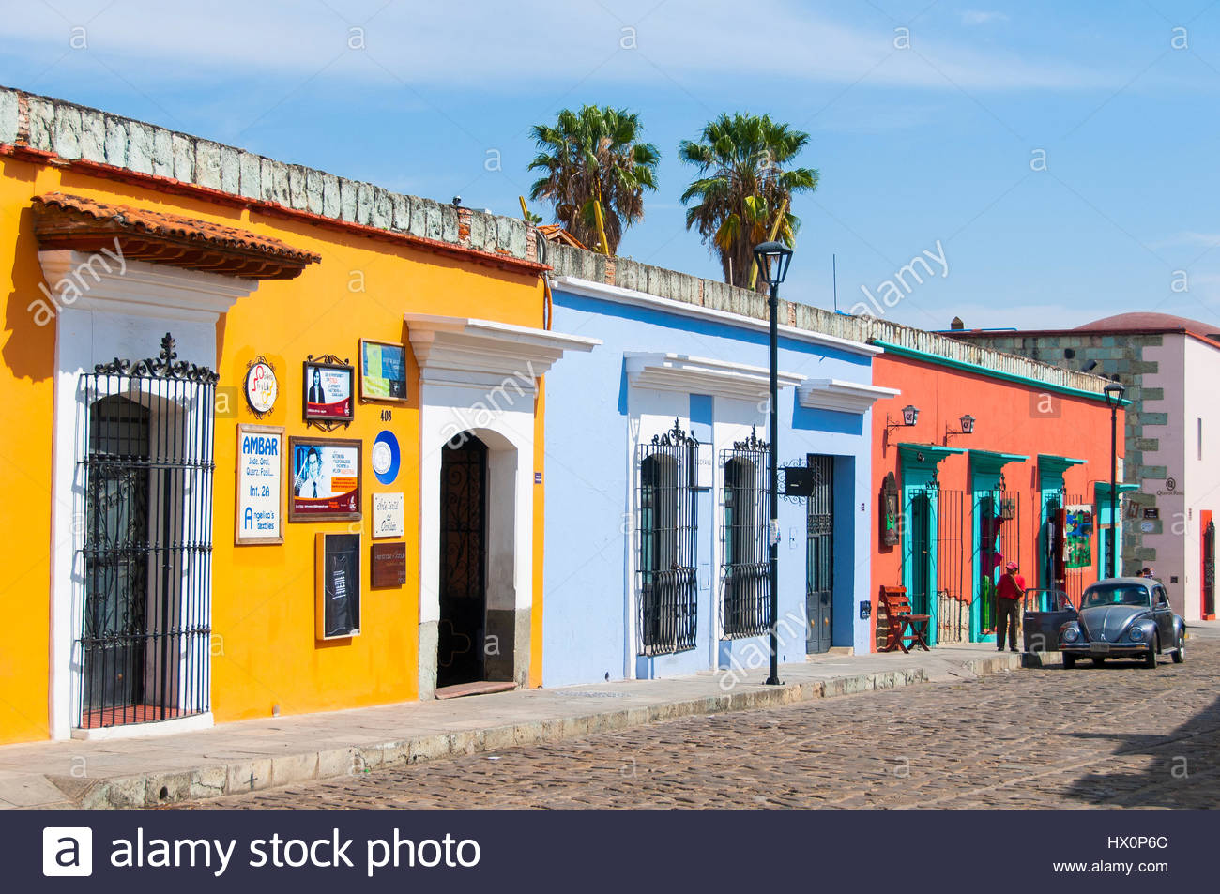
nota cultural: los colores
Many Hispanics love bright colors. Mexicans and Nicaraguans for example paint their buildings bright colors such as blue, pink, and yellow.

Slide 33
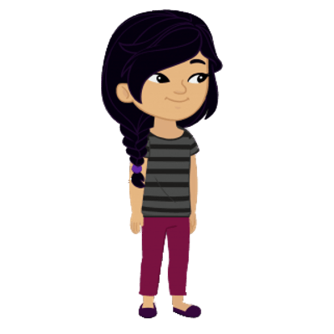
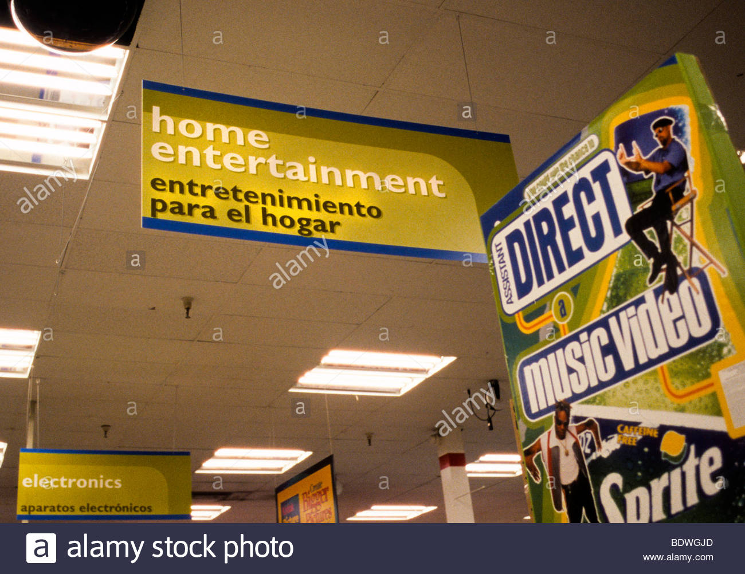
For example, Osco Drug in Chicago uses bilingual signs with bright colors to attract new Latin@ customers
nota cultural: los colores
Companies in the U.S. who would like to advertise to Hispanics, often change their signs to suit their culture.

Slide 34
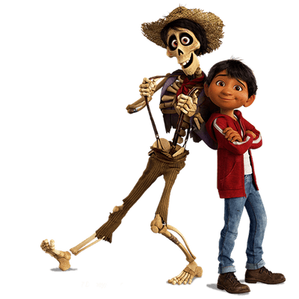
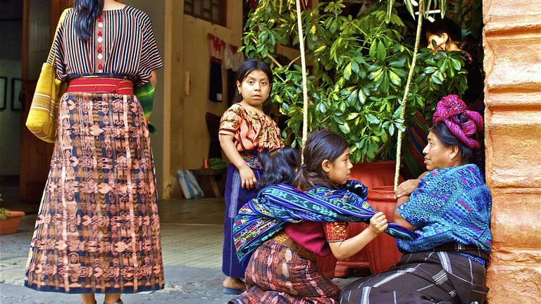
Also, they type of dress may also show how much money the family has.
In Guatemala, there are many people of the Mayan tradition. Even today, they wear traditional clothing, which is very bright.
Each village has its own unique pattern, which differentiates it from other villages.
Click to watch

Slide 35
¿Cómo te llamas?
¿Cómo estás?
¿Cuántos años tienes?
¿De dónde eres?
¿Cuántos hermanos tienes?
¿Cómo se escribe tu nombre?
¿Cuántos ___ hay?
¿Cuál es tu color favorito?
¿De qué color es?
¡luz, cámara, acción!
Instrucciones: With your partner, use the questions on the right to create a story. Then, it’s lights, camera, action time!! Practice and prepare a conversation to present!

