Slide 1
Level II part Iv
body parts

Slide 2
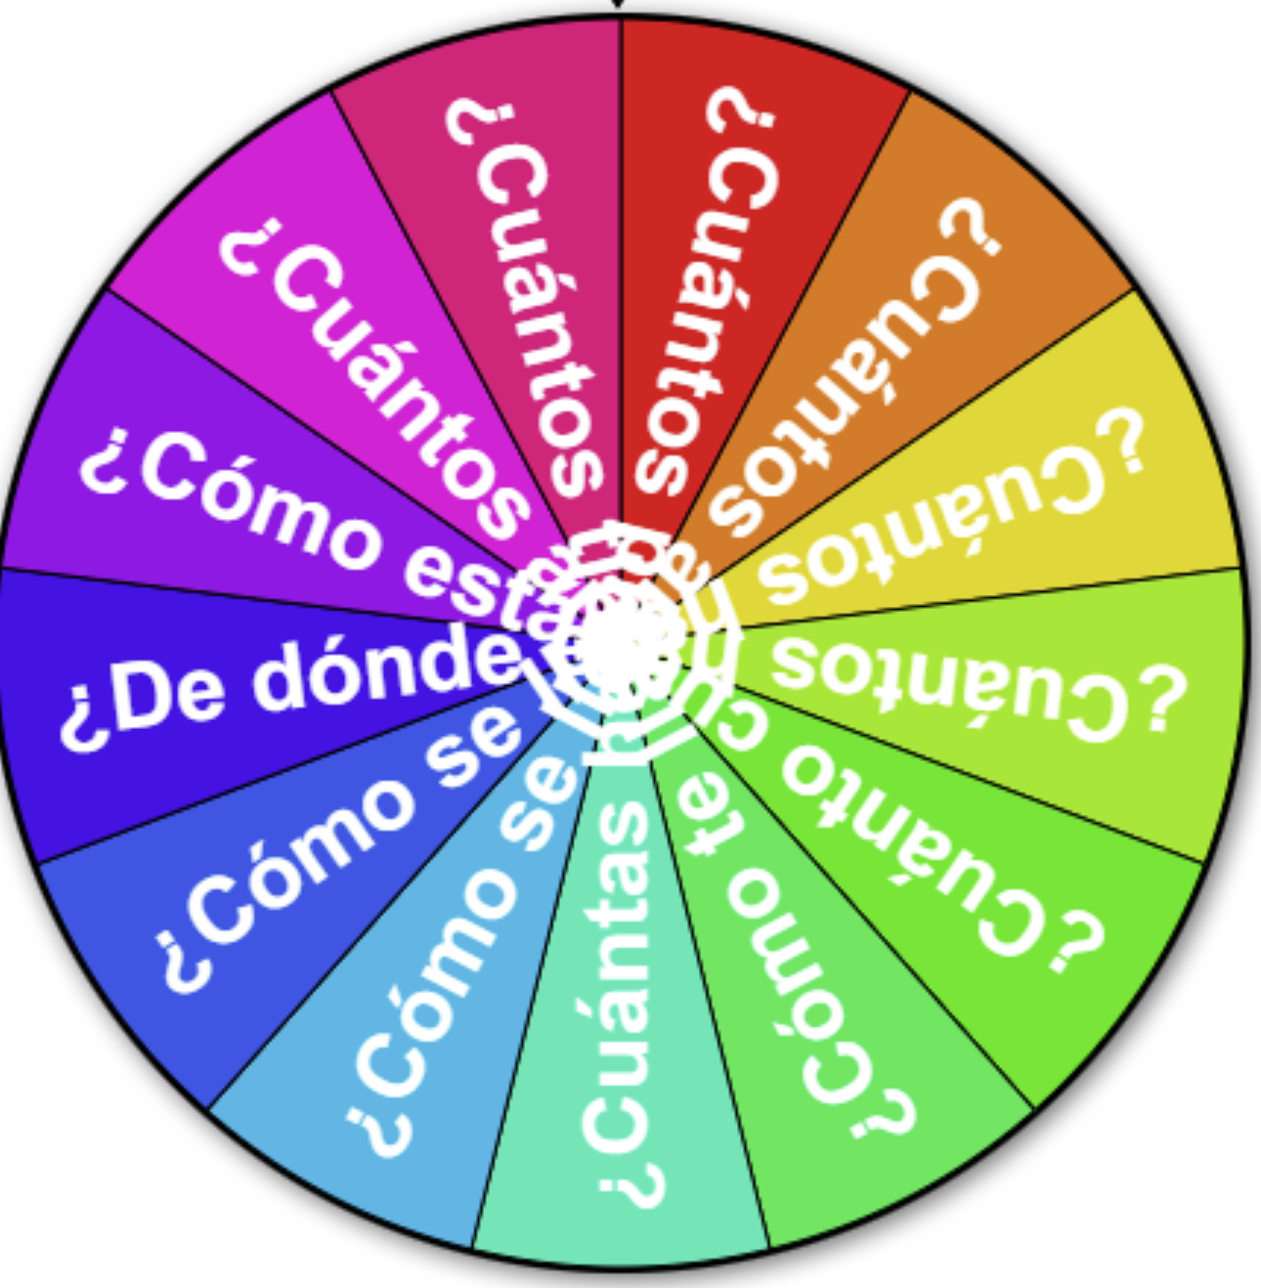
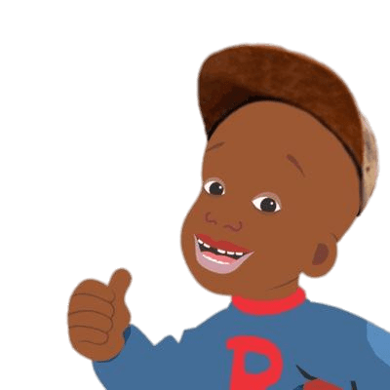
EL cuerpo
¡Calentemos con preguntas!
Instructions: Let’s warm up with some review questions! Click the spinner and respond in Español.
¡Si se puede!

Slide 3
Level I Part IV
la ropa
los colores
los animales
el tiempo
las estaciones
el cuerpo
Notes:
🍐 This is a Pear Deck Draggable™ Slide.
🍐 To edit the type of question, go back to the "Ask Students a Question" in the Pear Deck sidebar.

Slide 4
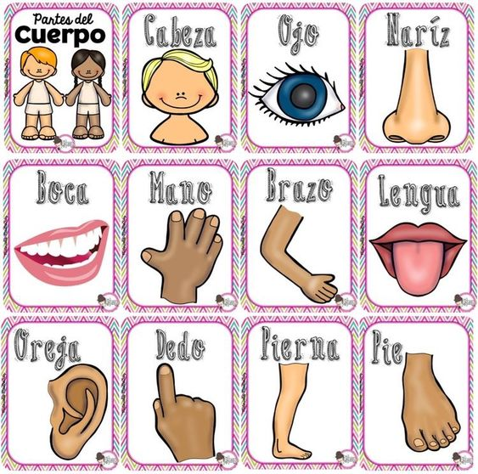
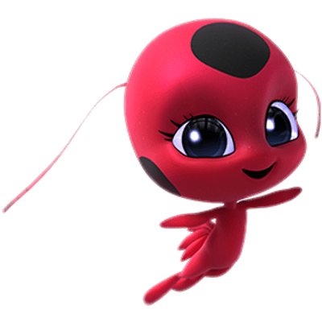
¡Hola amigo! Continuamos con el cuerpo!!

Slide 5
i. BODY PARTS
STUDENTS WILL BE ABLE TO NAME THEIR BODY PARTS, TELL WHAT BODY PARTS HURT, AND HOW MANY OF EACH BODY PART THEY HAVE

Slide 6
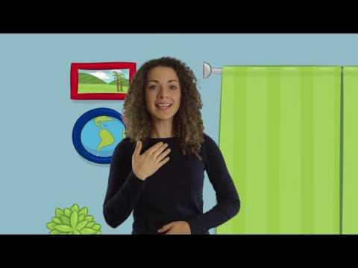
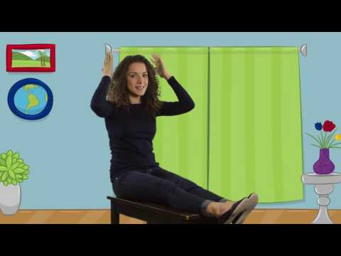
¡cantemos de la cara!
¡cantemos del cuerpo!
click to sing

Slide 7
el cuerpo
Spanish | english
la cara | the face
la boca | the mouth
las orejas | the ears
las piernas | the legs
los dedos de los pies | the feet
los brazos | the arms
los hombros | the shoulders
los ojos | the eyes
la lengua | the tongue
Spanish | english
el cuerpo | the body
el pecho | the chest
las rodillas | the knees
los dedos | the fingers
el cuello | the neck
la nariz | the nose
los dientes | the teeth
el pelo | the hair
el estómago | the stomach
Spanish | english
los pies | the feet
las manos | the hands
la espalda | the back
la garganta | the throat
la cabeza | the head
alta | tall
baja | short
¿Cuántos __tienes? | How many__do you have?
Me duele/n (body part/s) | My __ hurts
Tengo # (body parts) | I have # (body parts)

Slide 8
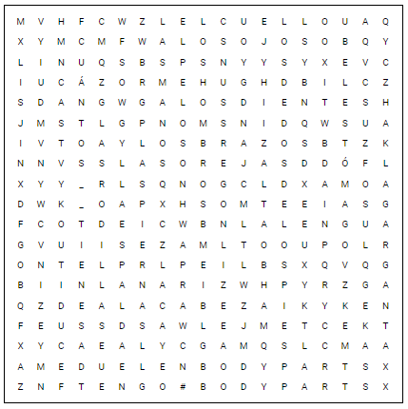

Slide 9
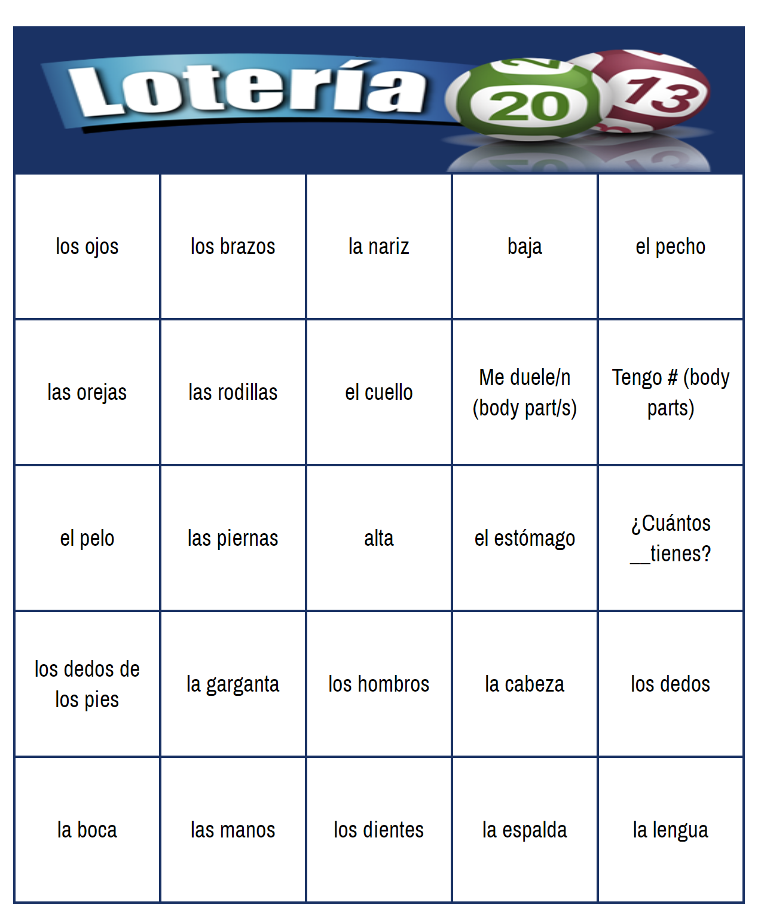
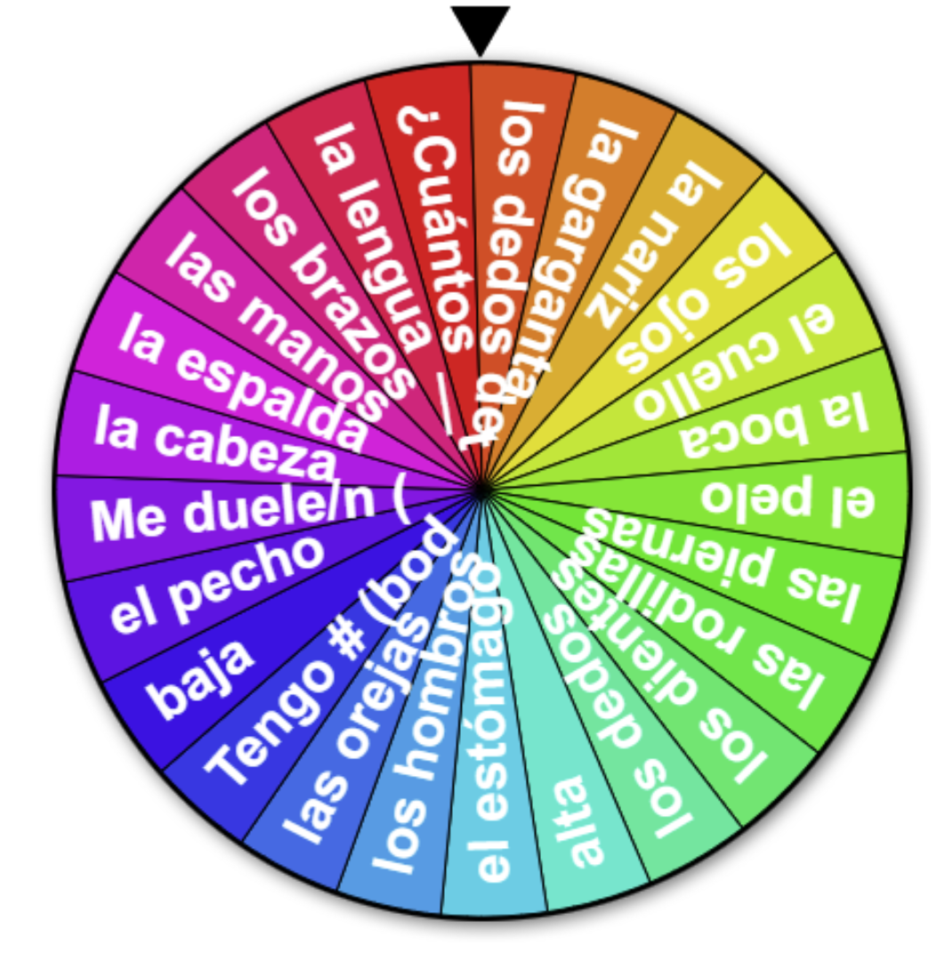
loteria
randomizer
Click to play
Click to play
https://flippity.net/bi-pl.php?k=1v4rA4CZpic1fCQI1nWF9vPUrlP2xHaVJlXrgGS9kkTc
https://flippity.net/bi-pl.php?k=1v4rA4CZpic1fCQI1nWF9vPUrlP2xHaVJlXrgGS9kkTc

Slide 10
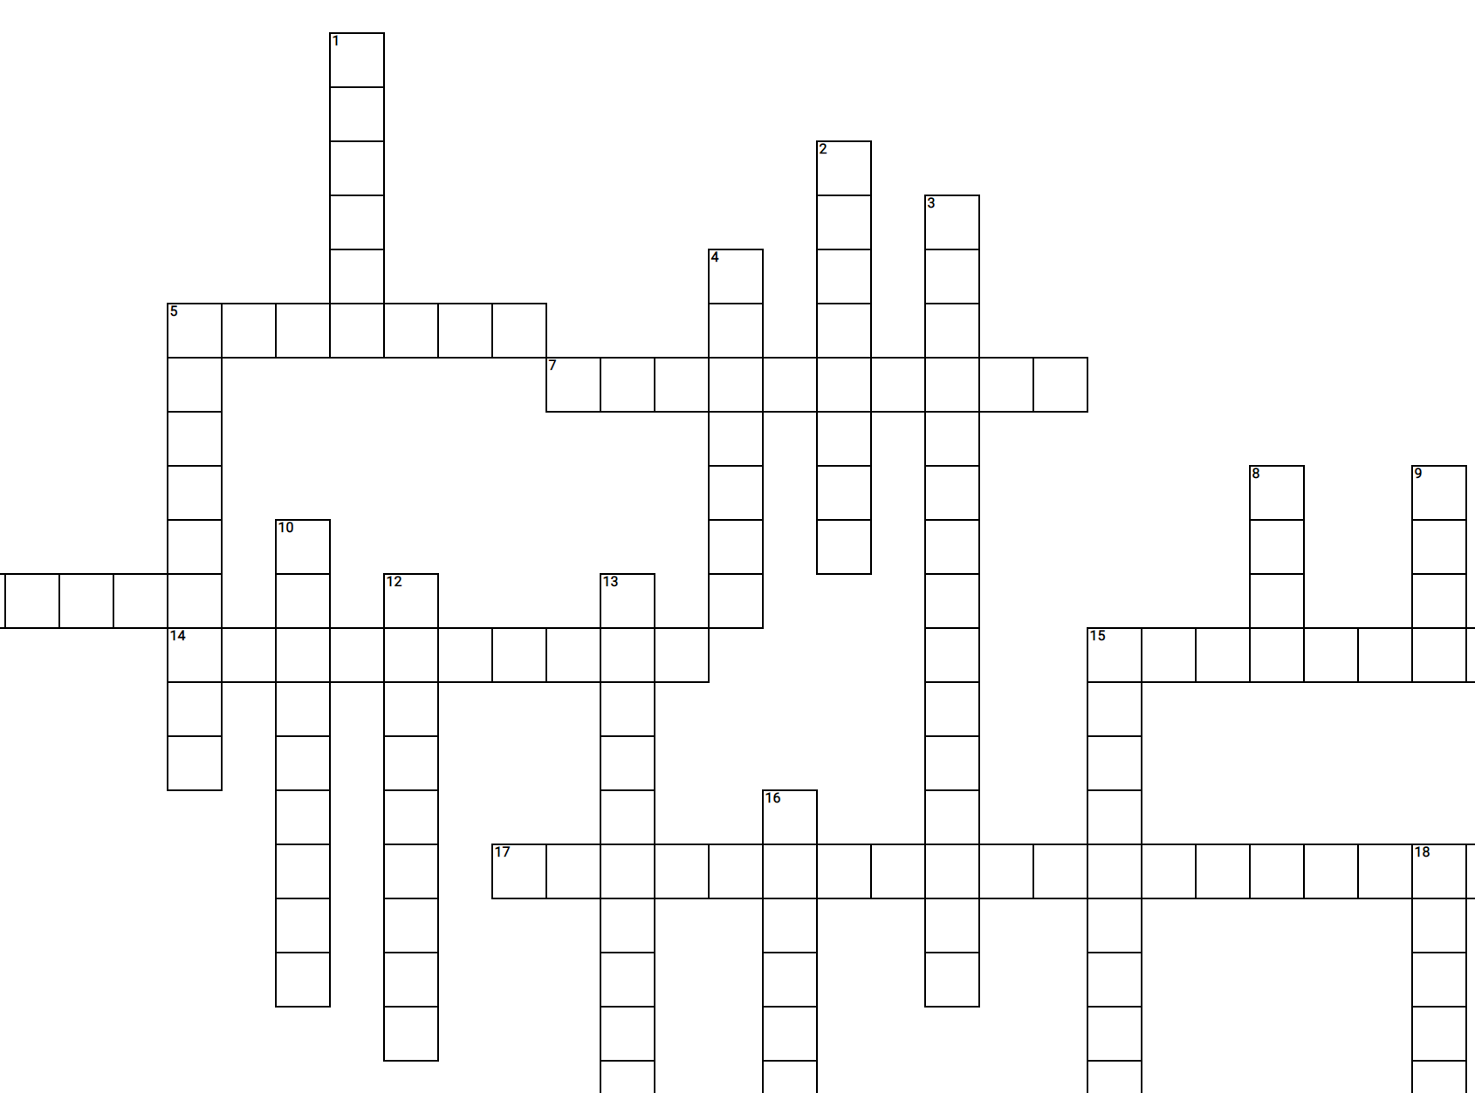
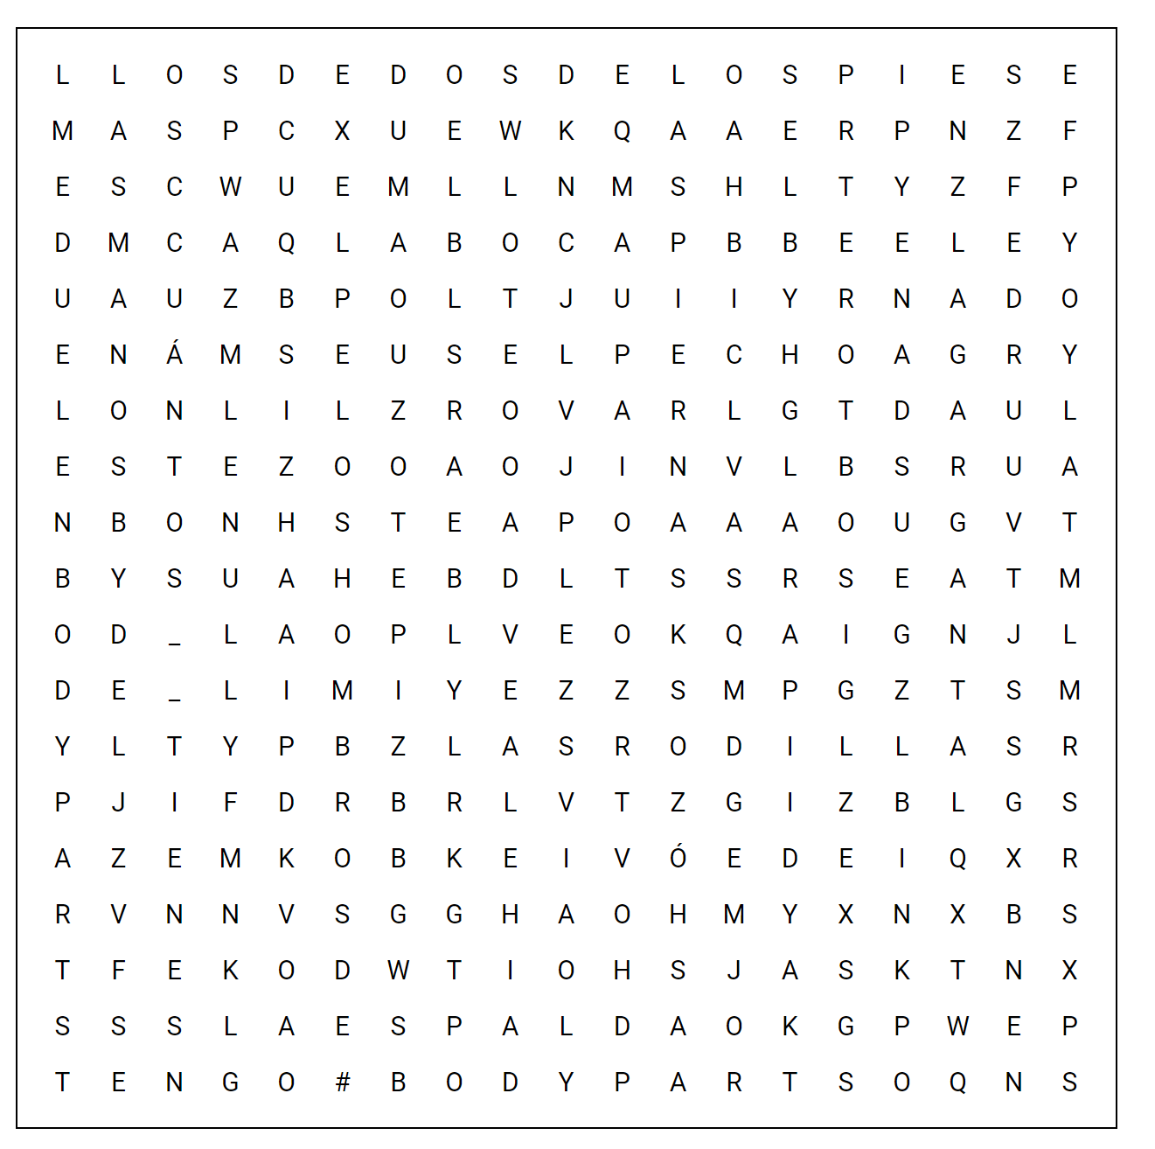
Crossword puzzle
word search
Click to download
Click to download PDF

Slide 11
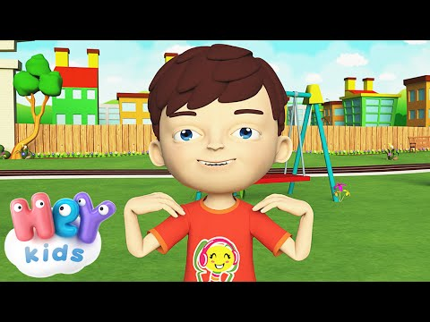
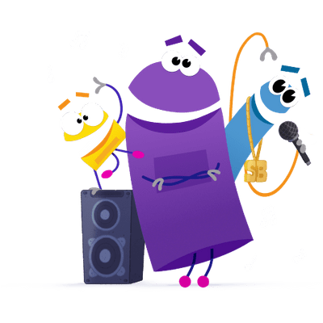
EL CUERPO
bailemos
Stand up and let’s do the gestures and have a lip sync battle!
Click to listen

Slide 12
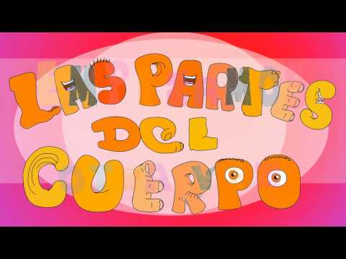
EL CUERPO
bailemos
Stand up and let’s do the gestures and have a lip sync battle!
Click to listen

Slide 13
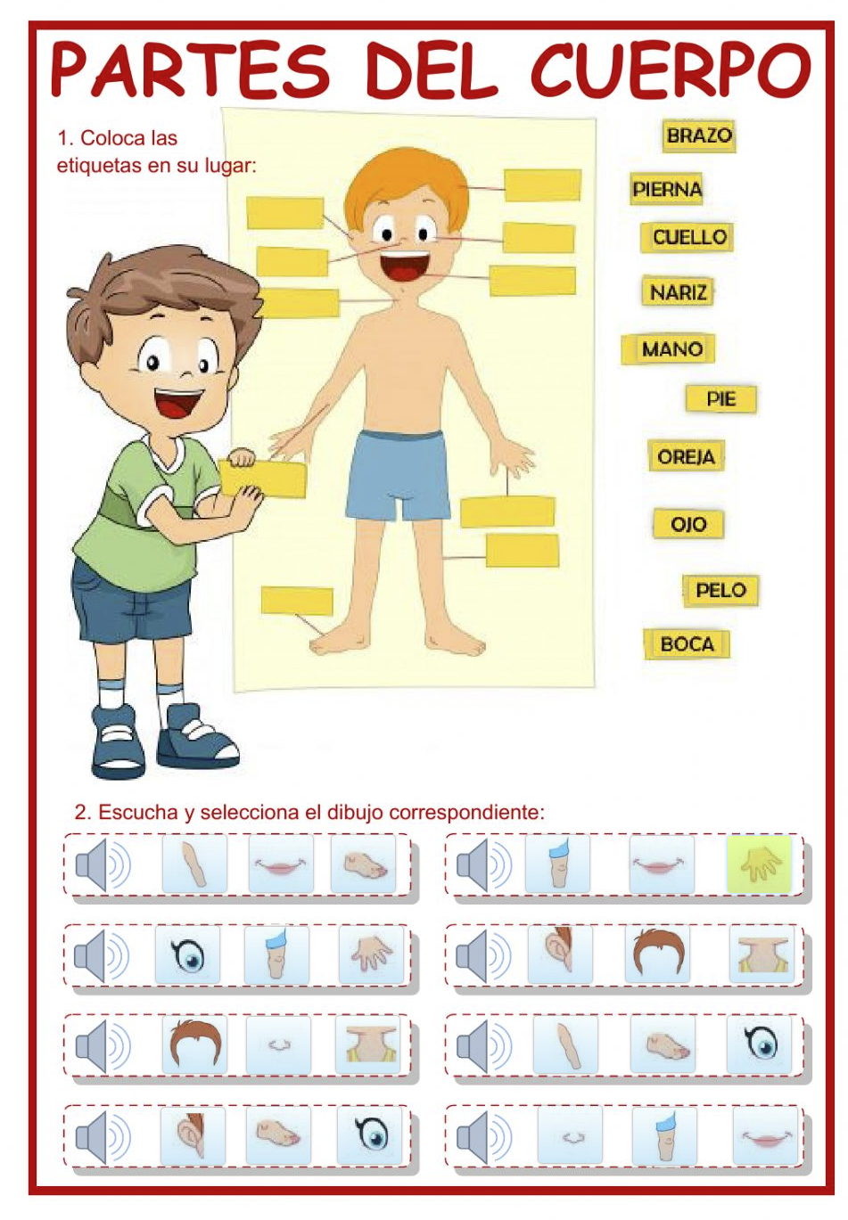
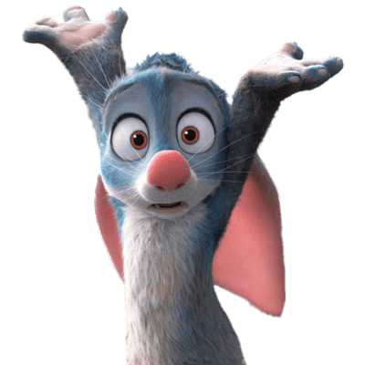
EL CUERPO
LISTEN AND LABEL
Instrucciones: Listen to each word and select the picture of what you hear. Then, drag the words to the correct spot.
Click to play

Slide 22
tiene # _
It has # _
¿de qué color es?
what color is it?
¿Cuántos tiene?
UNO DOS TRES
Instrucciones: Look at the monsters and count its body parts! Then, answer what color they are!
CUATRO CINCO SEIS
¿Cuántos tiene?
how many_does it have

Slide 23
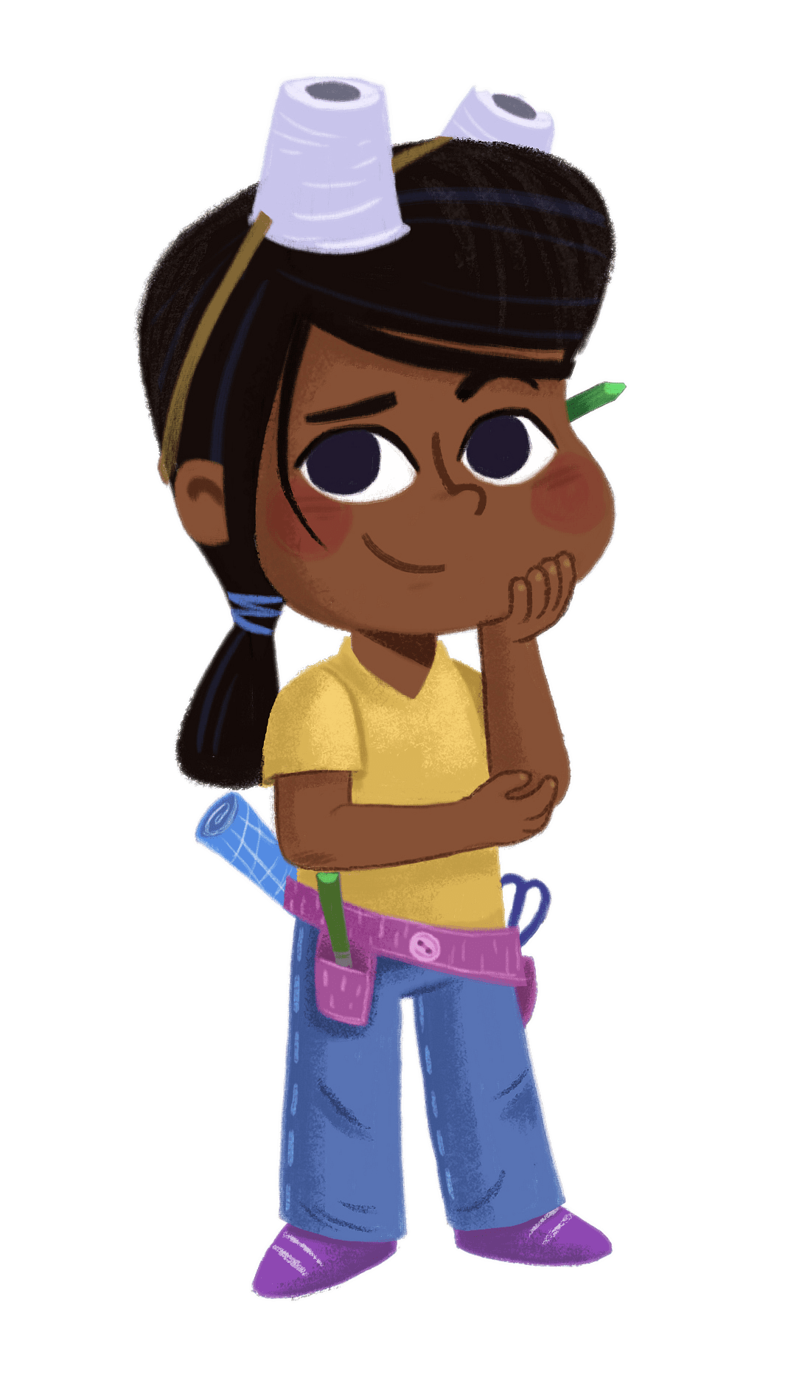
¿Cómo se escribe…?
Instrucciones: Either print a copy or do it digitally using Google Draw. Read the poem and then draw and label the characters facial features (ojos, nariz, boca, orejas)
Click to download PDF

Slide 24
EL CUERPO
la maestra Dice toca la...
Instrucciones: It’s Simon Says in Spanish! Don’t touch the body part unless I say La Maestra Dice Toca la.
If you hear me say, La Maestra Dice Toca la, then be the first to correctly touch it!

Slide 27
EL CUERPO
la maestra Dice toca la...
la maestra mala Dice toca la...
Instrucciones: It’s Simon Says in Spanish! Don’t touch the body part unless I say La Maestra Dice Toca la.
If you hear me say, La Maestra Dice Toca la, then be the first to correctly touch it!
Instrucciones: It’s a twist! Same rules as la Maestra Dice Toca La...but this time, I might point to the correct body part...or I might not! Listen closely and remember...it’s maestra mala time!

Slide 28
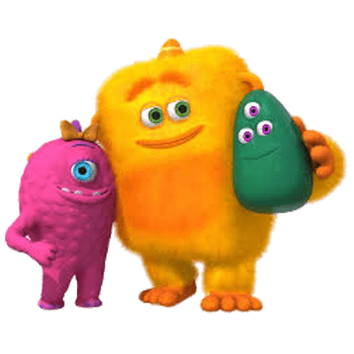
EL CUERPO
DIBUJEMOS
Instrucciones: On a blank sheet of paper, draw a crazy monster! Add as many features as you want, then, label 10 of our vocabulary words

Slide 29
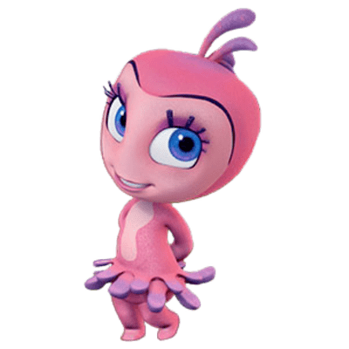
EL CUERPO
persona divertida
monstruo secreto
Instrucciones: Each person will be assigned a body part to draw. Then, we’ll put them altogether to make our own silly person. Make sure you drawing fills your whole page.
Instrucciones: Each person will fold their paper into 3 sections (like you’re mailing a letter). On the top ⅓, draw the head, fold it, and pass it along! The next person will draw the mid section, fold it, and pass it. The last person will draw the legs and feet.

Slide 30
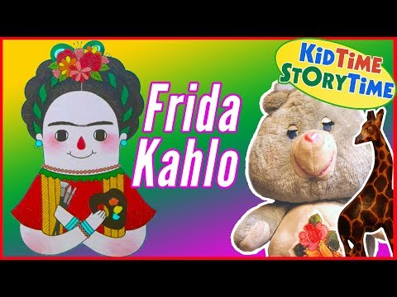
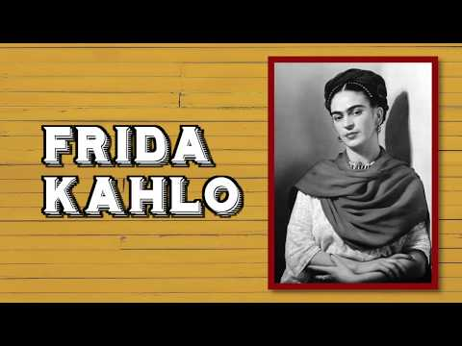
nota cultural: frida kahlo
Self portraits are a very common form of artistic expression. Friday Kahlo is one of the greatest Mexican artists who primarily painted self portraits.

Slide 31
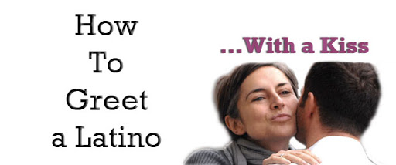
EL CUERPO
nota cultural: ABRAZOS
in the Hispanic culture, people greet each other very differently. Most often, when women see each other, they kiss one another on the cheek. Men will also kiss women on the cheek and give their friends big hugs. Even when people meet for the first time, they often kiss.

