Slide 1
Level II part vI
animals

Slide 2
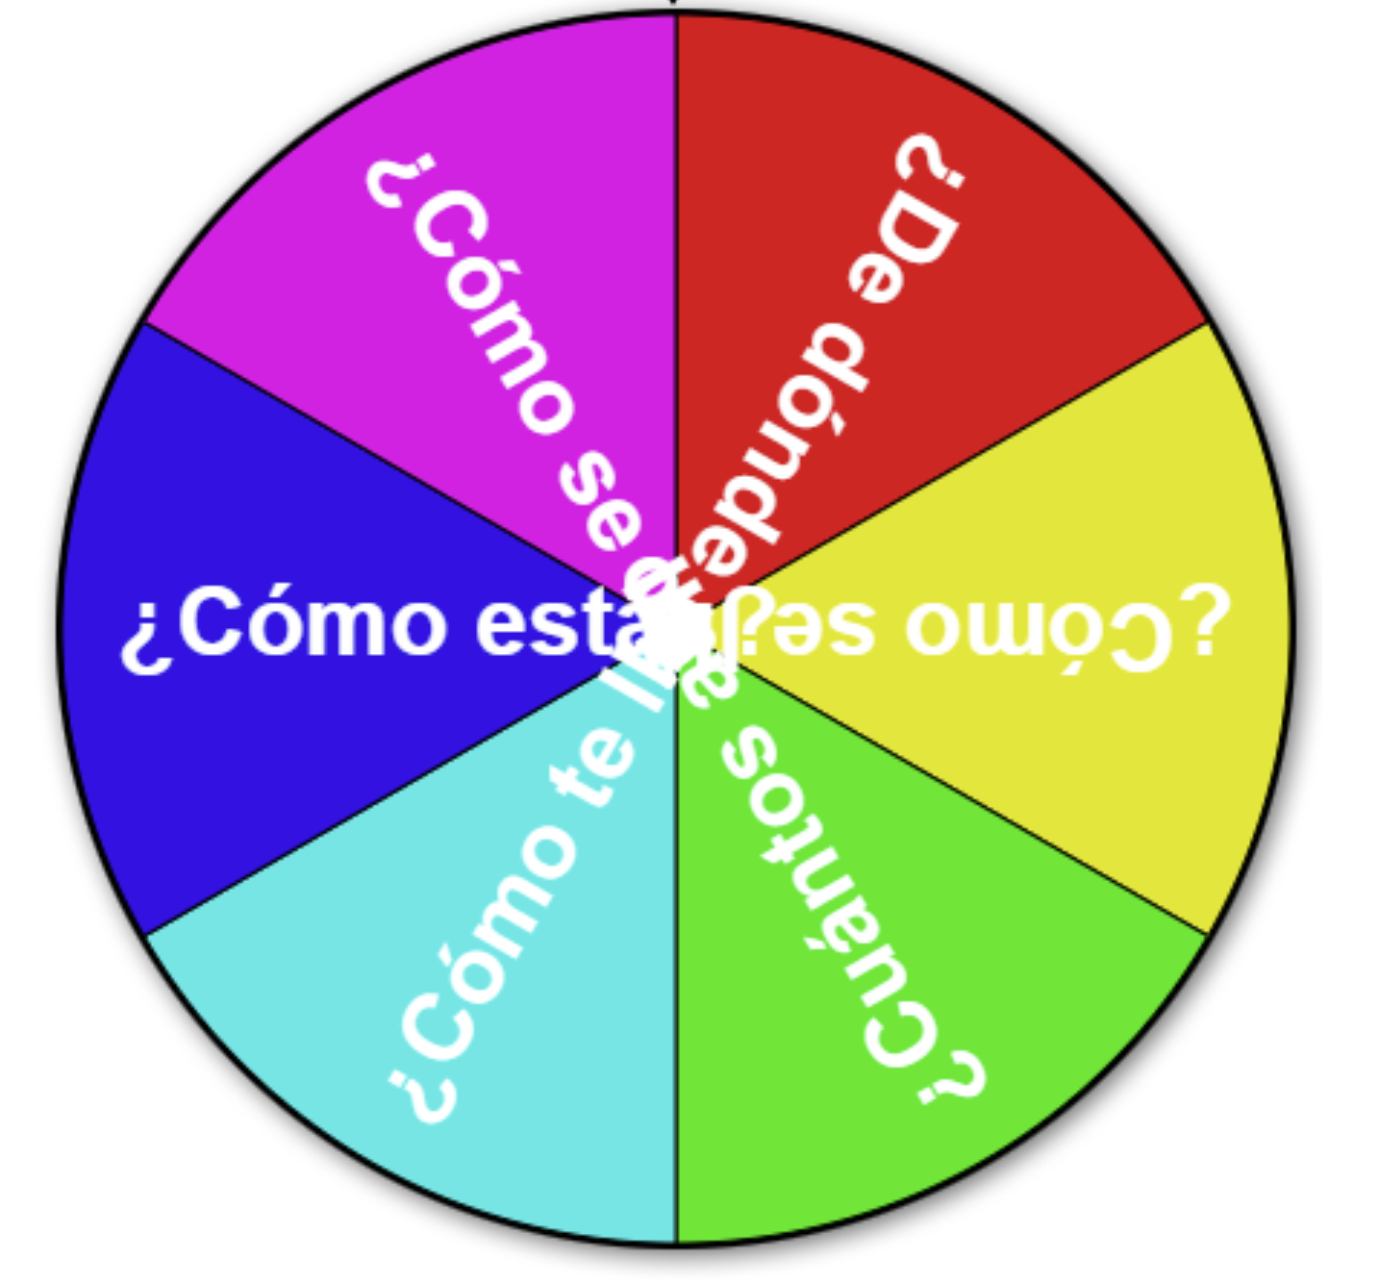
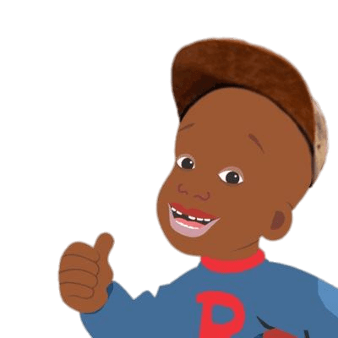
¡Calentemos con preguntas!
Instructions: Let’s warm up with some review questions! Click the spinner and respond in Español.
¡Si se puede!

Slide 3
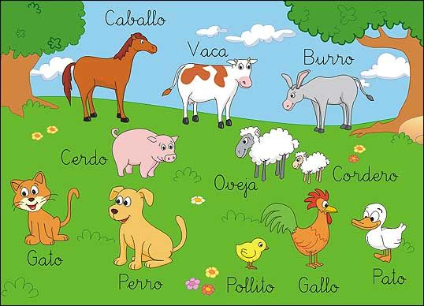
Level I Part VI: ANIMALS
la ropa
los colores
los animales
el tiempo
las estaciones
el cuerpo

Slide 4
¿Què color es el ___?
Es el color____

Slide 5
¿Cuàntas piernas tiene el ____?
El ___ tiene # piernas

Slide 6
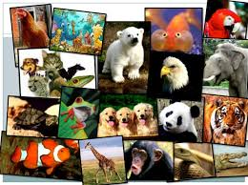
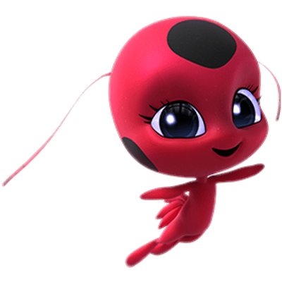
los animales
¡Hola amigo! Continuamos con los animales!
¿Cómo se dice?
How do you say

Slide 7
i. ANIMALS
STUDENTS WILL BE ABLE TO ASK IF ANYONE HAS A CERTAIN ANIMAL, SAY THAT THEY HAVE A CERTAIN ANIMAL, DESCRIBE ANIMALS ACCORDING TO THEIR COLORS AND BODY PARTS, AND ASK THE NAME OF OTHERS’ ANIMALS

Slide 8
los animales
español | inglés
el pájaro | bird
el perro | dog
el gato | cat
el oso | bear
el ratón | mouse
la mascota | pet
el caballo | horse
la vaca | cow
el pez | fish
la gallina | chicken
español | inglés
el cerdo | pig
la serpiente | snake
el mono | monkey
el conejo | bunny
los animales | animals
la tortuga | turtle
el pato | duck
el tigre | tiger
el pavo | turkey
español | inglés
el gallo | rooster
la oveja | sheep
el león | lion
el pingüino | penguin
¿Quién tiene (animal) | Who has (animal)?
(student name) tiene (animal) | Student has (animal)
Yo tengo (animal) | I have (animal)
Su nombre es (name) | It’s name is (name)
¿Cómo se llama su (animal) | What is your (animal´s) name?
Se llama (name) | it’s name is

Slide 9
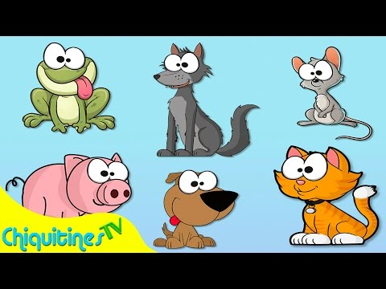
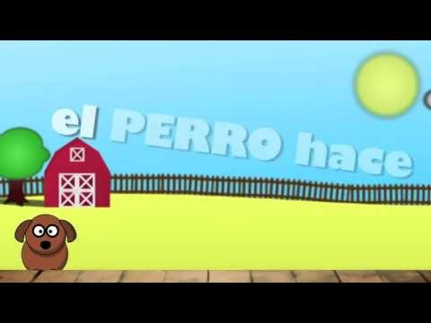
¡cantemos de los animales!
¡cantemos de los animales!
Click to watch
click to sing

Slide 10
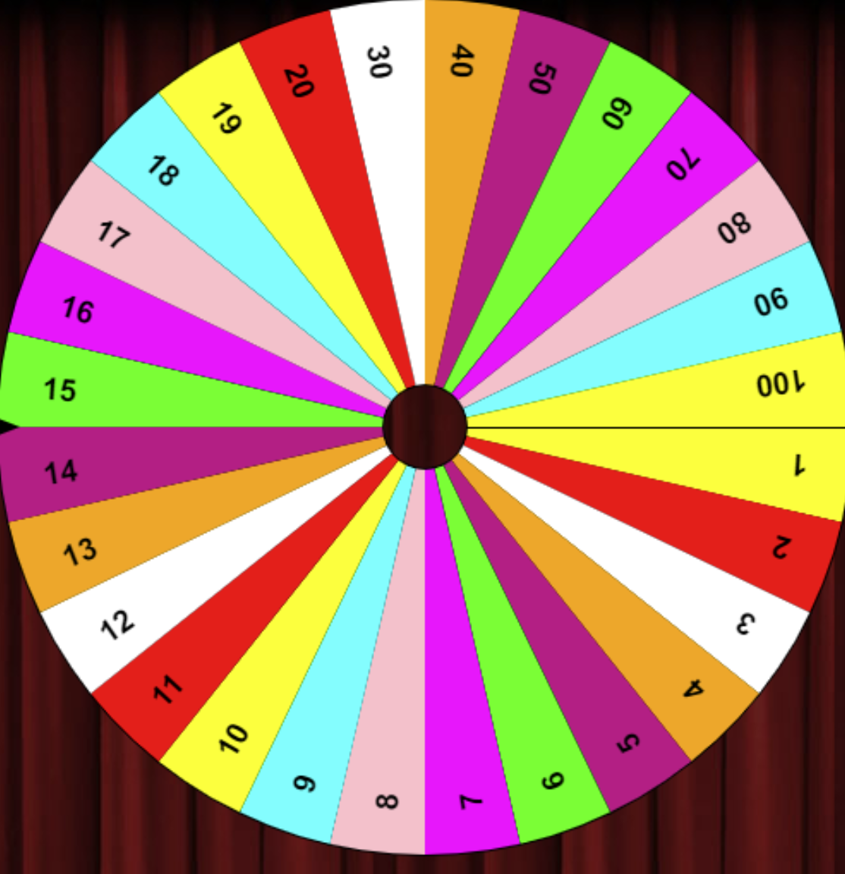
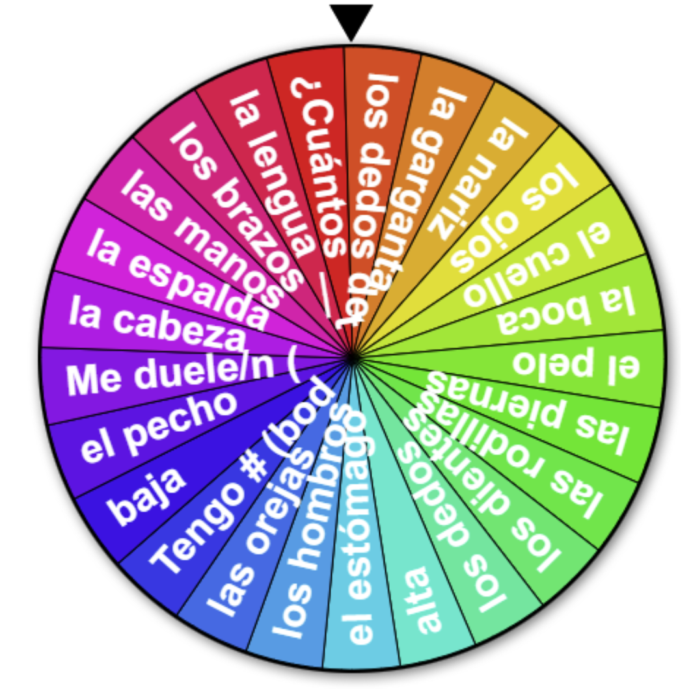
los números
¡REPASEMOS!
We are going to describe our favorite animals...so we need to recall our numbers, colors, and body parts!
Juguemos Muéstrame to show the numbers and La Maestra Dice to review the body parts!
Click to play
Click to play
15
Notes:
🍐 This is a Pear Deck Number Slide
🍐 To edit the type of question, go back to the "Ask Students a Question" in the Pear Deck sidebar.

Slide 11
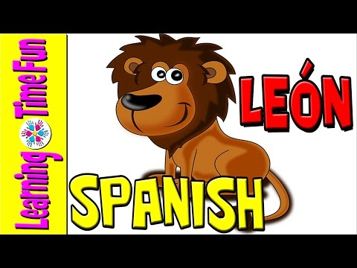
¡Miremos un video!

Slide 12
¡REPASEMOS!
We are going to describe our favorite animals...so we need to recall our numbers, colors, and body parts!
¿Qué color es?
What color is this?

Slide 13
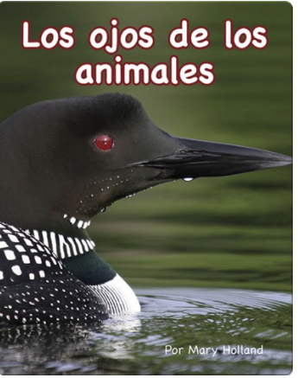

Slide 14
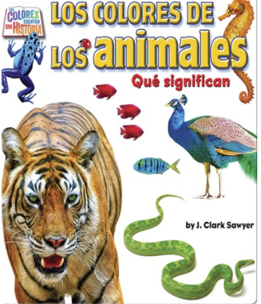

Slide 17
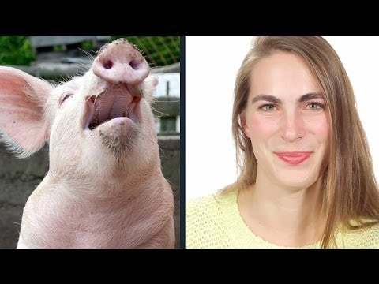
nota cultural
How do we make dog, cat, pig, horse, and cow sounds in English?
Did you know that in other countries, people make different noises? In Spain, a dow says, guau-guau, birds say pío-pío and the rooster says cu-curru-cu-cú
Why do you think that is?

Slide 18
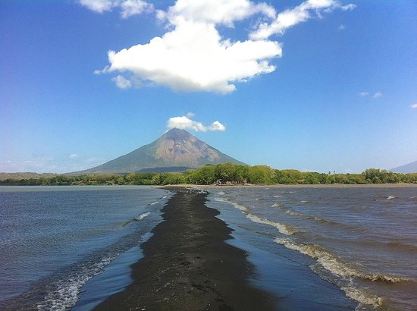
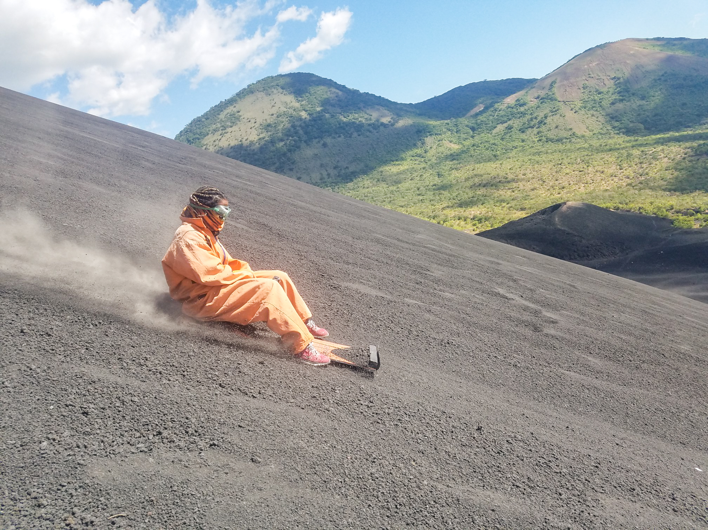
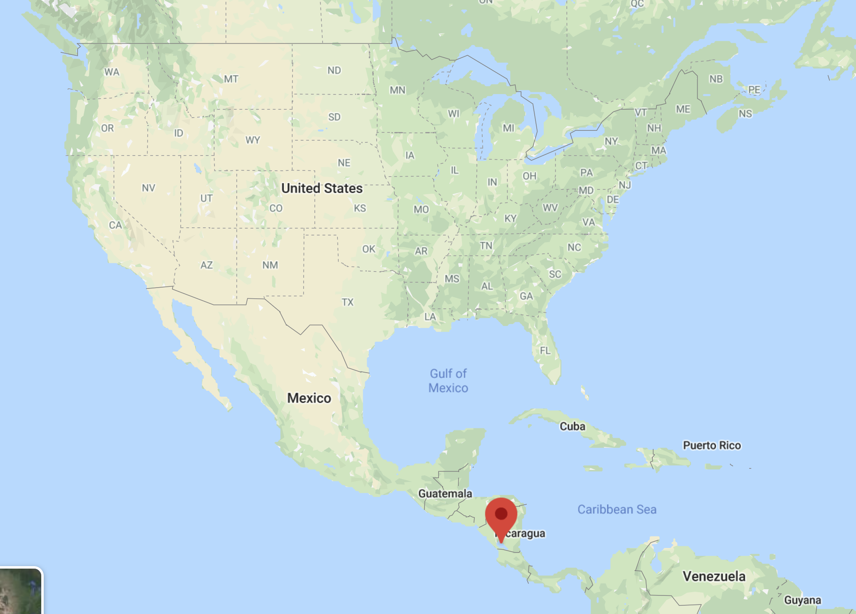
nota cultural: Nicaragua
Did you know that Nicaragua has the only freshwater lake in the world with sharks in it? The Nicaraguans call Lake Nicaragua “the sweet sea” (Colcibola) because the lake has everything that makes up the sea...except the salt! Do you know the Spanish word for shark? It also has over 400 islands...and the island Ometepe has 2 volcanoes on it!
click

Slide 19
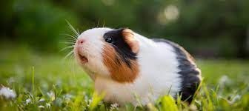
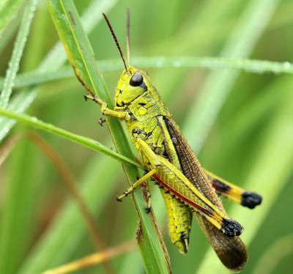
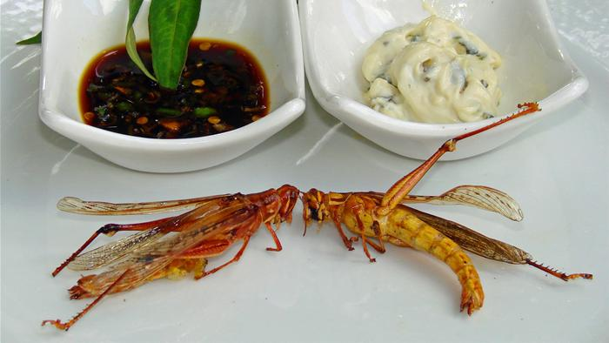
nota cultural: Weird foods
Guinea pig (cuy or conejillo de indias) is really common eaten in Ecuador, Peru, and Bolivia.
Fried grasshoppers (chapulines) are a popular treat found in markets (mercados) in Mexico.
Would you be brave enough to try these foods?

Slide 20
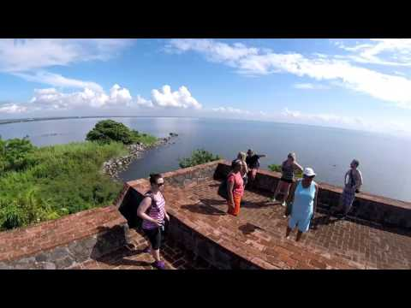
nota cultural: Nicaragua
Instrucciones: Before you watch the video, fill in the first 2 boxes of the KWL. Fill in the 3rd one after you watch the video.

Slide 21
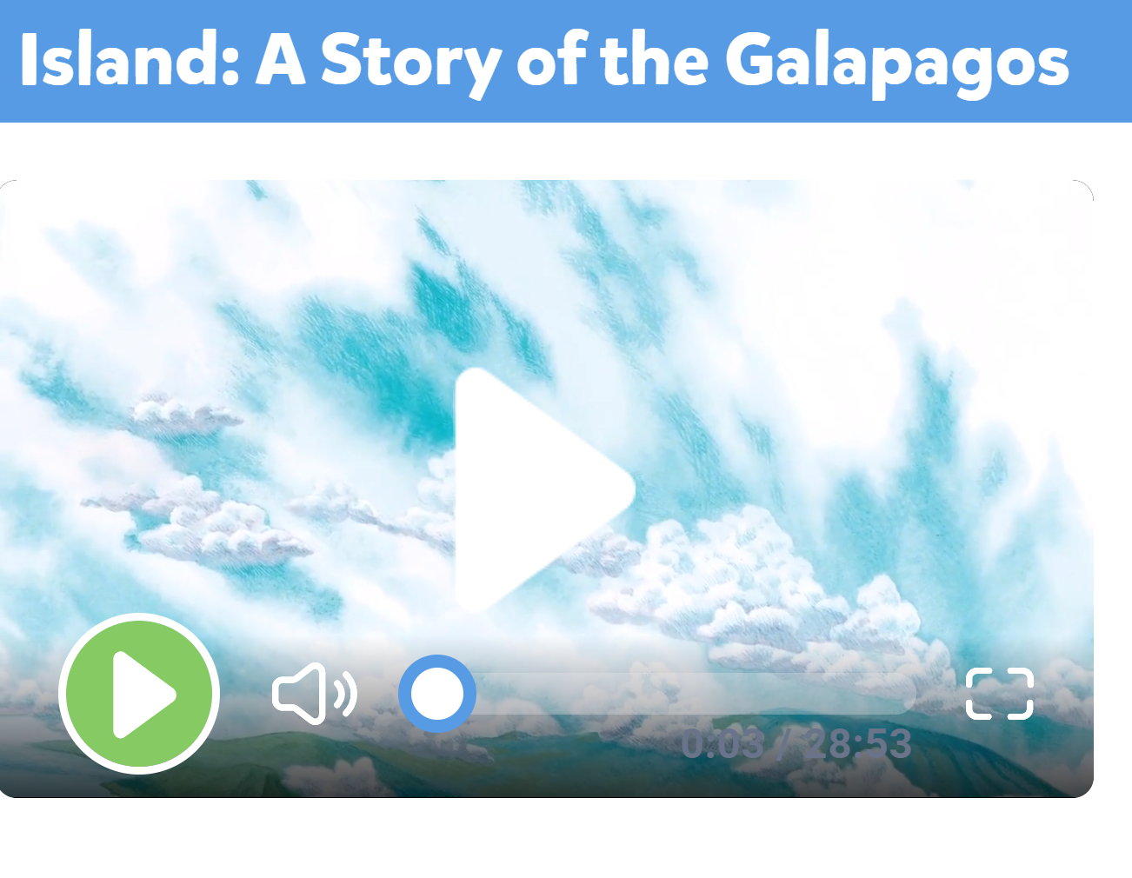

Slide 22
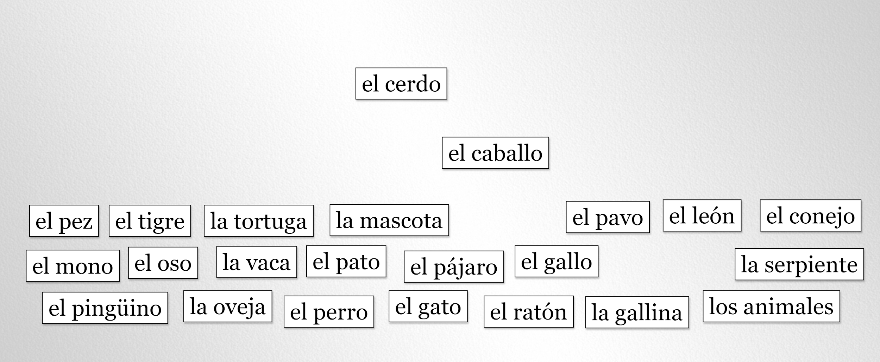
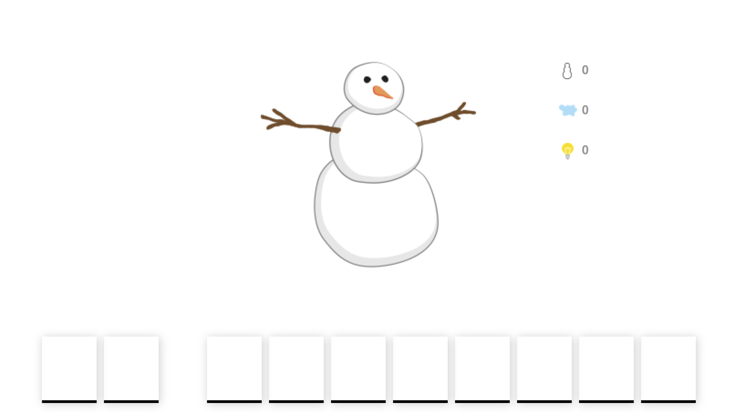
Manipulatives
Muñeco de nieve
Click to play
Click to play

Slide 23
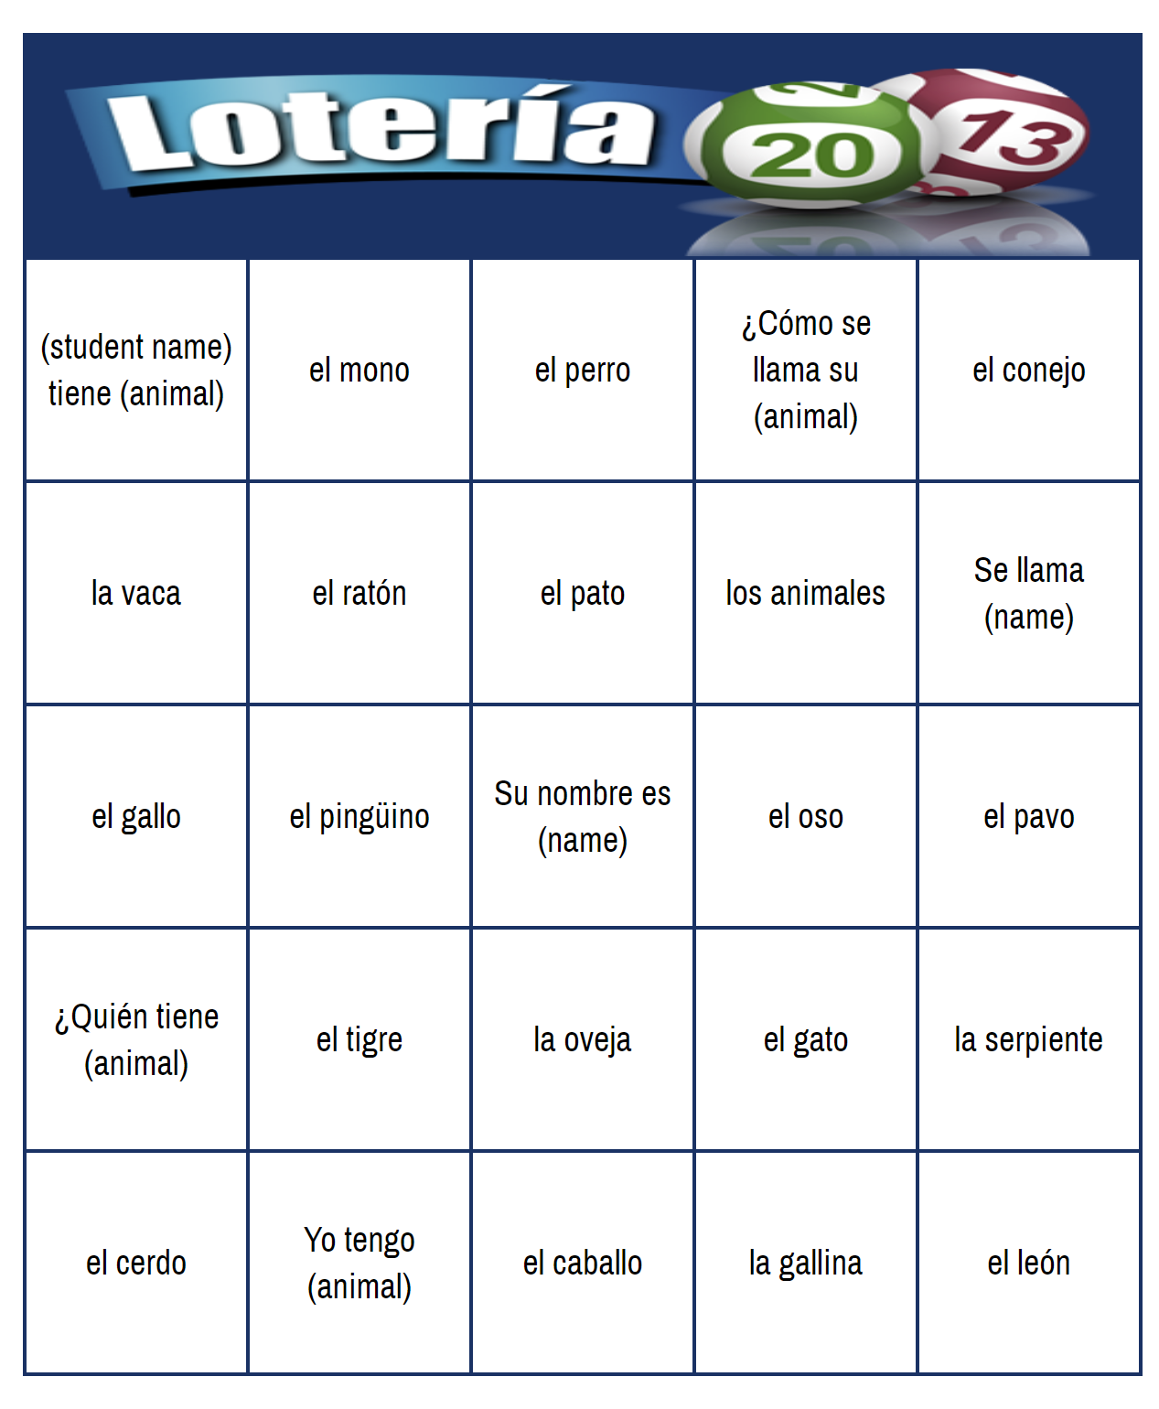
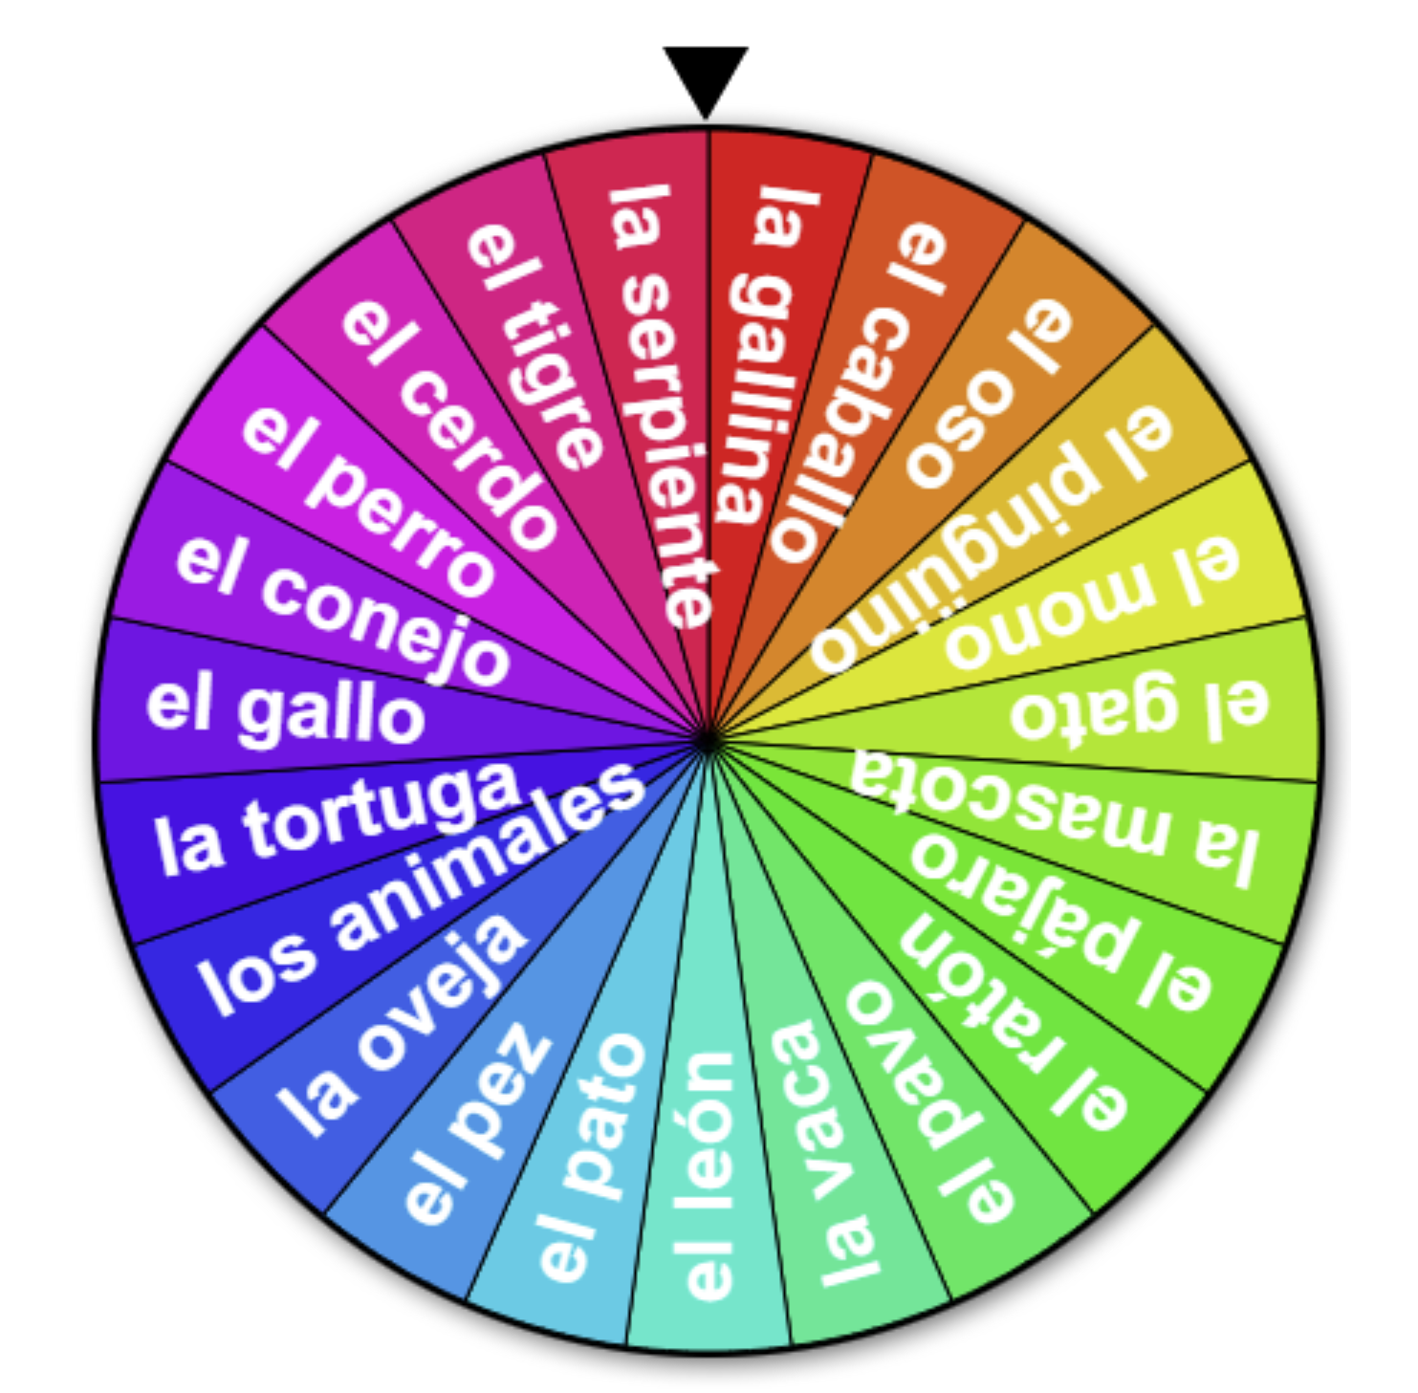
loteria
randomizer
Click to play
Click to play

Slide 24
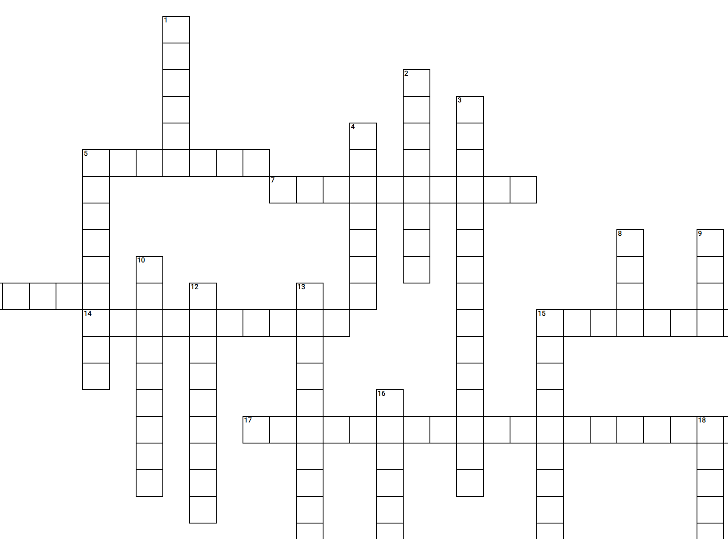
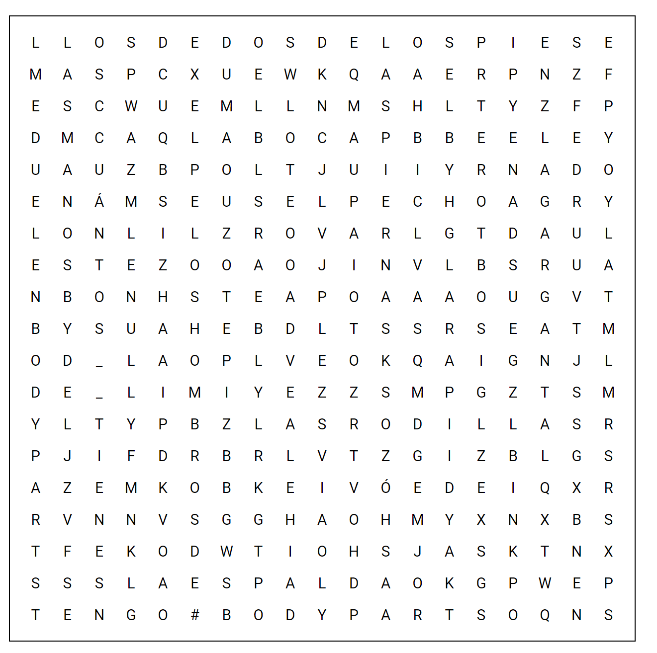
Crossword puzzle
word search
Click to download
Click to download PDF

Slide 25
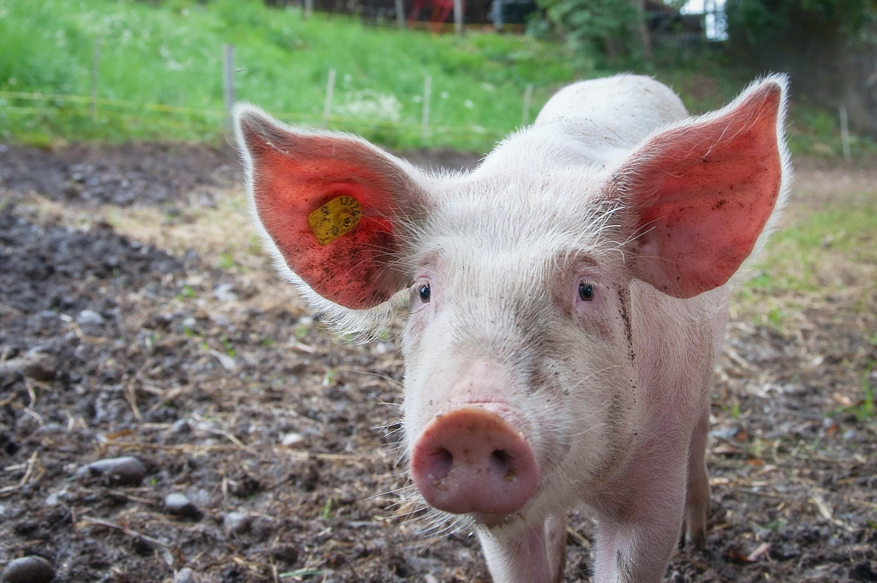
Es un ___
Tiene ___ piernas
Es el color ____

Slide 26
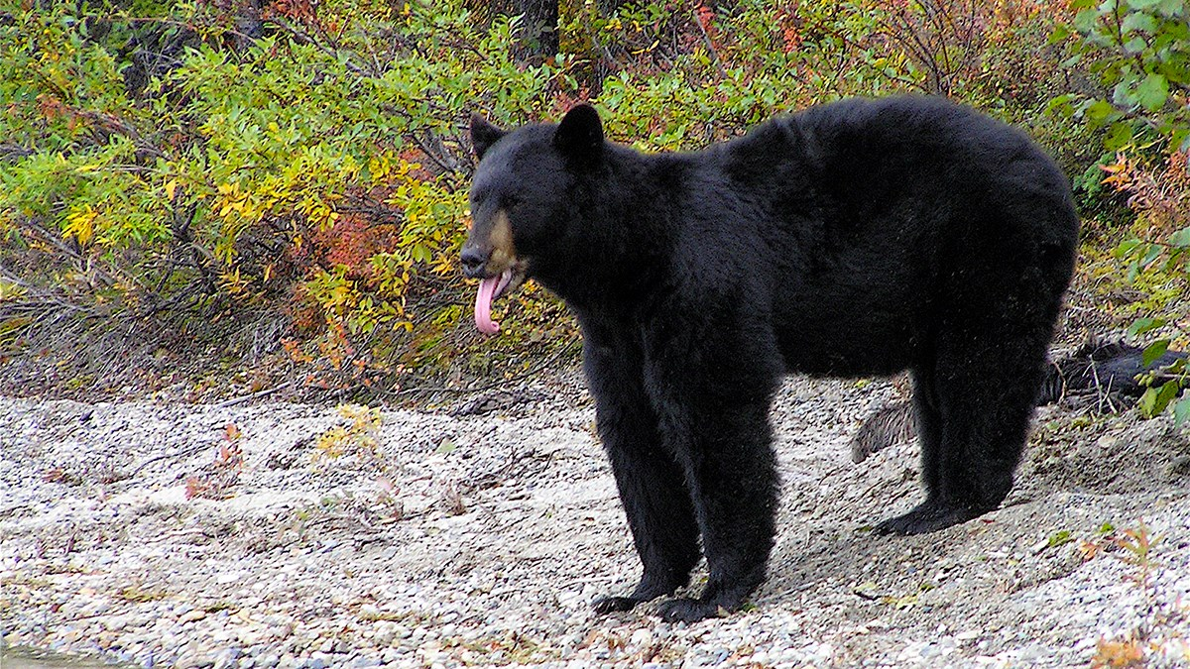
Es un ___
Tiene ___ piernas
Es el color ____

Slide 27
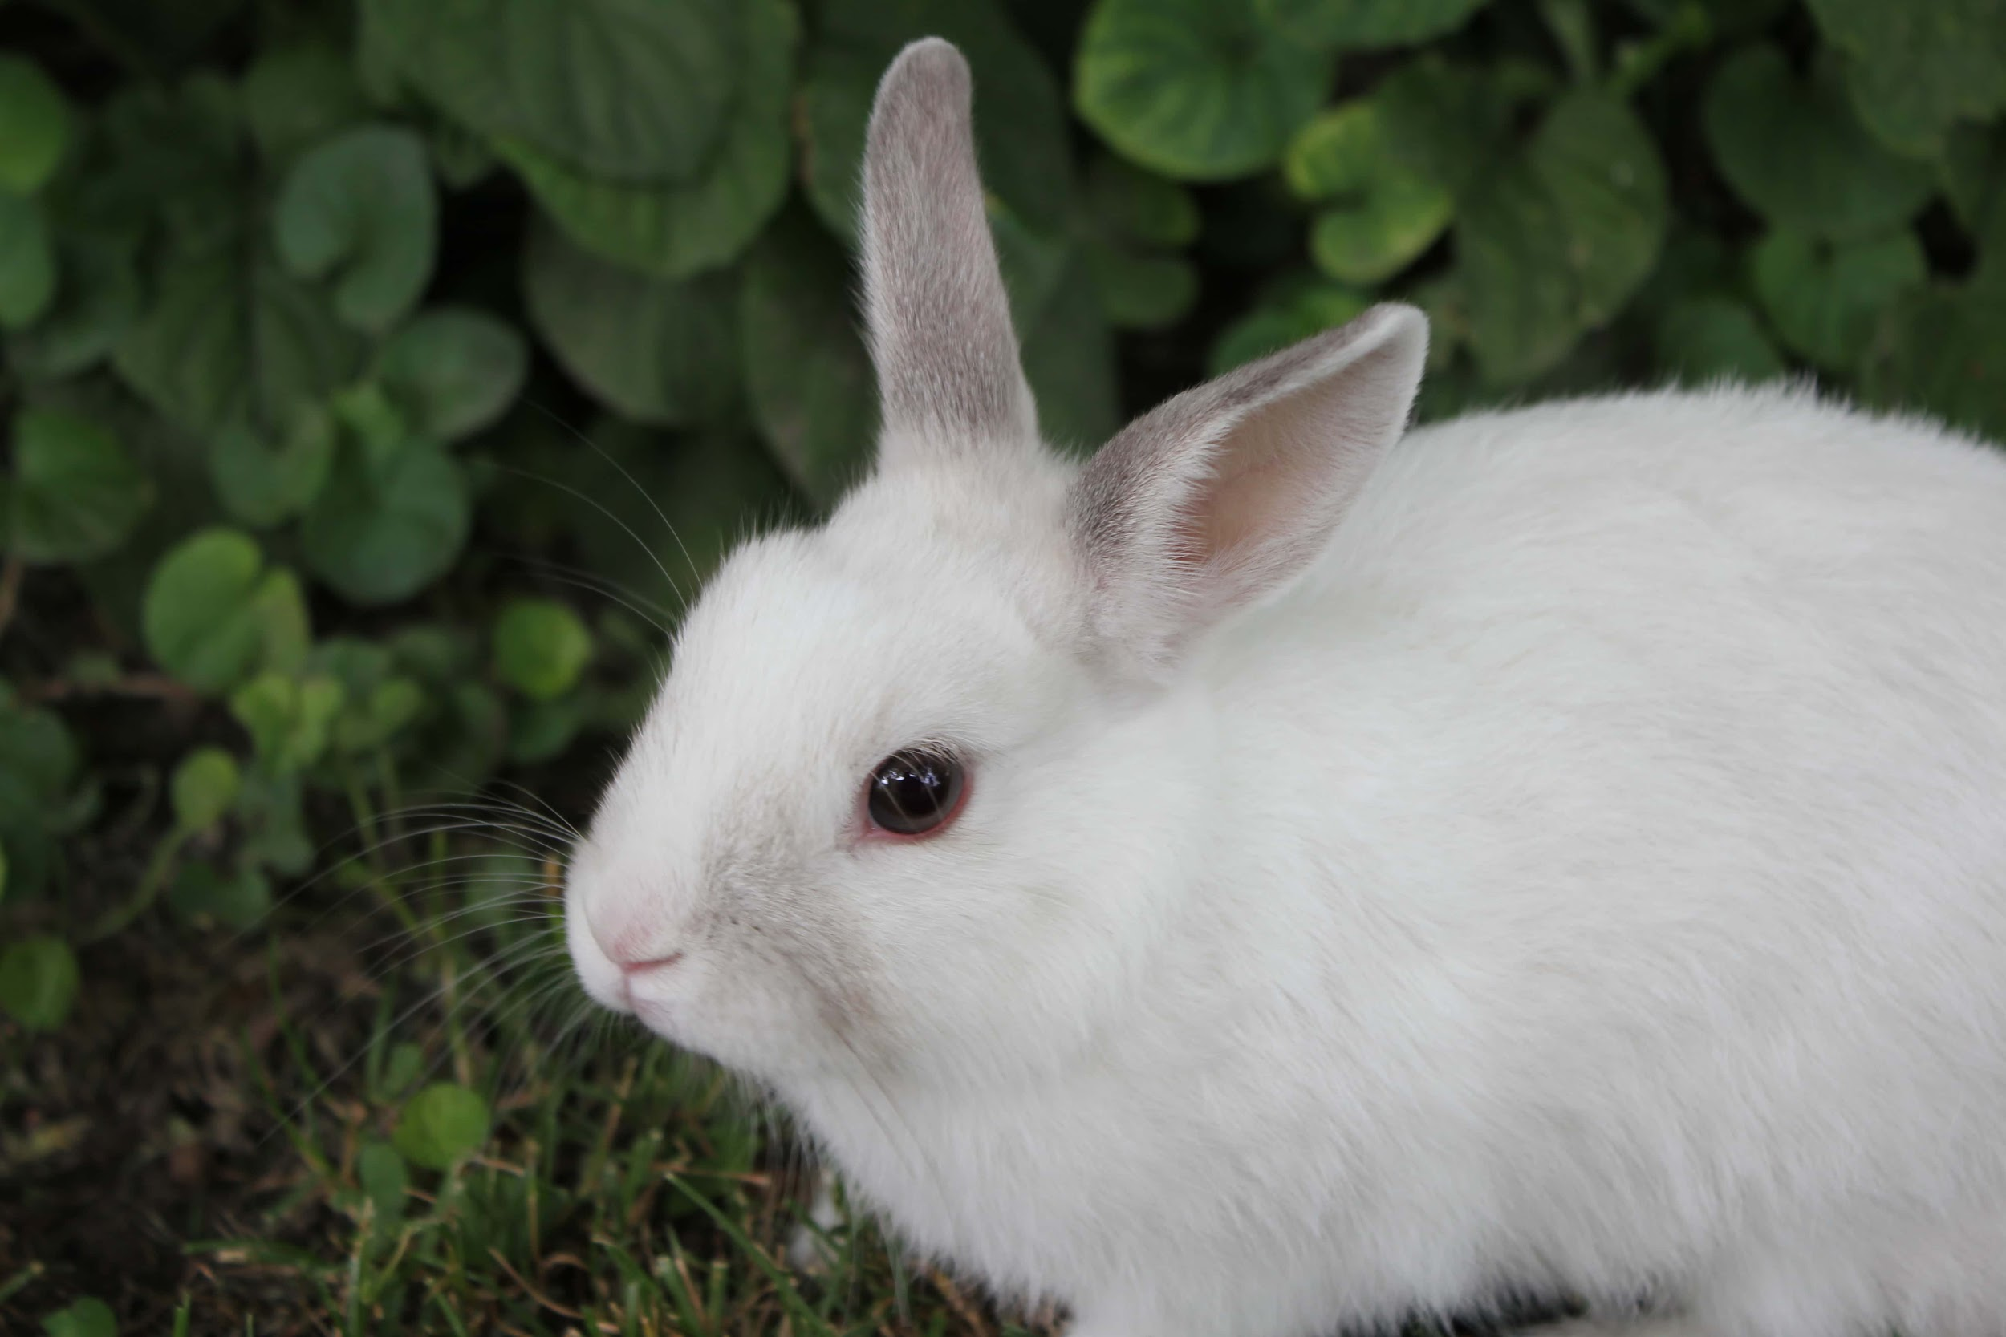
Es un ___
Tiene ___ piernas
Es el color ____

Slide 28
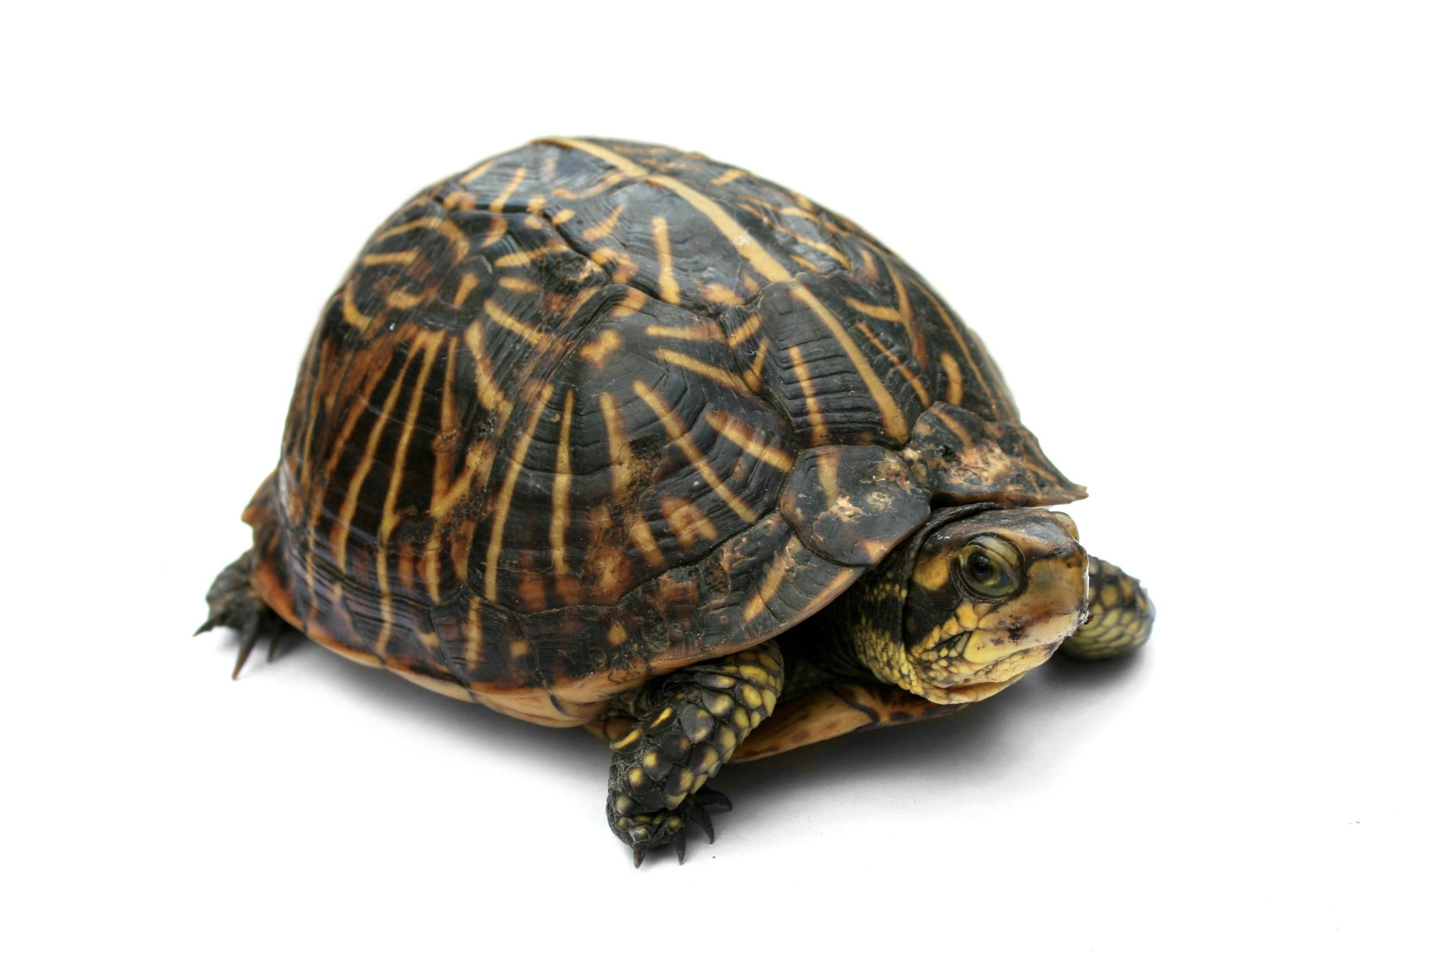
Es un ___
Tiene ___ piernas
Es el color ____

Slide 29
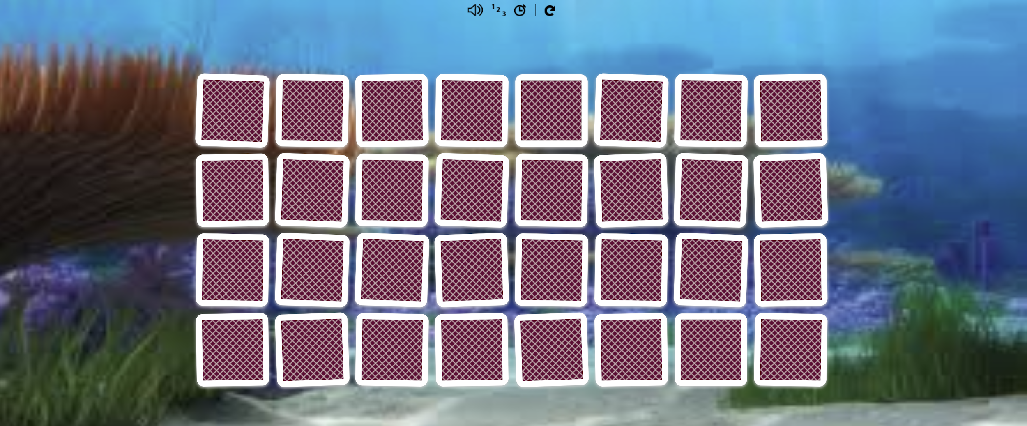
juguemos memoría
Instrucciones: Click on the image to play memory with our vocabulary. Turn the volume up so you can hear the correct pronunciation of the words!
Click to play

Slide 30
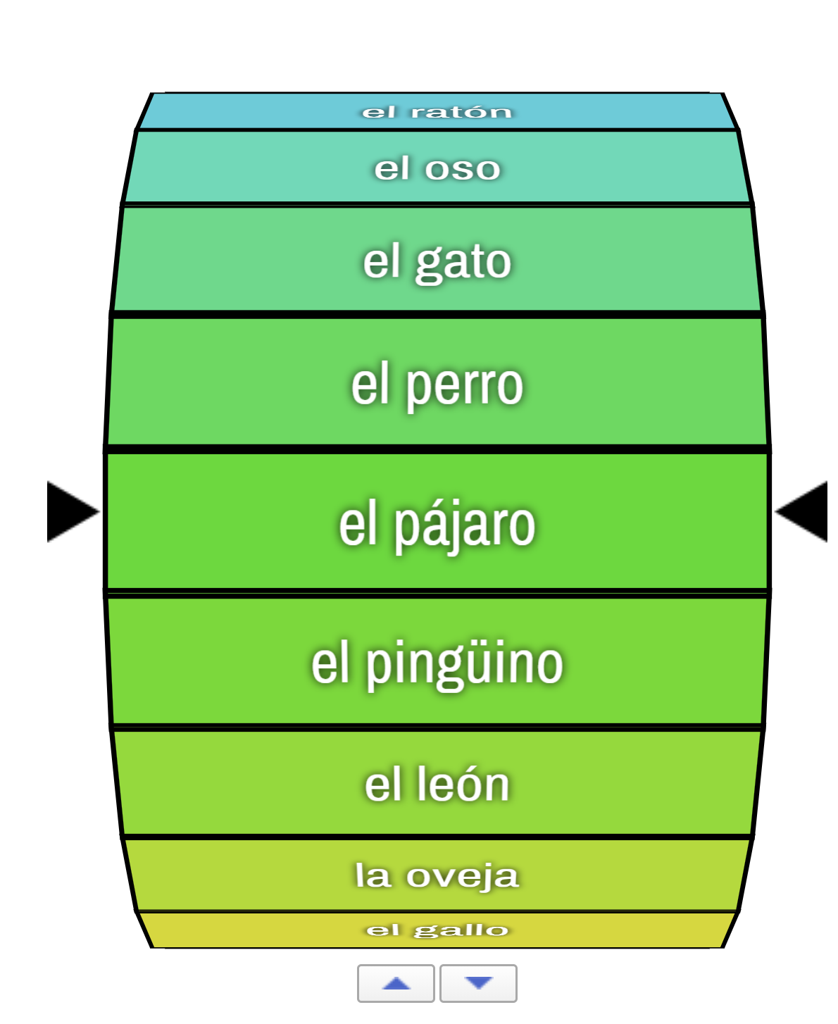
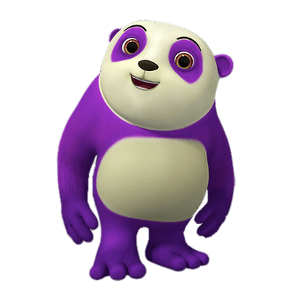
randomizer wheel
¡Juguemos!
Instrucciones: Charades time! I’ll call out an animal in Español and you will act it out and make the noises!
Click to play

Slide 31
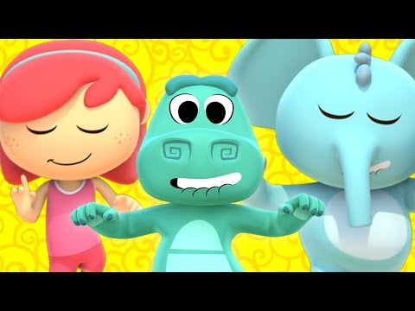
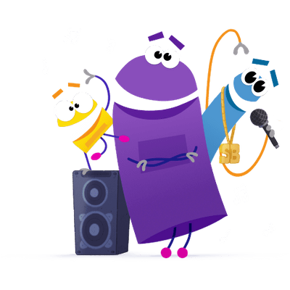
bailemos
Stand up and let’s do the gestures and have a lip sync battle!
Click to listen

Slide 32
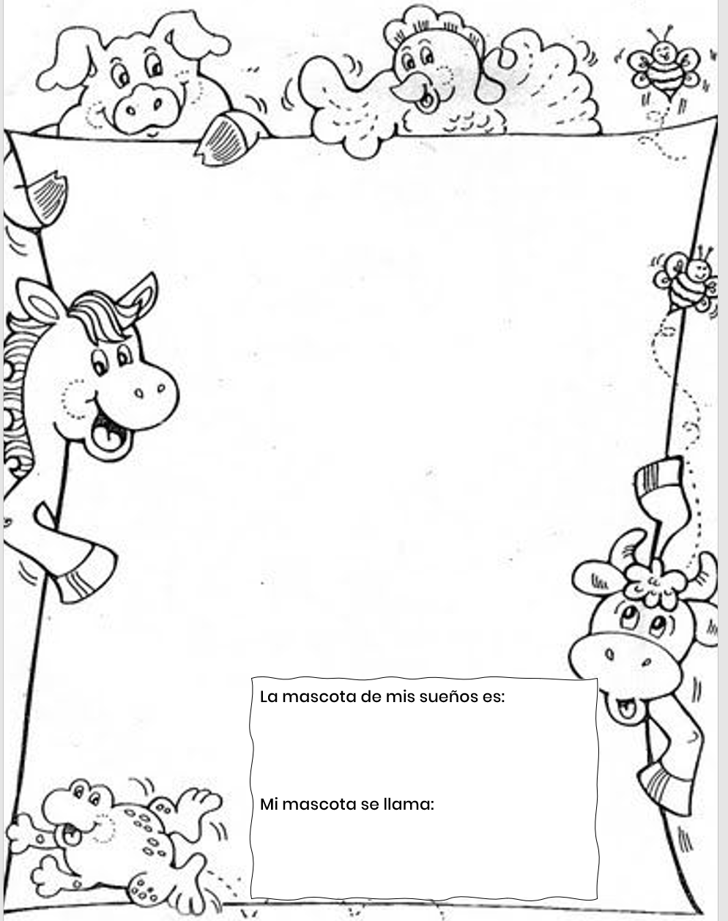
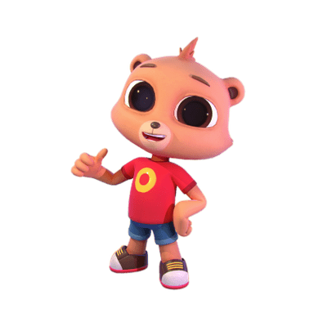
la mascota de tus sueños
If you could have any animal as a pet, what would it be? You get to draw and name your pet in this activity!
Make sure you
say the type of
animal in Español!
Click to download PDF

Slide 33
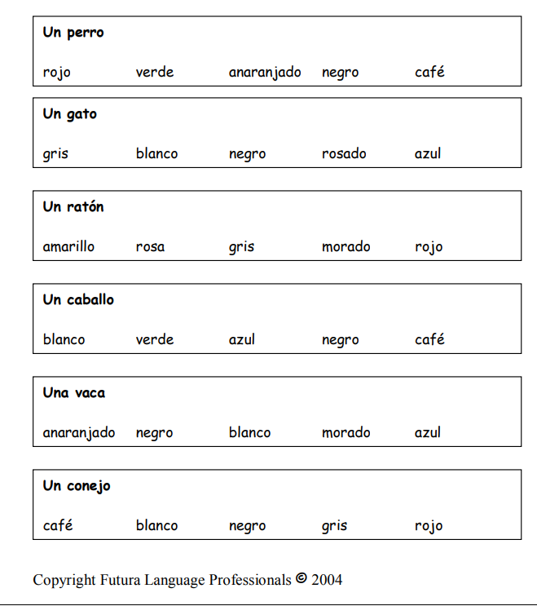
los animales y los colores
Instrucciones: Drag an X over the colors each animal cannot be.
Click to download PDF

Slide 34
Click to download PDF

Slide 35
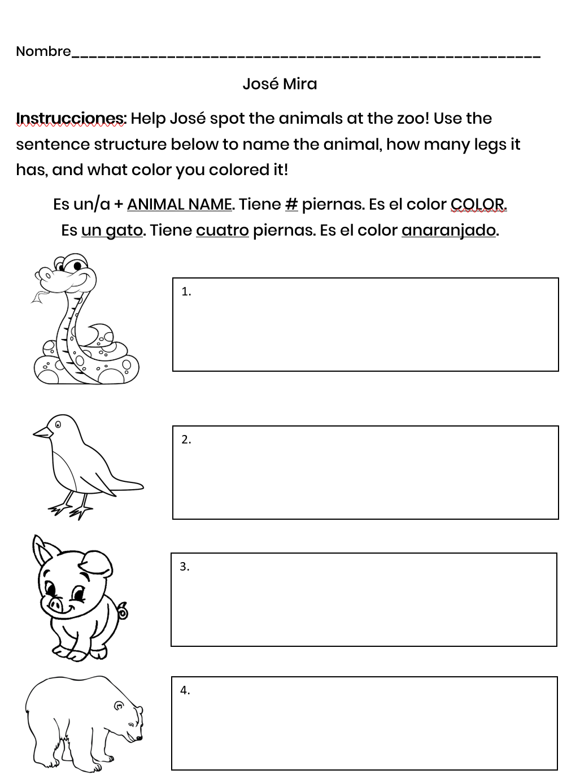
Click to download PDF
¡josé mira!
Instrucciones: José loves animals. Help him spot them at the zoo! Name the animal and how many legs it has

Slide 36
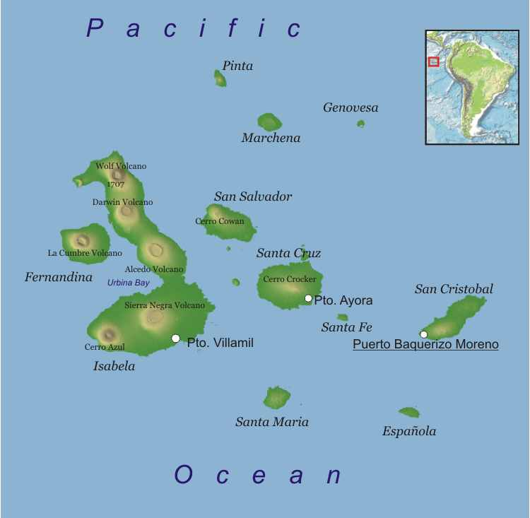
They are right off the coast of Ecuador!
There are many animals on the islands that don’t exist anywhere else in the world!
La familia martinez visita los galápagos
BY: brita kuhrmeirer
The Martinez Family loves los animales. So, the Galápagos Islands are a perfect place for them to visit.
Do you know where they Galápagos Islands are?

Slide 37
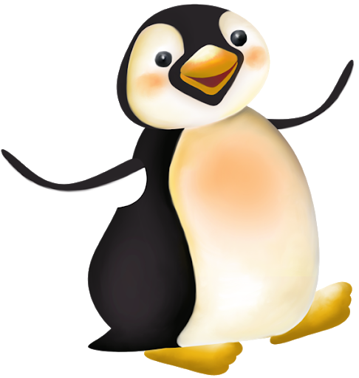
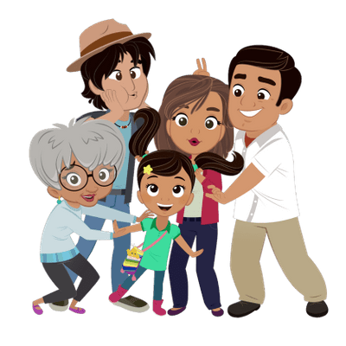
¿De qué color es el pingüino?
Did you guess blanco, negro y anaranjado?
Little Josefina loves los animales that live by the sea, so the family visits the beach first.
Guess what animal she sees!
¡Un pingüino!

Slide 38
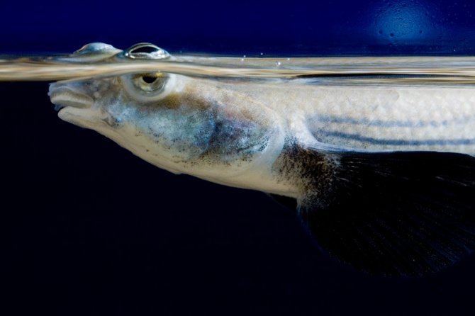
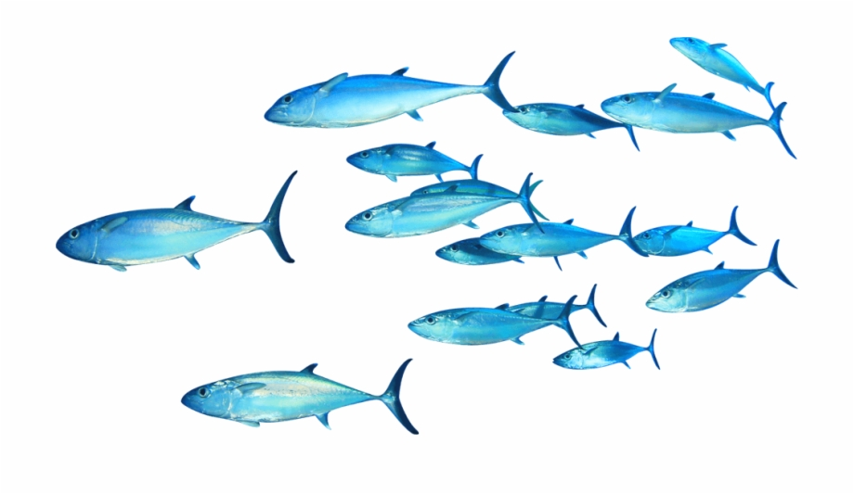
There is a pez en Los Galápagos que tiene cuatro ojos! Do you remember what los ojos son?
Did you know there are 450 kinds of peces that live in the Galápagos?
¿Cuántos peces hay aquí?

Slide 39
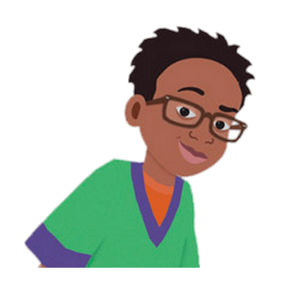
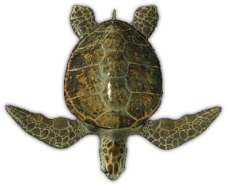
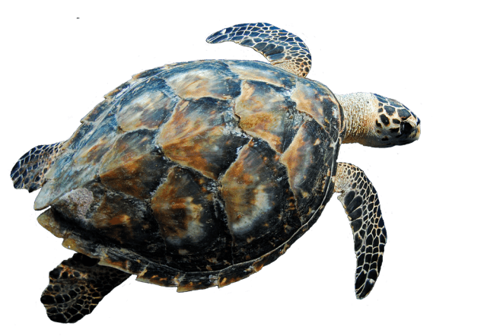
You are correcto! Es una tortuga.
On the Galápagos Islands, there are only tortugas verdes. La tortuga gigante pesa 500 libras!
Carlitos likes los animales that lives in the water and on the land. ¿Cuál es el animal favorito de Carlitos?

Slide 40
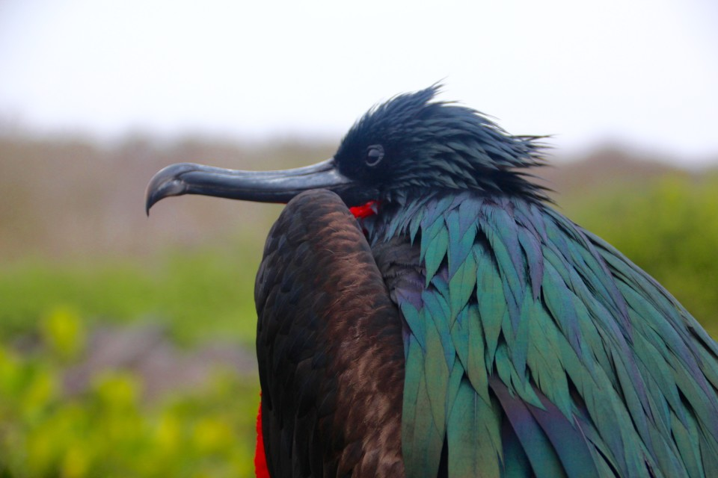
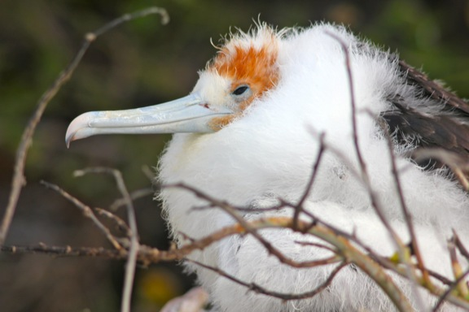
¿Cuántos tipos de pájaros hay aquí?
Señora Martínez loves watching los pájaros. There are veintidós tipos de pájaros that live on the Galápagos and nowhere else on earth!

Slide 41
¡Si! Es un serpiente. ¿Te gustan los serpientes?
La Familia Martínez had a great time in Los Galápagos. Did you?
What did they see? Tell me in Español!
Si, hay cinco! ¡Cuántos más nos faltan? Hint:
Veintidós menos cinco son
There is only 1 animal que le gusta Señor Martínez.
Can you guess what that is?

