Slide 1
REFUERZO DE ESPAÑOL PARA PRINCIPIANTES
Beginner Spanish Boost
Summer Course. Day 2

Slide 2
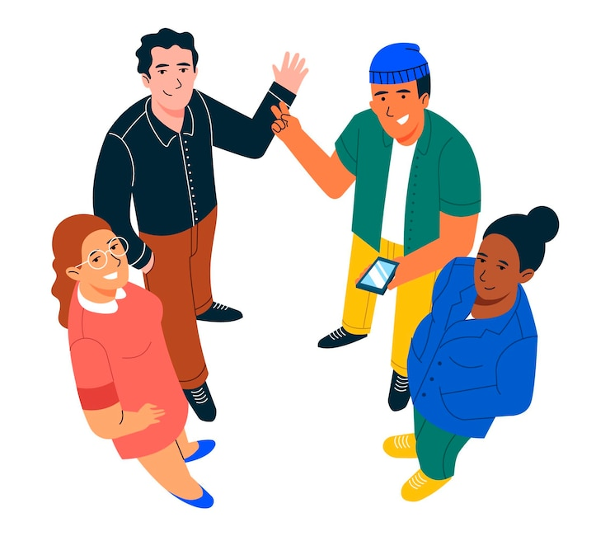
¡A romper el hielo! Icebreaker
Please tell us:
¿Cómo te llamas? What is your name?
¿Cómo estás? How are you?
¿Dónde vives? Where do you live?
¿Dónde trabajas? Where do you work?

Slide 3
¡A romper el hielo! Icebreaker
Me llamo_____.My name is_________.
Estoy________. (bien, mal, más o menos)
I am ________. (fine, bad, okay, so so)
Trabajo en_____. I live in___________.
Vivo en_____. I work in___________.

Slide 4
#1. PRONOMBRES PERSONALES
SINGULAR
yo | I
tú | you (informal)
él Ella usted | he she you (formal)
PLURAL
nosotros | we
vosotros | you all (informal)
ellos ellas ustedes | they (masc/mix) they (feminine) you all (formal)

Slide 5
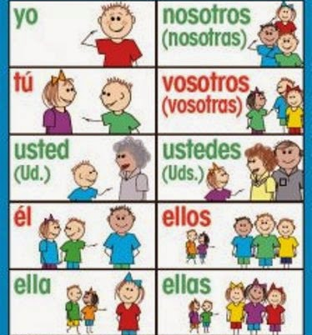
NOTAS IMPORTANTES
“Yo,” the word for “I,” is only capitalized at the beginning of a sentence.
Tú (You informal) is used for people you have confidence in or your same age.
Usted (You Formal) for people older than you or to show respect (your doctor, a priest, your boss, etc.)
Ellos could include all males or a mixture of males and females.
Ellas only includes all females.
The “vosotros” form is only used in Spain. Everywhere else, the ustedes form is used for formal or informal “you all.”

Slide 6
¡PRACTIQUEMOS! Written practice.
Richard and Becky
Myself
Sophia & me
John & Paul
Your sister
Gloria & Susan
ellos
yo
nosotros /nosotras
ellos
ella
ellas

Slide 7
#2. EL VERBO SER

Slide 8
CONJUGACIONES DEL VERBO SER
Verb TO BE conjugations
SINGULAR
PLURAL
yo soy – I am
tú eres – you are (informal)
él es – he is
ella es – she is
usted es – you are (formal)
nosotros somos – we are
vosotros sois – you all are(informal)
ellos son – they are (male/mix)
ellas son – they are (female)
ustedes – you all are (formal)

Slide 9
USES of SER /TO BE

Slide 10
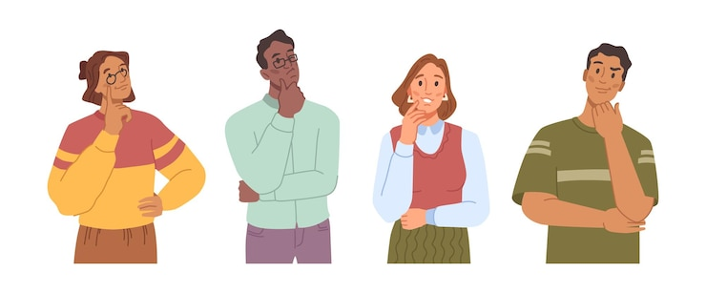
WHOLE CLASS ACTIVITY!
Fill in the blanks with the correct SER conjugation. Then, write in the chart the correct use of SER. Use the acronym DOCTOR as reference.

Slide 11
Tú eres americano. / You are American.
Josh y Frank son altos. / They are tall.
Karen es tímida. / Karen is shy.
Vosotros sóis rubios. / You all are blond.
O-ORIGIN
D- DESCRIPTION (physical)
C- CHARACTERISTICS (personality)
D- DESCRIPTION (physical)

Slide 12
5. James es atlético. / James is athletic.
6. Sarah y Karla son de Perú. / They are from Peru.
7. Ustedes son amables. / You are kind.
8. Nosotros somos de los Estados Unidos. / We are from the United States.
D- DESCRIPTION (physical)
O-ORIGIN
C- CHARACTERISTICS (personality)
O-ORIGIN

Slide 13
#3. ADJECTIVES
Adjectives for males will end with an O. Example: alto, tímido.
Adjectives for females will end with an A. Example: alta, tímida.
There are also neutral adjectives that can be used for both boys and girls. *They have been marked down for you on the following chart with an asterisk (*)

Slide 14
D-Description (physical characteristics) |  | C-Character (personality)
ADJETIVOS | ADJECTIVES | ADJETIVOS | ADJECTIVES
alto/a | tall | amable* | kind
mediano/a | medium /average height | antipático/a | unfriendly
bajo/a | short | interesante* | interesting
moreno/a | brunette | aburrido/a | boring
rubio/a | blond | extrovertido/a | outgoing
pelirrojo/a | red-haired | tímido/a | shy
canoso/a | gray-haired | alegre* | happy
bonito/a | pretty | enojón/a | grumpy
hermoso/a | beautiful | aventurero/a | adventurous
guapo/a | handsome | generoso/a | generous
feo/a | ugly | tacaño/a | stingy

Slide 15
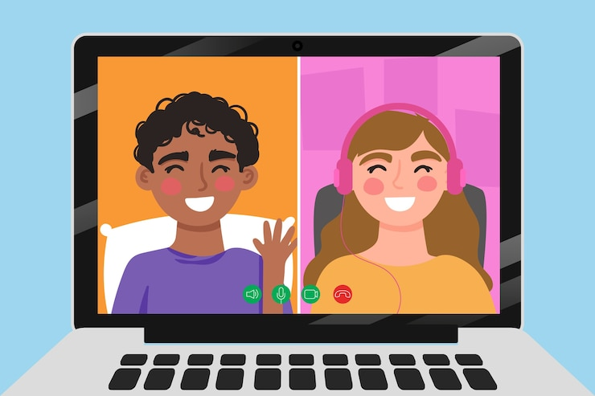
¡Vamos a Conversar!
Let’s go over the partner conversation before we go to breakout rooms!

Slide 16
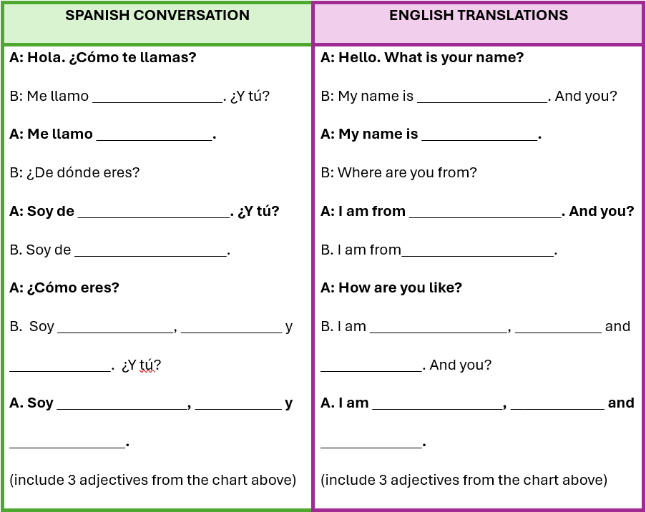

Slide 17
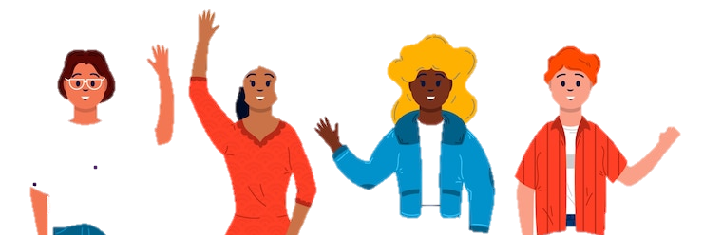
¡Hasta la vista!
¡Hasta pronto!
adiós
¡Cuídate!
¡Que te vaya bien!
¡Nos vemos!
¡Hasta la próxima!

