Slide 1
Español para Viajar Spanish for Travel
Summer Course. Day 4 –Final Class

Slide 2
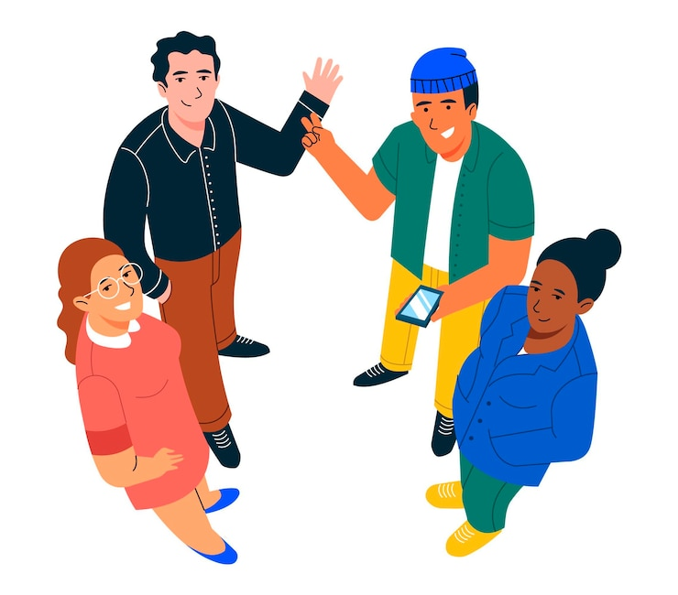
¡A romper el hielo! Icebreaker
Please tell us:
¿Qué te gustaría comer ahora? What would you like to eat just now?
Menciona 2 elementos que necesitas poner en la mesa.
Mention 2 elements that you need for setting up a table before eating.

Slide 3
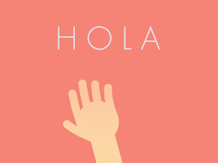
¡A romper el hielo! Icebreaker
Me gustaría comer_____.
I would like to eat_________.
el bistec
el pollo
la ensalada
el postre
la merienda
Necesito______ y ______. I need___________ and ____________.
el plato
el cuchillo
el tenedor
la cuchara
la servilleta

Slide 4
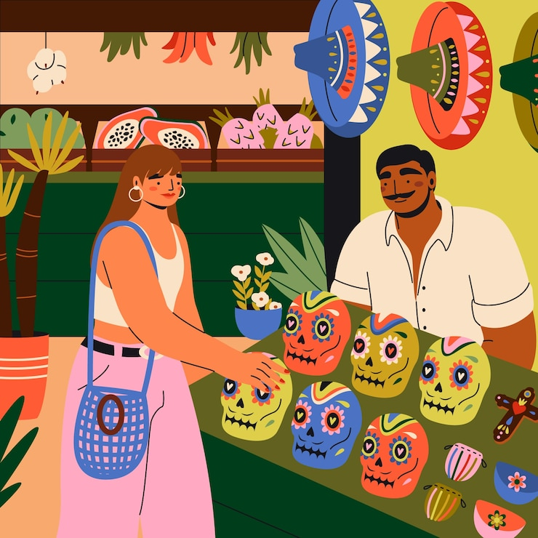
LAS COMPRAS VOCABULARY

Slide 5
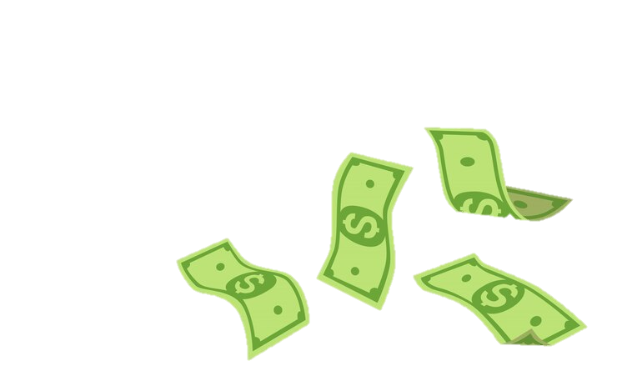
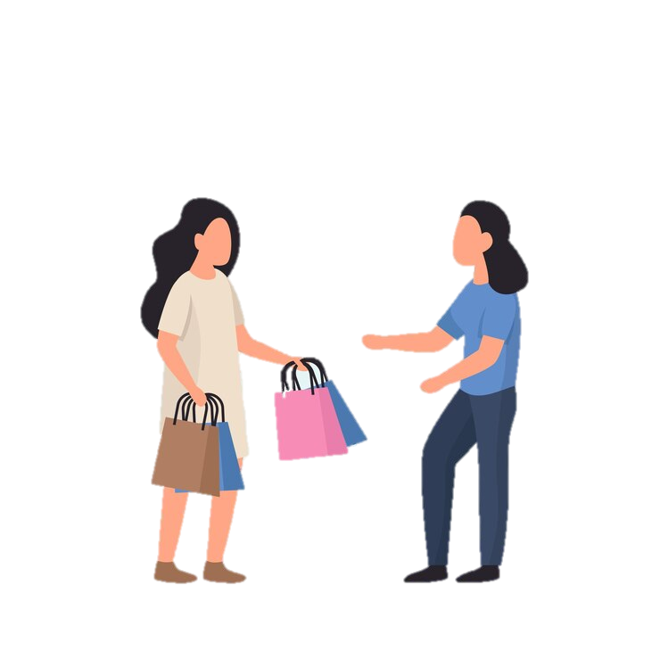
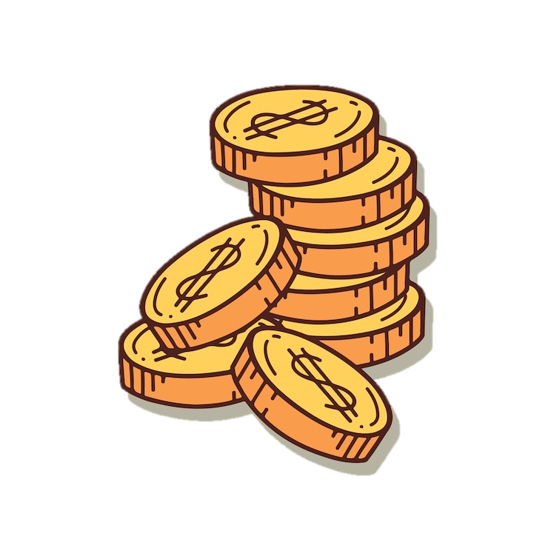
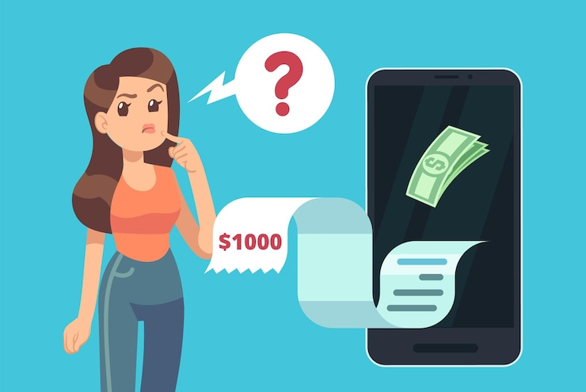
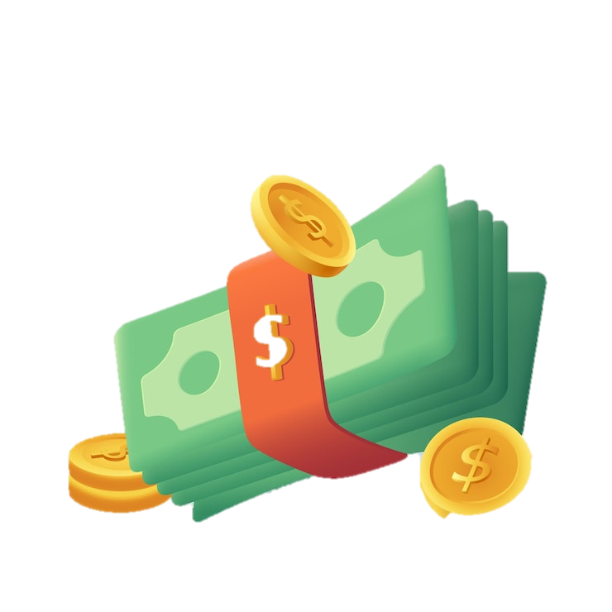
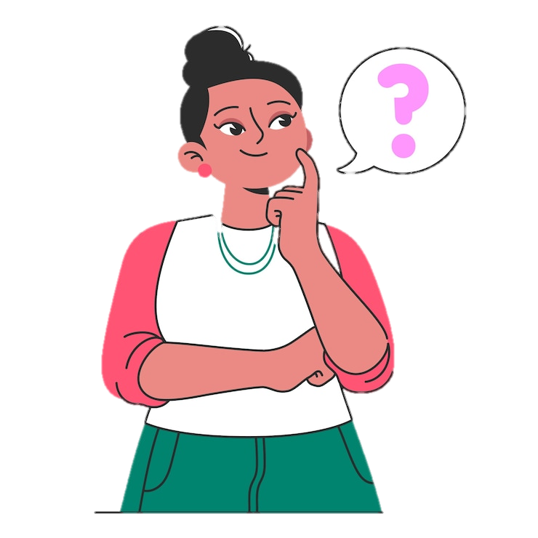
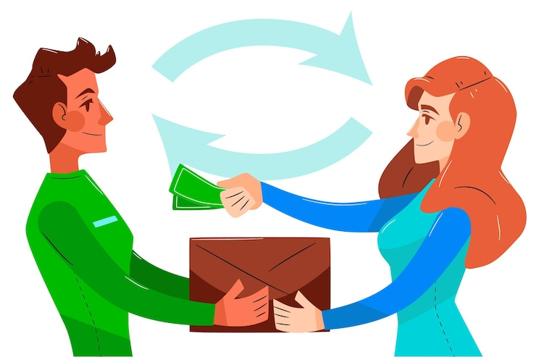
¿Cuánto cuesta…? | How much is…?
Quiero… | I want…
¿Tienes…? | Do you have…?
Necesito…. | I need…
el dinero | money
el efectivo | cash
los dólares | dollars
los centavos | cents
el cambio /el vuelto | change
el banco | bank

Slide 6
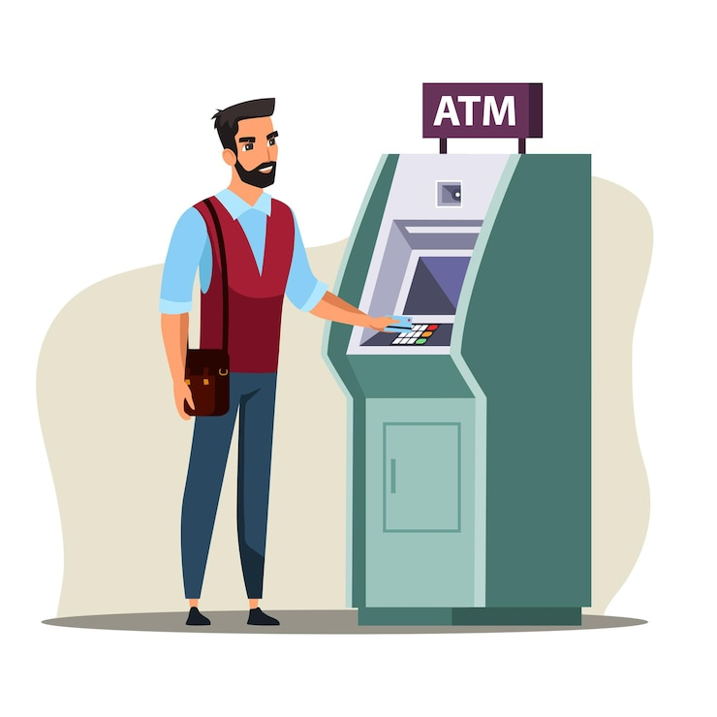
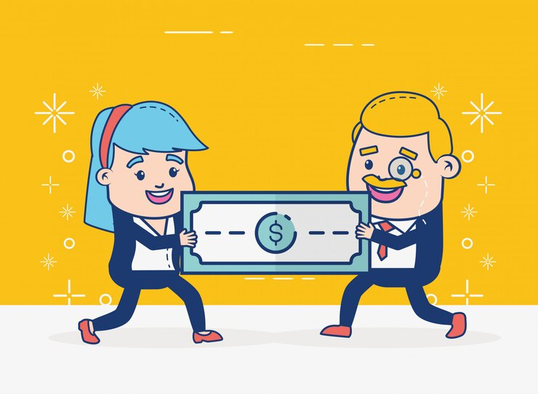
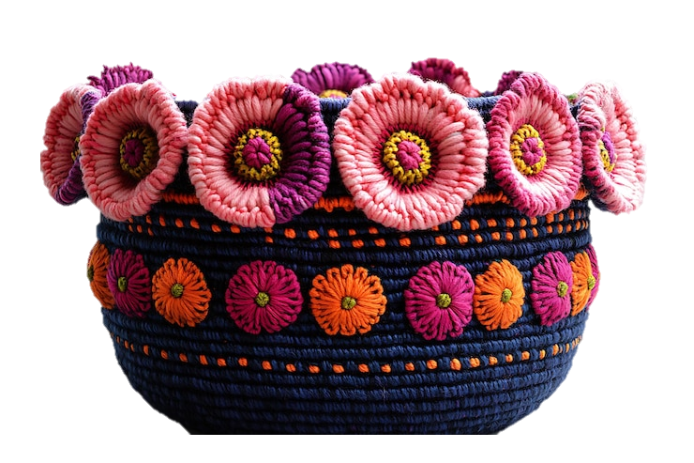
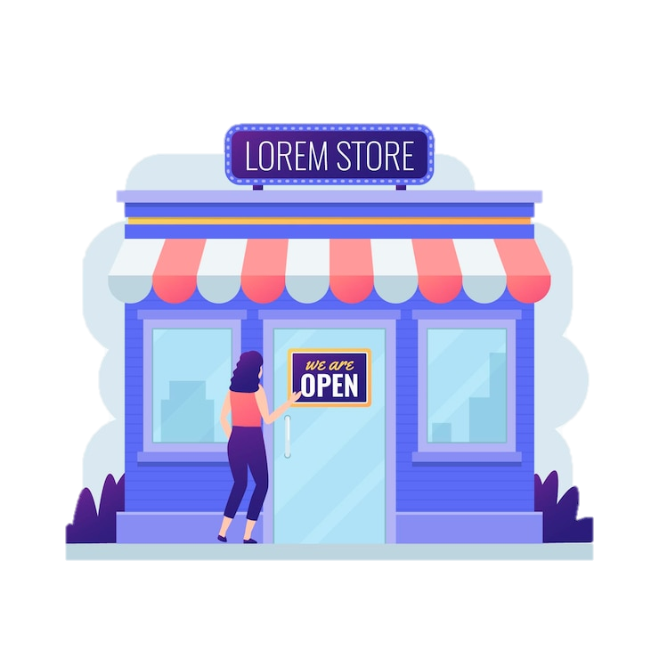
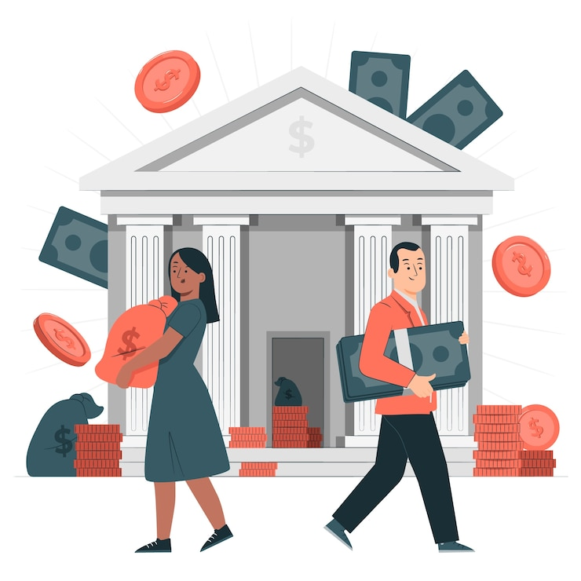
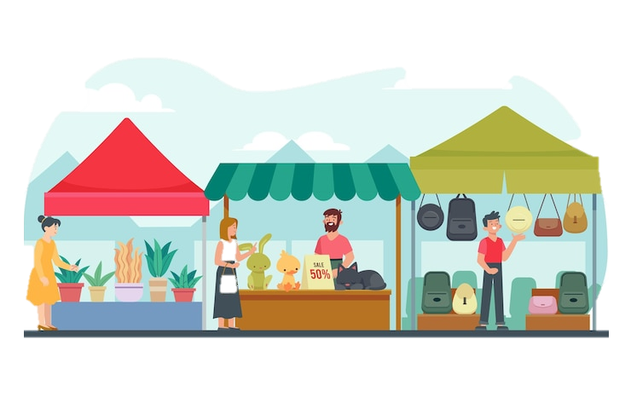
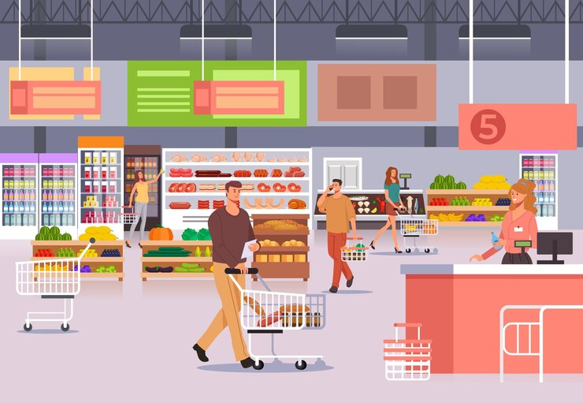
la casa de cambio | exchange bank
cambiar ($) | to exchange ($)
el precio | price
el cajero automático | the ATM
el mercado | market
la tienda | store
el supermercado | supermarket /grocery store
el recuerdo /un recuerdito | souvenir / a souvenir
la artesanía | crafts/handicraft

Slide 7
¡PRACTIQUEMOS! Written practice.
Do you have cash? ______________________________________________________________
I need dollars and cents. ______________________________________________________________
How much does the souvenir cost? ______________________________________________________________
I want to go to the market. ______________________________________________________________
I need the bank or the ATM. ______________________________________________________________
¿Tienes efectivo?
Necesito dólares y centavos.
¿Cuánto cuesta el recuerdito?
Quiero ir al mercado.
Necesito el banco o el cajero automático.

Slide 8
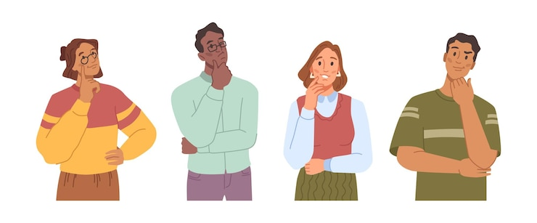
WHOLE CLASS ACTIVITY!
~ La Ruleta Adivinadora –Randomizer Wheel!
Let’s review the shopping vocabulary learned! Please share your answers using lots of Spanish!
Notes:
Screen share the randomizer provided in your lesson plan.

Slide 9
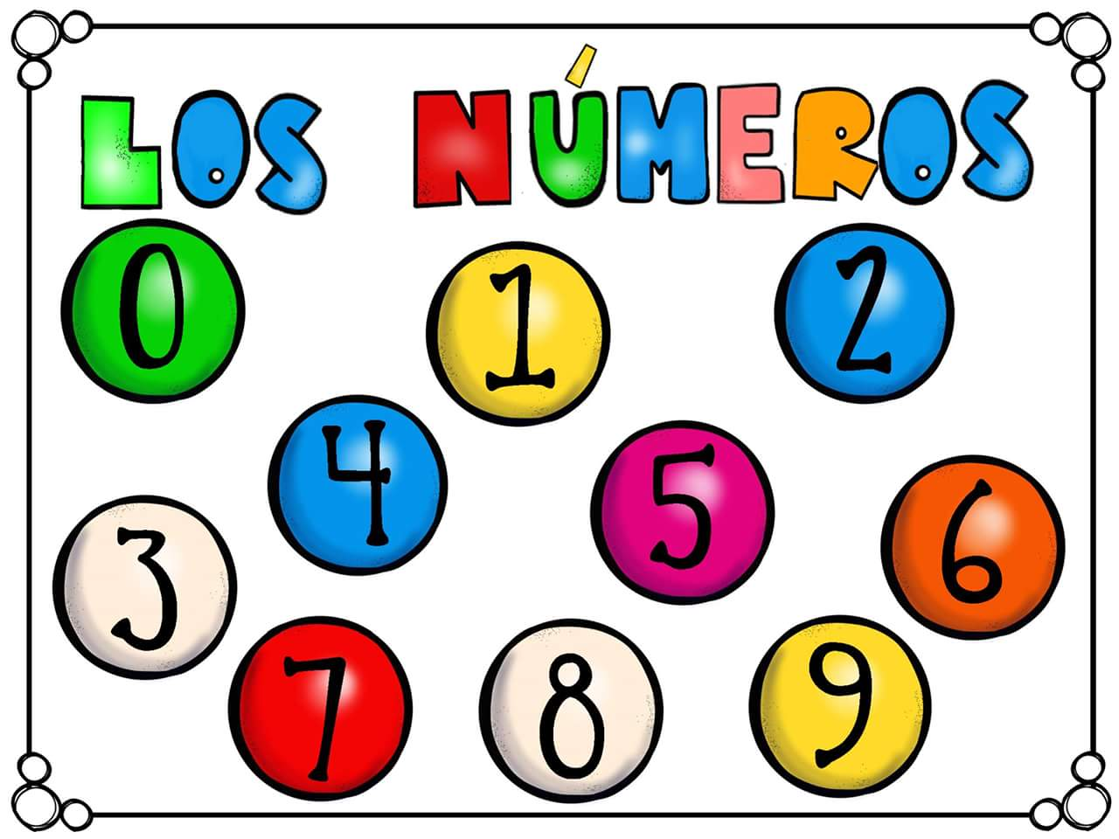
SPANISH NUMBERS

Slide 10
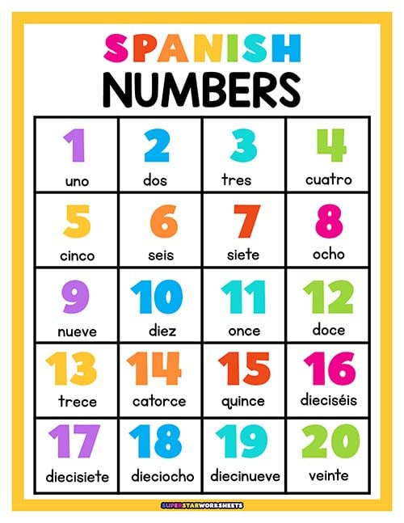

Slide 11
30
treinta
50
cincuenta
10
diez
70
setenta
20
veinte
40
cuarenta
60
sesenta
80
ochenta
90
noventa
100 CIEN

Slide 12
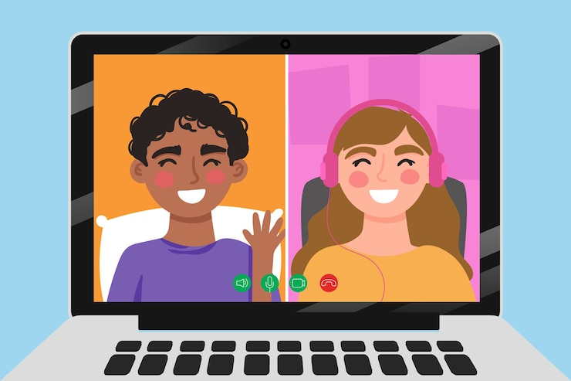
¡Vamos a Conversar!
Let’s go over the group conversation before we split into breakout rooms!

Slide 13
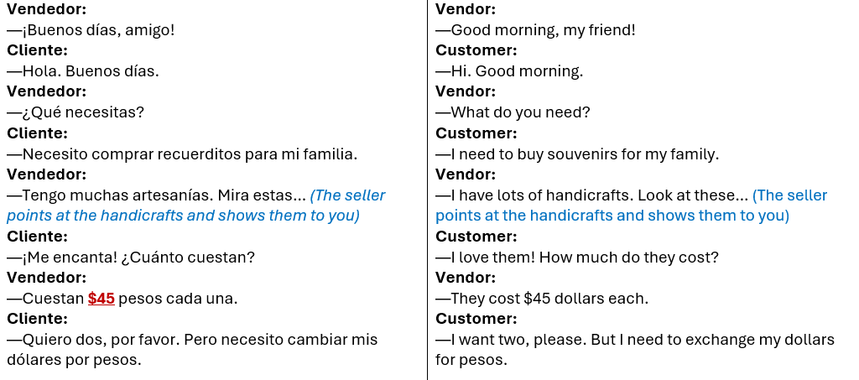
Part #1

Slide 14
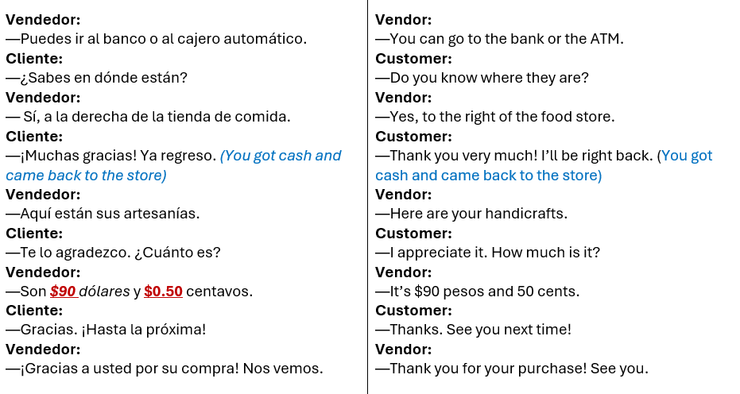
Part #2

Slide 15
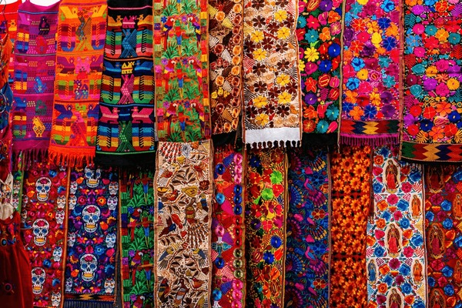
NOTA CULTURAL
El Mercado de Chichicastenango

Slide 16
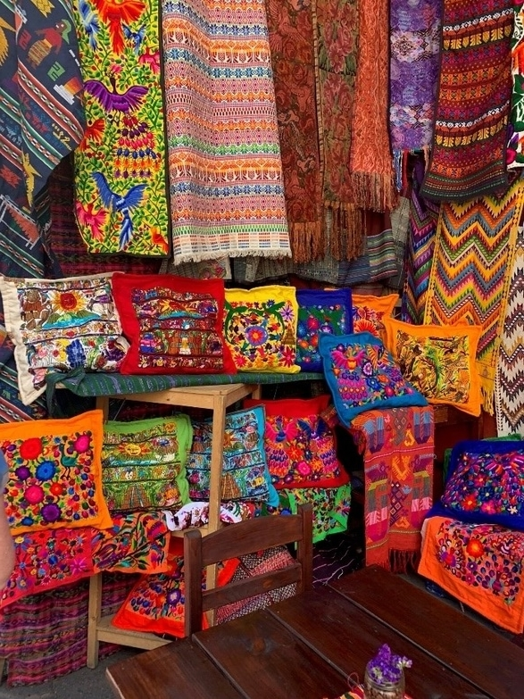
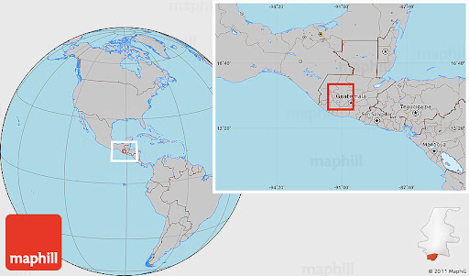
Perched on a high mountain ridge encircled by a pine forest, the
Quiche Maya town of Chichicastenango in Guatemala hosts the
most famous indigenous market in Central America.

Slide 17
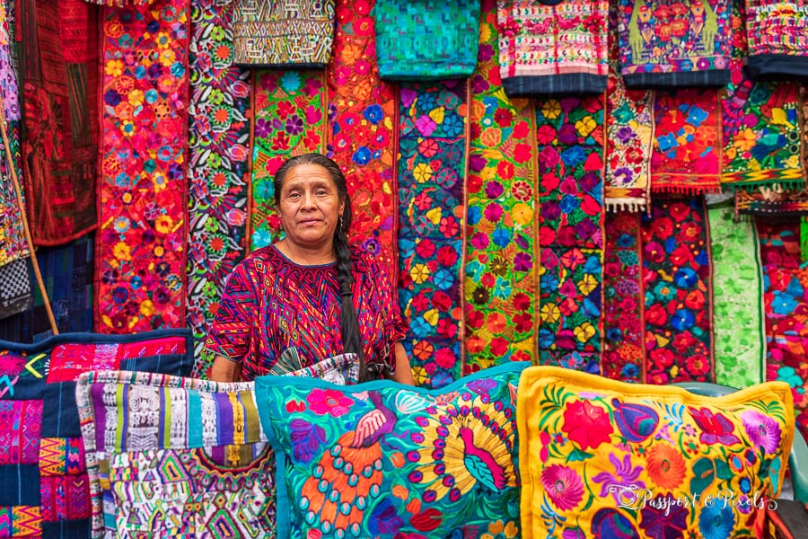
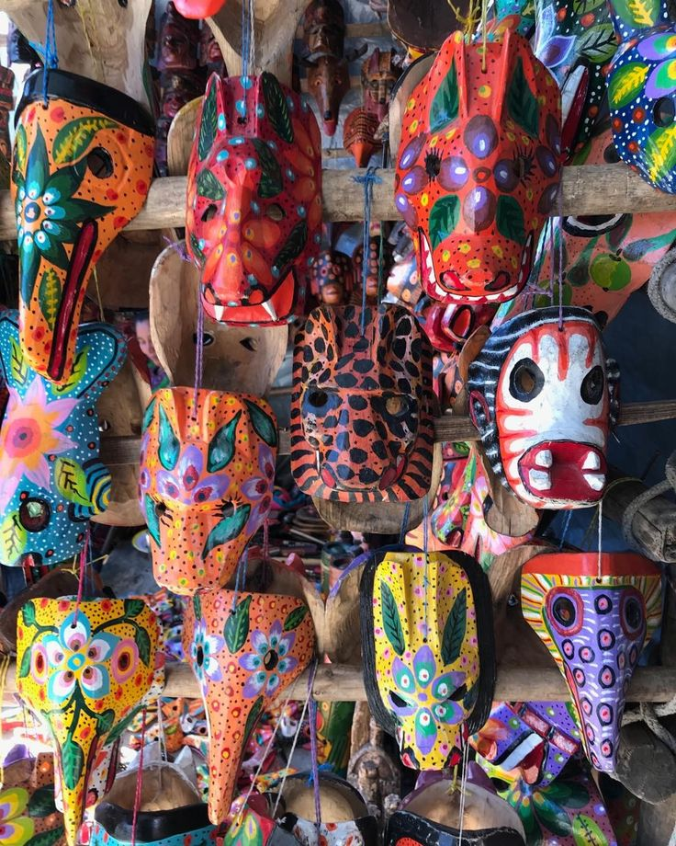
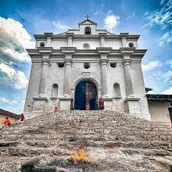
Chichicastenango or “Chichi” (called by the locals) is renowned for its vibrant, open-air market and for its rich Mayan culture and religious practices.
On Sundays and Thursdays, its central plaza overflows with fresh flowers, traditional foods, colorful handcrafts and practical housewares. The town is a center for K'iche' Maya traditions, with its market serving as a meeting point for villagers from surrounding areas.
Though the ride involves winding mountain roads, the views are breathtaking and well worth the journey. Chichicastenango Market is more than just a marketplace; it's a vibrant cultural hub where centuries-old traditions come alive. The journey to get there is as much a part of the experience as the market itself.

Slide 18
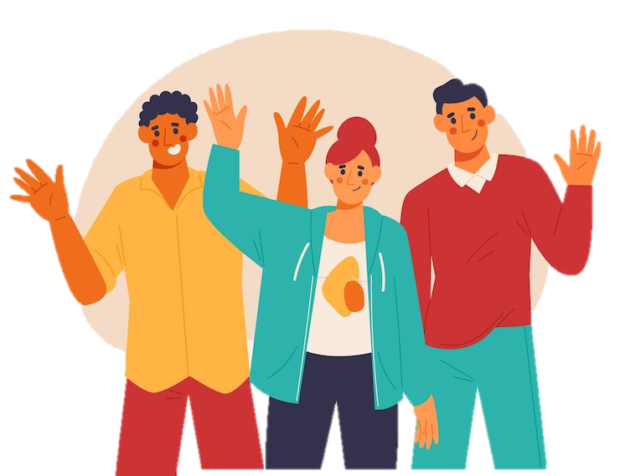
¡Hasta la vista!
¡Hasta pronto!
¡Cuídate!
¡MUCHAS
GRACIAS!
¡Nos vemos!
¡Que te vaya bien!
¡Hasta la próxima!

