Slide 1



JEOIPARDY DEL ESPACIO

Slide 2
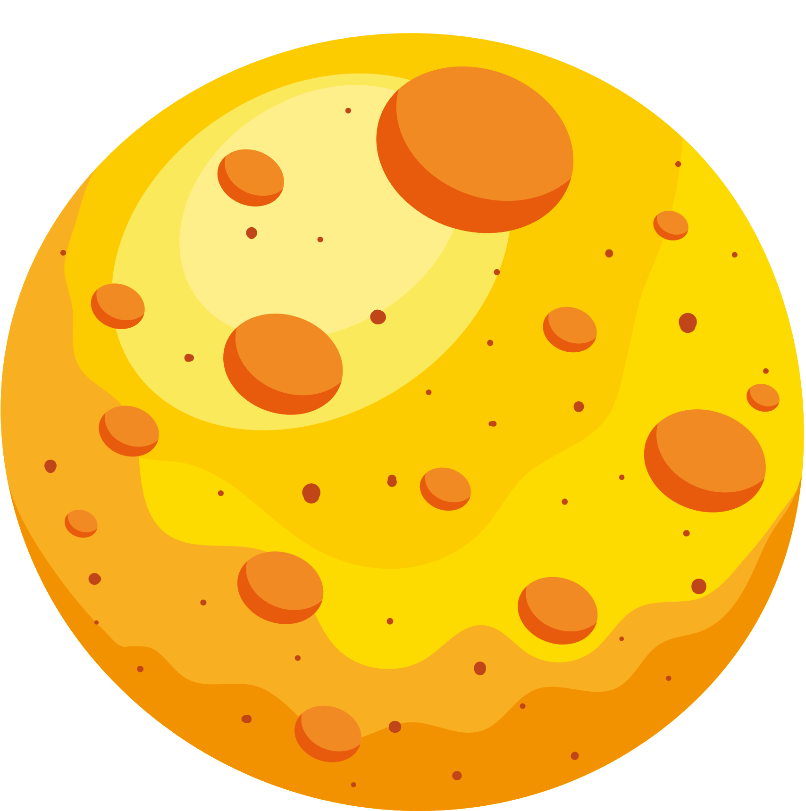
JEOPARDY
Phrases | Figuras | Colores | Números | El Espacio | Verbos
100 | 100 | 100 | 100 | 100 | 100
200 | 200 | 200 | 200 | 200 | 200
300 | 300 | 300 | 300 | 300 | 300
400 | 400 | 400 | 400 | 400 | 400

Slide 3

What does, “¿Cómo te llamas?”, mean?
Respuesta

Slide 4
What does, “¿Cómo te llamas?”, mean?
Answer: What is your name?
Main page

Slide 5
How do you say, “How are you?”, in Spanish?
Respuesta

Slide 6
How do you say, “How are you?”, in Spanish?
Answer: ¿Cómo estas?
Main page

Slide 7
What does, “Yo veo...”, mean?
Respuesta

Slide 8
What does, “Yo veo...”, mean?
Answer: I see...
Main page

Slide 9
How do you say, “I like...”, in Spanish?
Respuesta

Slide 10
How do you say, “I like...”, in Spanish?
Answer: “Me gusta...”
Main page

Slide 11
What shape is a círculo?
Respuesta

Slide 12
What shape is a círculo?
Answer: A circle
Main page

Slide 13
How do you say triangle in Spanish?
Respuesta

Slide 14
How do you say triangle in Spanish?
Answer: Triángulo
Main page

Slide 15
What shape is a rectángulo?
Respuesta

Slide 16
What shape is a rectángulo?
Answer: Rectangle
Main page

Slide 17
How do you say cuadrado in English?
Respuesta

Slide 18
How do you say cuadrado in English?
Answer: Square
Main page

Slide 19

How do you say azul in English?
Respuesta

Slide 20

How do you say azul in English?
Answer: Blue
Main page

Slide 21

How do you say red in Spanish?
Respuesta

Slide 22
How do you say red in Spanish?
Answer: Rojo
Main page

Slide 23
What is amarillo in English?
Respuesta

Slide 24

What is amarillo in English?
Answer: Yellow
Main page

Slide 25

What is pink in Spanish?
Respuesta

Slide 26
What is pink in Spanish?
Answer: Rosado/Rosa
Main page

Slide 27

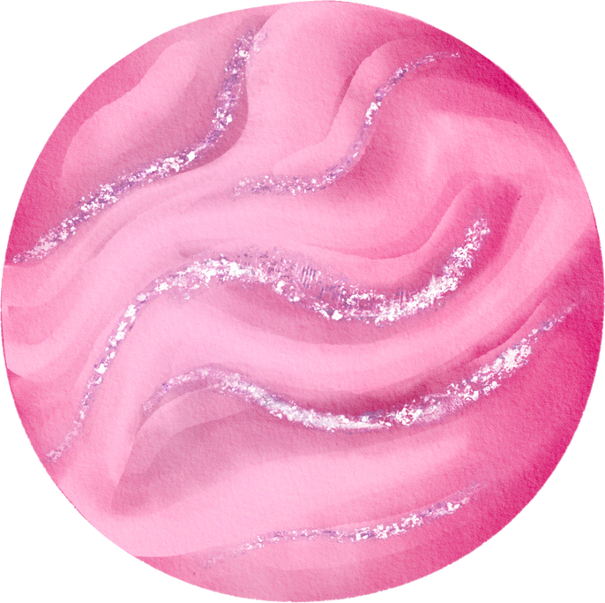
What is two (2) in Spanish?
Respuesta

Slide 28
What is two (2) in Spanish?
Answer: Dos
Main page

Slide 29
What does cinco mean?
Respuesta

Slide 30
What does cinco mean?
Answer: Five (5)
Main page

Slide 31
What is seven (7) in Spanish?
Respuesta

Slide 32
What is seven (7) in Spanish?
Answer: Siete
Main page

Slide 33
What does nueve mean?
Respuesta

Slide 34
What does nueve mean?
Answer: Nine (9)
Main page

Slide 35

What is astronaut in Spanish?
Respuesta

Slide 36
What is astronaut in Spanish?
Answer: Astronauta
Main page

Slide 37
What is an estrella?
Respuesta

Slide 38

What is an estrella?
Answer: A star
Main page

Slide 39

How do you say helmet in Spanish?
Respuesta

Slide 40
How do you say helmet in Spanish?
Answer: Casco
Main page

Slide 41
What is la Tierra?
Respuesta

Slide 42

What is la Tierra?
Answer: Earth
Main page

Slide 43
What does volar mean?
Respuesta

Slide 44

What does volar mean?
Answer: To fly
Main page

Slide 45
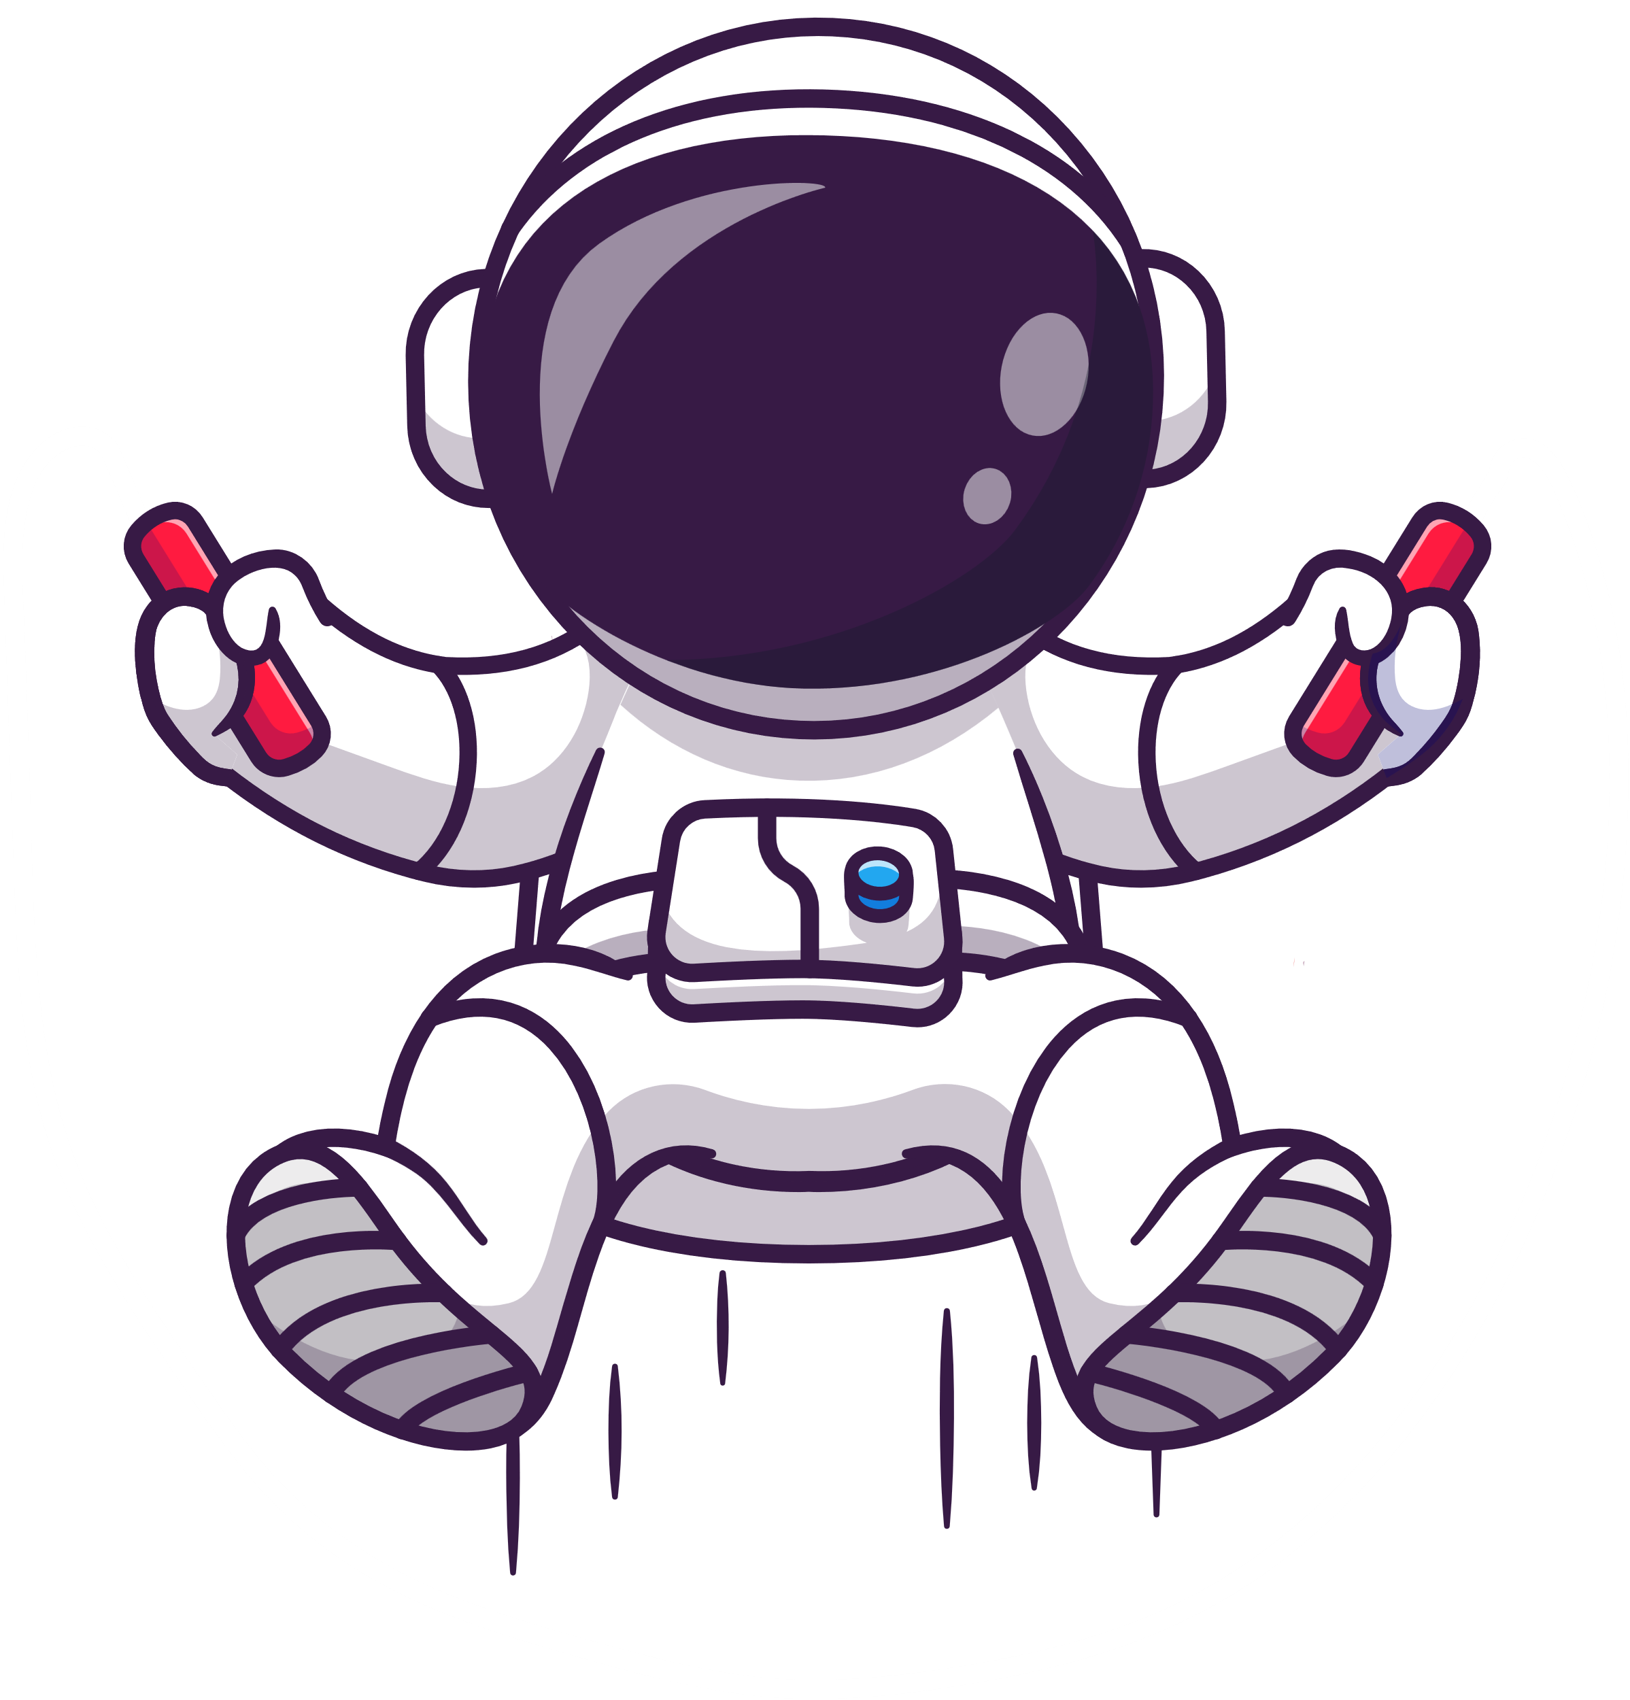
How do you say jump in Spanish?
Respuesta

Slide 46
How do you say jump in Spanish?
Answer: Saltar
Main page

Slide 47

How do you say float in Spanish?
Respuesta

Slide 48
How do you say float in Spanish?
Answer: Flotar
Main page

Slide 49
What does, “¡Despega!”, mean?
Respuesta

Slide 50

What does, “¡Despega!”, mean?
Answer: Blast off!
End Page

Slide 51
¡GRACIAS!

