Slide 1
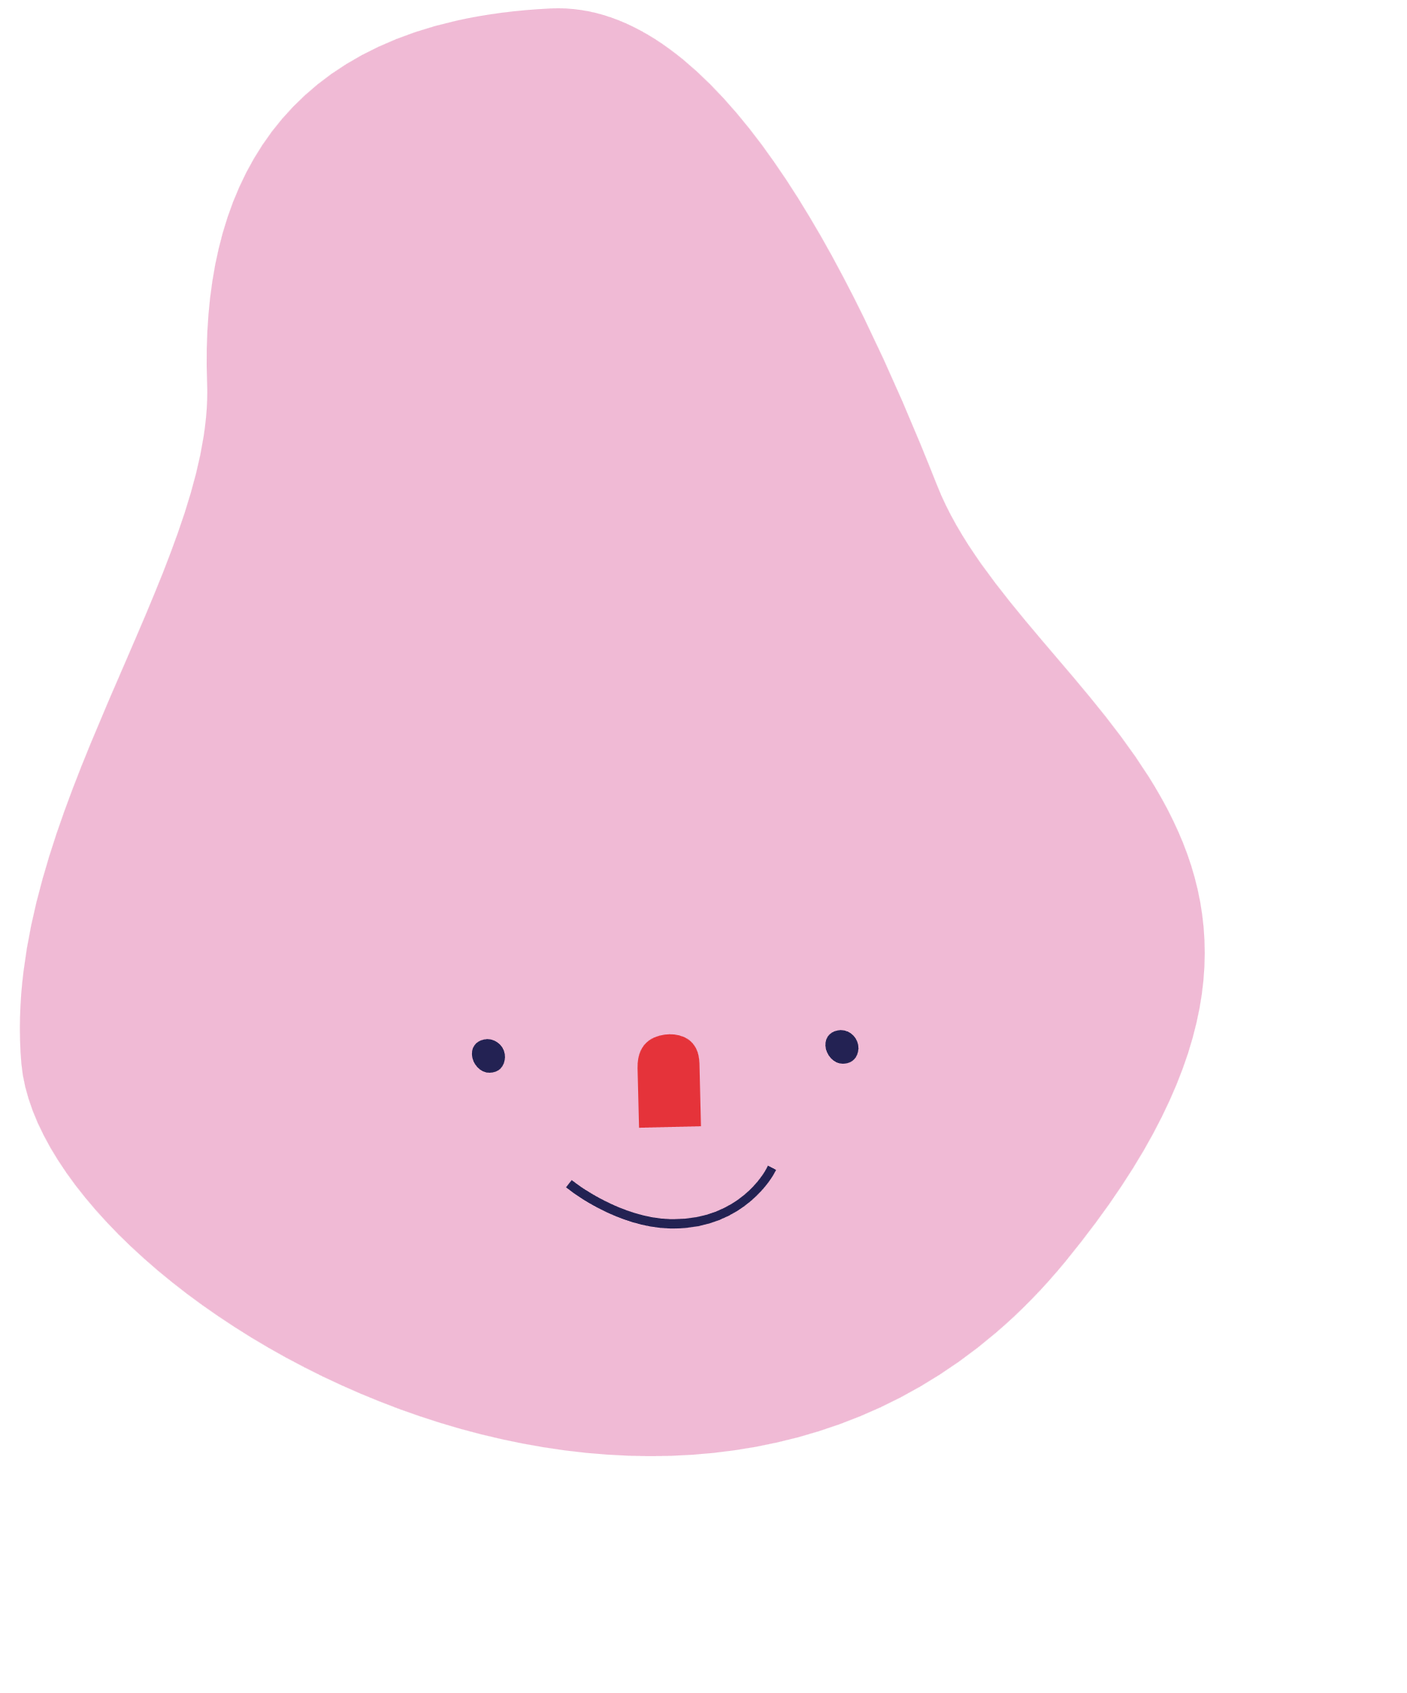
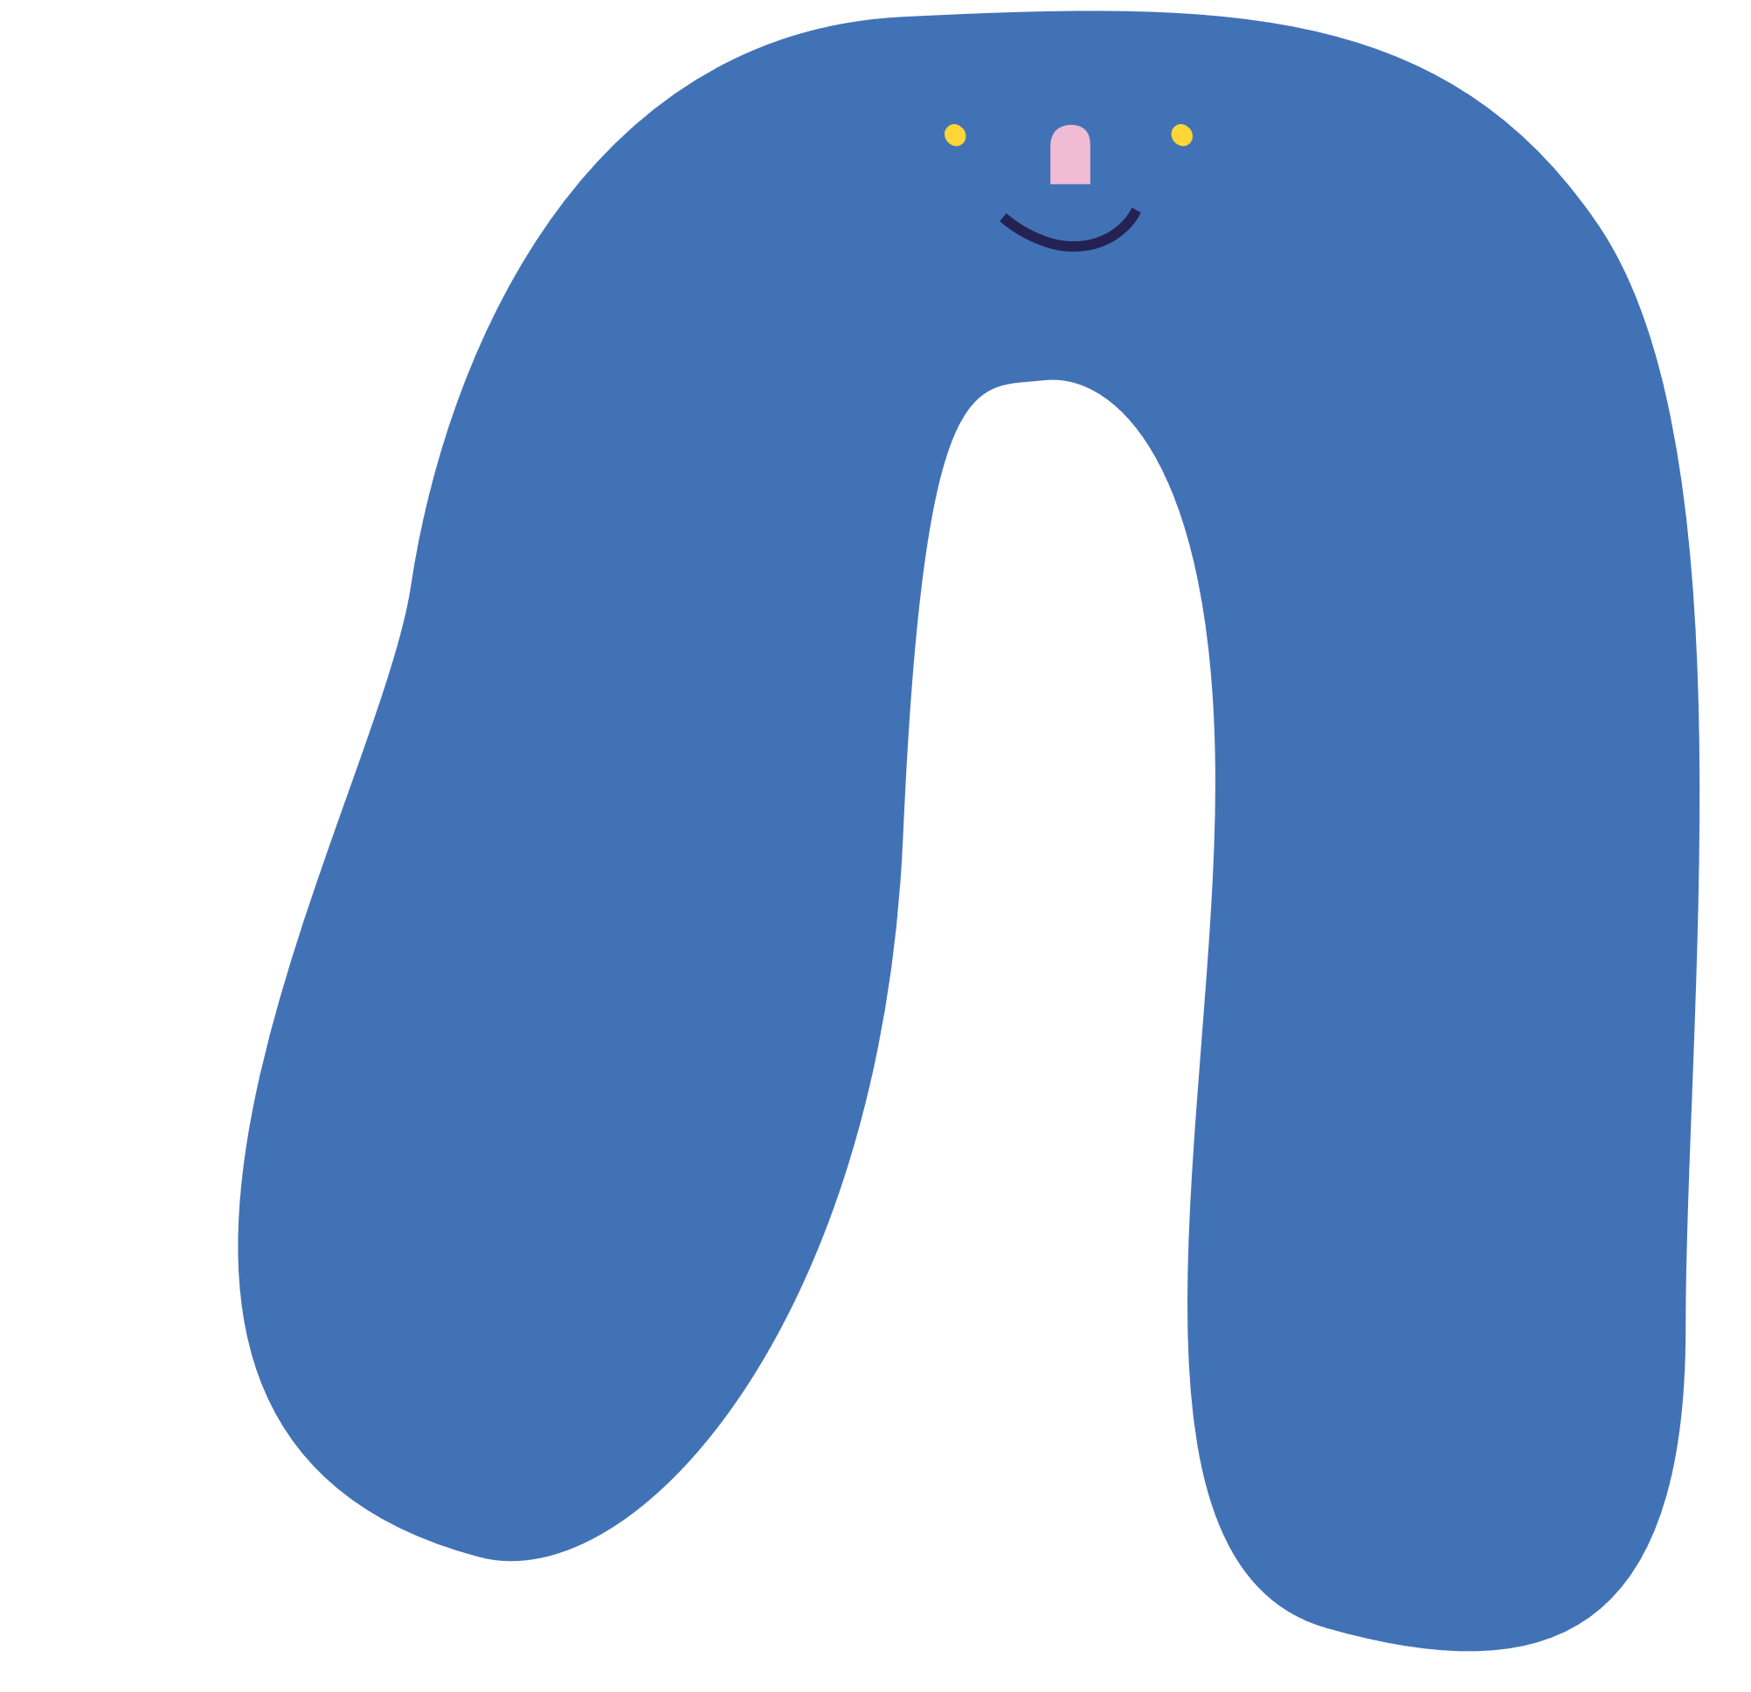


Guess the
SHAPES

Slide 2

Welcome to our
Guess the Shape Game!
Today, we’ll have some fun with shapes.
Let’s read the descriptions, think carefully,
and try to guess in Spanish what shape is being described.
Are you ready to test your shape knowledge?

Slide 3
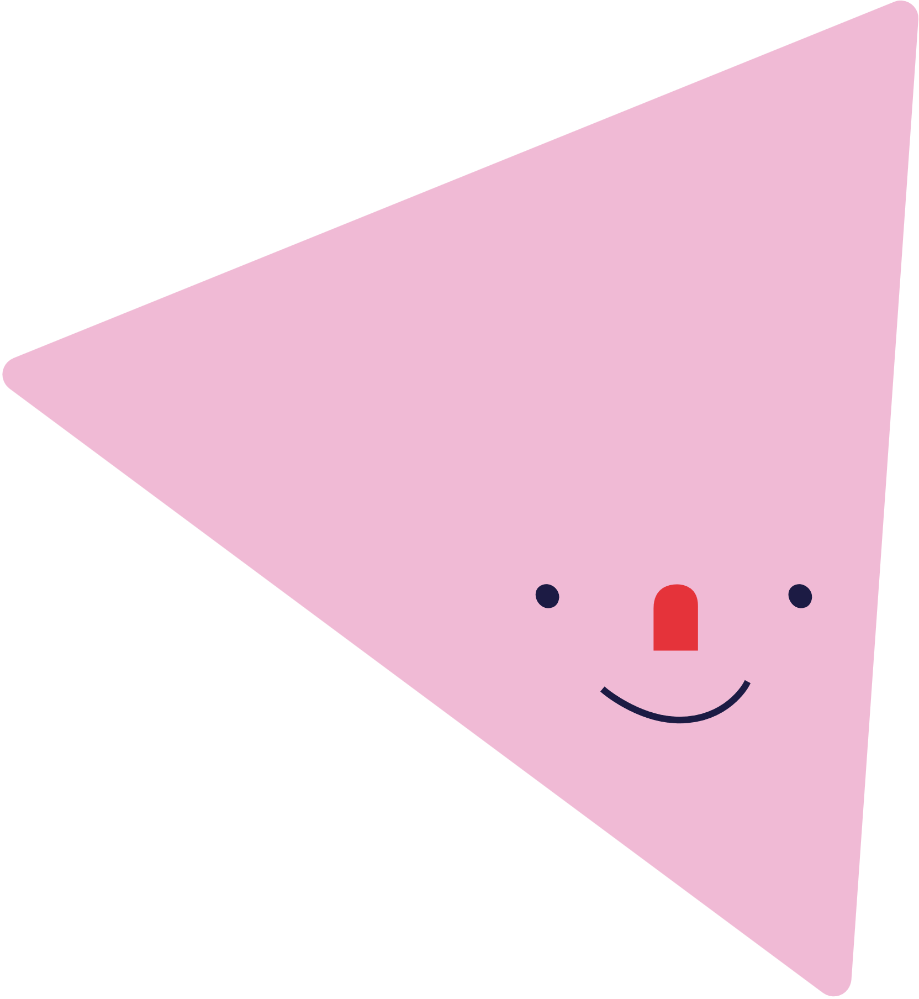
It has 3 sides and 3 angles.
It looks like a pizza slice or a piece of cheese.
What shape is it?

Slide 4
Yes!
It's un triángulo!

Slide 5

It has no sides.
It looks like a pizza, a ball or an orange
What shape is it?

Slide 6
Yes!
It's un círculo!

Slide 7

It has four sides, but only two of them are long.
It looks like a door or a book.
What shape is it?

Slide 8
Yes! It's un rectángulo

Slide 9

It has four equal sides and four corners.
It looks like a window or a present.
What shape is it?

Slide 10
Yes!
It's un cuadrado!

Slide 11
It has five points, and you can find this in the sky. It shines very bright and is so far away and you need a telescope to see it up close.
What shape is it?

Slide 12
Yes!
It's una estrella!

Slide 13
Great Job!
You did an amazing job guessing the shapes! Now you know how to describe shapes and their properties. Keep practicing, and soon you’ll be a shape expert!

