Slide 1
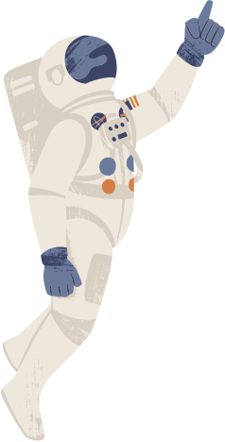







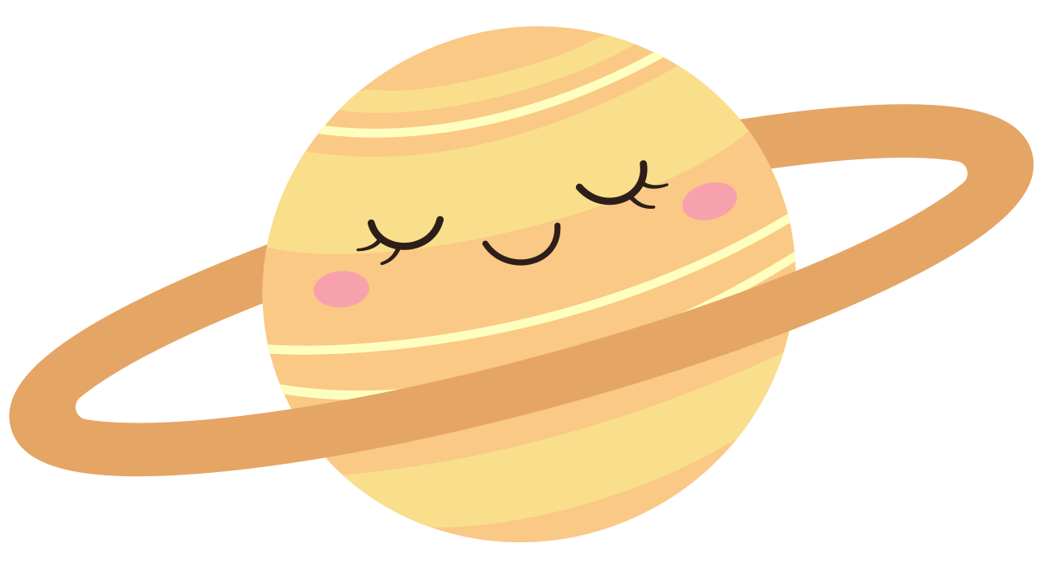
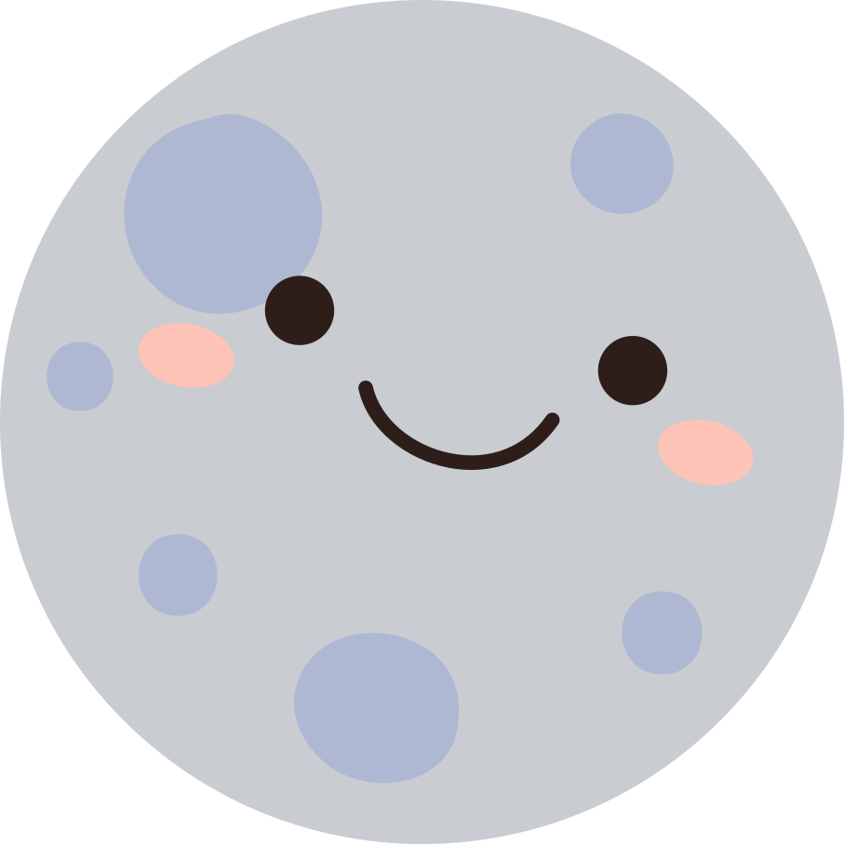

Planetas del Sistema Solar
1. Drag and drop the planets illustrations in the correct order.
2. Now put the correct label under each planet and the sun.
JÚPITER
MARTE
SATURNO
TIERRA
NEPTUNO
MERCURIO
URANO
EL SOL
VENUS

Slide 2
Planetas del Sistema Solar
1. Drag and drop the planets illustrations in the correct order.
2. Now put the correct label under each planet.
JÚPITER
MARTE
NEPTUNO
VENUS
URANO
MERCURIO
SATURNO
TIERRA

