Slide 1

Presenta…
Middle School Prep
¡Preparación para la escuela secundaria!

Slide 2
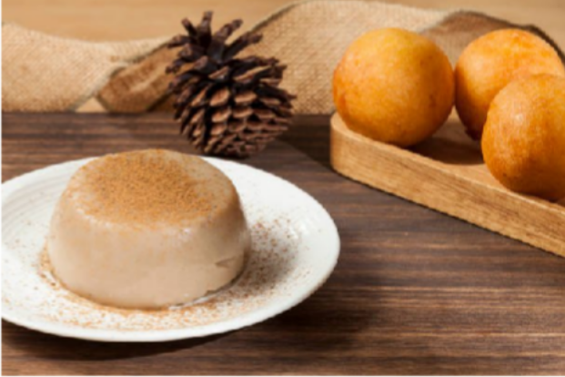
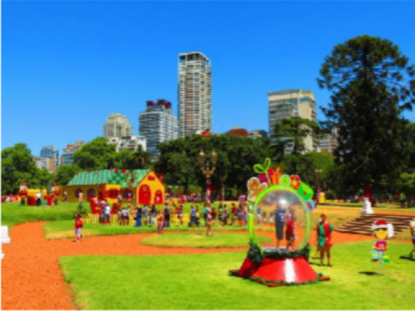
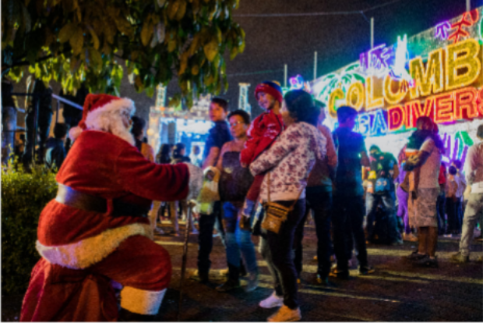
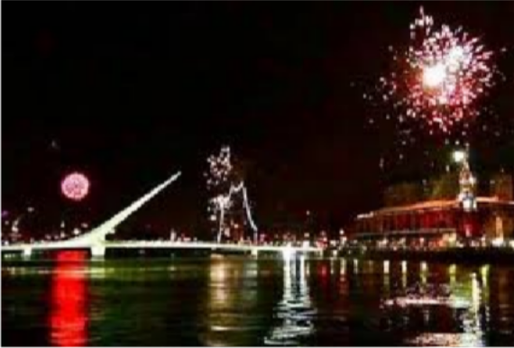

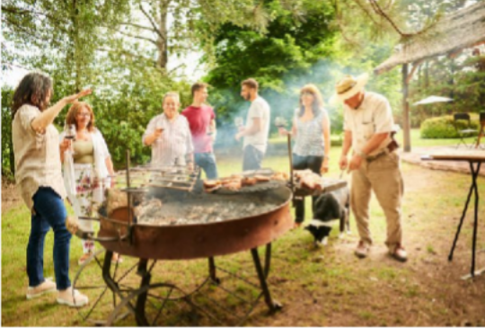
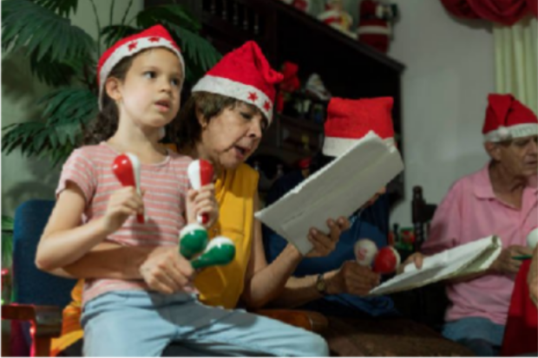
Colombian bunuelos (fried
ARGENTINA
cheese bread) and natilla
Argentina shoots fireworks at midnight to celebrate Christmas
COLOMBIA

Slide 3
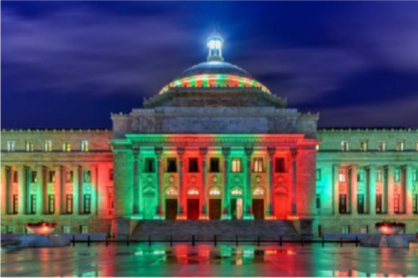
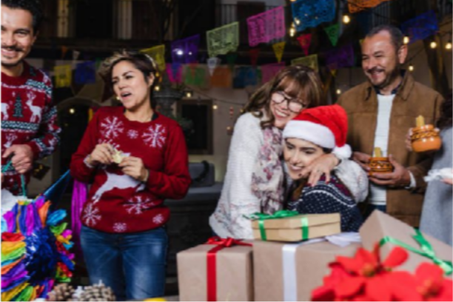
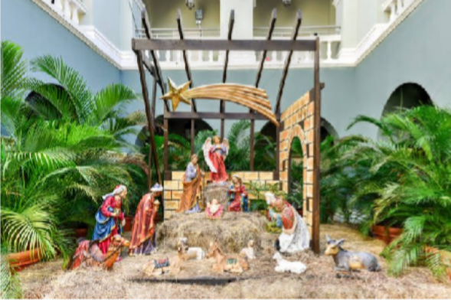
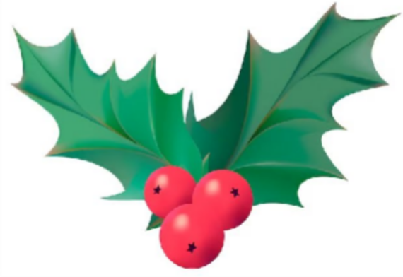
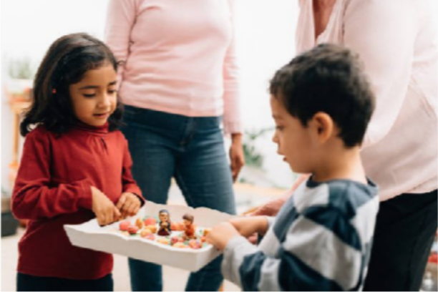
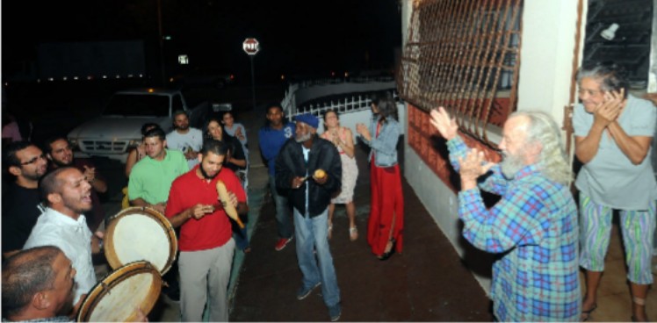
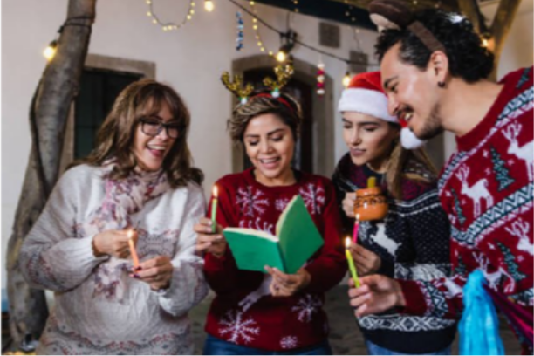
PUERTO RICO
MEXICO
Parrandas: A small group of friends gather to surprise another with carols
Posadas: Families go around singing and playing out Mary and Joseph’s journey to Bethlehem to give birth to Jesus.

Slide 4
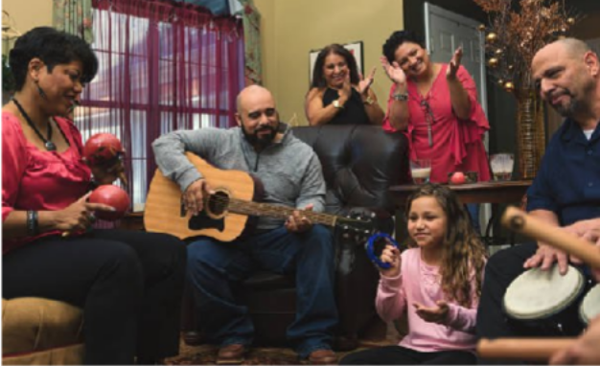
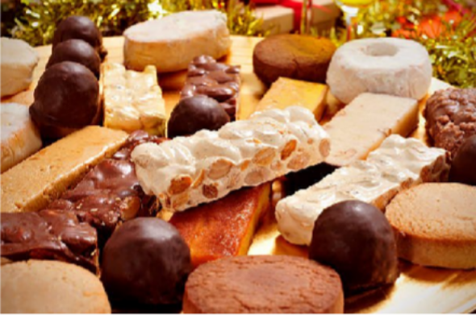

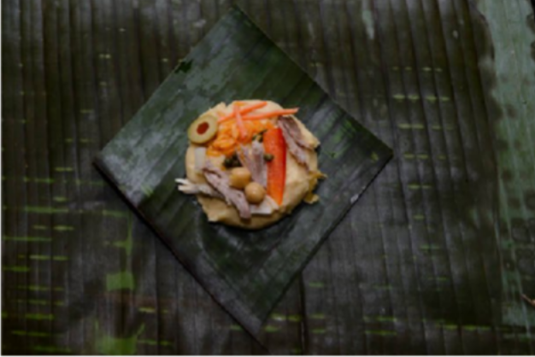
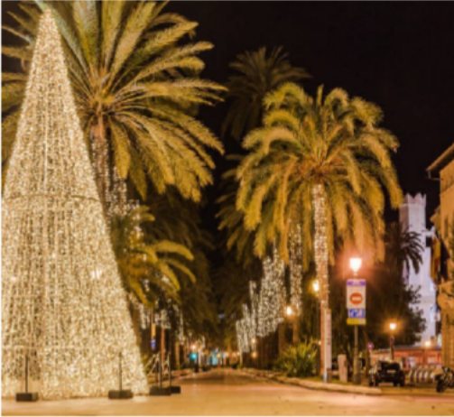
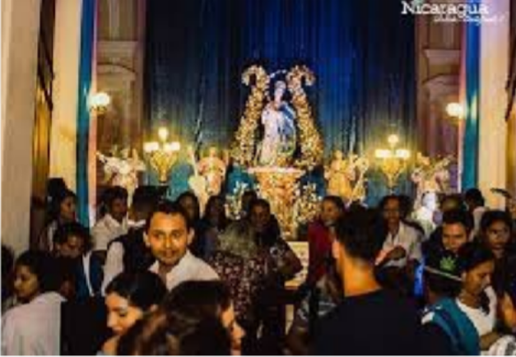
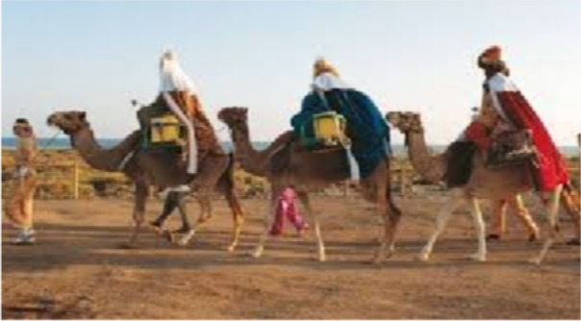
NICARAGUA
ESPAÑA
Epiphany or “Fiesta de Los tres Reyes Magos” is celebrated where kids will leave their shoues on windowsills, balconies or under the Christmas tree to be filled with presents
Nicaraaguans celebrate “La Purisima” or the Immaculate Mary and sing humns from house to house

