Slide 1

Middle School: Class Intro
La pregunta del día

Slide 2

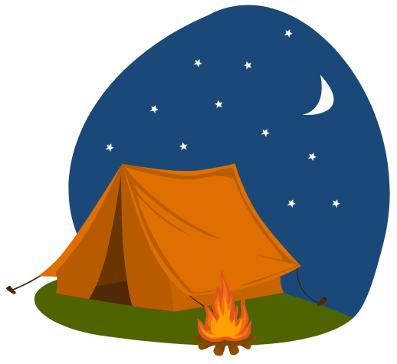
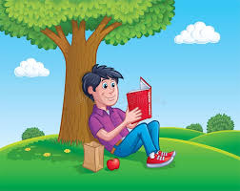
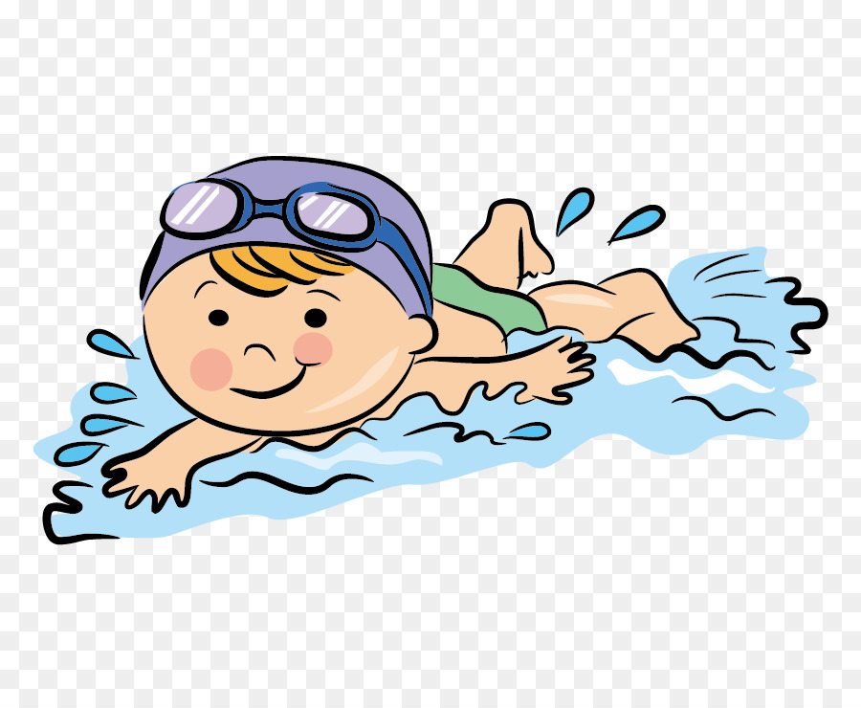
¿Qué te gusta hacer en el verano?
Me gusta _______.
acampar
nadar
jugar deportes
leer un libro

Slide 3

Tips for Pregunta del día:
– keep it “low stress”
– use pictures to support text
– students love “tally mark” questions
– incorporate questions that review old vocabulary

Slide 4
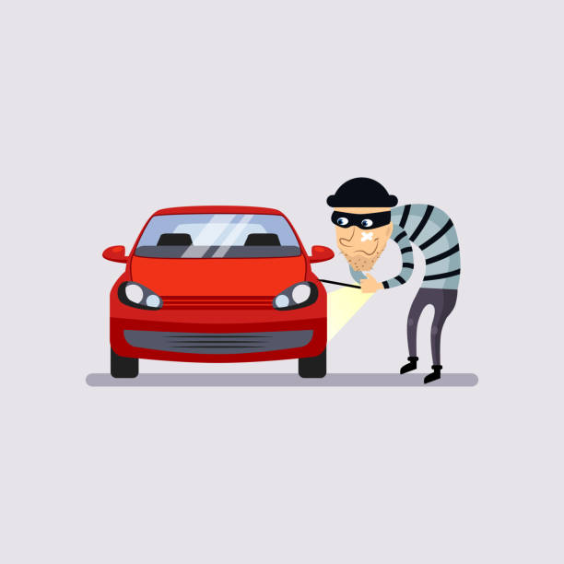
A non-traditional assessment
Parte Tres: La ropa (con repaso de adjetivos y colores)
Students read an “eye- witness account” of a car thief. They then draw the car thief according to the description in Spanish.

