Slide 1

Adult Conversational Spanish: Beginner Part I
Day 4

Slide 2
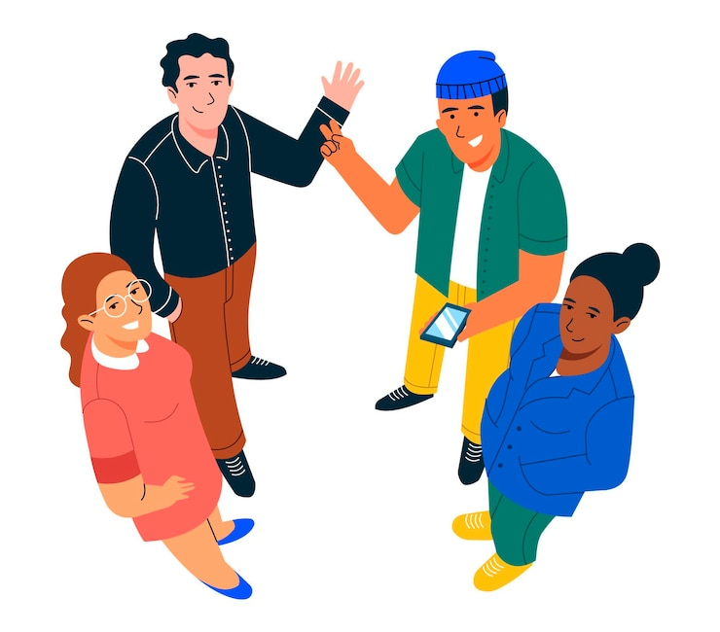
¡A romper el hielo! Icebreaker
Please tell us:
¿Cómo está el clima hoy? How is the weather like today?
¿En qué mes estamos? In what month are we in?

Slide 3

¡A romper el hielo! Icebreaker
Está __________.It is_____________.
Estamos en_____. In ________________________.

Slide 4
PRONOMBRES PERSONALES
SINGULAR
yo | I
tú | you (informal)
él ella usted | he she you (formal)
PLURAL
nosotros | we
vosotros | you all (informal)
ellos ellas ustedes | they (masculine OR mix) they (feminine) you all (formal)

Slide 5
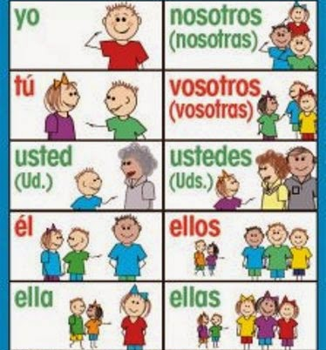
NOTA CULTURAL
“Yo,” the word for “I,” is only capitalized at the beginning of a sentence.
Tú (You informal) is used for people you have confidence in or are your same age.
Usted (You Formal) for people older than you or to show respect (your doctor, a priest, your boss, etc.)
Ellos could include all males or a mixture of males and females.
Ellas only includes all females.
The “vosotros” form is only used in Spain. Everywhere else, the ustedes form is used for formal or informal “you all.”

Slide 6

¡PRACTIQUEMOS! Written practice.
Richard and Becky
Myself
Sophia & me
John & Paul
Your sister
Gloria & Susan
ellos
yo
nosotros /nosotras
ellos
ella
ellas

Slide 7
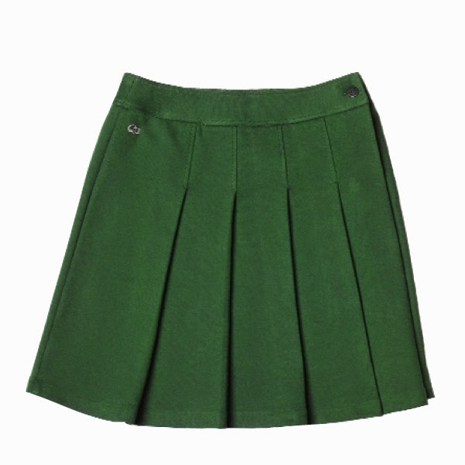
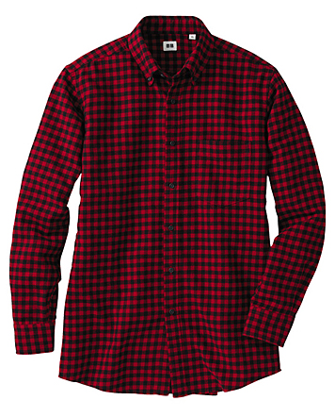
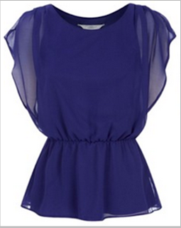
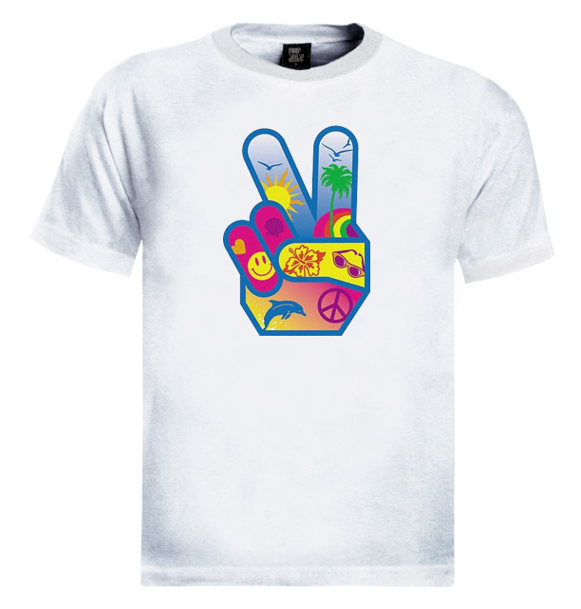
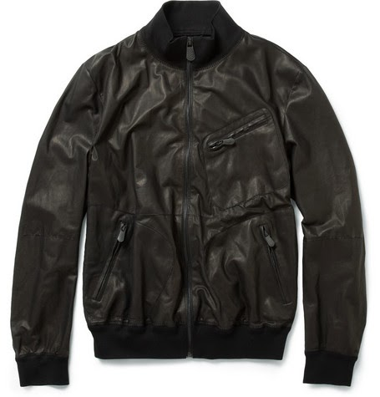
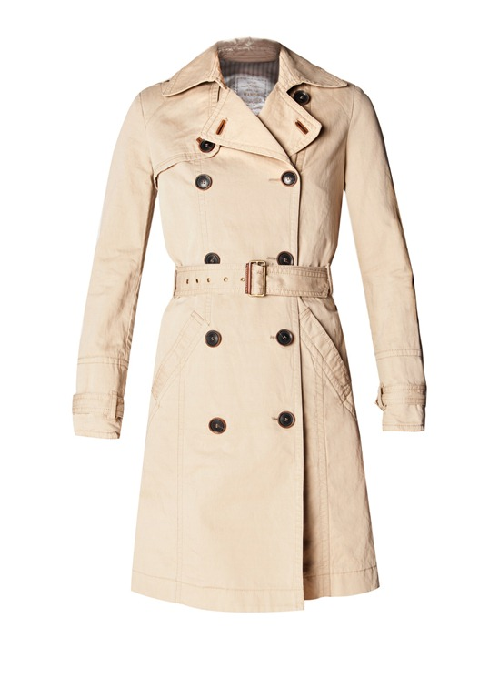
LA ROPA
LA ROPA | THE CLOTHES
la falda | skirt
la camisa (for men) | shirt
la blusa (for women) | blouse
la camiseta/ la playera | T-shirt
la chamarra/ la chaqueta (except in mexico) | jacket
abrigo | coat
This Photo by Unknown Author is licensed under CC BY-NC-ND
This Photo by Unknown Author is licensed under CC BY-SA-NC

Slide 8
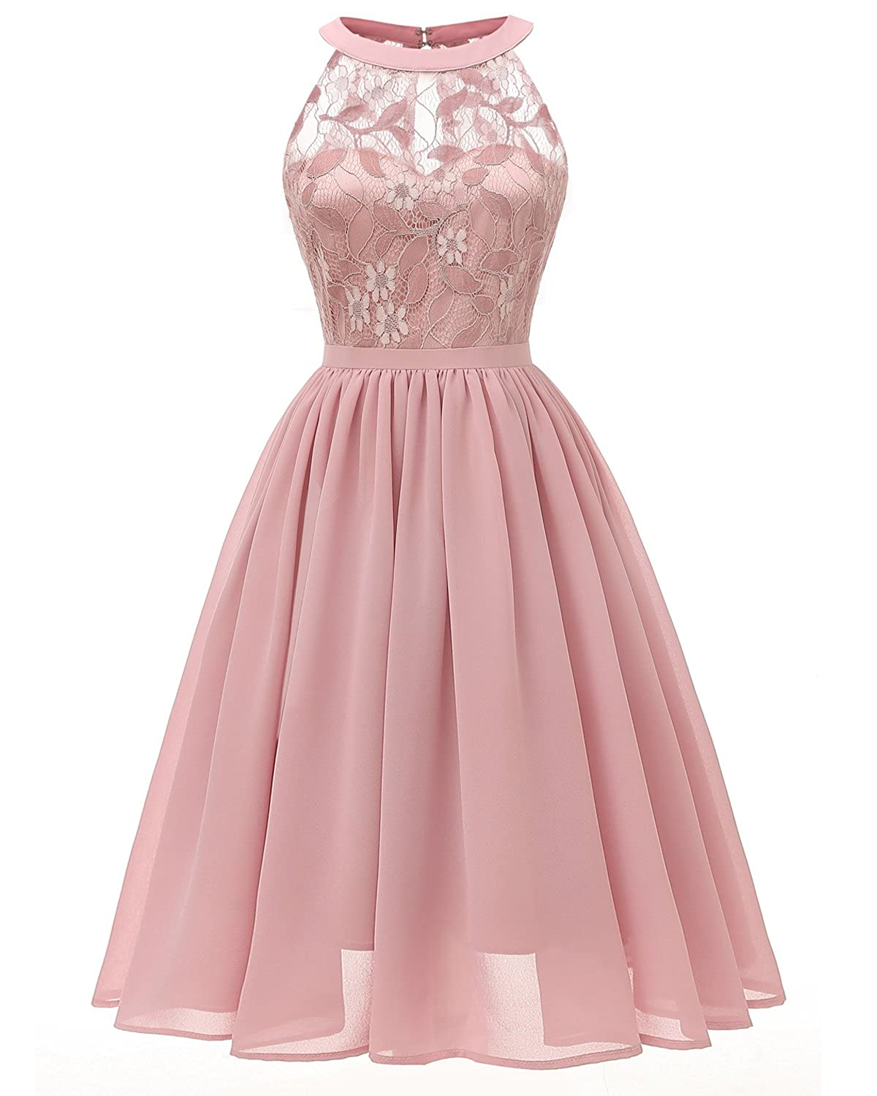
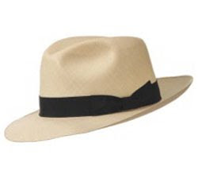
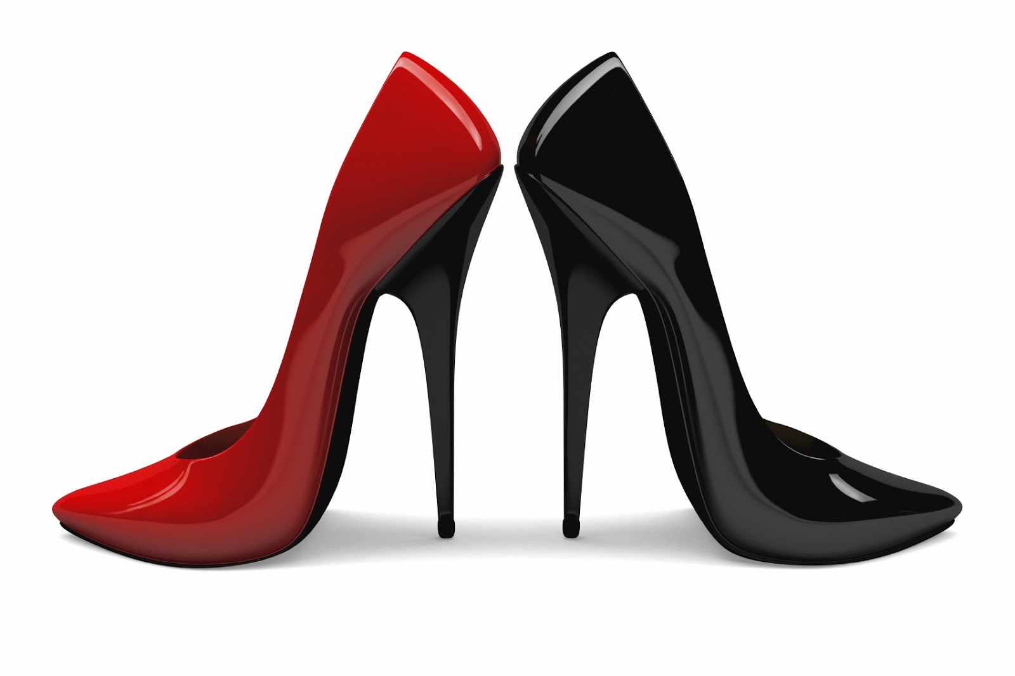
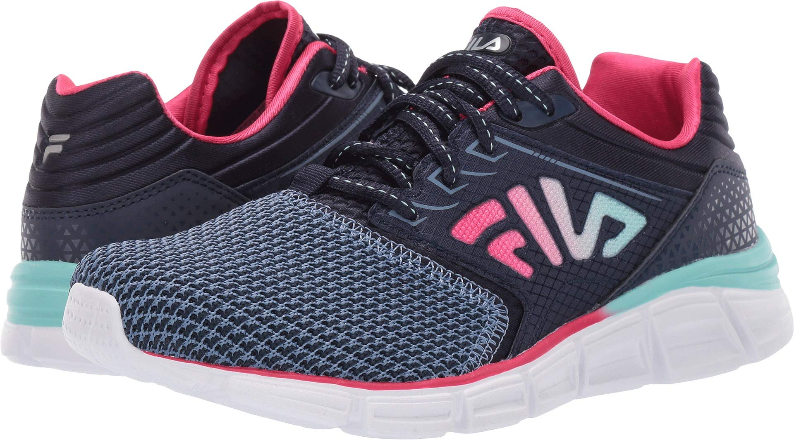
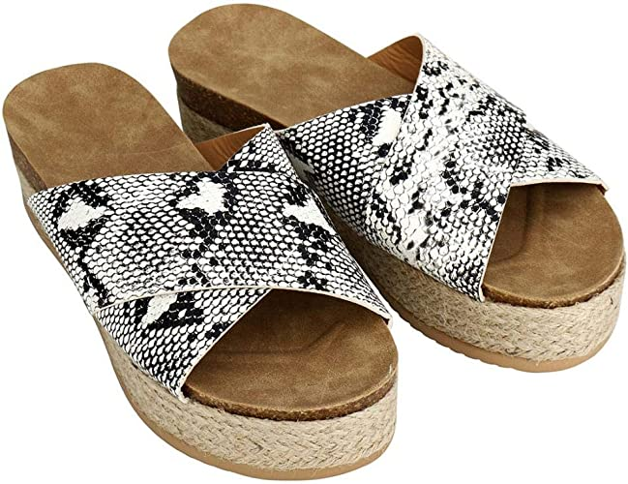
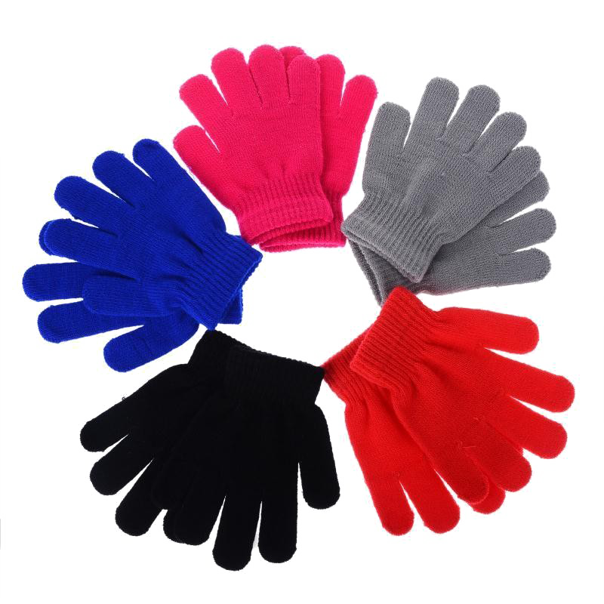
LA ROPA
LA ROPA | THE CLOTHES
el vestido | dress
el gorro/ el sombrero | hat
los zapatos | shoes
los tenis | shoes
las sandalias | sandals
los guantes | gloves
This Photo by Unknown Author is licensed under CC BY

Slide 9
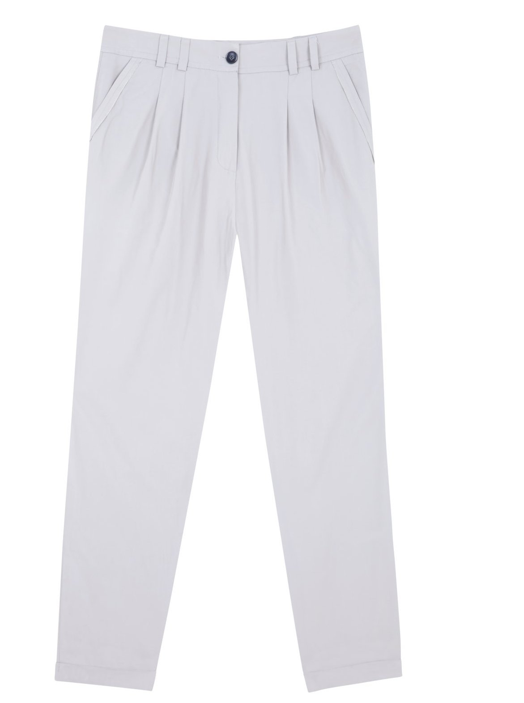
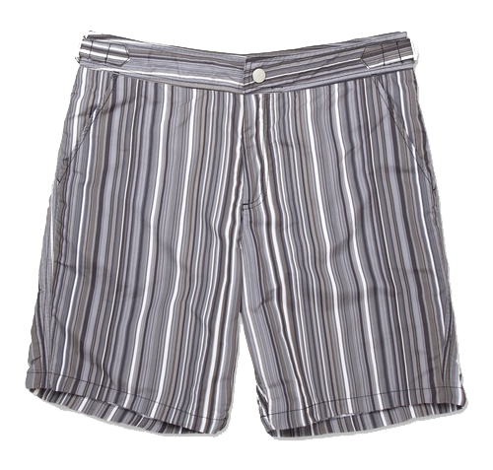
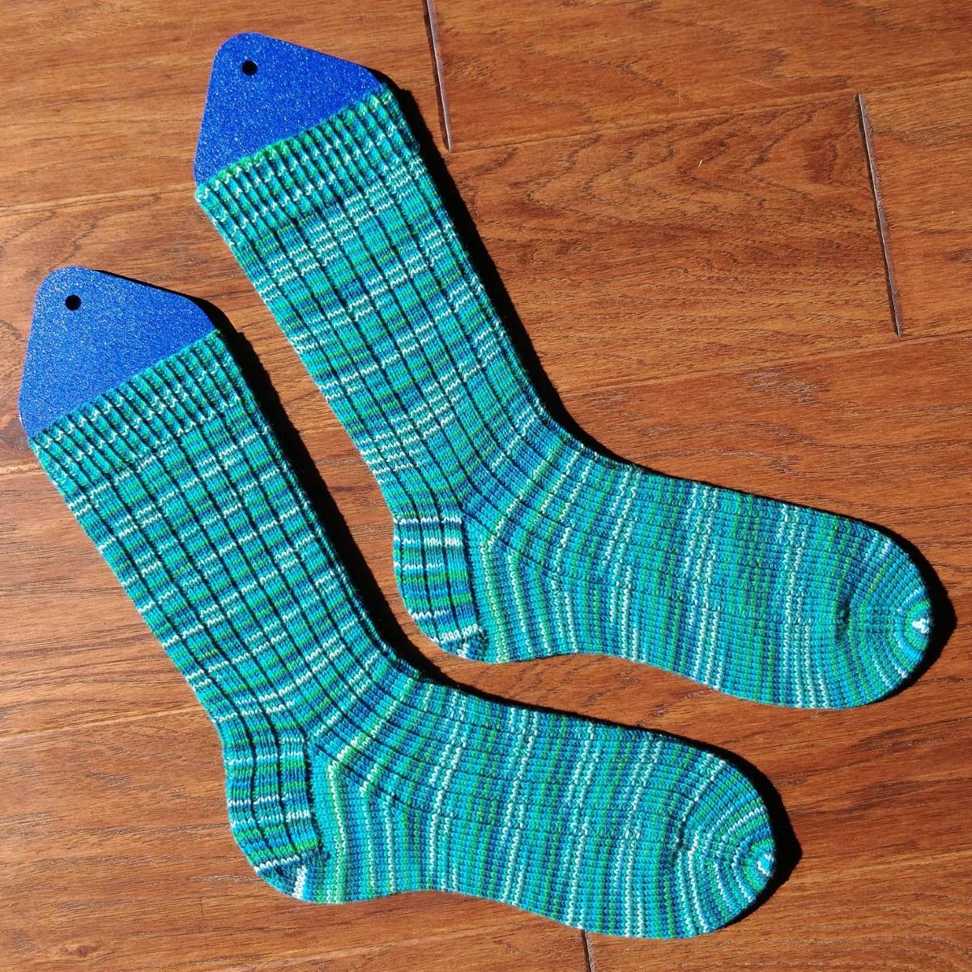
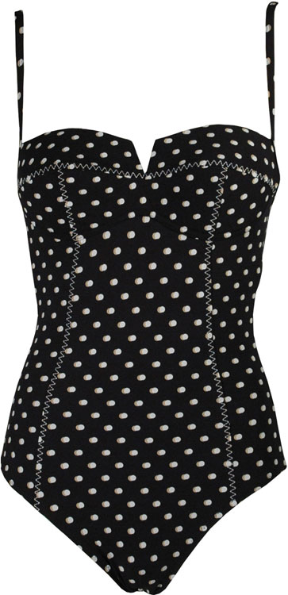
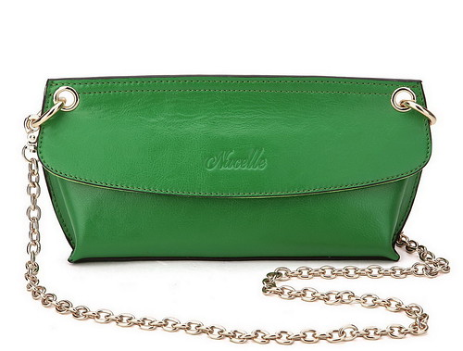
LA ROPA
LA ROPA | THE CLOTHES
los pantalones | pants
los shorts (los pantalones cortos) | shorts
los calcetines | socks
el traje de baño | swimsuit
la bolsa | purse
This Photo by Unknown Author is licensed under CC BY-SA-NC

Slide 10
BUILDER PHRASES: CLOTHING
¿Tiene … en talla....?
¿Cuanto cuesta?
¿Cuánto cuestan?
grande / mediano / pequeño
¿Que colores tiene?
Color…
¿Dónde está el probador?
Me queda ..(pequeño, grande)
Me da …. por favor.
Do you have….in size….?
How much is it?
How much are these?
large / medium / small
In what colors do you have?
Color
Where is the fitting room?
It is..(small, big) for me.
Give me …. please.

Slide 11
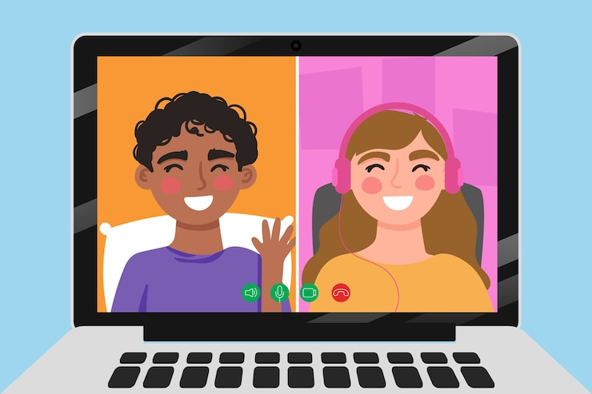
¡Vamos a Conversar!
Let’s go over the partner conversation before we go to breakout rooms!

Slide 12
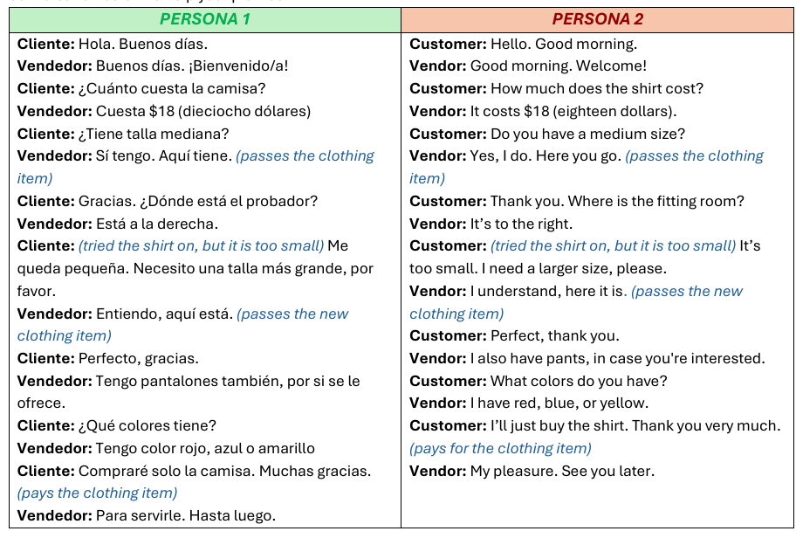

Slide 13
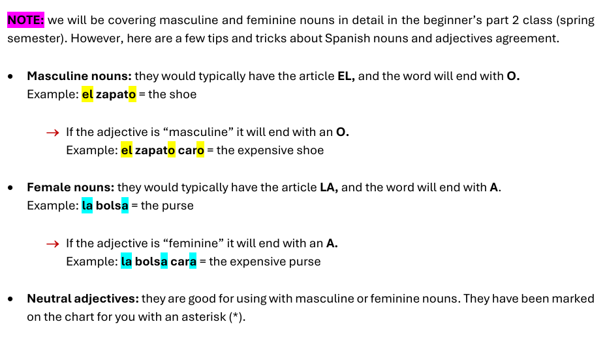
ADJETIVOS SIMPLES – simple adjectives

Slide 14
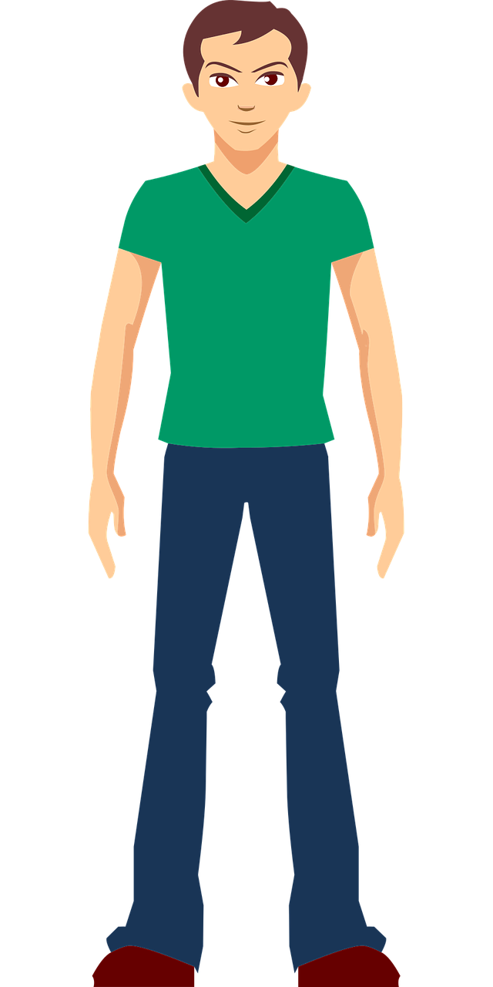


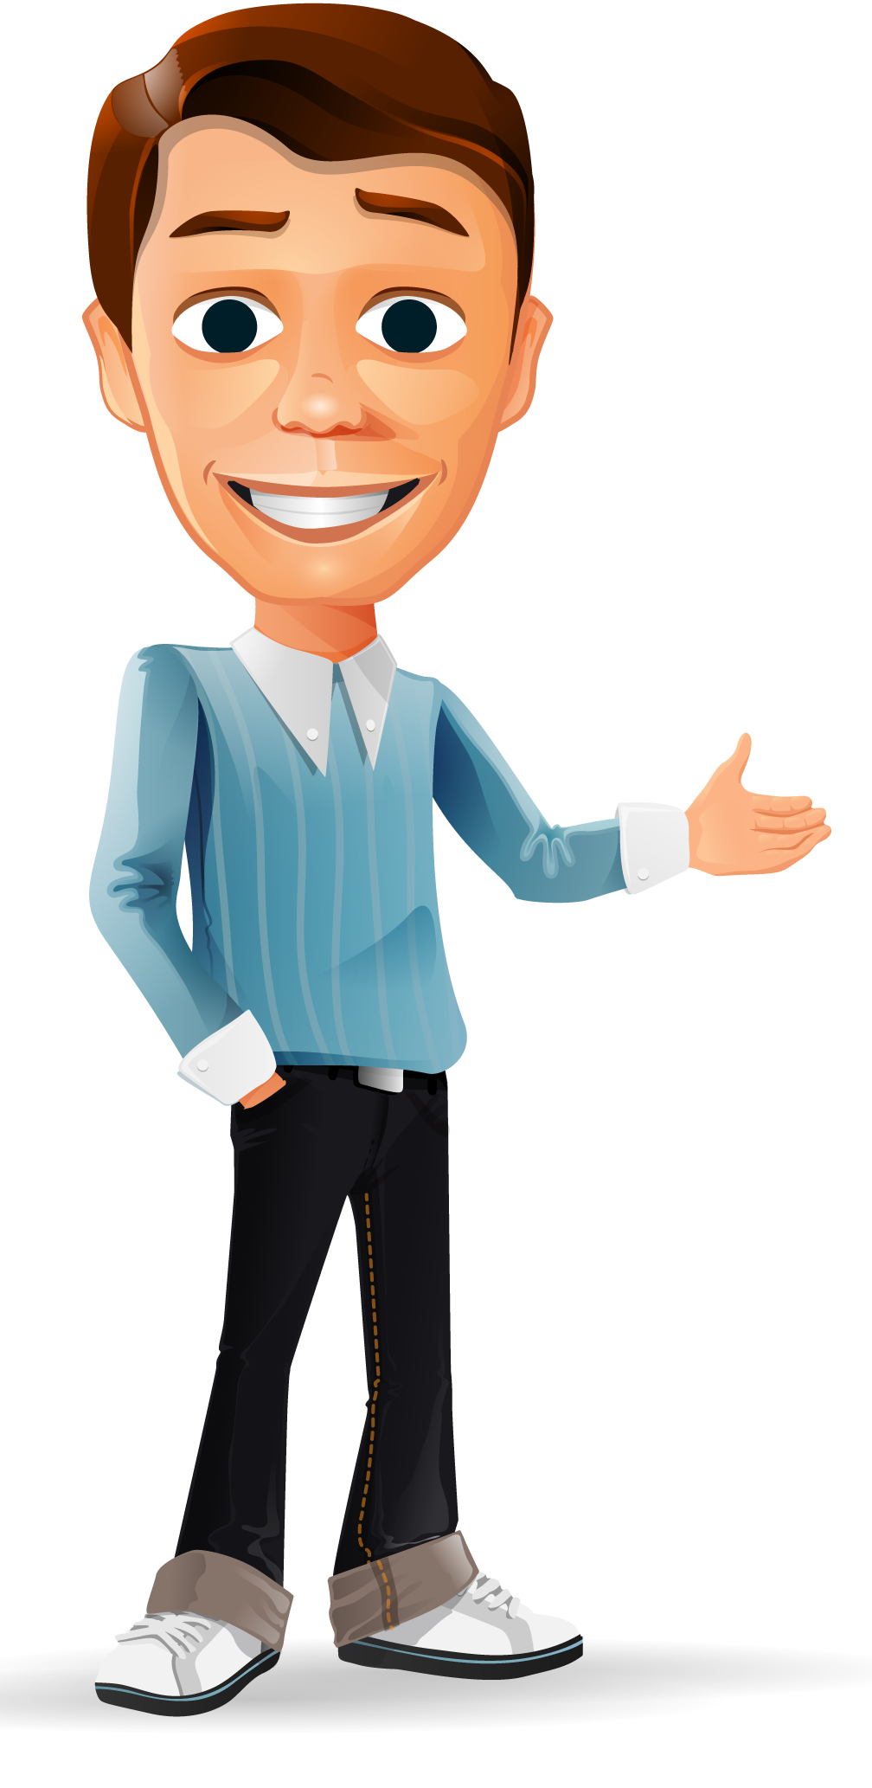
ADJETIVOS SIMPLES – simple adjectives
alto/a
bajo/a
caro/a
barato/a
This Photo by Unknown Author is licensed under CC BY-NC

Slide 15
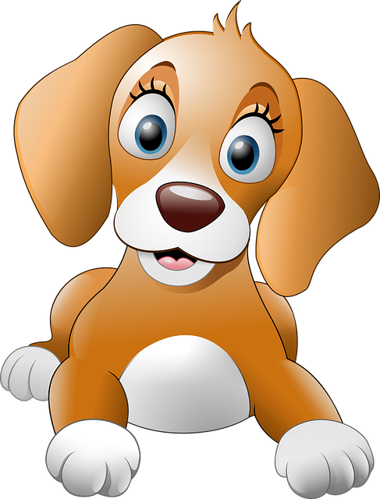

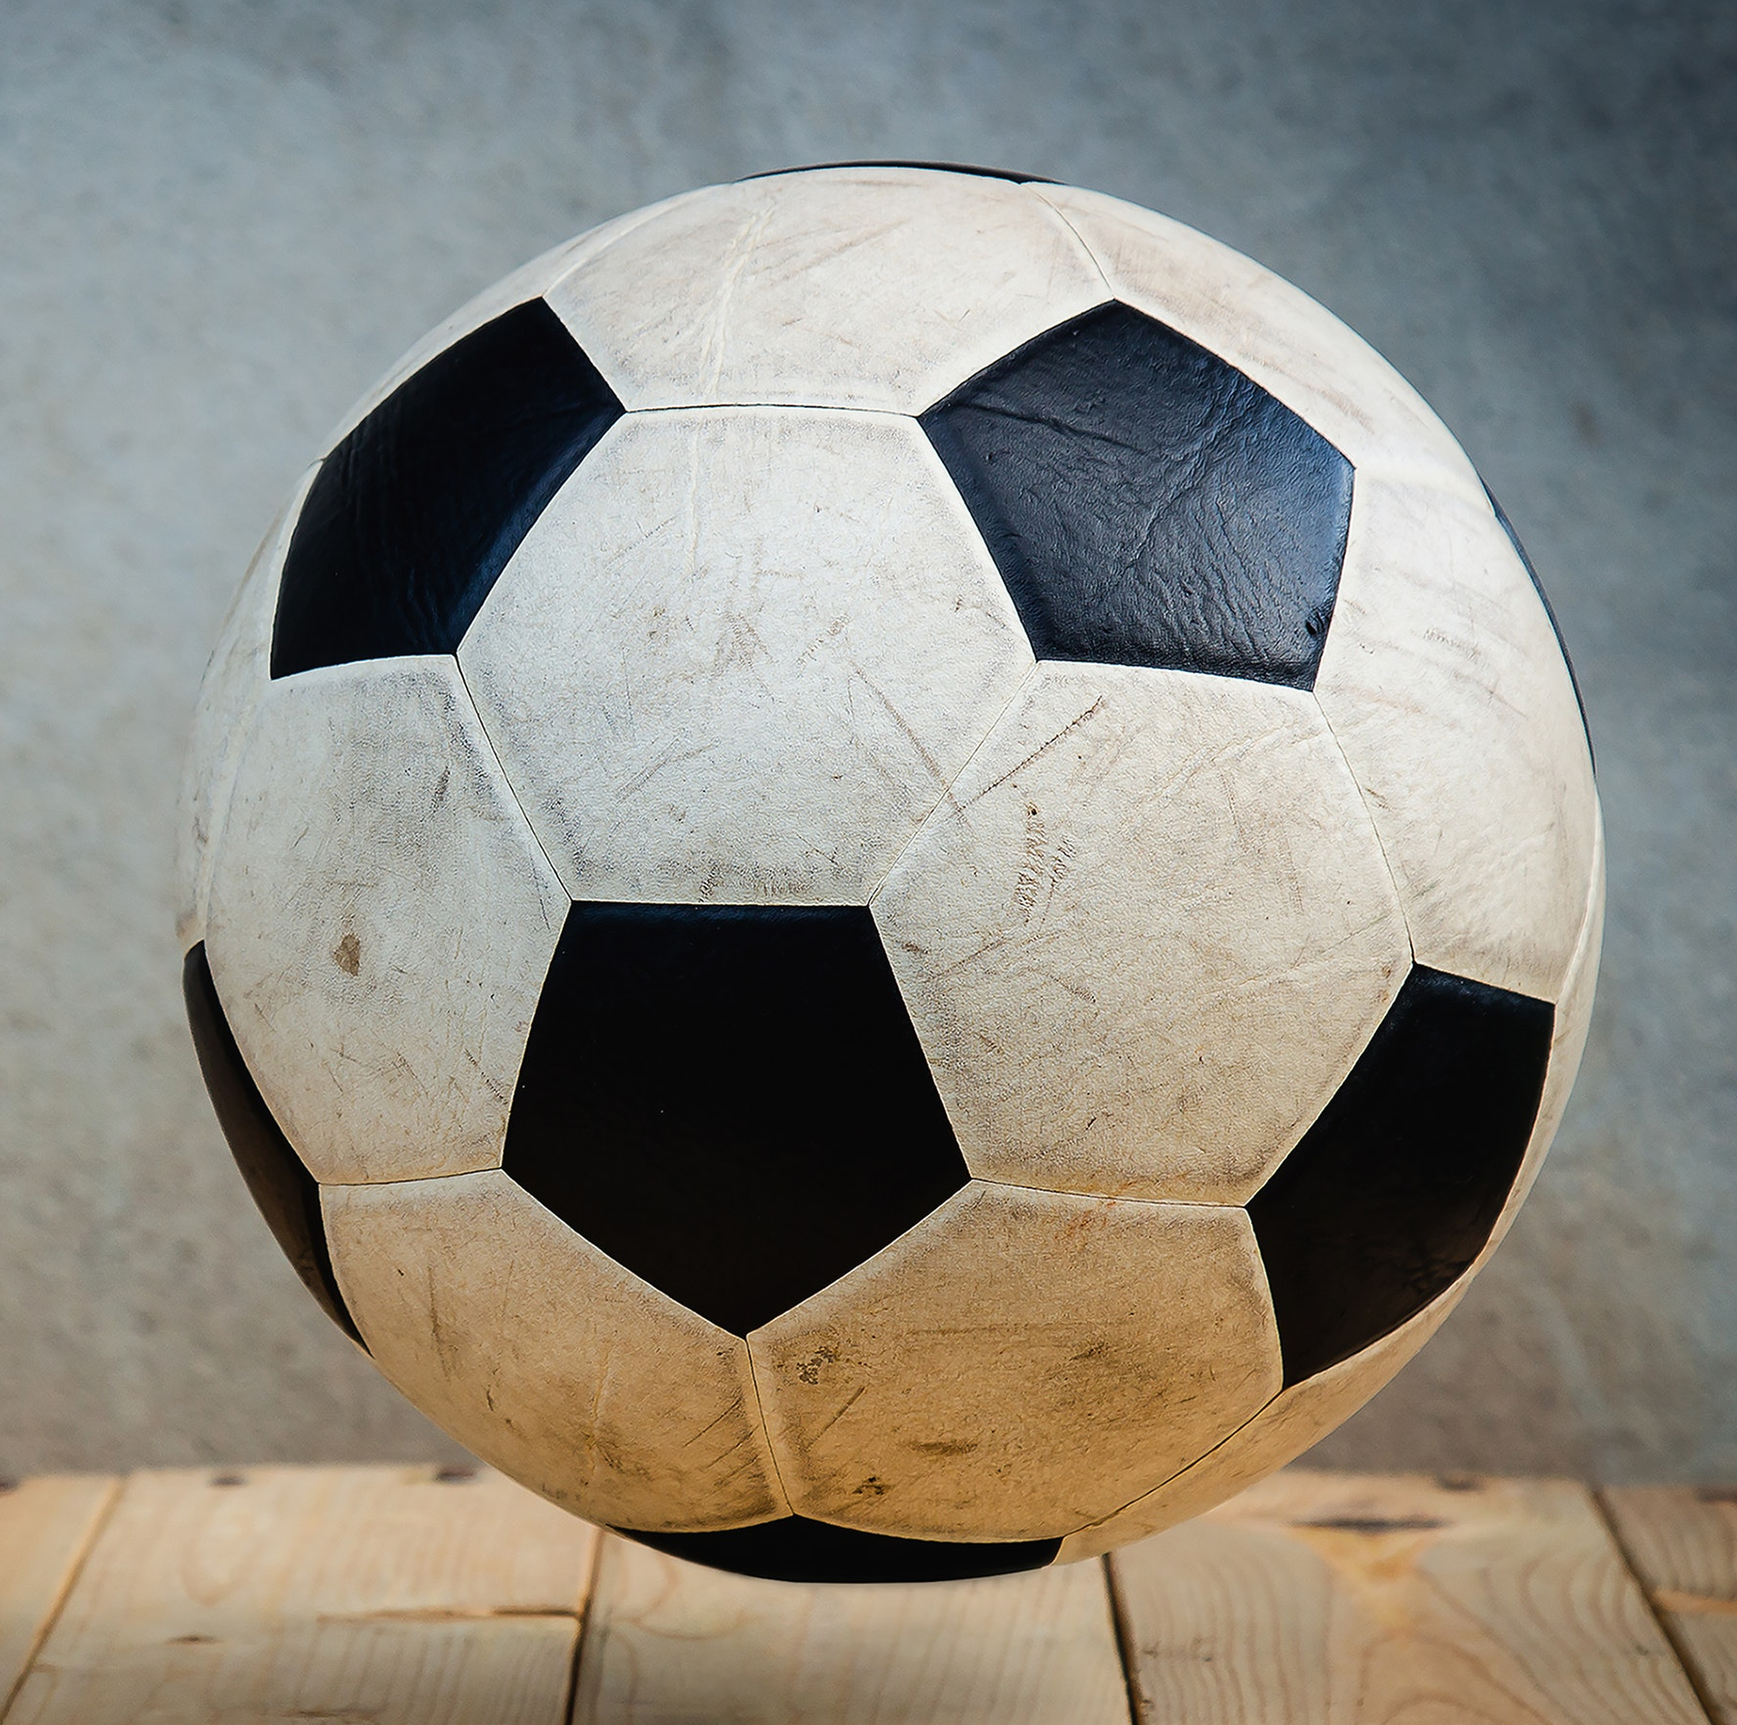
ADJETIVOS SIMPLES – simple adjectives
grande
mediano/a
nuevo/a
viejo/a
chico/a

Slide 16
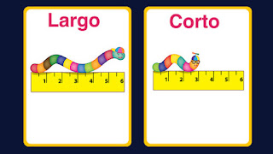
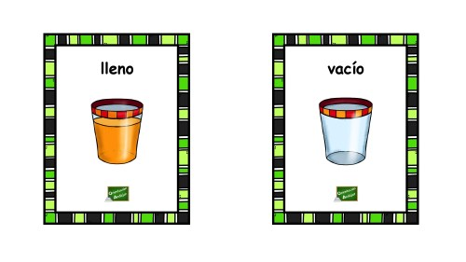
ADJETIVOS SIMPLES – simple adjectives
largo/a
corto/a
lleno/a
vacío/a

Slide 17
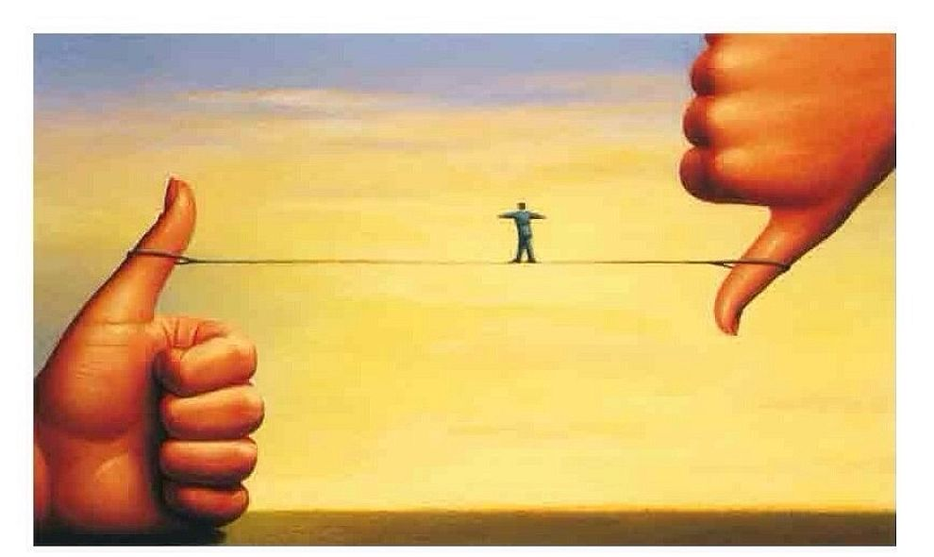
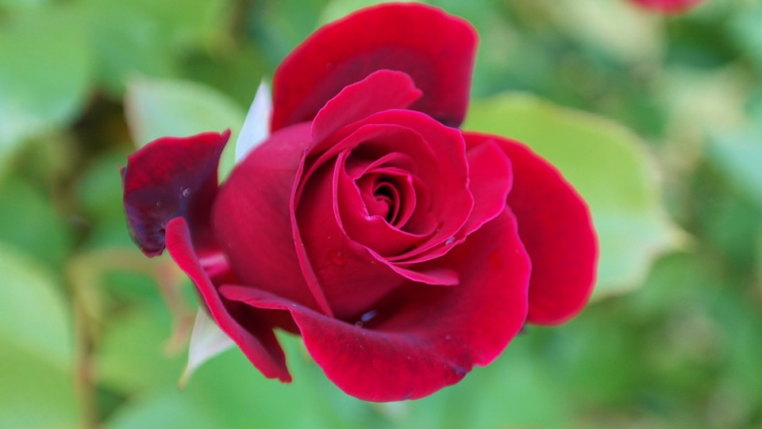
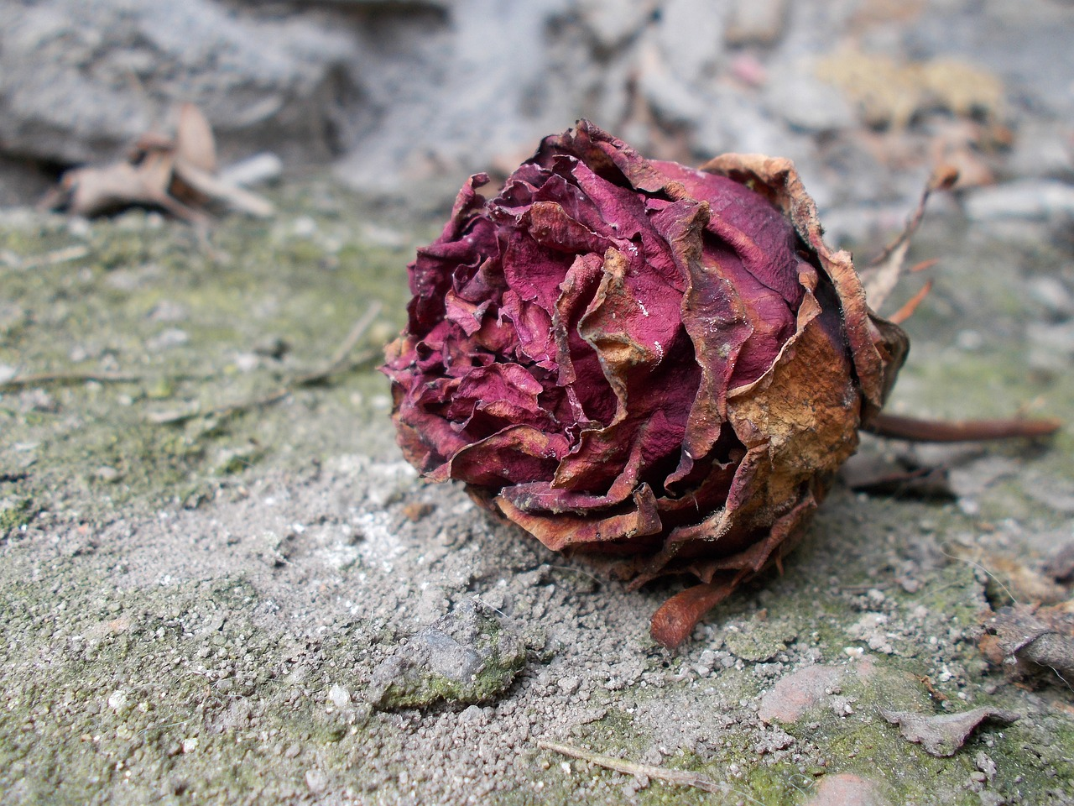
ADJETIVOS SIMPLES – simple adjectives
bueno/a
malo/a
bonito/a
feo/a

Slide 18
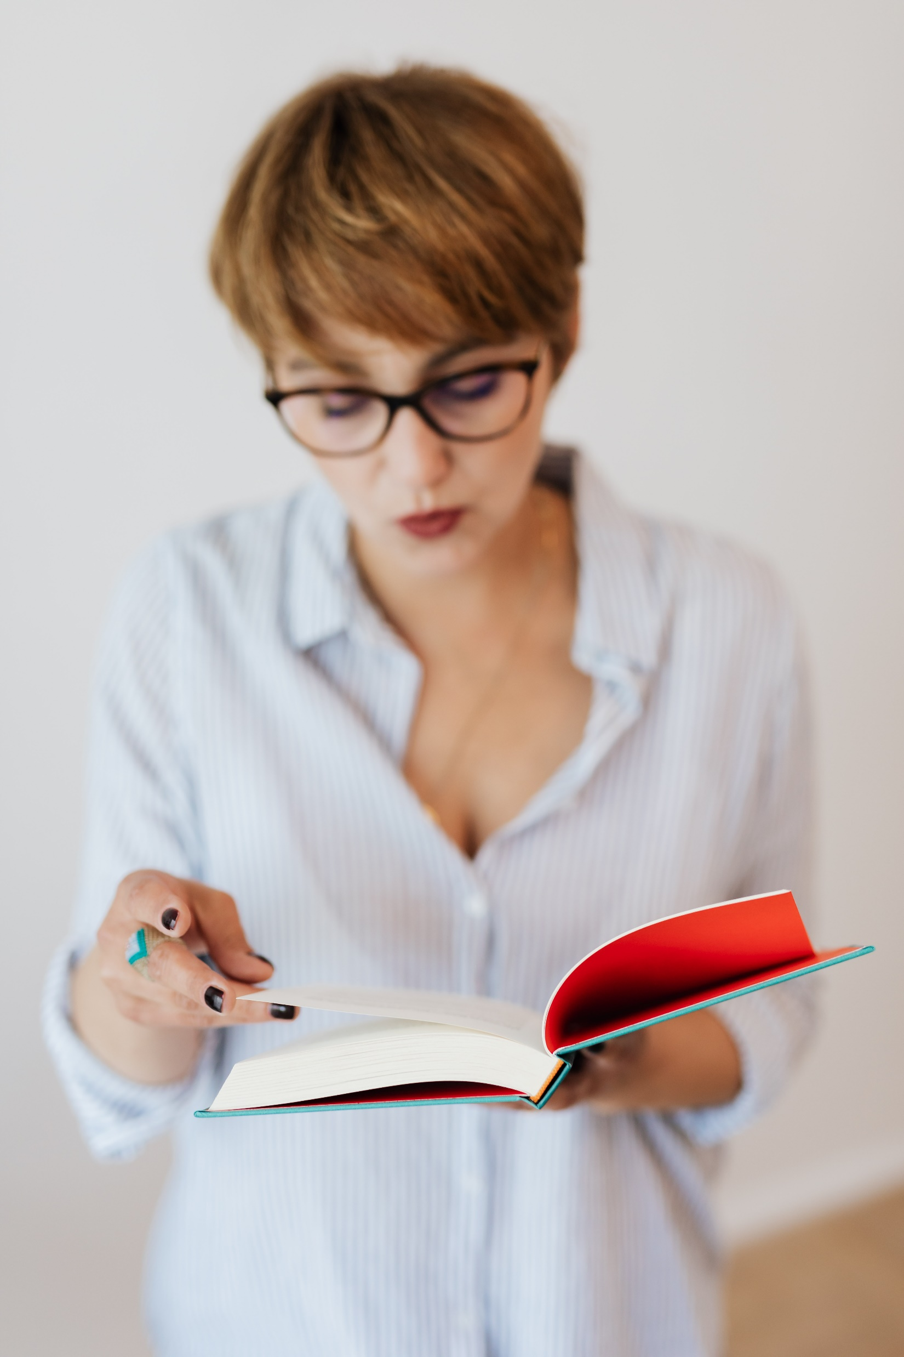


ADJETIVOS SIMPLES – simple adjectives
interesante
cerca
lejos
aburrido/a

Slide 19
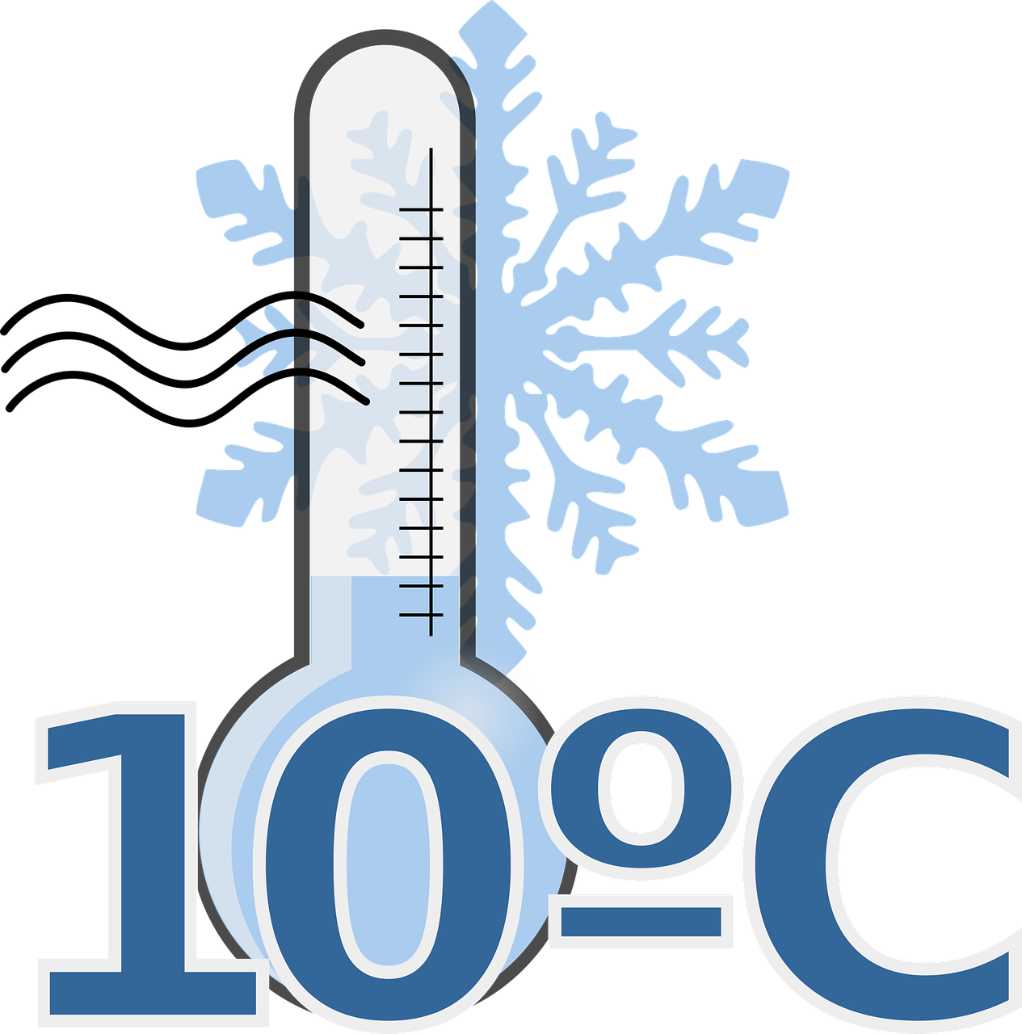
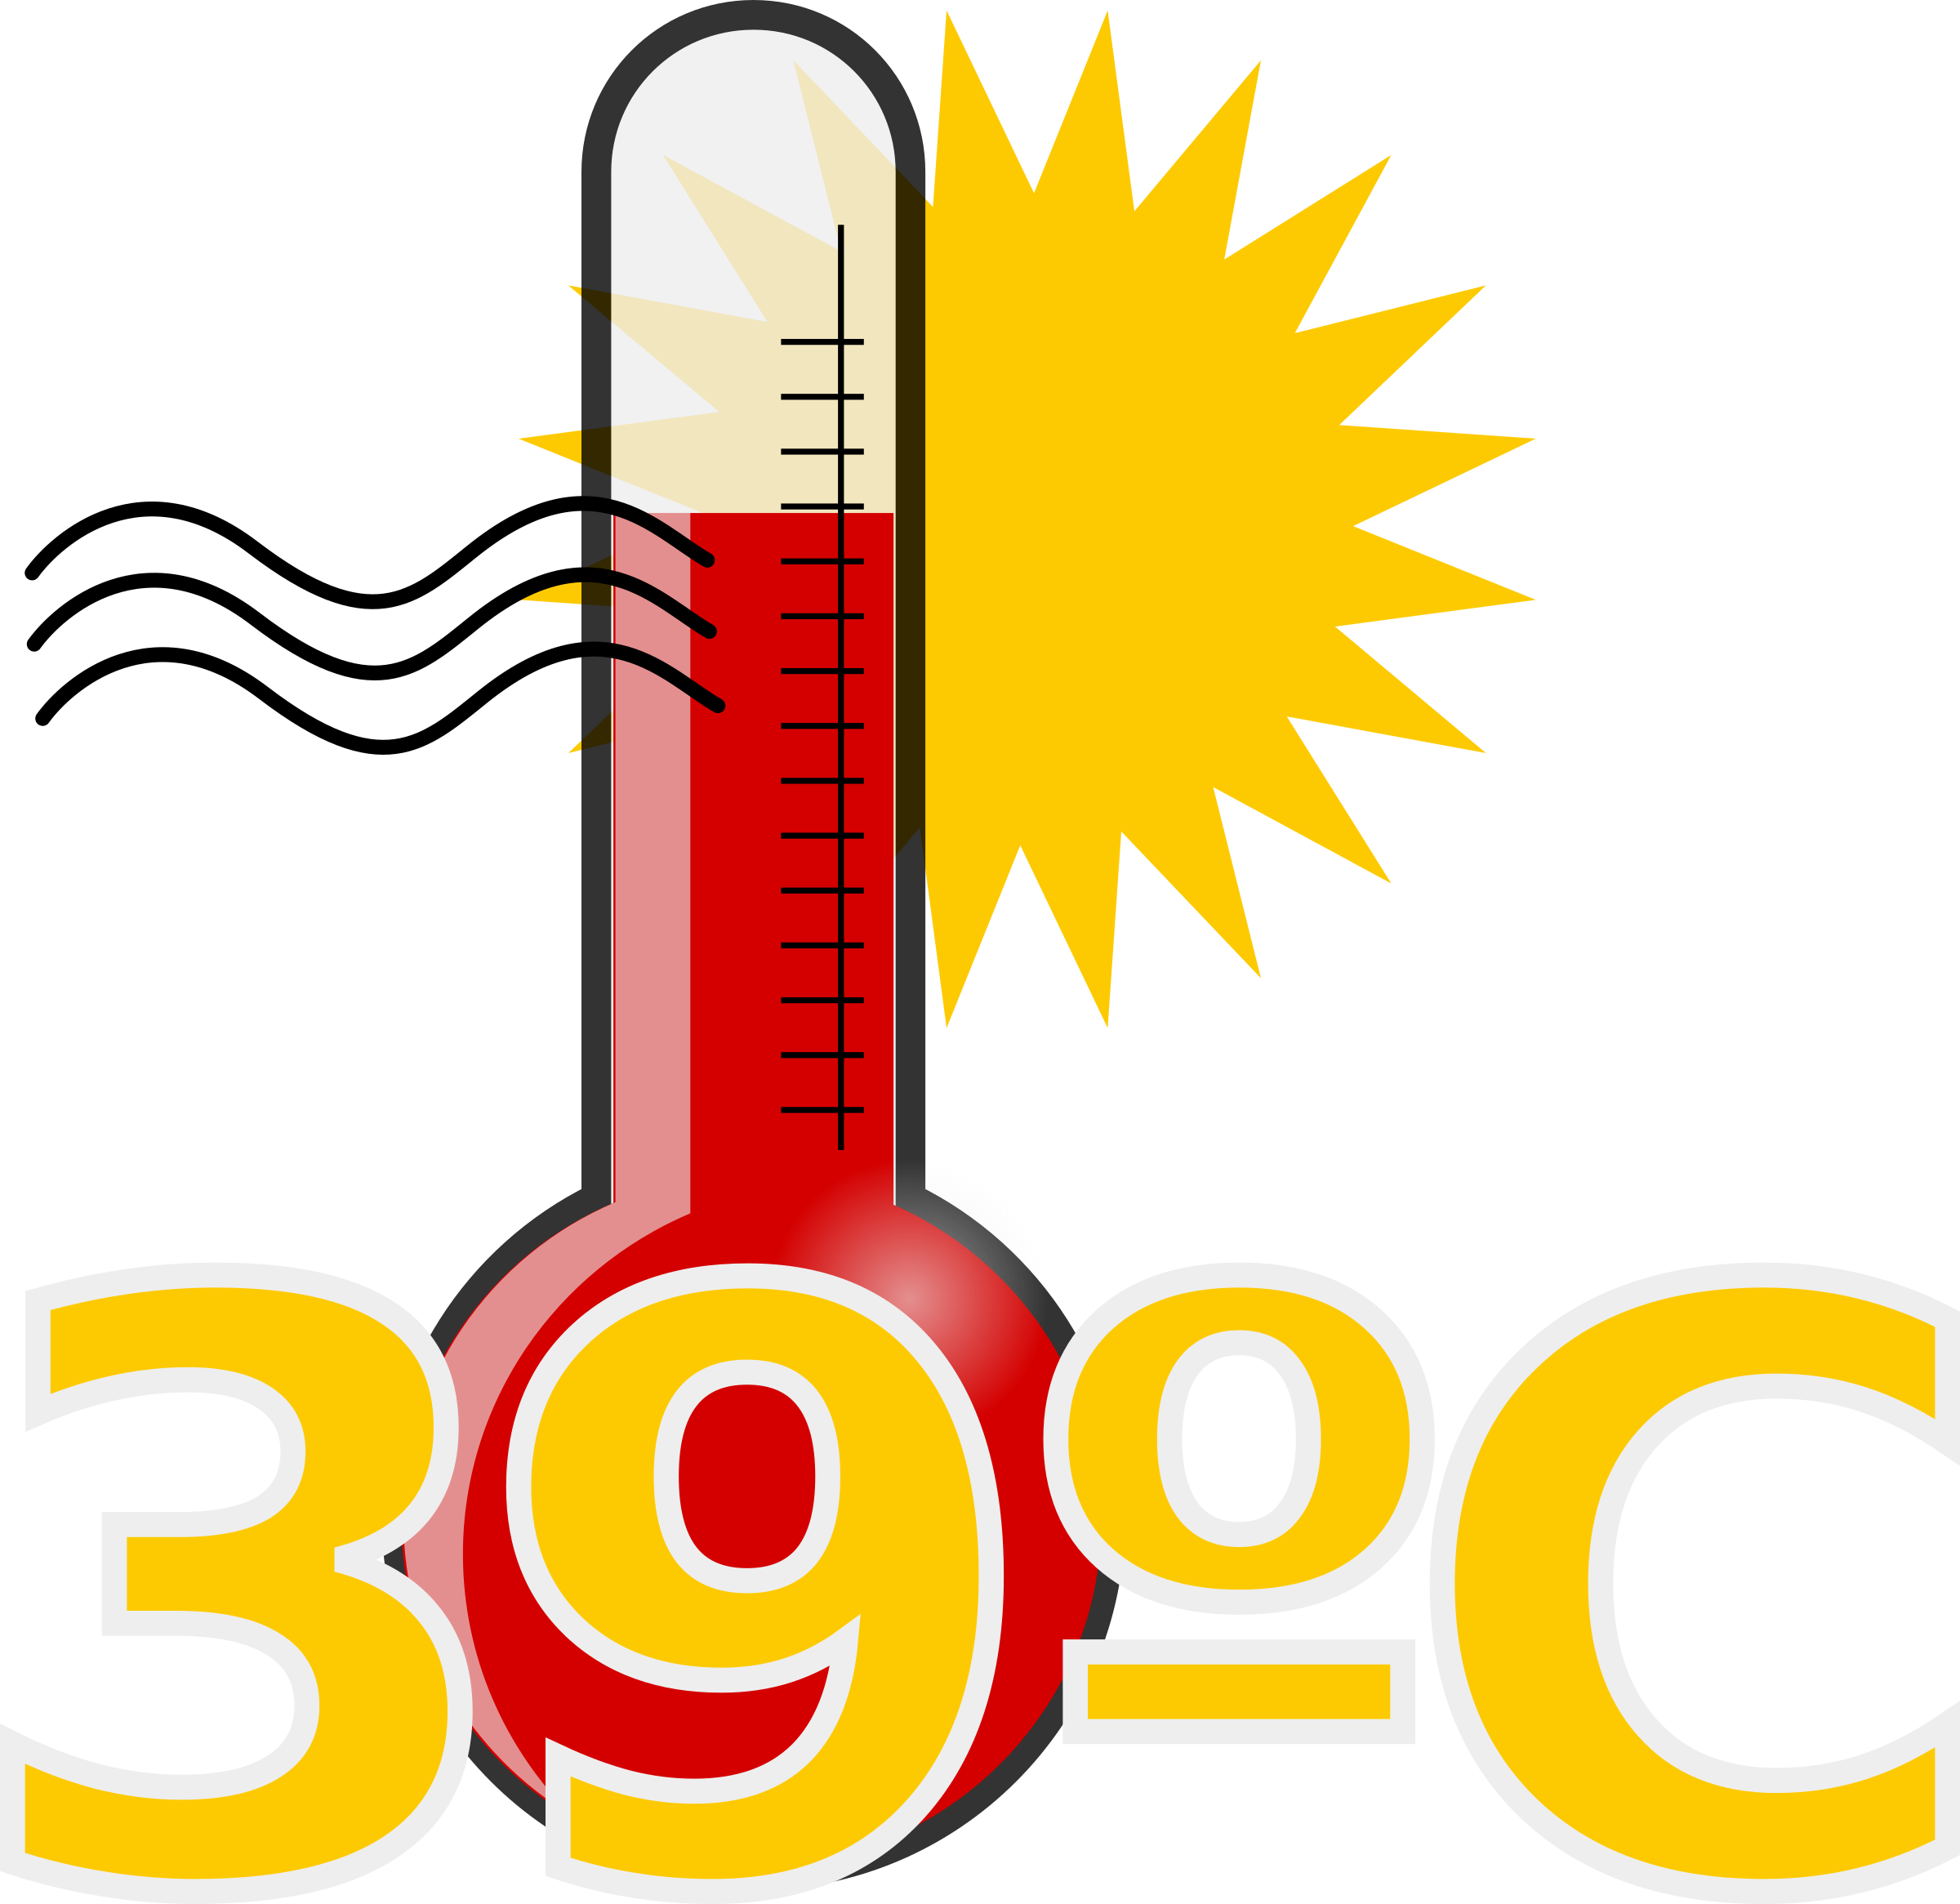
Vocabulario: Adjetivos simples
frío/a
caliente

Slide 20
¡Vamos a Conversar!
Let’s go over the partner conversation before we go to breakout rooms!

Slide 21
Taking turns, “person 1” will say a Spanish adjective from their chart below. Then “person 2” will read the sentences that belong to each adjective. Keep going until you say and read all the information from both charts.
****Note that the adjectives in Spanish are after the noun:
La camiseta vieja. The old t-shirt.
El vestido bonito. The pretty dress.
Los guantes grandes. The big gloves.

Slide 22
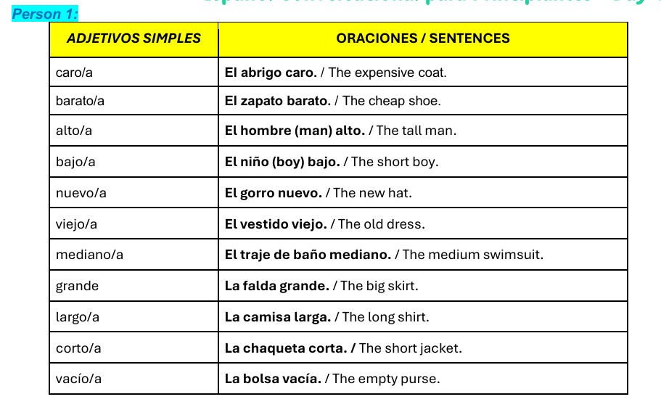

Slide 23
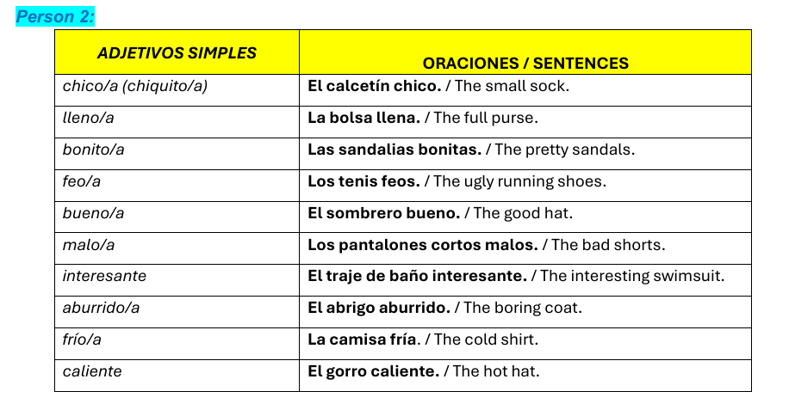

Slide 24
LA DESPEDIDA ….
¡Hasta la vista!
¡Hasta pronto!
adiós
¡Cuídate!
¡Que te vaya bien!
¡Nos vemos!
¡Hasta la próxima!

