Slide 1

Verbos Reflexivos y Autocuidado
Reflexive Verbs and Self-Care

Slide 2
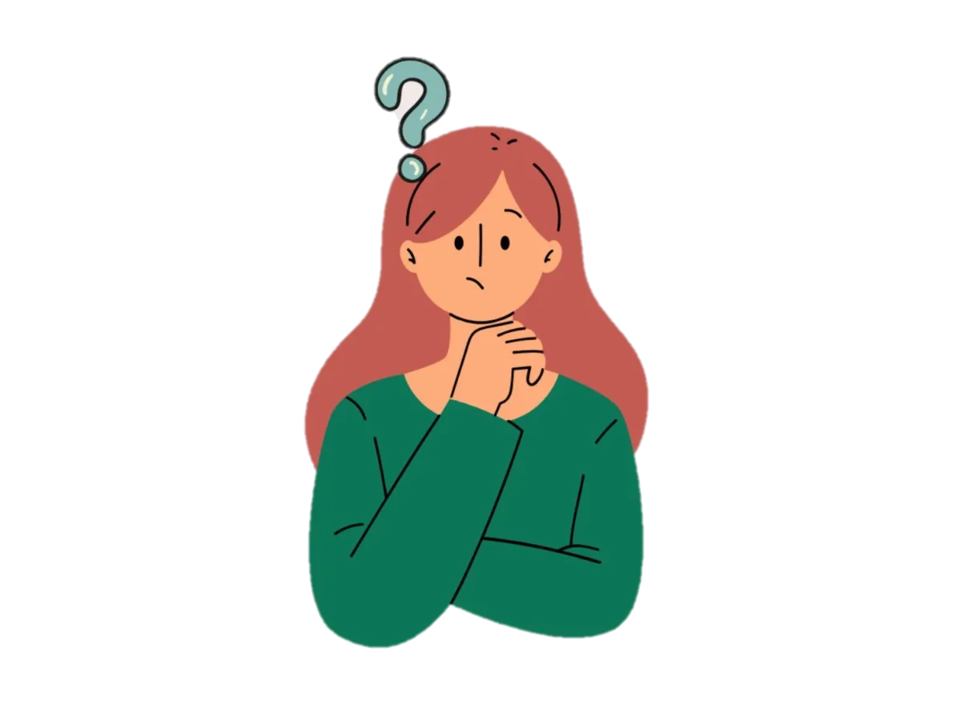
What is a reflexive verb? *A reflexive verb describes what a person or thing is doing to him/herself.
What’s the difference between reflexive verbs and regular verbs?
*When using reflexive verbs, the action in the sentence is “reflected” back on to the person or thing
Examples:
He washes the car. → This sentence is describing what he is doing to “the car.” It is NOT reflexive.
He washes himself. →This sentence is describing what he is doing to “himself.” This is a reflexive sentence.

Slide 3
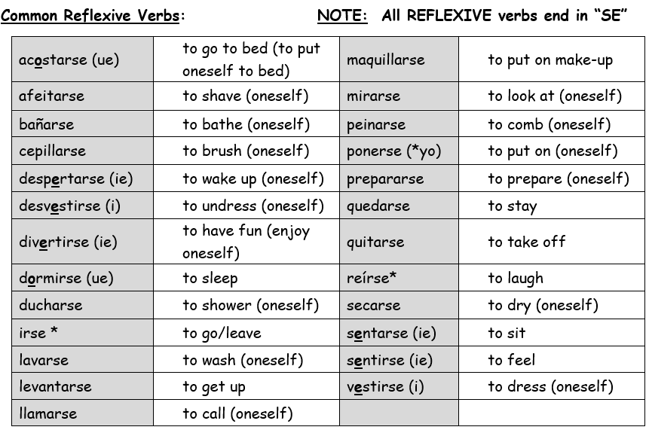

Slide 4
ADIVINA EL VERBO REFLEXIVO

Slide 5
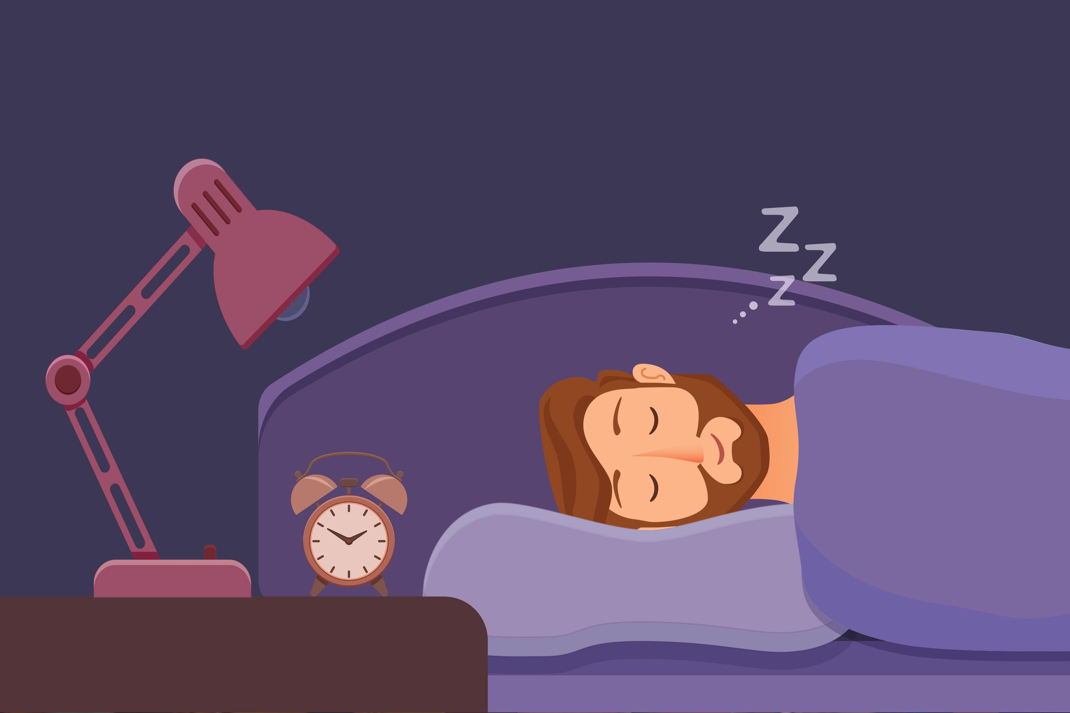

Slide 6
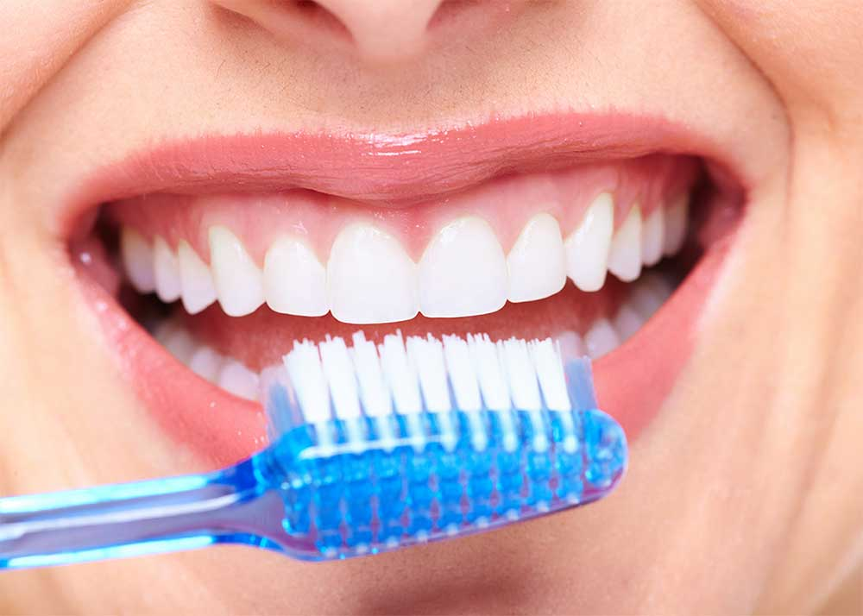

Slide 7
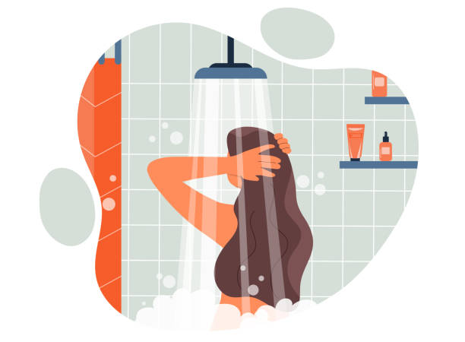

Slide 8
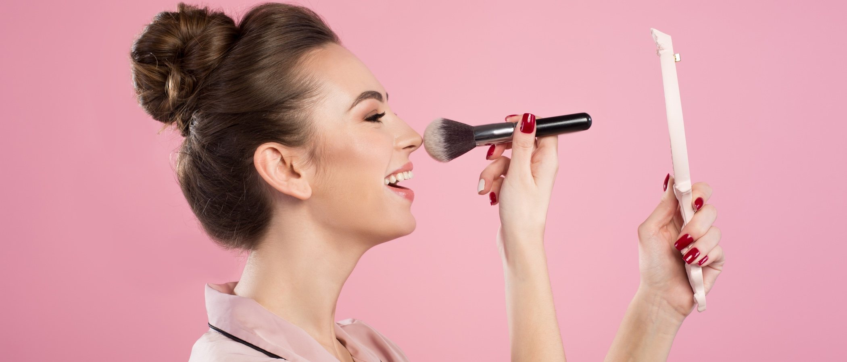

Slide 9
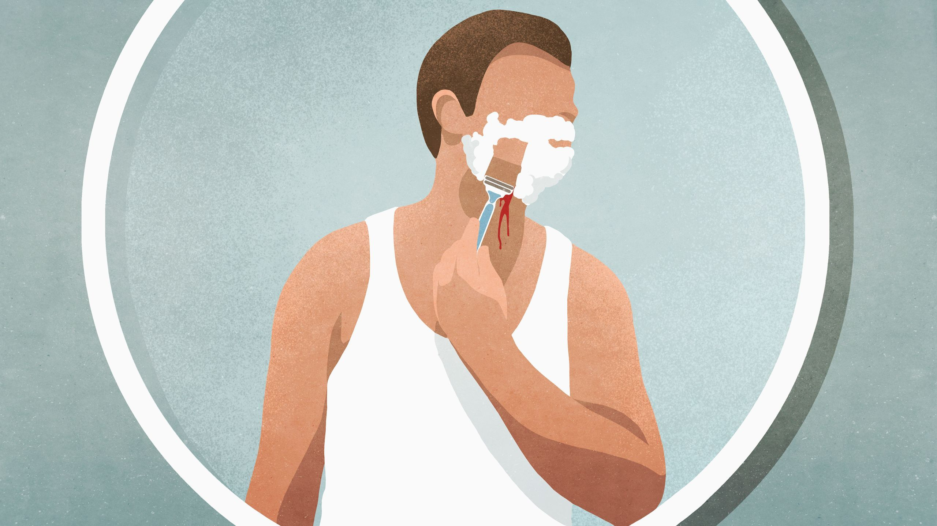

Slide 10


Slide 11
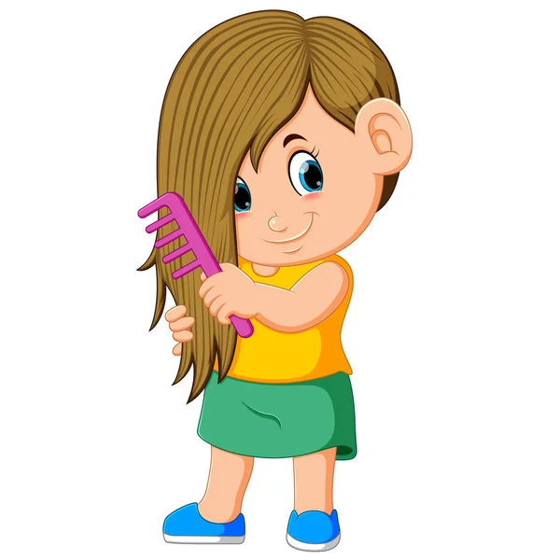

Slide 12
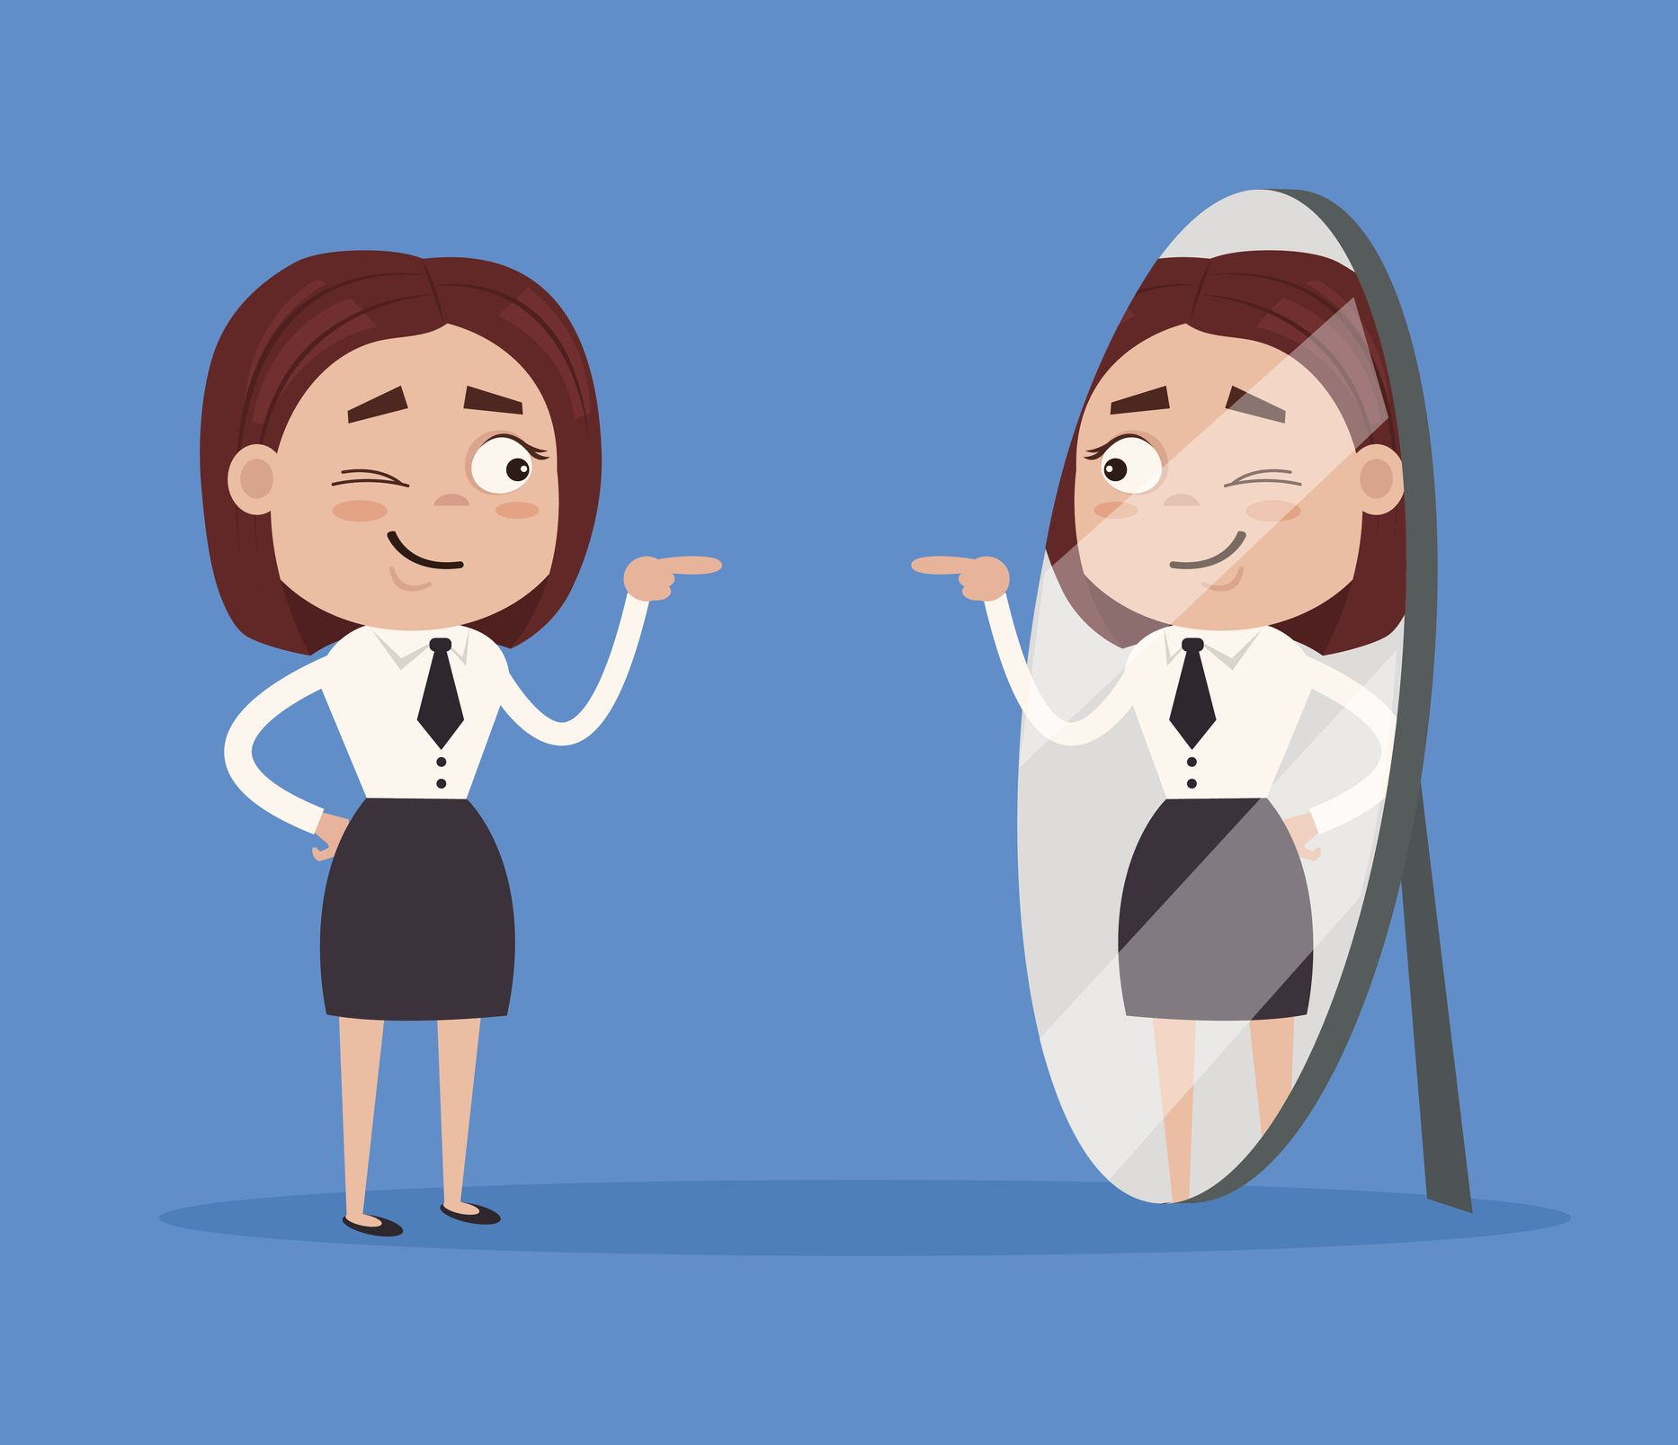

Slide 13
HOW DO YOU CONJUGATE A REGULAR REFLEXIVE VERB?

Slide 14
Here's the process for saying "I wash myself":
Step 1: Yo lavarse. (Choose the appropriate pronoun and verb)
Step 2: Yo se lavar. (Remove “se” and place it in front of the verb)
Step 3: Yo se lavo. (Conjugate the verb as usual)
Step 4: Yo me lavo. (Make the reflexive pronoun agree)
*The reflexive pronoun “se” becomes “me” when the subject is “yo.” What about other subjects?
yo | me | nosotros/as | nos
tú | te | vosotros/as | os
él ella usted | se | ellos ellas ustedes | se

Slide 15
MÁS VOCABULARIO

Slide 16
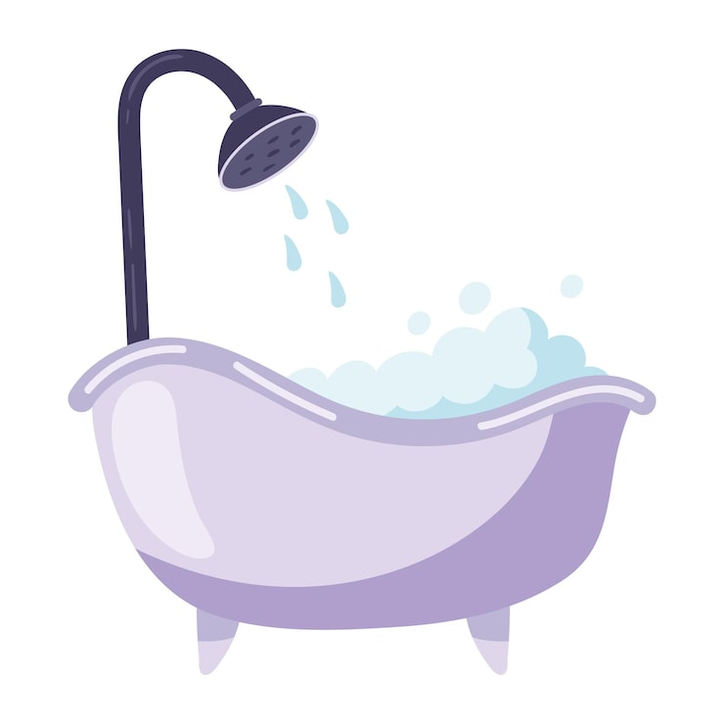
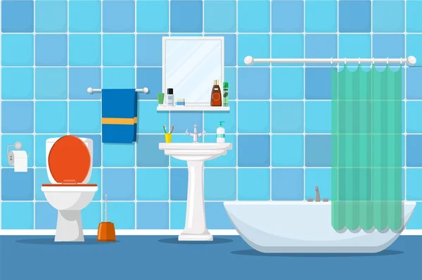
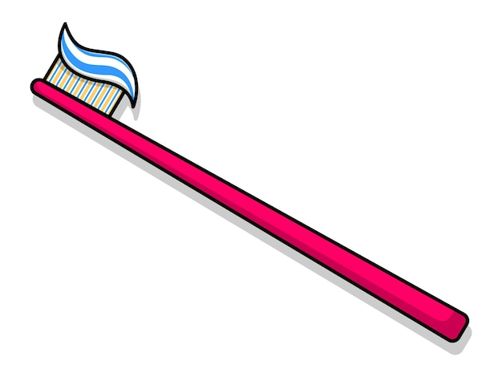


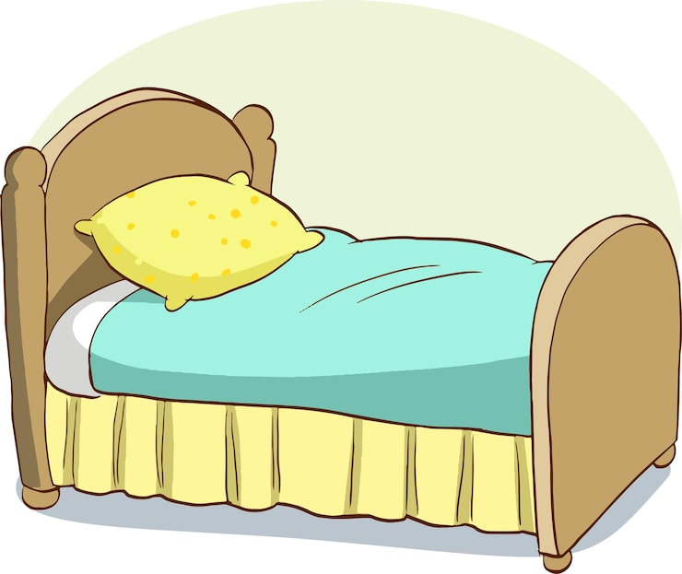


la bañera | the bathtub
el baño | the bathroom
la cama | the bed
el cepillo | the brush
el cepillo de dientes | the toothbrush
el champú | the shampoo
el despertador | the alarm clock
la ducha | the shower

Slide 17


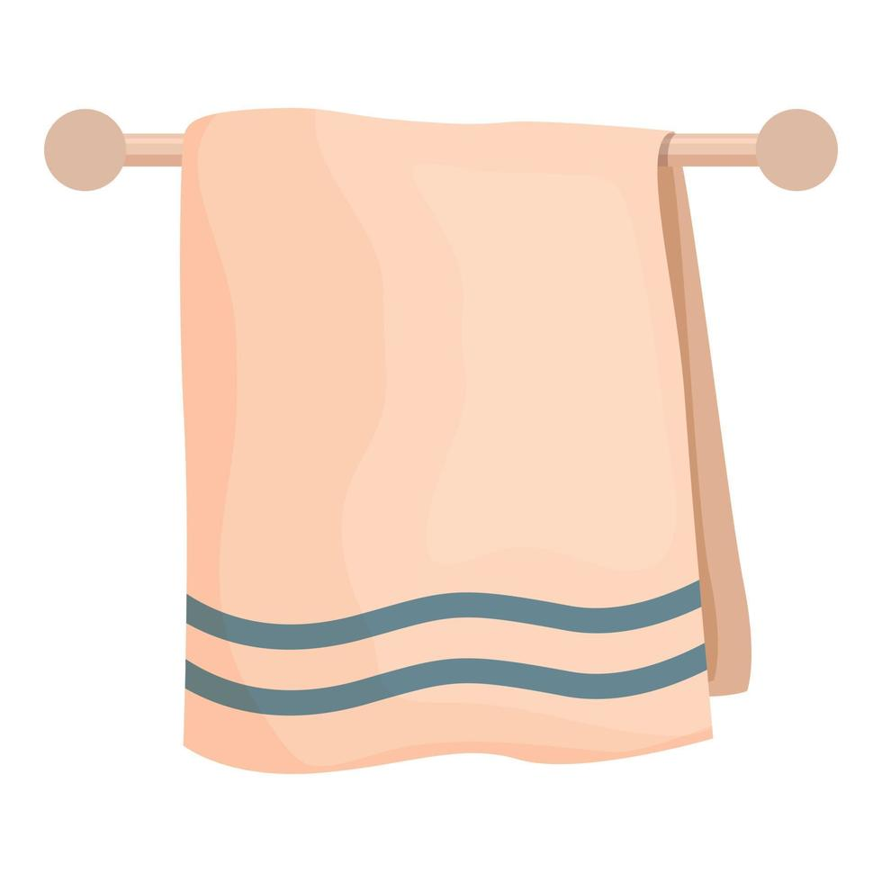

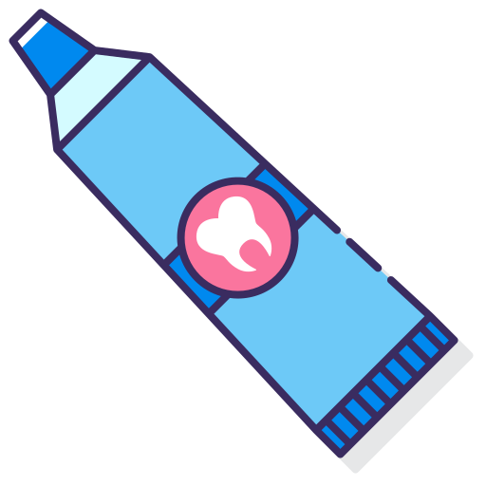


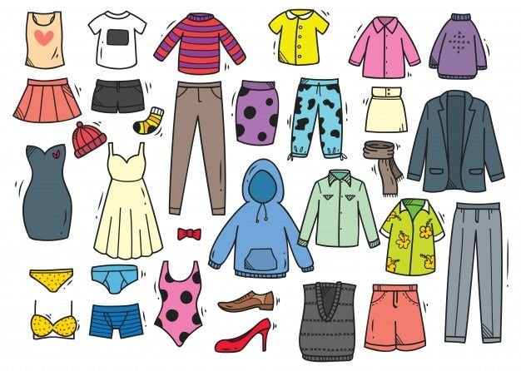
el espejo | the mirror
el jabón | the soap
el maquillaje | the make-up
la pasta dental | the toothpaste
el peine | the comb
la ropa | the clothes
el secador de pelo | the hair dryer
la toalla | the towel

