Slide 1




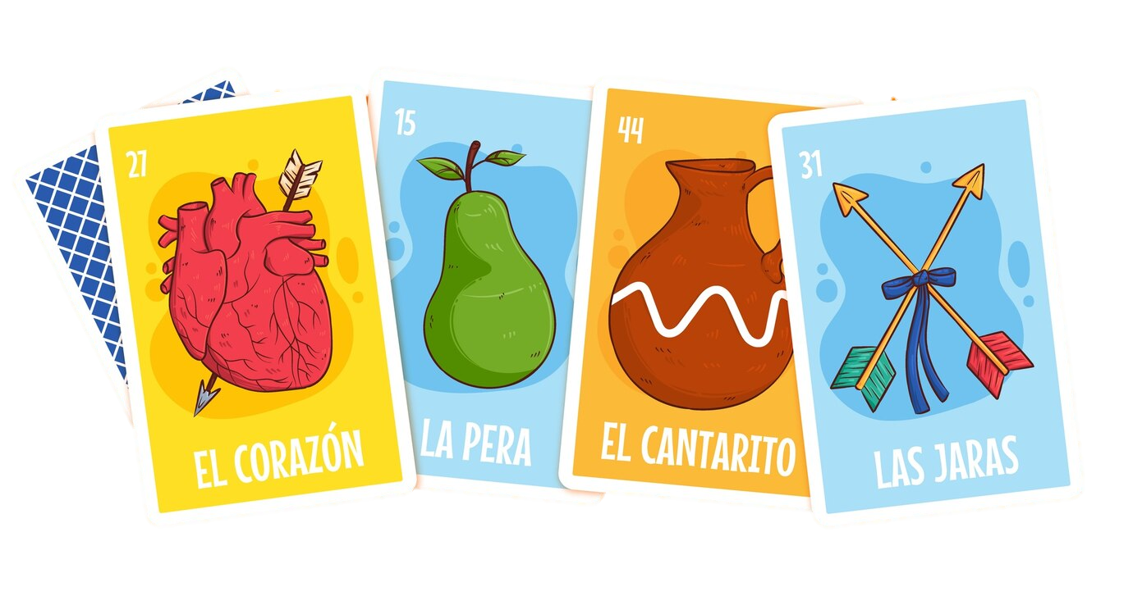
Futura Spanish Jeopardy

Slide 2
Panel
¿El o La?
¿LOS o Las?
Comida
Restaurant terms
Verbos
Saber y conocer
$200
$200
$200
$200
$200
$200
$400
$400
$400
$400
$400
$400
$600
$600
$600
$600
$600
$600
$800
$800
$800
$800
$800
$800
$1000
$1000
$1000
$1000
$1000
$1000

Slide 3
FILL IN THE CORRECT SPANISH GENDER: ____ libro
¿El o La? · $200

Slide 4
FILL IN THE CORRECT SPANISH GENDER: ____ mochila
¿El o La? · $400

Slide 5
GIVE THE ENGLISH TRANSLATION: La escuela
¿El o La? · $600

Slide 6
GIVE THE SPANISH TRANSLATION: The teacher (female)
¿El o La? · $800

Slide 7
GIVE THE SPANISH TRANSLATION: The notebook
¿El o La? · $1000

Slide 8
FILL IN THE CORRECT PLURAL SPANISH GENDER: ____ papeles
¿Los o Las? · $200

Slide 9
FILL IN THE CORRECT PLURAL SPANISH GENDER: ____ reglas
¿Los o Las? · $400

Slide 10
GIVE THE ENGLISH TRANSLATION: Los lápices
¿Los o Las? · $600

Slide 11
GIVE THE SPANISH TRANSLATION: The lights
¿Los o Las? · $800

Slide 12
GIVE THE SPANISH TRANSLATION: The homework
¿Los o Las? · $1000

Slide 13
GIVE THE ENGLISH TRANSLATION: El café
Comida· $200

Slide 14
GIVE THE ENGLISH TRANSLATION: La papa
Comida · $400

Slide 15
GIVE THE SPANISH TRANSLATION: The rice
Comida · $600

Slide 16
GIVE THE SPANISH TRANSLATION: The beans
Comida · $800

Slide 17
GIVE THE SPANISH TRANSLATION: The vegetables
Comida · $1000

Slide 18
GIVE THE ENGLISH TRANSLATION: La cena
Restaurant terms· $200

Slide 19
GIVE THE ENGLISH TRANSLATION: El plato
Restaurant terms · $400

Slide 20
GIVE THE SPANISH TRANSLATION: The drink
Restaurant terms · $600

Slide 21
GIVE THE SPANISH TRANSLATION: The breakfast
Restaurant terms · $800

Slide 22
GIVE THE SPANISH TRANSLATION: The snack
Restaurant terms · $1000

Slide 23
GIVE THE ENGLISH TRANSLATION: Leer
Verbos · $200

Slide 24
GIVE THE ENGLISH TRANSLATION: Escribir
Verbos · $400

Slide 25
GIVE THE SPANISH TRANSLATION: To learn
Verbos · $600

Slide 26
GIVE THE SPANISH TRANSLATION: To ask
Verbos · $800

Slide 27
GIVE THE SPANISH TRANSLATION: To work
Verbos · $1000

Slide 28
DOES THIS SENTENCE USE SABER OR CONOCER? Yo sé como dibujar.
Saber y Conocer · $200

Slide 29
DOES THIS SENTENCE USE SABER OR CONOCER? Yo conozco a Pedro.
Saber y Conocer · $400

Slide 30
FILL IN THE BLANK WITH THE PROPER FORM OF SABER: Tú ______
Saber y Conocer · $600

Slide 31
FILL IN THE BLANK WITH THE PROPER FORM OF CONOCER: Nosotros ______
Saber y Conocer · $800

Slide 32
FILL IN THE BLANK WITH THE PROPER FORM OF SABER: Ellas ______
Saber y Conocer · $1000

Slide 33
Winner!

Slide 34
Instructions for use
EDIT IN GOOGLE SLIDES
Click on the button under the presentation preview that says "Use as Google Slides Theme".
You will get a copy of this document on your Google Drive and will be able to edit, add or delete slides.
You have to be signed in to your Google account.
EDIT IN POWERPOINT®
Click on the button under the presentation preview that says "Download as PowerPoint template". You will get a .pptx file that you can edit in PowerPoint.
Remember to download and install the fonts used in this presentation (you’ll find the links to the font files needed in the Presentation design slide)
More info on how to use this template at slidescarnival.com/help-use-presentation-template
This template is free to use under Creative Commons Attribution license. You can keep the Credits slide or mention SlidesCarnival and other resources used in a slide footer.

Slide 35
Credits
Special thanks to all the people who made and released these awesome resources for free:
Presentation template by SlidesCarnival

Slide 36
Presentation design
This presentation uses the following typographies:
Titles: Bebas Neue
Body copy: Della Respira
Download for free at: https://www.fontsquirrel.com/fonts/bebas-neue https://www.1001fonts.com/della-respira-font.html
You don’t need to keep this slide in your presentation. It’s only here to serve you as a design guide if you need to create new slides or download the fonts to edit the presentation in PowerPoint®

Slide 37
MAP

Slide 38
GADGETS

Slide 39
SlidesCarnival icons are editable shapes. This means that you can:
Resize them without losing quality.
Change fill color and opacity.
Change line color, width and style.
Isn’t that nice? :) Examples:
Find more icons at slidescarnival.com/extra-free-resources-icons-and-maps

Slide 40
Diagrams and infographics

Slide 41
😉
You can also use any emoji as an icon! And of course it resizes without losing quality.
How? Follow Google instructions https://twitter.com/googledocs/status/730087240156643328
✋👆👉👍👤👦👧👨👩👪💃🏃💑❤😂😉😋😒😭👶😸🐟🍒🍔💣📌📖🔨🎃🎈🎨🏈🏰🌏🔌🔑 and many more...

Slide 42

Free templates for all your presentation needs
For PowerPoint and Google Slides
100% free for personal or commercial use
Ready to use, professional and customizable
Blow your audience away with attractive visuals

