Slide 1

Presenta…
Middle School Prep
¡Preparación para la escuela secundaria!

Slide 2

Los Verbos Infinitivos

Slide 3
Steps to Conjugate Infinitive Verbs:
Step 1- Drop the -er or -ir, to leave the stem.
Step 2- Decide which pronoun is needed
Step 3- Add the corresponding ending.

Slide 4
-er Verbs

Slide 5
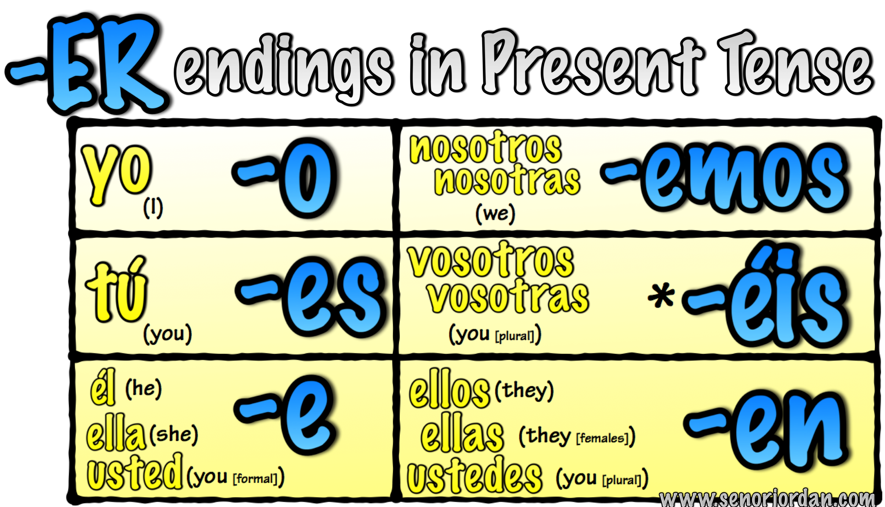

Slide 6

aprender
- to learn

Slide 7

beber
-
to drink

Slide 8
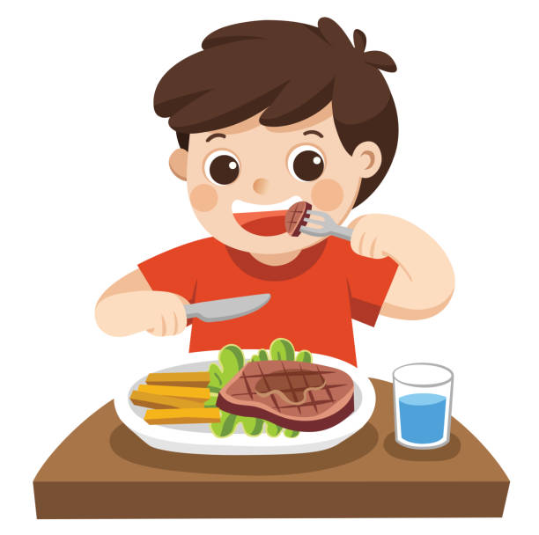
comer
-
to eat

Slide 9

comprender
- to understand

Slide 10

correr
- to run

Slide 11

creer
-
to believe

Slide 12

- to read
leer

Slide 13
-ir Verbs

Slide 14


Slide 15

abrir
-
to open

Slide 16

decidir
-
to decide

Slide 17

discutir
-
to discuss

Slide 18

escribir
-
to write

Slide 19

recibir
-
to receive

Slide 20

subir
-
to climb /to go up

Slide 21

vivir
- to live

